Slide 1
Chapter 7: Satellite Communications

Slide 2
History of satellite communication
1945 Arthur C. Clarke publishes an essay about “Extra Terrestrial Relays”
1957 first satellite SPUTNIK
1960 first reflecting communication satellite ECHO
1963 first geostationary satellite SYNCOM
1965 first commercial geostationary satellite: 240 duplex telephone channels or 1 TV channel, 1.5 years lifetime
1976 three MARISAT satellites for maritime communication
1982 first mobile satellite telephone system INMARSAT-A
1988 first satellite system for mobile phones and data communication INMARSAT-C
1993 first digital satellite telephone system
1998 global satellite systems for small mobile phones
2008 GlobalStar has 315,000 subscribers
2015 Iridium orbits (though smaller number of satellites)

Slide 3
Applications
Traditionally
weather satellites
radio and TV broadcast satellites
military satellites
satellites for navigation and localization (e.g., GPS)
Telecommunication
global telephone connections
backbone for global networks
connections for communication in remote places or underdeveloped areas
global mobile communication
➔ satellite systems to extend cellular phone systems to hard to reach regions.

Slide 4
Typical satellite systems
Inter Satellite Link (ISL)
Mobile User Link (MUL)
Gateway Link (GWL)
MUL
GWL
small cells (spotbeams)
base station
or gateway
footprint
ISDN
PSTN
GSM
PSTN: Public Switched
Telephone Network
User data

Slide 5
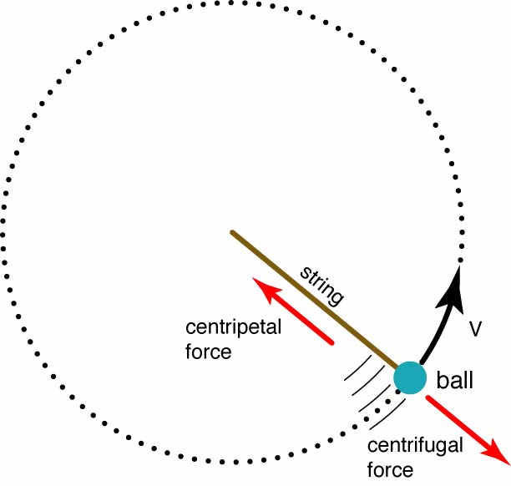
Basics (Physics 101)
Satellites in circular orbits
attractive force F_{g} = m g (R/r)²
centrifugal force F_{c} = m r ω²
m: mass of the satellite
R: radius of the earth (R = 6370 km)
r: distance to the center of the earth
g: acceleration of gravity (g = 9.81 m/s²)
ω: angular velocity
(ω = 2 π f, f: rotation frequency)
Stable orbit
F_{g} = F_{c}

Slide 6
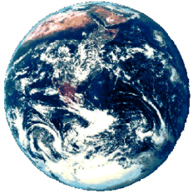
Satellite period and orbits
24
satellite
period [h]
velocity [ x1000 km/h]
20
16
12
8
4
synchronous distance
35,786 km
10
20
30
40 x10⁶ m
radius

Slide 7
Basics
elliptical or circular orbits
complete rotation time depends on distance satellite-earth
inclination: angle between orbit and equator
elevation: angle between satellite and horizon
LOS (Line of Sight) to the satellite necessary for connection
➔ high elevation needed, less absorption due to e.g. buildings
Uplink: connection base station - satellite
Downlink: connection satellite - base station
typically separated frequencies for uplink and downlink
transponder used for sending/receiving and shifting of frequencies
transparent transponder: only shift of frequencies
regenerative transponder: additionally signal regeneration

Slide 8
Inclination
plane of satellite orbit
satellite orbit
perigee
δ
inclination δ
equatorial plane

Slide 9
Elevation
Elevation:
angle ε between center of satellite beam
and surface
minimal elevation:
elevation needed at least
to communicate with the satellite
ε
footprint

Slide 10
Link budget of satellites
Parameters like attenuation or received power determined by four parameters:
sending power
gain of sending antenna
distance between sender and receiver
gain of receiving antenna
Problems
varying strength of received signal due to multipath propagation
interruptions due to shadowing of signal (no LOS)
Possible solutions
Link Margin to eliminate variations in signal strength
satellite diversity (usage of several visible satellites at the same time) helps to use less sending power
L: Loss
f: carrier frequency
r: distance
c: speed of light

Slide 11
Atmospheric attenuation
Attenuation of
the signal in %
Example: satellite systems at 4-6 GHz
50
40
rain absorption
30
ε
fog absorption
20
10
atmospheric absorption
5°
10°
20°
30°
40°
50°
elevation of the satellite

Slide 12
Four Different Orbits
Four different types of satellite orbits can be identified depending on the shape and diameter of the orbit:
GEO: geostationary orbit, ca. 36000 km above earth surface
LEO (Low Earth Orbit): ca. 500 - 1500 km
MEO (Medium Earth Orbit) or ICO (Intermediate Circular Orbit): ca. 6000 - 20000 km
HEO (Highly Elliptical Orbit) elliptical orbits

Slide 13
Orbit Illustration
GEO (Inmarsat)
HEO
MEO (ICO)
LEO (Globalstar, Irdium)
inner and outer Van
Allen belts
earth
1000
10000
Van-Allen-Belts:
ionized particles
2000 - 6000 km and
15000 - 30000 km
above earth surface
35768
km

Slide 14
Geostationary satellites
Orbit 35.786 km distance to earth surface, orbit in equatorial plane (inclination 0°)
complete rotation exactly one day, satellite is synchronous to earth rotation
fix antenna positions, no adjusting necessary
satellites typically have a large footprint (up to 34% of earth surface!), therefore difficult to reuse frequencies
bad elevations in areas with latitude above 60° due to fixed position above the equator
high transmit power needed
high latency due to long distance (~275 msec)
not useful for global coverage for small mobile phones and data transmission, typically used for radio and TV transmission

Slide 15
LEO systems
Orbit ca. 500 - 1500 km above earth surface
visibility of a satellite ca. 10 - 40 minutes
global radio coverage possible
latency comparable with terrestrial long-distance connections, ~5 - 10 ms
smaller footprints, better frequency reuse
but now handover necessary from one satellite to another
many satellites necessary for global coverage
more complex systems due to moving satellites
Examples:
Iridium (start 1998, 66 satellites)
Globalstar (start 1999, 48 satellites)

Slide 16
MEO systems
Orbit ca. 5000 - 12000 km above earth surface
comparison with LEO systems:
slower moving satellites
fewer satellites needed
simpler system design
for many connections no hand-over needed
higher latency, ca. 70 - 80 ms
higher sending power needed
special antennas for small footprints needed
Example:
ICO (Intermediate Circular Orbit, Inmarsat) start ca. 2000

Slide 17
Routing
One solution: inter satellite links (ISL)
reduced number of gateways needed
forward connections or data packets within the satellite network as long as possible
only one uplink and one downlink per direction needed for the connection of two mobile phones
Problems:
more complex focussing of antennas between satellites
high system complexity due to moving routers
higher fuel consumption
thus shorter lifetime
Iridium and Teledesic planned with ISL
Other systems use gateways and additionally terrestrial networks

Slide 18
Localization of mobile stations
Mechanisms similar to GSM
Gateways maintain registers with user data
HLR (Home Location Register): static user data
VLR (Visitor Location Register): (last known) location of the mobile station
SUMR (Satellite User Mapping Register):
satellite assigned to a mobile station
positions of all satellites
Registration of mobile stations
Localization of the mobile station via the satellite’s position
requesting user data from HLR
updating VLR and SUMR
Calling a mobile station
localization using HLR/VLR similar to GSM
connection setup using the appropriate satellite

Slide 19
Handover in satellite systems
Satellite systems encounter several new situations for handover
Movements of satellites
Mobile phone movements as compared to satellite movements

Slide 20
Handover in satellite systems
Intra satellite handover
handover from one spot beam to another
mobile station still in the footprint of the satellite, but in another cell
Inter satellite handover
handover from one satellite to another satellite
mobile station leaves the footprint of one satellite
Gateway handover
Handover from one gateway to another
mobile station still in the footprint of a satellite, but gateway leaves the footprint
Inter system handover
Handover from the satellite network to a terrestrial cellular network
mobile station can reach a terrestrial network again which might be cheaper, has a lower latency etc.

Slide 21
Overview of LEO/MEO systems

Slide 22
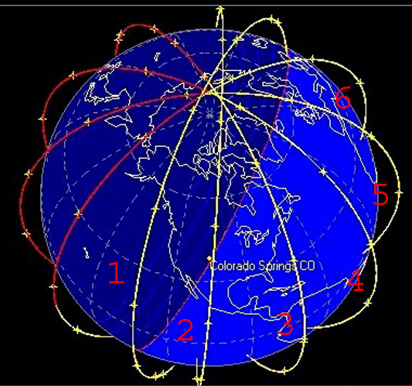
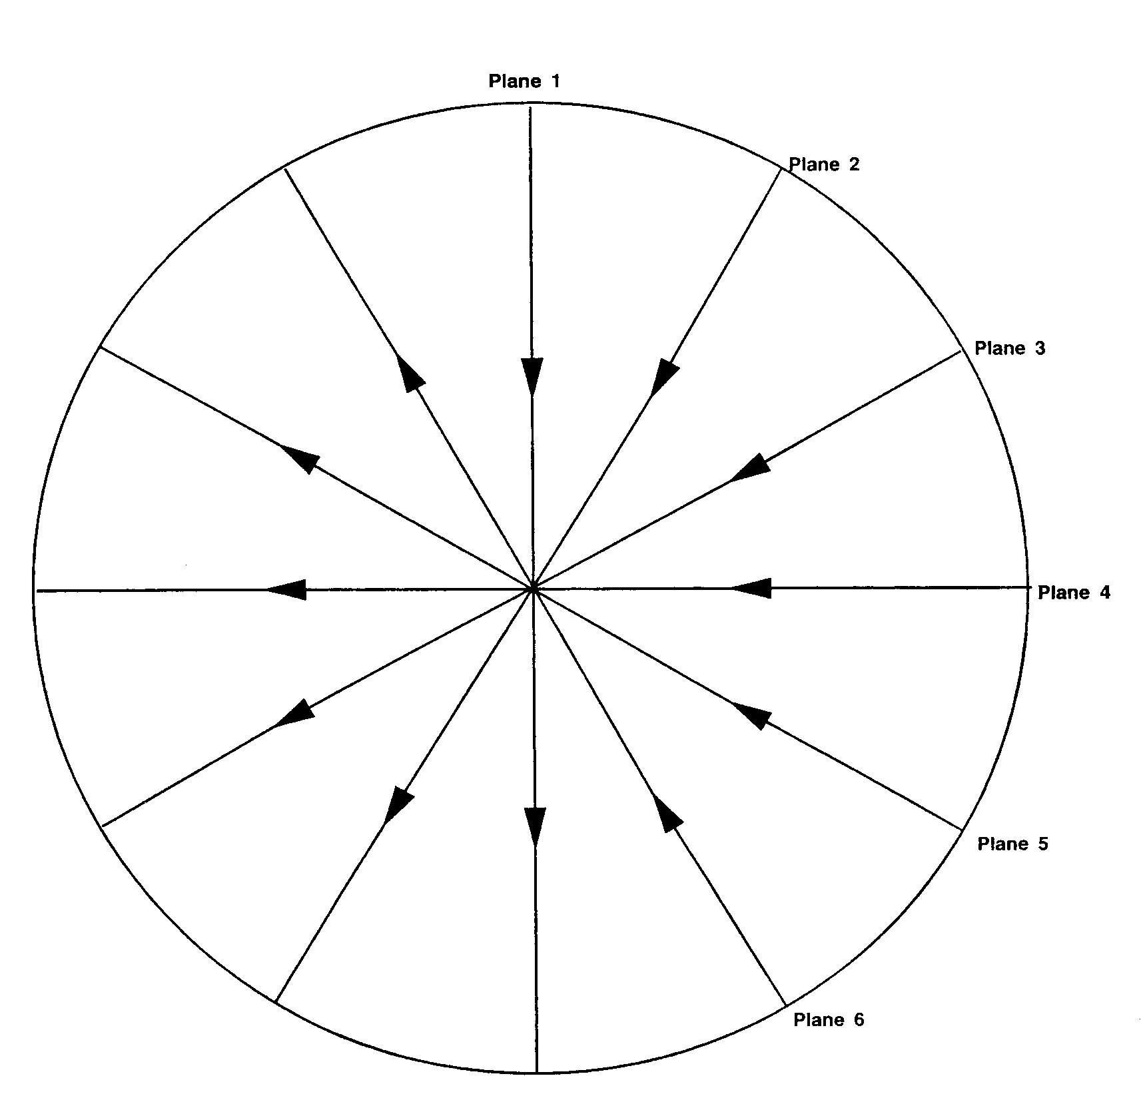
Constellations
3D-view and top-view

Slide 23
Starlink
Initial plan was to have 4,000 satellites
12,000 or 30,000 possible.
Key is SpaceX Falcon rocket
Overall, about 2,000 satellites are orbiting the earth.
Satellite details
500 lb
Size of a table
LEO, lower than 600km
Internet provision to low coverage areas
Issues:
Finance
Debris
https://satellitemap.space

