Slide 1

CSC407 Network analysis Project
Michael McCulloch / Ronald S King

Slide 2







Programming solution
Software Application
Python
Excel
Graphviz
File Sharing
GitHub
Add-ins and Imports
random
linecache
numpy
pandas
pvgraphviz
References
Python Crash Course – Eric Matthes

Slide 3
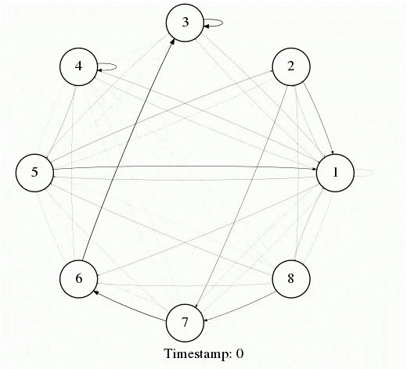
Part a – network simulation graph
Network Game 5
Time Interval: [0 -30]
Represents the probabilities of edges in who-looks-at-whom network

Slide 4
Part b – interaction prediction
Part b – inte
Samples of In-degree centrality predicts the average overall in-degree centrality
Across all unweighted games the two highest and lowest ranking nodes from a sample size of as small as 10% predicted overall rank roughly 90% of the time
The highest ranking node could be predicted 90% of the
time from a sample of half a game
A sample of network allows for predictions of the most and least important connected nodes on average

Slide 5
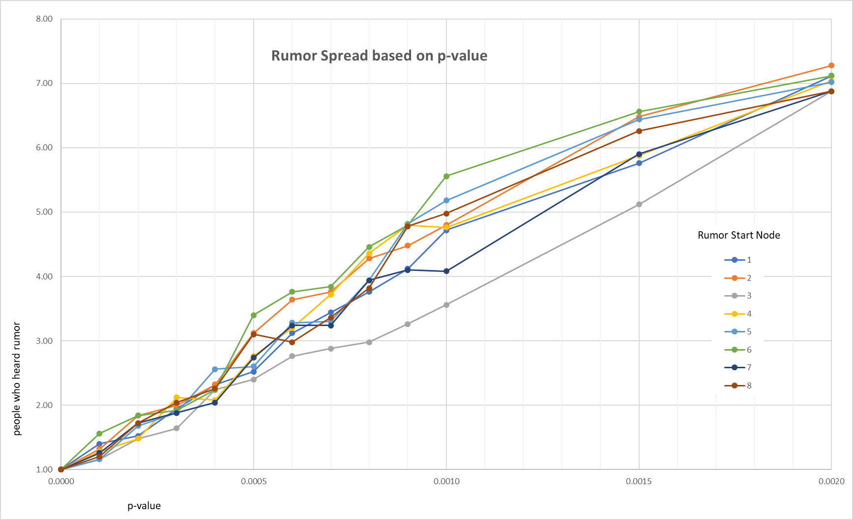
Part c – rumor spread thru interactions
Comments and Observations:
Over 3200 time segments remaining in last 1/3 of game
Data output based on average for 50 iterations for each p-value
Even with very low p-value, full rumor spread across all 8 people (p=0.006 almost guarantees full spread)
Rumor spread when started at player 3 vs. player 6

Slide 6
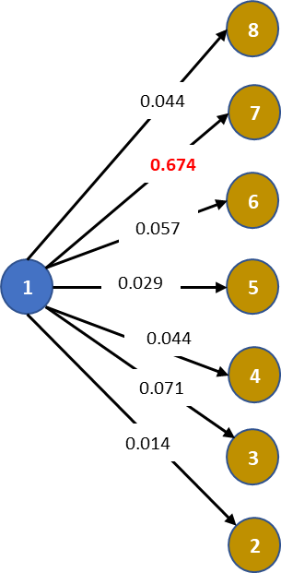
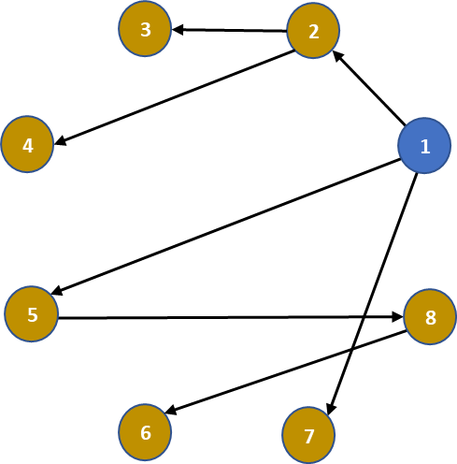
Part d – weighted probability
Typical probability sample
Sample Path
p = 0.02
Times heard = 12

