Slide 1
Group Exercise
Reproducible and FAIR Bioinformatics Analysis of Omics Data
July 13, 2024

Slide 2

Data Source
Notes:
Today we’re going to be working with some totally new data to put what you’ve learned the past couple of days into practice!
The new data set that you'll be using today is from a paper from 2021 from our lab looking at RNA-Seq responses of primary human monocyte-derived macrophages in response to EVs from airway epithelium cells. If you’re interested in the paper you can get both it and these slides within the group exercise info folder that you will download from the course workspace for today’s activity.

Slide 3
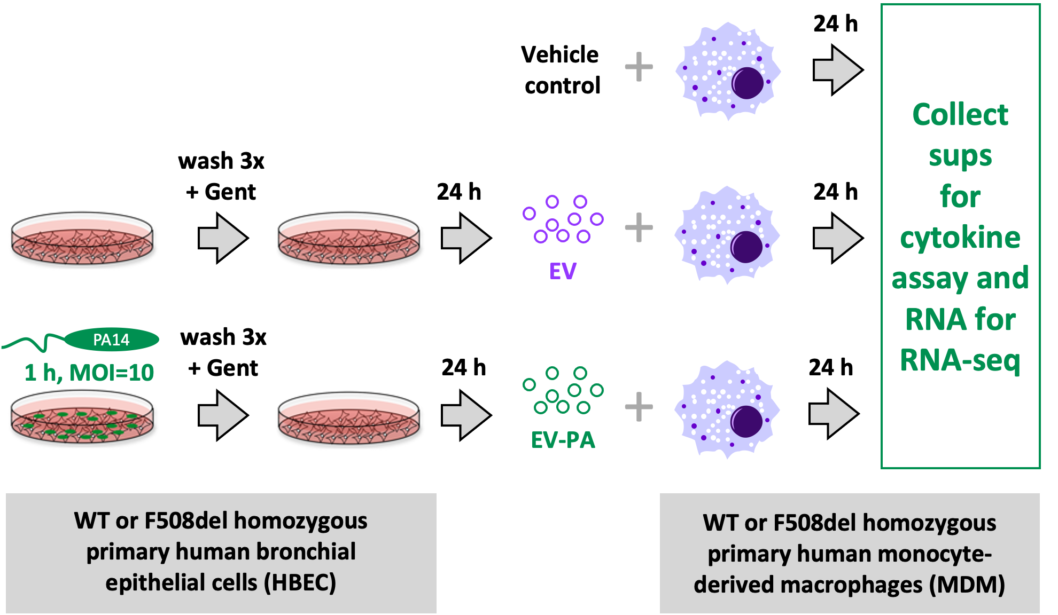
Experimental Design
Notes:
Here is the experimental design. On the on the left-hand side are the airway epithelium cells, which are also primary cells from different donors. And we either had controls or we had airway cells that were exposed to Pseudomonas aeruginosa for an hour and then thoroughly washed and an exposed to gentamicin to kill off any remaining bacteria and we for 24 hours then isolated Evs that the cells secreted, which will now be referred to either EV (for the ctrl, non-PA exposure group) or EV-PA (EVs from cells that were exposed to PA).
This was done for both WT cells and cells that have the CF delta F508 mutation.
In the second part of the experiment, WT and CF primary human monocyte-derived macrophages (these purple fellas) were exposed to either a vehicle ctrl, EVs, or the EV-PA. 24 hrs after exposure, the supernatants were collected to measure cytokines and RNA was collected from the macrophages for RNA-Seq, which is what you will be working with today!

Slide 4

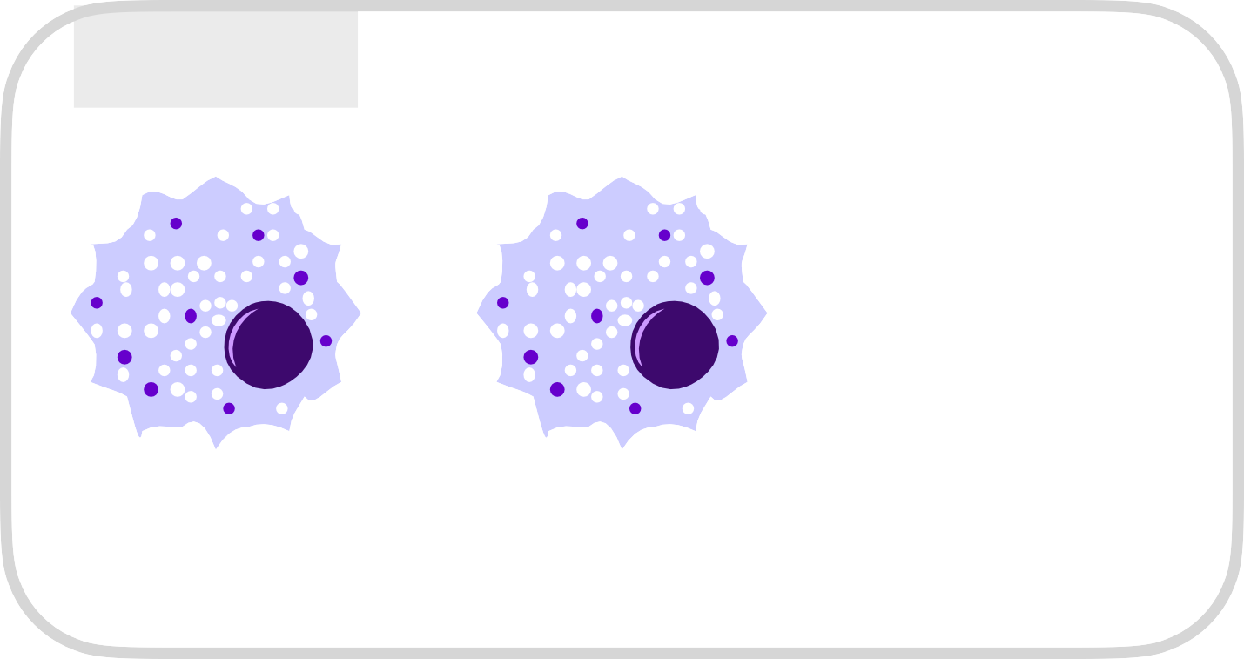
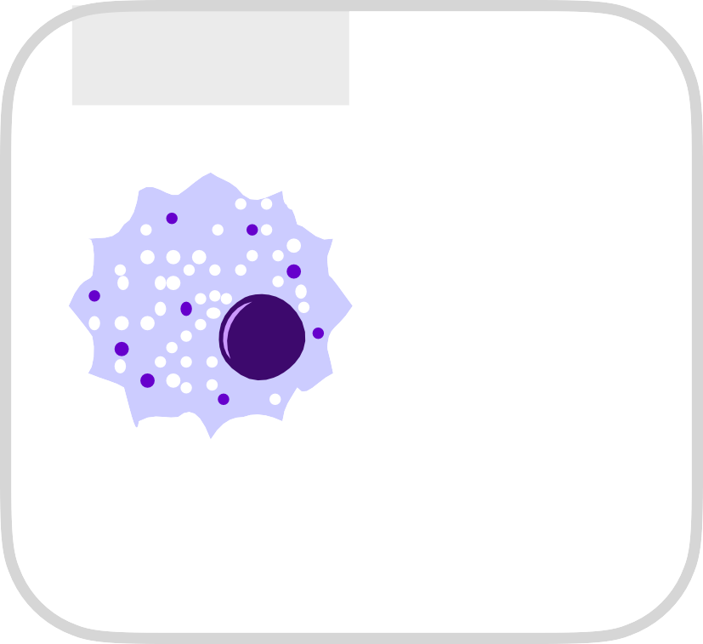

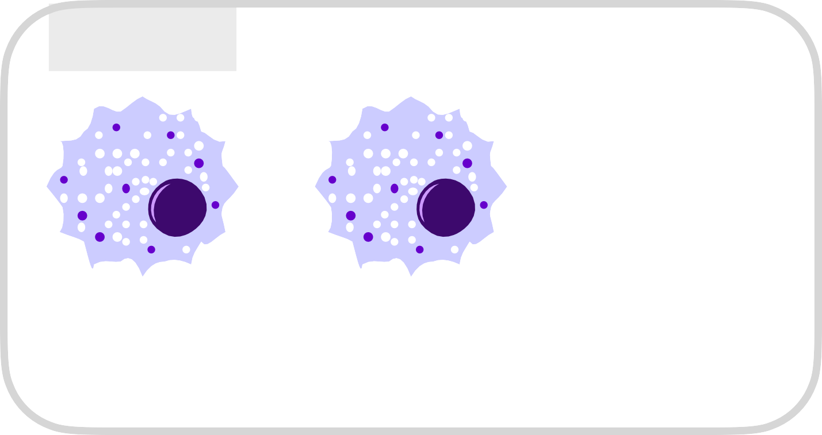


Group Subsets
Group 1
Group 3
No EV
control
CF MDM
CF MDM
WT MDM
Group 2
Group 4
No EV
control
WT MDM
CF MDM
WT MDM
Notes:
There will be 4 groups today each looking at a different subset of the data. Different comparisons will make for more interesting presentations at the end of the day! ☺
The first group will look just at the CF macrophages either exposed to EV or EV-PA. The second group will look just at the WT macrophages again either exposed to EV or EV-PA.
So these groups will have a donor factor because there will be samples from three different donors of CF macrophages and three different donors of WT macrophages and you're also, of course, have a treatment which is either EV or EV-PA.
Group three will have data from both CF and WT macrophages that are either exposed to EVs or the no-EV vehicle control. Group four will have again CF and WT macs, but in this case it’s EV-PA or no-EV vehicle control .
And that will be the main question here so groups one and two will be interested in the treatment effect and group, three and four will mostly be looking at genotype effects CF vs WT.

Slide 5
Instructions
You will be randomly assigned to one of the 4 groups.
Download the ZIP file for your group and follow the instructions in the included document.
You will be performing exploratory analysis, diﬀerential gene expression analysis and (if time allows) pathway analysis on your subset of the data.
Each group will present a short (10 min) summary of their findings starting at 4 PM.
Notes:
On the course website are detailed instructions for each group that you can download. The group assignments document is also in today’s section of the course website.
So, the overall idea is that you will start with a COUNT TABLE. So you will not need to deal with FASTQ files or using the server, since you already have the aligned reads. In the file that you download with your instructions, you have that counts table with ESEMBLE gene IDs ready to go and an annotation file provided containing ENSEMBL gene IDs, ENTREZ IDs, and gene symbols.
Your first step will be to make sure you perform some exploratory analysis to make sure the data looks good and then move on the EdgeR analysis to look at differential gene expression.
If there's any time left, you can also do a pathway analysis either using one of the online tools or in R, whatever you choose. But you don’t have to if you run out of time at the end of the day.
Each group will have a short 10 minute summary of their findings. You’ll put this in a powerpoint presentation with all of the figures you generate and show them as a group.
And that’s it!

