Slide 1


ZENITHLEDGER
SCALING TOKENS THROUGH PAYMENTS-SPECIFIC PROTOCOL.

Slide 2

TABLE OF CONTENTS
1
Our mission
2
Goal
3
4
Problem
Solution
5
Why?
6
Potential Impact
7
Use-cases
8
How it works
9
Next steps
Thank you
10
INFO@COMPANY.COM
AUGUST 2032

Slide 3

OUR MISSION
Mission
Our project aims to transform the payments infrastructure by utilizing rollup technology to separate payments from
on-chain computations, leading to a revolutionary
advancement in the field.
AUGUST 2032
INFO@COMPANY.COM

Slide 4
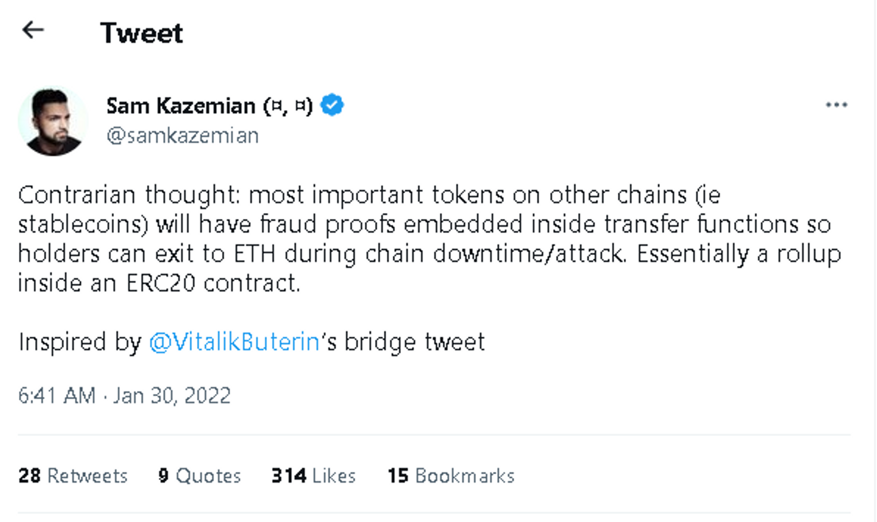
OUR MISSION
Goal
The goal is to enable scaling of tokens or tokenized assets by providing them with a payments-specific protocol layer which also involves fast, scalable, and cost-effective transactions for companies such as banks,fintech firms, E-commerce Platforms,
Payment Service Providers, Gaming and Esports Companies, Supply Chain and Logistics Companies, Cross-Border Remittance Providers, Mobile Payment Apps, Non-Profit Organizations e.t.c.
AUGUST 2032
INFO@COMPANY.COM

Slide 5

The Problem
Blockchain networks suffer from high transaction fees, making simple payments and asset transfers costly and impractical for everyday use.
Tokenized assets face scalability issues, impeding their widespread adoption and hindering efficient asset transfers.
Existing scaling solutions fail to separate payment/transfer fees from complex computation fees, leading to increased costs and complexity for users.
Leveraging the security and reliability of established blockchain protocols like Bitcoin poses challenges in scaling simple payments and asset transfers effectively.
INEFFICIENCY IN SCALING TOKENIZED ASSETS:
AUGUST 2032
INFO@COMPANY.COM

Slide 6
Solution
The project will implement rollup technology designed specifically for payments, addressing existing problems in the payment industry.
By utilizing the scalability of the BNB rollup chain, the project aims to achieve lower fees for transactions while maintaining the security and protocol attributes of Bitcoin.
. The project intends to move payment processing and settlement off-chain, resulting in significant reduction of transaction costs and improved transaction throughout. Near-instantaneous payment confirmations become possible through this solution. ​
The rollup solution provides a secure and scalable environment for companies to manage their payment infrastructure needs. It leverages the security and consensus mechanisms of the base chain, ensuring faster and more cost-effective transactions.
Companies, including banks, fintech firms, and payment processors, can deploy their own customized rollups according to their requirements. This enables efficient scaling of payment operations and allows companies to adapt the solution to their specific needs.
AUGUST 2032
INFO@COMPANY.COM

Slide 7
PROBLEM
Why now?
Growing Transaction Volumes
Traditional payment systems struggle to
handle the surge in transaction volumes, causing bottlenecks, slower processing time, and higher costs.
Customer Expectations
Meeting customer expectations for seamless,
instant, and affordable payment experiences is crucial to avoid
dissatisfaction, reduced loyalty, and missed business opportunities.
Competitive Advantage
Embracing innovative payment solutions like rollups provides a significant competitive advantage by attracting and
retaining customers, positioning .
businesses as industry leaders.
Cost Optimization
Adopting a rollup solution helps reduce transaction costs and
operational expenses, enabling resource allocation for innovation and growth, while delaying implementation prolongs financial strain.
AUGUST 2032
INFO@COMPANY.COM

Slide 8

BUSINESS MODEL
Potential Impact
Faster Transactions
Scalability
Cost-Effectiveness
Customization
Innovation and Growth
Improved Customer Experience
Security and Transparency
AUGUST 2032
INFO@COMPANY.COM

Slide 9
Use-cases
AUGUST 2032
Retail Payments
Fund Transfers
Remittances
Peer-to-Peer Payments
Micropayments
E-commerce
Cross-Border Payments
Bill Payments
Subscription Services
Financial Inclusion
Business-to-Business Payments
INFO@COMPANY.COM

Slide 10

How it works
A user is able to spin up an OP-node which listens to BNB chain for any deposits and also gets
transactions from the L2 execution engine in this case OP-BTC.
Both node come together to form either a sequencer or the verifier.
AUGUST 2032
INFO@COMPANY.COM

Slide 11
PROBLEM
Next Steps
Development
Extend the node networking capability
Testing
Reach out to stablecoins teams for more research
Live Launch
Live launch deploy to mainnet (BNB)
AUGUST 2032
INFO@COMPANY.COM

Slide 12

SOLUTION
AUGUST 2032
INFO@COMPANY.COM

