Slide 1
Machine Vision Homework#6 Deadline: 2024/06/19 23:59:59
Robot Vision Lab (Room 1421)
TAs: 魏士涵 t112598058@ntut.edu.tw
賴靖嫺 t112598008@ntut.edu.tw

Slide 2
HW#6
Canny Edge Detection
Noise Reduction
Find the intensity gradient of the image
Sobel operator
Non-maximum suppression
Double threshold
Edge Tracking by Hysteresis

Slide 3
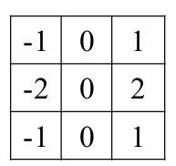
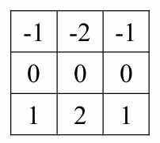
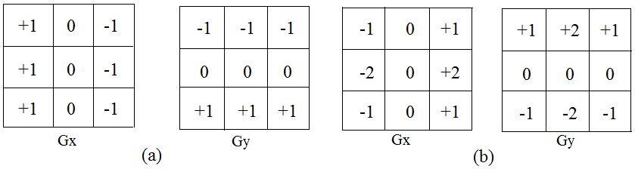
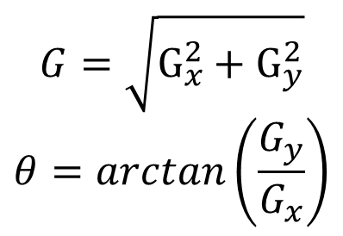
1. Noise Reduction
Use the Gaussian filter to remove the noise
Chose the kernel size yourself
2. Finding Intensity Gradient of the Image
Use operator to get image gradient in 𝑥 and 𝑦 directions.
Then, the magnitude G and the slope θ of the gradient are calculated
Sobel
$$G=\sqrt{G_{x}^{2}+G_{y}^{2}}$$
$$θ=arctan\left(\frac{G_{y}}{G_{x}}\right)$$

Slide 4
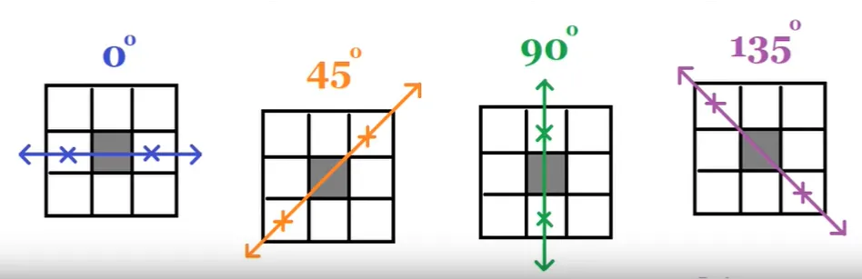
3. Non-maximum suppression.
Consider in 4 directions and compare with neighbor pixels
4. Double threshold
Used to determine strong edge and weak edge
> high threshold : strong edge
> high threshold && < low threshold : weak edge
5. Edge Tracking by Hysteresis
Connect all weak edges in the extension direction of the strong edges

Slide 5
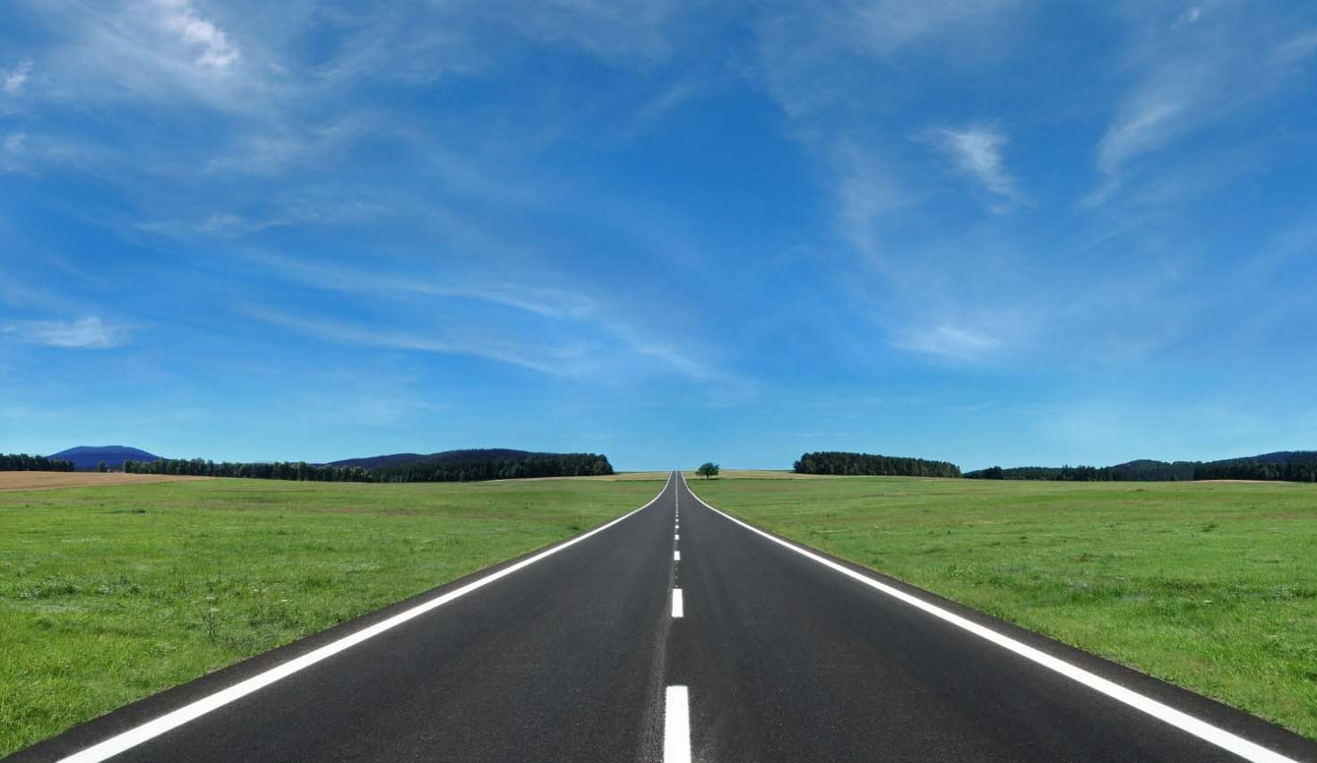
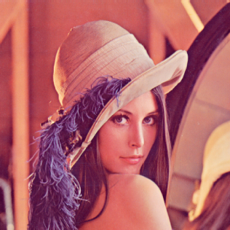
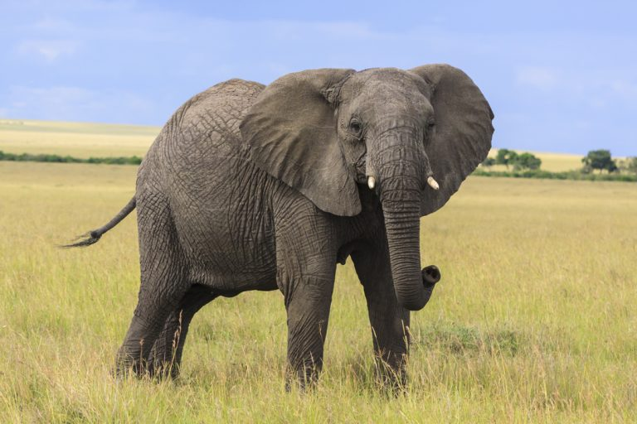
IMAGES

Slide 6
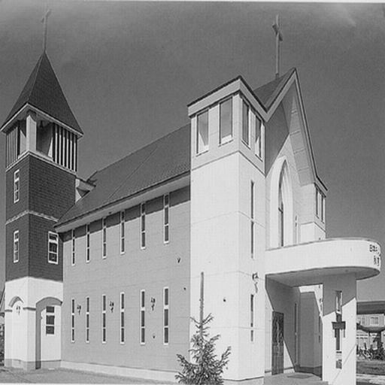
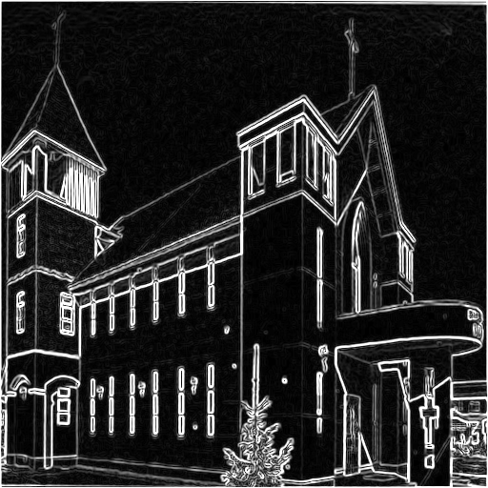
EXAMPLE

Slide 7
HW#6
Report
Student ID
Name
Describe the main part of your method or explain your code
3 result images
Describe the result images what you observe

Slide 8
HW#6
Rules in using C/C++ OpenCV Lib
Use OpenCV-2.x version
Allow use:
Read, save, show image (cvLoadImage, cvShowImage, …)
Define image (Mat)
Get image size (cvSize, cvGetSize)
Not Allow use:
Cannot use the function of Lib to do the main part of homework.
Example: Canny, threshold
Other libs also not allow use to do the main part of homework

Slide 9
HW#6
Rules in using Python OpenCV Lib
Allow use:
Read, save, show image (cv2.imread, cv2.imshow, …)
Define image
Get image size
Not Allow use:
Cannot use the function of Lib to do the main part of homework.
Example: cv.filter2D, cv.medianBlur, cv.GaussianBlur, cv.blur
Other libs also not allow use to do the main part of homework

Slide 10
HW#6
Grade
Program(80%)
Find the intensity gradient of the image (20%)
Non-maximum suppression (20%)
Double threshold (20%)
Edge Tracking by Hysteresis (20%)
Report(20%)

Slide 11
HW#6
Python
C/C++
112598008_hw6/
├─ images/
│ ├─ img1.jpg
│ ├─ img2.jpg
│ └─ img3.jpg
├─ results/
│ ├─ img1_sobel.jpg
│ ├─ img2_sobel.jpg
│ ├─ img3_sobel.jpg
├─ 112598008_hw6.py
├─ 112598008_hw6.pdf
└─ Readme.txt (Optional)
112598008_hw6/
├─ project_hw6/
│ ├─ images/
│ │ ├─ img1.jpg
│ │ ├─ img2.jpg
│ │ └─ img3.jpg
│ ├─ results/
│ │ ├─ img1_soble.jpg
│ │ ├─ img2_soble.jpg
│ │ ├─ img3_soble.jpg
│ ├─ include/
│ │ └─ func.h
│ ├─ func.cpp
│ └─ main.cpp
├─ 112598008_hw6.pdf
└─ Readme.txt (Optional)
Folder Structure
There are 3 images in the results folder.
Write homework on the one program.

Slide 12
HW#6
Please compress your files.
Example: 112598008_hw6.zip
Deadline: 2024/06/19 23:59:59
For each hour late, 10% of the total score will be deducted.
Don’t share your code and your report with other students. Do it by yourself.

