Slide 1

ITU Overview and WTSA-08 Results:
Forum on Next Generation Network Standardization
Colombo, Sri Lanka, 07-10 April 2009
Malcolm Johnson
Director, Telecommunication Standardization Bureau, ITU

Slide 2
ITU Structure
Plenipotentiary Conference
ITU Council
ITU-T
World Telecommunication Standardization Assembly
ITU-R
World Radiocommunication Conference
Radiocommunication Assembly
General
Secretariat
ITU-D
World Telecommunication Development Conference

Slide 3
ITU-T Structure
Workshops,
Seminars,
Symposia…
WTSA
World Telecommunication
Standardization Assembly
Telecommunication Standardization
Advisory Group
Focus
Groups
IPR
ad hoc
SG
Study Group
SG
Working Party
Focus Group
WP
WP
WP
Q
Q
Questions: Develop Recommendations
Q
Q

Slide 4

ITU-T Objectives
Develop and publish
standards for global ICT
interoperability
Identify areas for future
standardization
Provide an attractive and effective forum for the development of international standards
Promote the value of ITU standards
Disseminate information and know-how
Cooperate and collaborate
Provide support and assistance

Slide 5

ITU-T Key Features
Truly global public/private partnership
95% of work is done by private sector
Continuously adapting to market needs
Pre-eminent global ICT standards body

Slide 6
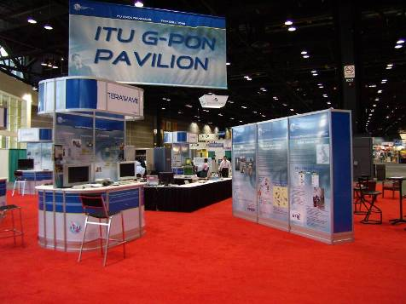
ITU-T provides Broadband Access
Copper:
  Hundreds of millions use ITU-T’s DSL
  Up to 200Mbit/s aggregate with VDSL 2
Cable:
  IPCablecom
Optical access:
  ITU-T’s GPON allows up to 2.5Gbit/s
  New types of optical fibre for access networks
GPON interoperability pavilion
Nxtcomm, Chicago, 2007

Slide 7

ITU-T puts the Super in Information Super Highway
Optical transport now to 100 Gbit/s
Carrier class Ethernet
Carrier class MPLS (MPLS-TP)
Evolution towards an All Optical Networks (AON)

Slide 8

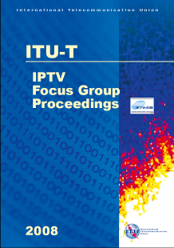
Next Generation Networks
Telecoms revolution:
From circuits to packets
Managed and secured
With Quality of Service
Saving money for customers
and service providers
IPTV standards well advanced

Slide 9

The network knocks at your door
Home Networking to
achieve interoperability
on a global scale
  Converged architecture
  and services
  Next generation
  set-top box
  PC World (US) 13.12.08: “The powerful world standards organization …[ITU].. has reached agreement on G.hn a set of specifications that would encompass phone lines, power lines, and coaxial cable to provide HDTV room to room…”

Slide 10

ITU-T’s quantum leaps in speech, audio and video quality
Emmy award received on behalf of ISO, IEC & ITU
Call for technical contributions
for H.265
Extension of work on speech coding to wideband

Slide 11

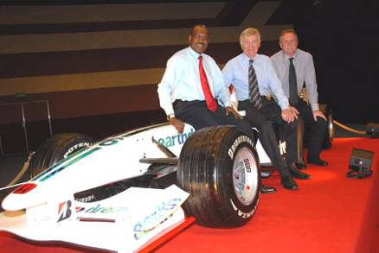
Intelligent Transport Systems: new work, new members
ITU, ISO and IEC and Geneva Motor Show
  Annual Event
New work:
  Wideband communication in cars
  Vehicle gateway protocol

Slide 12

Safety in the cyber world
Identity management
Security standards for:
  NGN
  IPTV
  Home networks
  Ubiquitous sensor networks
  Mobiles
Traceback
Countering spam

Slide 13

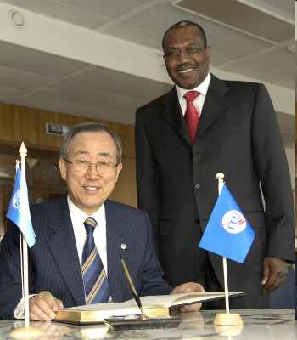
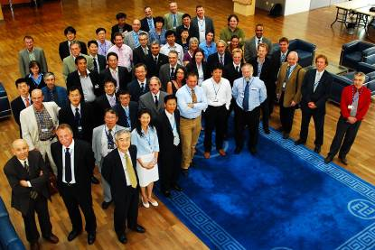
ICTs and Climate Change
Checklist to ensure new standards take climate change into account
Methodology to describe and estimate present and future user [energy] consumption of ICTs over their entire life-cycle
UN Secretary-General,
Ban Ki-moon: "ITU is one of the very important stakeholders in the area of climate change."
Participants in Focus Group ICT and Climate Change

Slide 14

Emergency Communications
Common Alerting Protocol (CAP)
  A consistent method of delivery for warning messages
Call priority schemes
  Giving priority in disaster zones to emergency calls
In Case of Emergency numbers
ITU has deployed satellite terminals to
help restore communications in the
aftermath of disasters around the world

Slide 15

Future networks
Focus Group
Collect and identify visions of future networks
First meeting
6-10 July Geneva

Slide 16
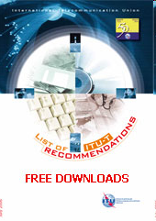
Free Recommendations
Since beginning of 2007, ITU-T Recommendations
are available without charge.
With only a small number of
exceptions all
in-force ITU-T Recommendations
are available in PDF form
via a simple mouse click:
itu.int/ITU-T/publications/recs.html

Slide 17
WTSA-08

Slide 18
WTSA-08 Statistics
Five regional preparatory meetings
(Brazil, Ghana, Uzbekistan, Syria,
Viet Nam) in association with Regional
Development Forums on Bridging the
Standards Gap in collaboration with BR,
BDT and Regional Offices
Resulted in regional common proposals from five regions
WTSA adopted 21 new Resolutions, revised 27 existing Resolutions, adopted two new Recommendations and revised
7 existing Recommendations
Total of 350 contributions
99 participating countries
Over 1000 attendees
13 Ministers/Vice-Ministers
VIPs spanning the world and the ICT industry sector

Slide 19
Key Resolutions
Resolution 44 Bridging the standardization gap between developing and developed countries
Resolution 58 to encourage the creation of national Computer Incident Response Teams (CIRTs) particularly for developing countries
Resolution 64 instructs ITU-T Study Groups 2 and 3 to study the allocation and economic aspects of IP addresses taking account of the ITU workshop on IPv6 in September 2008
Resolution 69 invites Members to refrain from taking any unilateral and/or discriminatory actions that could impede another Member State to access public Internet sites, within the spirit of Article 1 of the ITU Constitution and WSIS principles and to report any such incident to TSB.

Slide 20
Key Resolutions (2)
Resolution 70 encourages more work in the field of telecommunication/ICT accessibility for persons with disabilities
Resolution 71 to encourage cooperation between ITU-T and academia, universities and their associated research establishments, and invite Council to consider reduced fee
Resolution 73 on ICTs and Climate Change encourages the membership to work towards reductions in greenhouse gas in line with the United Nations Framework Convention on Climate Change
Resolution 74 instructs Director TSB to propose to Council reduced ITU-T fee for Sector Members from developing countries based on ITU-D model, and that it include its consideration of this matter in preparation of PP-10
Resolution 76 requires ITU-T to develop conformance and interoperability testing Recommendations as quickly as possible

Slide 21
Recommendations
Recommendation ITU-T D.50 asks that international Internet connection arrangements take into account the possible need for compensation for the value of elements such as traffic flow, number of routes, geographical coverage and cost of international transmission, and the possible application of network externalities.
Recommendation ITU-T D.156 asks that developing countries examine appropriateness of a network externality premium on incoming international traffic from the operators of developed networks to the operators of developing-country networks to fund extending networks in developing countries

Slide 22
Action Plan

Slide 23

Industry Advisory Group
Resolution 68 and GSS proposal:
  High-level industry
  executives
  Identify and coordinate
  priorities and subjects
  to minimize number of
  forums/consortia
  Consult first with
  developing countries
  Report to next WTSA

Slide 24
Council Group to be established
Resolution 75 requests that Council establish a group on Internet public policy issues to be integrated within the Council WG on WSIS
Implemented by Council-08 and first meeting held February

Slide 25
Reports to Council-09
Resolution 76 Compatibility and Interoperability
  Expert advisory group has been established to assist TSB to develop the Report to Council-09
  Consultant appointed to assist TSB
  Subject of later presentation

Slide 26
Reports to Council-09 (2)
Resolution 64 on allocation and economic aspects of IP addresses
  Questionnaire will be issued soon to identify regional needs of developing countries in association with BDT
  New web page on IPv6 soon
  Organize seminars for developing countries on IPv6
  TSB conduct study on IPv6 address allocation and registration for interested countries
  Report to Council-2009

Slide 27
Reports to Council-09 (3)
Director will propose to Council-09 that new members from developing countries can join
ITU-T on level of financial contribution equal to that in ITU-D and report to PP-10 (Resolution 74)
Director will invite the ITU Council to consider the admission of academic institutions, universities and their associated research establishments in the work of ITU-T as Sector Members or Associates, at a reduced level of financial contribution, particularly academic institutions of developing countries (Resolution 71)

Slide 28
Bridging the Standards Gap
Resolution 44 actions plan has 4 programmes:
Programme 1: Strengthening standard-making capabilities
Programme 2: Assisting developing countries in enhancing efforts in respect of standards application
Programme 3: Human resource building
Programme 4: Flagship groups for bridging the standardization gap
Director establishing an implementation group within TSB which organizes, mobilizes resources, coordinates efforts and monitors work related to the action plan

Slide 29
Assistance to
Developing Countries
Resolutions 17, 44, 56, 59, 72 and more:
  Organize workshops and seminars in the regions concerns (including related to human exposure to electromagnetic fields)
  Support regional activities and study group VCs from developing countries
  More meetings in regions
  Regional and Flagship groups
  Remote participation
  Provide fellowships to all ITU-T Study Group and TSAG meetings

Slide 30
Actions
Increased number of study group meetings in the regions planned
New regional group meetings planned
Workshops in regions on implementation of WTSA-08 actions and application of ITU-T Recommendations in regions
Fellowships now available for all ITU-T study group meetings
New ITU-T Flagship Group for Latin America
Study Group 3 Regional Group for Latin America Lima, Peru - 22 to 26 June 2009
ICT and Climate Change Symposium, Quito, Equator 9 to 11 July 2009 preceded on 8 July by a briefing on the ITU implementation of the WTSA-08 decisions
NGN-GSI and ITU-T SGs 11 and 13 - Mar del Plata, Argentina
2 to 12 September preceded by the “Kaleidoscope” 31 August and 1 September 2009

Slide 31
Conclusions
ITU world’s pre-eminent global ICT standards body
Bridging the standardization gap recognised as essential to ITU’s mission to Connect the World
New team of chairmen and vice-chairmen from 33 countries
First SG15 meeting since WTSA-08 was completely paperless, had largest ever participation (367 delegates) largest ever number of contributions (336) consented 28 Recommendations including new high profile global standard on home networking:
Full list of WTSA Resolutions is at:
http://www.itu.int/publ/T-RES/e

