Slide 1

ITU-T’s NGN Global Standards Initiative Leading NGN Forward
Malcolm Johnson
Director, Telecommunication Standardization Bureau, ITU
NGN Europe Summit,
19 November 2007

Slide 2

Outline
Introduction to ITU/ITU-T
Networks in transition
ITU and NGN
ITU and cooperation
ITU and development

Slide 3
Introduction to ITU
International partnership of 191 governments and over 700 private sector entities
Founded in 1865, it is oldest intergovernmental organisation
ITU named in Booz Allen Hamilton survey as one of the world’s ten most enduring institutions that have changed and grown in unswerving success and relevance — yet remained true through time to its founding principles
Standards making one of the ITU’s first activities
Headquarters Geneva, 11 regional offices

Slide 4
ITU Mission and More
Maintain and extend international cooperation in telecommunications
Technical and policy assistance to developing countries
To harmonize actions of Member States and promote cooperation between Member States and Sector Members
Leading managerial role in World Summit on the Information Society (WSIS), held in Geneva Dec 2003 and Tunis Nov 2005
Responsible for WSIS follow-up action on infrastructure and cyber security

Slide 5
Historical Highlights: Standards
2005: VDSL2
2004: NGN Focus Group established
2004: Standards for Gigabit passive optical network (PON)
2002: H.264/MPEG-4/AVC next generation video coding
2000: X.509 for public key infrastructure (PKI) updated
1999: Standards for cable modems
1998: V.90 modem standard
1998: SDH – key standard for digital information
1996: H.323 for VoIP and videoconferencing
1993: First DSL standards for broadband
1988: Key audio coding standards (G.711 and G.72x)
1988: 1981: Signaling system seven (SS7) standards
1976: First packet switching standard (X.25)
1968: First standards for fax transmission

Slide 6
ITU-T hot topics
Next generation network (NGN)
Bridging the standardization gap
IPTV
Cybersecurity including identity management (IdM)
Ubiquitous networks
Next generation multimedia conferencing
Videocoding
Broadband access
Packet based transport
Fibre optics
Home networking
ICTs and climate change

Slide 7


2006 Output
231 Recs/supplements published
Increase of 30% over 2005 in terms of meeting documents processed
61 meetings (44 in Geneva, 17 outside) increase of 13% over 2005
Strong NGN Focus
    Global NGN standards progressing rapidly within ITU-T
    Providing global leadership through overall framework and structure
    Building on the work of other bodies (not
    reinventing ...)
    22 Recommendations on NGN
        Transition from legacy, requirements, architecture, security, QoS, OAM (Ethernet and MPLS)

Slide 8
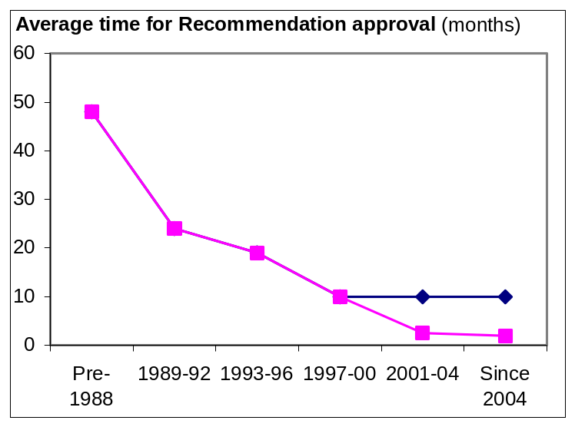
ITU-T Characteristics
Quick to respond and adapt to market pressure: contribution-driven
Unique partnership of private sector and government
Today, 95% of standards developed and agreed by private sector
Truly global and impartial
Consensus decisions
Very flexible
Fast procedures, transparent procedures
    start work: 1 day / few weeks
    develop work: weeks to 2-3 yrs
    approve work: average 2 months
Common IPR Policy with ISO and IEC

Slide 9
ITU-T Focus Groups
Provide quick reaction to standardization needs and giving participation and working method flexibility
    Forum-like entities with “arms-length” organization
    A high degree of independence, adopt own working methods
    Conclude working normally within 12 months
    Non-ITU members can participate and can benefit from:
        Worldwide visibility
        Networking opportunities
        Exposure to a large pool of expertise drawn from related work under progress in ITU-T Study Groups and other ITU-T Focus Groups.

Slide 10
Upcoming workshops
Can we Win the War Against Cyber-Threats: 12 November, Rio de Janeiro, Brazil
Making accessibility a reality in emerging technologies: 13 November, Rio de Janeiro, Brazil
Towards International Standards for a Truly Multilingual Global Internet: 13 November, Rio de Janeiro, Brazil
Human exposure to electromagnetic fields (EMFs): 20 November, Geneva, Switzerland
Broadband Wireless Access Seminar
26 November, Moscow, Russia
The Fully Networked Car: 5-7 March 2008, Geneva Motor Show – one of the world’s top five motor shows, Switzerland

Slide 11

Innovations in NGN
12-13 May 2008
Part of initiative to increase dialogue between academia/ITU
Follows January 2007 consultation meeting
First in a series of ‘Kaleidoscope’ events
Will identify new topics for standardization
IEEE Communications Society technical co-sponsor
Open to all (paper selection via call for abstracts)
itu.int/ITU-T/uni/kaleidoscope/

Slide 12
Networks in Transition

Slide 13
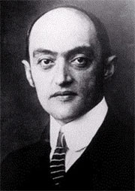
Networks in Transition: The Impact of New Communications Technologies
Technology-driven industries like the communications sector have historically been characterized by steady growth punctuated by “giant leaps” forward, usually when “new” technology is introduced
“Technology is not kind. It does not
wait. It does not say please. It
slams into existing systems. Often
destroying them, while creating
new ones”
    Economist, Joseph
    Alois Schumpeter (1937)
Notes:
Usually also corresponds
to periods of rapid
economic growth

Slide 14
Communications revolutions
1840s: Telegraph
1870s: Telephone
1890s: Radio telegraphy or “wireless”
1920s: Radio broadcasting
1950s: Television broadcasting
1960s: Geostationary satellite communications
1970s: Computer communications
1980s: Optical communications
1990s: Internet and mobile
2000s: IP-enabled NGNs or Next Generation Internet?
1865: ITU Created

Slide 15
Just How Fast Things Are Changing…
1998: Few ITU IP-based networks activities
  >> PP Res 101 (Minneapolis, 1998) calls upon ITU to “fully embrace the opportunities that arise from the growth of IP-based services”
2007: Almost all ITU’s day-to-day activities are related to IP-based networks or the Internet
Examples:
    New ITU standards (DSL, cable, FTTx) have brought broadband to over 280 million new users since 2000
    IP-enabled Next Generation Networks (NGNs)
    IPTV, ENUM, IPv6 deployment, IDNs, cybersecurity, countering spam, IP Policy Manual, IP interconnection policies, IXPs, convergence & regulatory policies etc

Slide 16

Approaching tipping point?
Deployment of new communications technologies is typically a series of relatively short cycles of one or two decades’ duration:
    beginning with invention
    early stages of rapid innovation and application
    typically over-hyped and not used for original purpose intended
      took 30 years for the “killer app” of the telephone to emerge (chat)
      WWW took time for business models to emerge
      SMS operators struggled to market at first
    finally deployed in way to scale to broader market acceptance and commoditization

Slide 17
Next Generation Network

Slide 18
ITU-T Definition of NGN (Y.2001)
Next Generation Network (NGN): a packet-based network able to provide telecommunication services and able to make use of multiple broadband, QoS-enabled transport technologies and in which service-related functions are independent from underlying transport-related technologies.
It enables unfettered access for users to networks and to competing service providers and/or services of their choice.
It supports generalized mobility which will allow consistent and ubiquitous provision of services to users.

Slide 19
Standards: The business case
World’s ICT business asked for ITU to take lead in NGN standards in 2004
Harmonization across boundaries increasingly important: consistent user experience
Revenues increasingly driven by content and services rather than by type of network
Meeting diverse and customer-segment-specific markets requires a range of solutions to interoperate
BT aims for annualized cost savings of £1bn pa from 21st century network (21CN)
NTT’s CEO Norio Wada speaking at ITU-T 50th anniversary, 2006: “…considering NGN performance requirements, we need de jure standards for that network. This need makes ITU-T’s role even more critical. Without ITU-T’s work in this area, telecoms cannot build global NGN as robust and reliable as conventional networks. I have high hopes that ITU-T will effectively address this essential need.…”

Slide 20
ITU’s NGN-GSI
GSI = Global Standards Initiative
Developing the detailed standards necessary for NGN deployment to give service providers the means to offer the wide range of services expected in NGN.
NGN-GSI harmonizes, in collaboration with other bodies, different approaches to NGN architecture worldwide.
Brings together ITU-T Study Groups working on NGN standards
      SG 13 Lead SG on NGN
      SG 19 Lead SG on mobility
      SG 11 Lead SG on signalling and protocols
      SG 2 Service provision, networks and performance
    Co-located meetings

Slide 21
Also…
Service requirements, features, architecture, and implementation scenarios of IMS based real-time conversational multimedia services
Requirements for Fixed Mobile Convergence
Protocols for QoS in NGN – six Recommendations
IdM-GSI – Identity management
IPTV-GSI
Advanced multimedia system (AMS)

Slide 22
Collaboration

Slide 23
ITU and Referencing
ITU does not do alone
    ITU-T Recs. A.4, A.5, A.6 provide mechanism to share results
    Process used in many Recommendations
      E.g., IMT-2000 Family Member specs transposed by 3GPP & 3GPP2 OPs globalized in Q.1741- & Q.1742-series

Slide 24
Relationship with other standards bodies
MoUs and cooperation agreements with over 70 standards bodies
3GPP: Iterative process between ITU-T and 3GPP agreed. September, 2007 meeting between TSB and 3GPP management
    ITU-T invitation to host 3GPP meetings
    3GPP as an ITU-T Focus Group?
    ITU-T as 3GPP Partner?
IEEE ComSoc: MoU work in progress
IETF: ITU-T / IETF Leadership Gathering, 21 July 2007
    Area Directors and Study Group chairs

Slide 25
Global Standards Collaboration
GSC 12, Kobe 8-13 July 2007
The mandate of GSC is to provide a venue for the leaders of the Participating Standards Organizations and the ITU to:
    ...exchange information on the progress of standards development…
    Collaborate in planning future standards development to gain synergy and to reduce duplication.
    …the mandate of GSC is to provide a venue… to:
    Support the ITU as the preeminent global telecommunication and radiocommunication standards development organization.

Slide 26
WSC Members have aligned their patent policies
WSC = World Standards Cooperation (ISO, IEC and ITU)
Common IPR Policy based on ITU-T policy
… strongly encourages the disclosure of known patented technology from the outset.
Allows for companies’ IPR to be included in standards as long as it is made available under reasonable and non-discriminatory terms and conditions.
WSC also adopted Guidelines for the Implementation of the Common Patent Policy and a Patent Statement and License Declaration Form.
Each of the three WSC organizations also has an online patent database.

Slide 27
ITU and Development

Slide 28
Global Standards Symposium
To be held one day before next ITU World Telecommunication Standardization Assembly (WTSA-08), in South Africa, on 20 October 2008
Aims to bring together all standards makers
Themes:
    Reducing the standardization gap
    Improving collaboration
Details discussed at: tsagroundtable@itu.int

Slide 29
Bridging the standardization gap - what does it mean?
The standardization gap might be defined as disparities in the ability of representatives of developing countries, relative to developed ones, to access, implement, contribute to and influence international ICT standards, specifically ITU Recommendations.
The standardization gap is itself both a cause and a manifestation of the wider digital divide
It contributes to the persistence of the wider digital divide

Slide 30
What has been done recently to reduce the standardization gap?
First in series of annual Forums in each region organised by TSB, BDT, Regional Office and Regional Organisation
Placing greater emphasis on implementation guidelines – exploring possible translation in regions?
Starting a series of Tutorial Groups on implementation
Directors TSB and BDT written to all Member States and Sector Members inviting contributions for fund on bridging standardization gap
Establishing Regional Groups
Trialling collaborative tool for remote participation in meetings
More meetings in regions

Slide 31
Bridging the standardization gap Forums
Addressing manufacturers, operators, service providers, regulators and administrations.
Providing an overview of technologies that have created major standardization challenges such as NGN, multimedia, VoIP, IPTV, security and regulation.
Highlighting ways and means to enhance cooperation and participation in ITU’s standardization work and standards implementation in developing countries.
One Forum in each region – Asia Pacific, Americas, Arab, Africa - before October 2008

Slide 32
Free Recommendations
Historic decision taken by the 2007 Council
Major step forward in bridging the standardization gap
During trial Jan-August 2007 16% of downloads to developing countries
300’000 downloads to developing countries during 8 month trail, compared with just 500 sold in 2006
Total of 2 million downloads during trial

Slide 33
NGN-GSI Key Recommendations
Rec. N. | Title
Y.2012 | Functional requirements and architecture of the NGN
Y.2091 | Terms and definitions for Next Generation Networks
Y.2111 | Resource and admission control functions in NGN
Y.2171 | Admission control priority levels in Next Generation Networks
Y.2021 | IMS for Next Generation Networks
Y.2261 | PSTN/ISDN evolution to NGN
Y.2031 | PSTN/ISDN emulation architecture
Y.2271 | Call server based PSTN/ISDN emulation
Y.2201 | NGN release 1 requirements
Y.2701 | Security requirements for NGN release 1
Q.1706/Y.2801 | Mobility management requirements for NGN
Q.3900 | Method of testing and model network architecture for NGN Technical means testing as applied to public telecommunication networks
M.3343 | Requirements and analysis for NGN trouble administration across B2B and C2B interface
Y.1542 | Framework for achieving end-to-end IP performance objectives

Slide 34
Conclusion
ITU the only international, intergovernmental organization developing telecommunication/ICT standards.
Global NGN standards progressing rapidly within ITU-T
    Providing global leadership through overall framework and structure
    Taking advantage of the work of other bodies (not reinventing ...)
    Extending benefits to developing world
Collaboration to avoid duplication of effort and incompatible implementations is essential

Slide 35
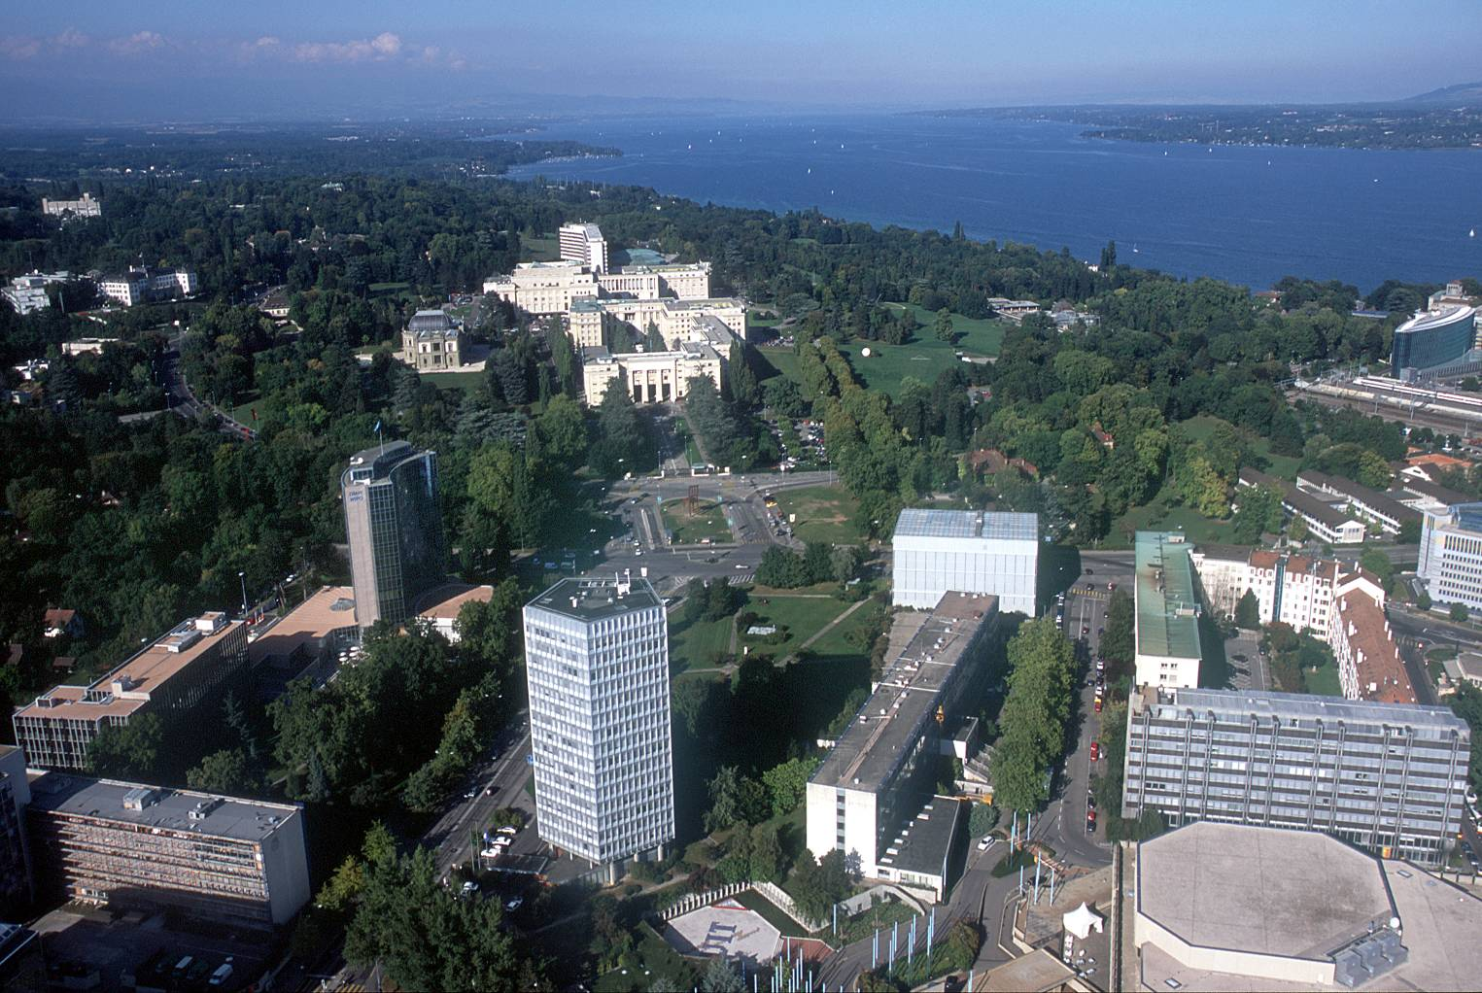
Malcolm.Johnson@itu.int

