Slide 1

Standardization and ITU
Malcolm Johnson
Director, Telecommunication Standardization Bureau, ITU
ITU at the heart of international Geneva
Fireworks meeting
Turin, 30 October 2007

Slide 2

Outline
ITU-T Characteristics
Work highlights
Focus Groups
Cooperation

Slide 3
ITU-T Characteristics
Market pressure forced, and continues to force ITU-T to adapt
Unique partnership of private sector and government
Work (mostly) done in Study Groups (13 of them)
Today, 95% of work is done by private sector
    Strong participation from Asia, esp. China
Truly global
Consensus decisions
Very flexible
Fast procedures, transparent procedures
    start work: 1 day / few weeks
    develop work: weeks to 2-3 yrs
    approve work: average 2 months
      AAP for technical standards (= 95% of work)
    publish work: couple of days after approval
IPR Policy

Slide 4
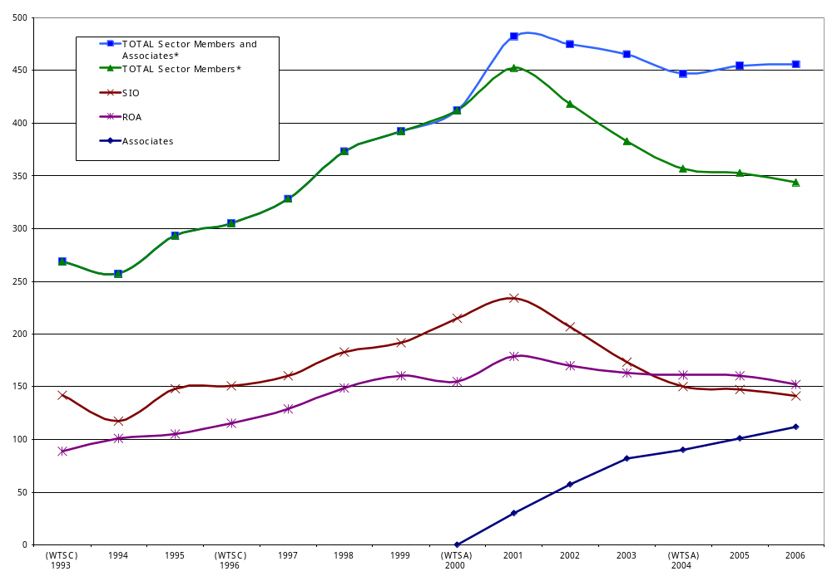
Sector Members and Associates
* including regional and other international organizations, regional telecommunications
organizations, intergovernmental organizations and other entities dealing with
telecommunications

Slide 5
Top-13 SG and WP Participation (2006)
= 79% of total admin attendance
76%
69%
49%
Administrations (841/1067) Members: 191 |  | ROA (328/432) Members: 154 |  | SIOs (700/1016) Members: 141 |  | Associates (42/86) Members: 112
China | 153 | France Telecom | 60 | NTT * | 129 | HHI | 6
Korea | 153 | BT | 47 | Huawei | 123 | Dilithium | 5
United States | 132 | KDDI | 36 | ETRI | 90 | OFS Fitel | 4
United Kingdom | 68 | China Telecoms. | 35 | Nortel Networks * | 53 | Semtech | 4
Syria | 62 | Telekom.Polska | 26 | Siemens * | 48 | UpZide | 4
Japan | 49 | Deutsche Telekom | 20 | Alcatel * | 47 | AULM | 3
France | 44 | Telecom Italia | 18 | Lucent * | 47 | RAD Data | 3
Russia | 44 | AT&T | 17 | ZTE | 45 | Yokogawa | 3
Canada | 40 | China Mobile Com. | 16 | Cisco | 33 | Anagran | 2
Germany | 35 | Swisscom | 16 | L.M. Ericsson | 23 | ASSIA | 2
Australia | 25 | NHK | 13 | NEC | 21 | Atos Origin | 2
Switzerland | 20 | Telenor ASA | 13 | Telcordia | 21 | Essex | 2
Kenya | 16 | KT Corp. | 11 | Hitachi | 20 | Finisar | 2
Sector Members
Associates
Number of participations
* Consolidated for various memberships

Slide 6
Work highlights

Slide 7
ITU-T hot topics
Next generation network (NGN)
IPTV
Cybersecurity including identity management (IdM)
Ubiquitous networks
Next generation multimedia conferencing
Videocoding
Broadband access
Packet based transport
Fibre optics
Home networking
ICTs and climate change

Slide 8


Work highlights 2006
231 Recs/supplements published
Increase of 30% over 2005 in terms of meeting documents processed
61 meetings (44 in Geneva, 17 outside)
    Increase of 13% over 2005
Strong NGN Focus
    Global NGN standards progressing rapidly within ITU-T
    Providing global leadership through overall framework and structure
    Building on the work of other bodies (not
    reinventing ...)
    22 Recommendations on NGN
        Transition from legacy, requirements, architecture, security, QoS, OAM (Ethernet and MPLS)

Slide 9

Upcoming workshops
Making accessibility a reality in emerging technologies: 13 November, Rio de Janeiro, Brazil
Human exposure to electromagnetic fields (EMFs) 20 November, Geneva, Switzerland
Broadband Wireless Access Seminar
26 November, Moscow, Russia
Standardization of mechanisms for ensuring ICT security and development of ICT services
6 December, Belarus
The Fully Networked Car
7 March 2008 - PALEXPO, Geneva, Switzerland

Slide 10

Innovations in NGN
12-13 May 2008
Part of initiative to increase dialogue between academia/ITU
Follows January 2007 consultation meeting
First in a series of ‘Kaleidoscope’ events
Will identify new topics for standardization
Call for papers issued
    Deadline 15 October
itu.int/ITU-T/uni/kaleidoscope/

Slide 11
Bridging the standardization gap: Forums 2008
Addressing manufacturers, operators, service providers, regulators and administrations.
Providing an overview of technologies that have created major standardization challenges such as NGN, multimedia, VoIP, IPTV, security and regulation.
Highlighting ways and means to enhance cooperation and participation in ITU’s standardization work and standards implementation in developing countries.
One Forum in each region – Asia Pacific, Americas, Arab, Africa - before October 2008

Slide 12

What is the standardization gap?
The standardization gap might be defined as disparities in the ability of representatives of developing countries, relative to developing ones, to access, implement, contribute to and influence international ICT standards, specifically ITU Recommendations.
The standardization gap is itself both a cause and a manifestation of the wider digital divide
It contributes to the persistence of the wider digital divide

Slide 13

What has been done recently to reduce the standardization gap?
First in series of annual Forums in each region organised by TSB, BDT, Regional Office and Regional Organisation
Placing greater emphasis on implementation guidelines – exploring possible translation in regions?
Starting a series of Tutorial Groups on implementation
Directors TSB and BDT written to all Member States and Sector Members inviting contributions for fund on bridging standardization gap
Establishing Regional Groups (e.g. SG2 for Arab Region)
Trialling collaborative tool for remote participation in meetings

Slide 14
Focus Groups

Slide 15

ITU-T Focus Groups
Augment Study Group work providing quick reaction to standardization needs and giving participation and working method flexibility
    Forum-like entities with “arms-length” organization under ITU-T Study Group
    A high degree of independence
    Outputs in well-defined areas:
        Stand-alone Focus Group deliverables or
        Provided as direct input into Study Groups for progression to ITU-T Recommendation
    Non-ITU members can participate and can benefit from:
        Worldwide visibility
        Networking opportunities
        Exposure to a large pool of expertise drawn from related work under progress in ITU-T Study Groups and other ITU-T Focus Groups.

Slide 16
ITU-T Focus Groups (1)
Identity Management
Meeting 1: Geneva, 13-16 February ’07 - Closed September 2007
    Explored mechanisms that allow different IdM frameworks to interoperate together
    Four deliverables sent to relevant Study Groups and to ISO/IEC/JTC 1/SC27
    Work will continue under banner IdM-GSI
From/In/To Cars Communication (I and II)
Meeting 1: Geneva, 26 Jan ’07
    Working on specifications that will enhance communications in vehicles
    Recently expanded to include wideband communications
IPTV (see following example)
Meeting 1: Geneva 10-14 July ’06
    Coordinating and promoting the development of global IPTV standards

Slide 17
ITU-T Focus Groups (2)
Security Baseline for Network Operators
Meeting 1: 30 March 2006 - Closed September 2007
    Defined a security baseline so that operators can assess their network and information security posture in terms of available standards
    Output will be published as supplement to X.800 – Security Architecture
NGN Management
Established Feb 2005
    Providing a centralized approach regarding specification of NGN related fault, configuration, accounting, performance, and security management interfaces
Open Communications Architecture Forum
Established May 2004
    Defining specifications for a set of components for a new carrier grade open platforms

Slide 18

IPTV FG Major achievements (1)
Collaboration With Other SDOs
    Liaison relationship with almost all SDOs involved with the
    development of IPTV
    Input from ATIS IIF, DSL Forum and Home Gateway Initiative (HGI)
    Working relationship with DVB project and ETSI TISPAN
Regional/national bodies and SDOs benefit from contributing to FG IPTV and having their work incorporated into globally recognized and accepted standards

Slide 19
IPTV FG Major achievements (2)
Agreed to a unique functional architecture covering legacy and NGN (IMS and non-IMS) based platforms
    Facilitates alignment between other SDOs
In depth discussion on home network architecture and other related issues
Captured vast number of requirements covering home network, metadata, middleware, public interest, QoS/QoE, security, unicast and multicast

Slide 20
Cooperation

Slide 21
MoU between ITU and ETSI
Considering:
    ITU as the intergovernmental and universal organization responsible for worldwide standardization of telecommunications
    ETSI as a regional organization
Allows
    Each organization to use the documents of the other in order to advance its own work
    Each will also be able to reference standards texts of the other
    Each organizations experts can participate in the others meetings

Slide 22


ITU-T and 3GPP
ITU-T participated at 3GPP PCG/OP meeting in New Delhi, April 2007
ITU-T will participate at future 3GPP PCG/OP meetings
3GPP "recognize[s] the importance of the relationship between 3GPP and the ITU"
Input from ITU-T into 3GPP:
    ITU-T can submit requirements on common IMS either through
      a liaison statement, or
      through an individual 3GPP membership contribution
Output from 3GPP into ITU-T: specs on common IMS to be submitted to ITU-T
September, 2007 meeting TSB and 3GPP management
    ITU-T invitation to host 3GPP meetings
    3GPP as an ITU-T Focus Group?

Slide 23
ITU-T and IEEE
Feb 2007: Mutual promotion of events of common interest was agreed in February 2007
May 2007: IEEE Global Standards and Developing Economies: Broadband Access and Infrastructure Seminar, Tunis May 9-10. ITU-T participation in IEEE-SA Corporate Advisory Group (CAG)
May 2007: IEEE 802.1 and 802.3 Interim Meeting hosted by ITU-T in Geneva May 28-31
May 2007: This Joint ITU-T/IEEE Workshop on Carrier-class Ethernet in Geneva May 31-June 1
June 2007: ITU-T welcomes IEEE 802 participants to its
4-15 June SG15

Slide 24
ITU-T and IETF
ITU-T Workshop on NGN in collaboration with IETF
Geneva, 1-2 May 2005
    High-level management meeting
ITU-T / IETF Leadership Gathering
21 July 2007

Slide 25
Global Standards Collaboration
GSC 12, Kobe 8-13 July 2007
The mandate of GSC is to provide a venue for the leaders of the Participating Standards Organizations and the ITU to:
    ...exchange information on the progress of standards development…
    Collaborate in planning future standards development to gain synergy and to reduce duplication.
    …the mandate of GSC is to provide a venue… to:
    Support the ITU as the preeminent global telecommunication and radiocommunication standards development organization.

Slide 26
WSC Members have aligned their patent policies
WSC = World Standards Cooperation (ISO, IEC and ITU)
Based on ITU-T policy
… strongly encourages the disclosure of known patented technology from the outset.
Allows for companies’ IPR to be included in standards as long as it is made available under reasonable and non-discriminatory terms and conditions.
WSC also adopted Guidelines for the Implementation of the Common Patent Policy and a Patent Statement and License Declaration Form.
Each of the three WSC organizations also has an online patent database.

Slide 27
Global Standards Symposium
To be held day before next ITU World Telecommunication Standardization Assembly (WTSA), October 2008
Aims to bring together all standards makers
Themes:
    Reducing the standardization gap
    Improving collaboration
Details discussed at: tsagroundtable@itu.int

Slide 28
World Telecommunication Standardization Assembly
October 2008
WTSA sets direction and structure for ITU-T
Meets every four years
Defines the general policy for the Sector
Establishes the study group structure
    Correspondence Group on SG Structure: tsagstructure@itu.int
Approves their expected work programme
Appoints their chairmen and vice-chairmen
WTSA Resolutions are available at:
www.itu.int/ITU-T/WTSA/resolutions

Slide 29
Free Recommendations
Historic decision taken by the 2007 Council
In 2001, Council approved three free Recs per year
In 2006, Council approved a trial programme of free ITU-T Recommendations online, without restriction
In 2007, Council made this trial permanent
ITU-T Recommendations | 2006 | 2007 | Change
Downloaded, Free of charge, Jan-April | 13,601 | 968,790 | +7,100%
Sold, on paper and via e-bookshop, Jan-April | 2,532 | 436 | -83%

Slide 30
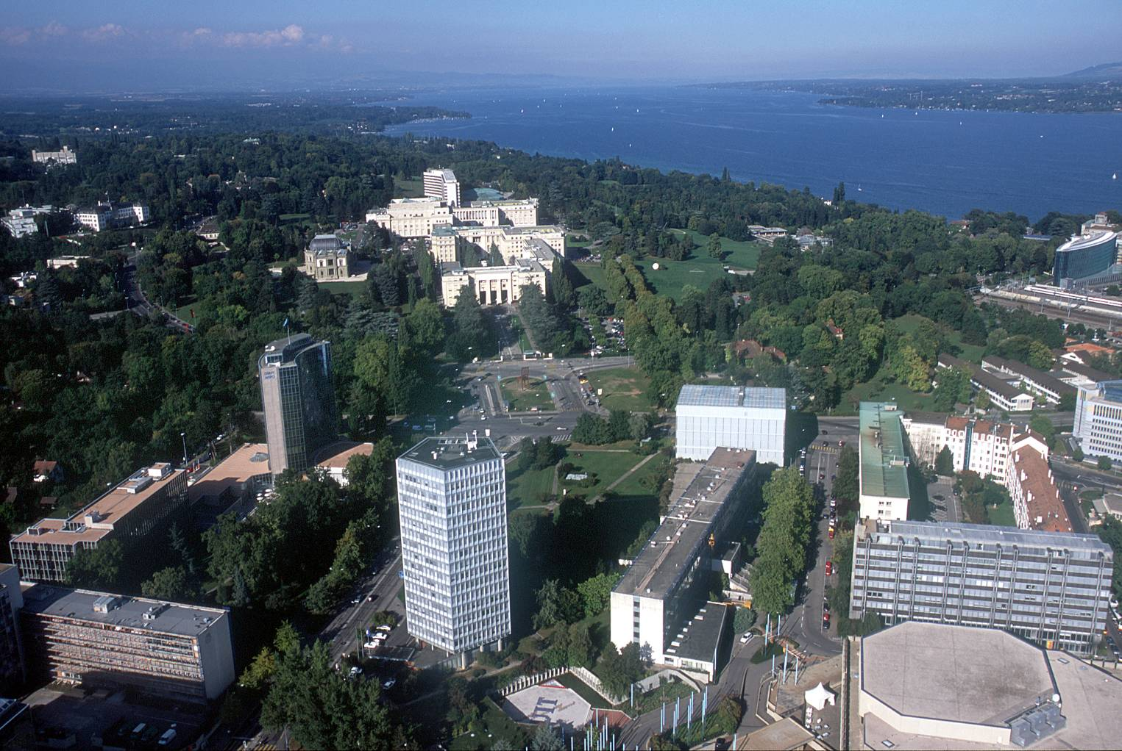
Malcolm.Johnson@itu.int

Slide 31
Back up slides

Slide 32
Work highlights 2006
GPON Interoperability demonstrations
VDSL 2
G.9954 - Home networking transceivers
Allocation of intl. dialling code 888 to UN
Recs J.360-366 – IPCablecom 2
14 new signalling protocols
Architecture of Transport MPLS (T-MPLS)
New work area – generic sound activity detection
Accessibility checklist
Rec. H.324 – speeds up set up time for 3G calls
Rec. G.729.1 – scaleable voice codec
ICT Security standards roadmap
Global NGN standards progressing rapidly within ITU-T
Providing global leadership through overall framework and structure
Building on the work of other bodies (not
reinventing ...)
22 Recommendations on NGN
    Transition from legacy, requirements, architecture, security, QoS, OAM (Ethernet and MPLS)

Slide 33
Forums/Consortia Approved for Cooperation and Exchange of information
G Association
ASN.1 Consortium
ATSC (Advanced Television Systems Committee)
AVS (Audio-Visual coding Standard working group)
DSL Forum
ETIS (e-and telecommunication information services)
GSM Association
Home Gateway Initiative
IMTC (Multimedia)
IPDR Organization
IPsphere Forum
IPv6 Forum
Liberty Alliance
MEF (Metro Ethernet Forum)
MMTA (Mobile Multimedia Technology Alliance)
MFA Forum
MSF (Multiservice Switching Forum)
NRO (Number Resource Organization)
OASIS
OIF (Optical Internetworking Forum)
OMA (Open Mobile Alliance)
OMG (Object Management Group)
SDL Forum Society
SDL Task Force Consortium
TM Forum (Tele Management Forum)
UNICODE
W3C (World Wide Web Consortium)
Under study: CEPCA (Consumer Electronics Powerline Communication Alliance), EPC Global, MAAWG, UPnP Forum

Slide 34
SDOs Approved for Cooperation and Exchange of Information
ARIB (Association of Radio Industries and Businesses)
ATIS ( Alliance for Telecommunications Industry Solutions)
CEA (Consumer Electronics Association)
CCSA (China Communications Standards Association)
Ecma International
ETSI (European Telecommunications Standards Institute)
IEEE (Institute of Electrical and Electronics Engineers)
JCTEA (Japan Cable Television Engineering Association)
NIST (National Institute of Standards and Technology)
SCTE (Society of Cable Telecommunications Engineers)
SMPTE (Society of Motion Picture and Television Engineers)
TIA (Telecommunications Industry Association)
TTA (Telecommunications Technology Association)
TC (Telecommunication Technology Committee)

Slide 35
Organizations Qualified for Including References in ITU-T Recommendations
ARIB (Association of Radio Industries and Businesses)
ATIS ( Alliance for Telecommunications Industry Solutions)
ATSC (Advanced Television Systems Committee)
AVS (Audio-Visual coding Standard working group)
CCSA (China Communications Standards Association)
DSL Forum
Ecma International
EPC Global
ETSI (European Telecommunications Standards Institute)
Home Gateway Initiative
IEEE (Institute of Electrical and Electronics Engineers)
IMTC (Multimedia)
ISOC/IETF (Internet Society/Internet Engineering Task Force)
JCTEA (Japan Cable Television Engineering Association)
Liberty Alliance
MAAWG
MEF (Metro Ethernet Forum)
MFA Forum
NIST (National Institute of Standards and Technology)
OASIS
OIF (Optical Internetworking Forum)
OMA (Open Mobile Alliance)
OMG (Object Management Group)
SCTE (Society of Cable Telecommunications Engineers)
SMPTE (Society of Motion Picture and Television Engineers)
TIA (Telecommunications Industry Association)
TM Forum (Tele Management Forum)
TTA (Telecommunications Technology Association)
TTC (Telecommunication Technology Committee)
UNICODE
UPnP Forum
W3C (World Wide Web Consortium)
Under study: EPC Global, MAAWG, UPnP Forum

