Slide 1
International
Telecommunication
Union
Preparation for the WTSA-08
Malcolm Johnson
Director, TSB
ASTAP-13
5 October 2007
Chiang Mai, Thailand

Slide 2

Outline
What is WTSA?
Hot topics
Interests of developing countries
The standardization gap
Getting involved

Slide 3

World Telecommunication Standardization Assembly
    Date and venue:
    To be held 21-30 October 2008,
    South Africa otherwise Geneva

Slide 4
World Telecommunication Standardization Assembly
    In accordance with Article 13 of the ITU Convention and Resolution 122, the World Telecommunication Standardization Assembly shall:
    adopt the working methods and procedures for the management of the Sector,
    adopt the Questions to be studied on which Recommendations shall be issued,
    consider the reports of study groups and of the Telecommunication Standardization Advisory Group (TSAG),
    approve the Sector’s work programme,

Slide 5
World Telecommunication Standardization Assembly
    In accordance with Article 13 of the ITU Convention and Resolution 122, the World Telecommunication Standardization Assembly shall:
    decide on the study group structure,
    consider the report of the Director on the activities of the Sector since the last conference,
    appoint chairmen and vice-chairmen of study groups, and additionally:
    take into consideration the conclusion of the Global Standardisation Symposium prior to WTSA-08

Slide 6
Global Standards Symposium
Resolution 122 (Rev. Antalya, 2006), “The evolving role of the World Telecommunication Standardization Assembly” proposes a worldwide standardization round table and coordination meeting prior to WTSA-08.
At its meeting 26 February - 1 March 2007, TSAG created a correspondence group to define the objectives and the concept of the event:
  Convenor: Jean-Yves Monfort
  tsagroundtable@itu.int
The event is intended to have the following two objectives:
Review SDOs actions to bridge the standardization gap
Improvements in collaboration to bridge the standardization gap

Slide 7
WTSA: Who can participate?
Member States
Sector Members
Observers:
    Regional telecom. organizations
    Intergovernmental organizations
    Any other regional or international org. dealing with matters of interest to WTSA-04
    United Nations
    Specialized agencies of UN and International Atomic Energy Agency
ITU elected officials have advisory capacity

Slide 8
WTSA-08 Preparations
TSAG meetings
    3-7 December 2007
    Early July 2008
ITU Regional preparation meetings
    Americas: Brazilia, 19-23 May 2008
    Africa: Accra, 26-30 May 2008

Slide 9
What are the objectives for restructuring the study groups
    Efficiency, relevance, clear mandates
    Visibility to outside world
    Many different views and objectives have been introduced by the membership
    A correspondence group on restructuring has been set up
      Convenor:
      Haruo Okamura tsagstructure@itu.int
    TSAG will start the review process
    Correspondence group on SG structure

Slide 10
WTSA Committees (1/2)
In accordance with section 12 of the General Rules of Conferences, Assemblies and Meetings of the Union, the following committees are proposed:
"Committee on Working Methods of ITU‑T", which considers the TSAG report and submits proposals on the working methods of ITU‑T providing an efficient implementation of the ITU‑T work programme.
"Committee on the ITU‑T Work Programme and Organization", which considers the report of TSAG, and submits a report setting out the allocation of work to study groups, and an organizational structure necessary to support the work programme consistent with ITU‑T priorities and strategy.
    This committee shall include: the chairmen of the study groups, the chairman of TSAG and the chairmen of other groups set up by WTSA.

Slide 11
WTSA Committees (2/2)
Standing Committees:
"Budget Control Committee", which examines, inter alia, the accounts for expenditure incurred by the current WTSA, as well as the estimate of the financial needs of ITU‑T up to the next WTSA, including those pertinent to the preparation of the biennial budgets and financial plan, as appropriate.
"Editorial Committee", which refines the wording of any text such as Resolutions arising from the WTSA's deliberations.
“Steering Committee", which coordinates all matters connected with the smooth execution of work of WTSA and plans the order and number of meetings, avoiding overlapping wherever possible in view of the limited number of members of some delegations.
The Plenary Meeting of WTSA may set up committees to consider matters referred to the Assembly.

Slide 12
Candidatures
WTSA Res. 35: on appointment of chairs/VC of SGs + TSAG:
In order to help the WTSA appoint chairmen/vice-chairmen, Member States, ITU-T Sector Members and the concerned study group or TSAG should be encouraged to indicate to the Director of TSB suitable candidates at least three months before the opening of the WTSA.
On the basis of received proposals, the Director of TSB will circulate to Member States and Sector Members the list of candidates. The list of candidates should be accompanied by an indication of the qualifications of each candidate
On the basis of this document and any relevant received comments, the heads of delegation, at a suitable time during WTSA, should be invited to prepare, in consultation with the Director of TSB, a consolidated list of designated study group chairmen and vice-chairmen to be submitted in a document to WTSA for final approval.

Slide 13
Candidates qualifications
No. 242 of the Convention states that:
"… In appointing chairmen and vice-chairmen, particular consideration shall be given to the requirements of competence and equitable geographical distribution, and to the need to promote more efficient participation by the developing countries."
As regards competence, the following qualifications, inter alia, appear to be of paramount importance when appointing chairmen and vice-chairmen:
    knowledge and experience;
    for SGs: continuity in participation in the relevant study group;
    for TSAG: continuity in the activities of the ITU in general and of ITU-T in particular;
    managerial skills;
    availability;
Particular reference to the above qualifications should be included in the biographical profile to be circulated by the Director of TSB.

Slide 14
Hot topics (1/2)
Study Group structure
    How to accommodate emerging technologies?
Election of new SG and TSAG chairs and vice-chairs
    Many current Chairs and vice-chairs will have completed their second term (WTSA Res 35)
Bridging the Standardization Gap
    Concrete actions to promote developing country participation in the standardization process
International Telecom Regulations

Slide 15
Hot topics (2/2)
Current and Future Focus Groups
Current and Future GSIs
Identification of new areas for standardization
ITU-T Technology Watch function
ITU-T follow-up for WSIS Action Lines C2 (infrastructure) and C5 (building confidence and security in use of ICTs)
Inclusion of new categories of members e.g. universities

Slide 16
Further considerations for 2008
Some consolidation of work might help
    Avoid divergent solutions
    Share time of experts among study items
    Reduce need for liaisons
Too much consolidation of work might hurt
    Less time per study item during meeting
    Parallel meetings cannot be covered by experts
    External liaison relationships become less clear

Slide 17
ITU-T should have a strong presence in certain areas
Critical areas for future work must include:
    Bridging the standardization gap
    Next Generation Network (NGN)
    IPTV
    Home networking
    Cybersecurity including Identity management
    Mobility
    Ubiquitous networks
    Telecoms and cars
    Network infrastructure: optical transport, network management, signalling, performance and QoS, electromagnetic compatibility (EMC), architecture, interoperability, etc.

Slide 18
ITU-T should have a strong presence in certain areas
Future work must include:
    Consideration of environmental issues (climate change)
    Accessibility
    Public interest issues: telemedicine; e-government; emergency communications and disaster relief; etc.
Take account of:
    ITU-T strengths and weaknesses
    Relationship with other bodies
    Need to increase membership

Slide 19
ITU Plenipotentiary Conference
6-24 November 2006, Antalya, Turkey
PP ’06 inter alia instructs ITU to…
    Strengthen regional presence
    Maximise the benefits of regional presence for the whole of the Union’s benefit
    Bridge the standardization gap between developing and developed countries
    Maintain close coordination among the three sectors of ITU at the regional level
    Continue studies to meet the needs of public protection and disaster relief
    Assist members in deploying NGN effectively and in finding appropriate solutions for affordable NGN deployment
    Conduct a review of the International Telecommunication Regulations

Slide 20
Action Plan related to the
Resolutions & Decisions of WTSA-04
Resolution | Title | Invites/instructs
WTSA 7 | Collaboration with the ISO and the IEC | - to request the Director of TSB, after consultation with the study group chairmen concerned, to reply, and to furnish any additional information as it becomes available; - to request the Director of TSB and the Telecommunication Standardization Advisory Group (TSAG) to consider and propose further improvements to the procedures for cooperation between the Telecommunication Standardization Sector, and ISO and IEC
WTSA 17 | Telecommunications standardization in relation to the interests of developing countries | - to request the Director of TSB to cooperate with the ITU regional offices, including the possibility of holding ITU‑T meetings in the regions; - to request the Director of TSB to strengthen cooperation and coordination with the relevant regional organizations - to provide BDT with all necessary support
WTSA 20 | Procedures for allocation and management of international numbering resources | the Director of the TSB before assigning, reassigning and/or reclaiming international numbering and addressing resources, to consult: …

Slide 21
Resolution | Title | Invites/instructs
WTSA 26 | Assistance to the Regional Tariff Groups | calls upon the Director of TSB to cooperate with the Director of BDT in order to continue to provide specific assistance to the Regional Tariff Groups
WTSA 29 | Alternative calling procedures on international telecommunication networks | The Director of TSB to cooperate with the Director of BDT in order to facilitate the participation of developing countries in these studies as well as in caring for such studies
WTSA 31 | Admission of entities or organizations to participate as Associates in the work of ITU-T | Instructs the Director of TSB to prepare the necessary logistics for the participation of Associates in the work of ITU-T, including possible impacts of study group reorganization.
WTSA 32 | Strengthening the use of electronic working methods for the work of ITU-T | Instructs the Director of TSB to: maintain the EDH Action Plan…
WTSA 38 | Coordination among ITU-T, ITU-R and ITU-D for IMT-2000 activities | Instruction The Director of TSB to bring this Resolution to the attention of the Director of BR and BDT Encourages the Directors of the three Bureaux to investigate new ways to improve the efficiency of ITU work on IMT-2000 and systems beyond IMT‑2000.

Slide 22
Resolution | Title | Invites/instructs
WTSA 42 | Implementation of results-based budgeting–Impact on planning in ITU-T | Resolves to invite the Director of the TSB 1 to request advice from TSAG on a set of pre-defined objectives and outputs 2 to prepare the draft budget of the Sector,
WTSA 43 | Regional preparations for WTSAs | Resolves to instruct the Director of the TSB to organize, within the financial limitations established by the Plenipotentiary Conference, one regional preparatory meeting per region, the closest in time possible to the next WTSA, followed by an informal meeting of the chairmen and vice-chairmen of the regional preparatory meetings and other interested parties, to be held not earlier than six months prior to WTSA.
WTSA 44 | Bridging the Standard gap | instructs the Director of the Telecommunication Standardization Bureau 1 to work closely with the Director of the BDT on implementing the objectives of the action plan annexed to this resolution; 2 taking into account financial constraints and existing and planned BDT activities, to include in the TSB budget proposal to the Council funds identified for the implementation of this resolution, invites the Director of the TSB to work closely with the Director of BDT to encourage the formation of Partnerships as one of the means for financing the plan,

Slide 23
Resolution | Title | Invites/instructs
WTSA 47 | Country code top-level domain names | Instructs the Director of the Telecommunication Standardization Bureau to take appropriate action to facilitate the above and to report to the ITU Council annually regarding the progress achieved in this area.
WTSA 48 | Internationalized domain names | Instructs the Director of the Telecommunication Standardization Bureau to take appropriate action to facilitate the above and to report to the Council annually regarding the progress achieved in this area.
WTSA 49 | ENUM | Instructs the Director of the Telecommunication Standardization Bureau to take appropriate action to facilitate the above and to report to the Council annually regarding the progress achieved in this area.
WTSA 50 | Cybersecurity | Further instructs the Director of the Telecommunication Standardization Bureau 1 to include in the annual report to the Council specified in Resolution 130 (Marrakesh, 2002)…; 2 to continue to take appropriate action to publicize the need to defend Information and communication networks against the threat of cyberattack…; 3 to liaise with other bodies active in this field, …

Slide 24
Resolution | Title | Invites/instructs
WTSA 51 | Combating spam | instructs the Director of the Telecommunication Standardization Bureau, in cooperation with the Directors of the other Bureaux and the Secretary-General to prepare urgently a report to the Council on relevant ITU and other international initiatives for countering spam, and to propose possible follow-up actions for consideration by the Council,
WTSA 52 | Countering spam by technical means | instructs the Director of the Telecommunication Standardization Bureau to provide all necessary assistance with a view to expediting such efforts, and to report on this to the Council.
WTSA 53 | Establishment of a seminar and workshop coordination committee | Instructs the Director of the Telecommunication Standardization Bureau to work closely with the Directors of the other Bureaux and provide all necessary support and advice to the committee in its task of encouraging and strengthening the participation of countries in the workshop and seminar activities of ITU-T within the existing budgetary allocation.

Slide 25
Resolution | Title | Invites/instructs
WTSA 54 | Creation of regional groups | Instructs the Director of the Telecommunication Standardization Bureau, in collaboration with the Director of the Telecommunication Development Bureau 1 to provide all necessary support for creating and ensuring the smooth functioning of the regional groups; 2 to take all necessary measures to facilitate the organization of the meetings and workshops of those groups,
WTSA 55 | Mainstreaming gender in ITU-T activities | Invites the Director of the Telecommunication Standardization Bureau 1 to encourage the mainstreaming of a gender perspective in the work of the Telecommunication Standardization Bureau in accordance with the principles already applied in ITU; 2 to encourage Member States and Sector Members to contribute to meeting gender-equality objectives through participation of qualified women and men in standardization activities as well as in leadership positions.

Slide 26
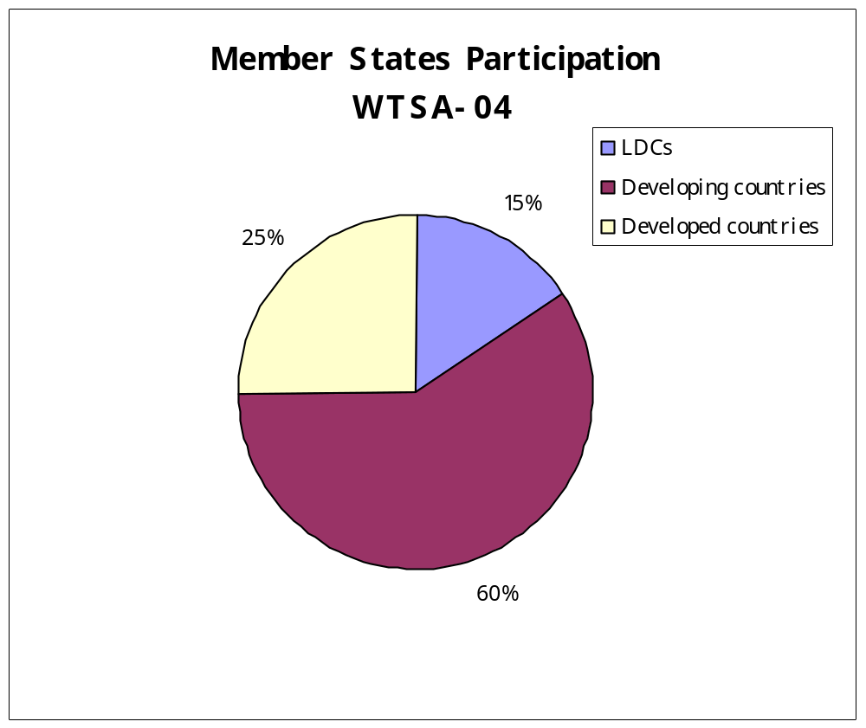
Developing country participation in WTSA
Based on participation of 72 Member States

Slide 27
What is the standardization gap?
The standardization development gap might be defined as disparities in the ability of representatives of developing countries, relative to developed ones, to access, implement, contribute to and influence international ICT standards, specifically ITU Recommendations.
The standardization development gap is itself both a cause and a manifestation of the wider digital divide
It contributes to the persistence of the wider digital divide

Slide 28
What has been done recently to reduce the standardization gap?
First in series of annual Forums on bridging the standardisation gap in each region organised by TSB, BDT, Regional Office and Regional Organisation
Placing greater emphasis on implementation guidelines – exploring possible translation in regions?
Starting a series of Tutorial Groups on implementation
Directors TSB and BDT written to all Member States and Sector Members inviting contributions for fund on bridging standardisation gap
Establishing Regional Groups (e.g. SG2 for Arab Region)
Trialling collaborative tool for remote participation in meetings

Slide 29
Free ITU-T Recommendations
Historic decision taken by the 2007 Council
During trial 16.1 per cent of downloads from developing countries
300’000 downloads by developing countries, compared with just 500 sold in 2006
Major step forward in bridging the standardization gap.

Slide 30
Consequences… or why does WTSA matter ?
Make ITU-T THE most attractive place to do international standards
Make best use of experts’ time and resources
Avoid duplication and overlap of work
Lower costs to membership and to ITU
A bad structure will slow down or stop work
A good structure can speed up work

Slide 31
Get involved
Regional preparatory meetings are a proven platform for the development of successful proposals by APT
Regional groups should coordinate local proposals
A TSB Circular letter will be issued
    Requesting Members to provide candidates for Chairs/Vice-Chairs
How to send in contributions:
    Electronically: email, web
    Paper copies: by post, fax
Deadlines for submission:
    Sooner the better

Slide 32
See you at WTSA-08!
Thank you for your attention

