Slide 1
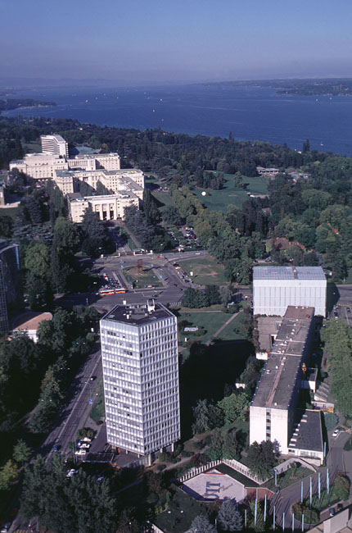
ITU and ETSI: collaboration
Malcolm Johnson
Director, Telecommunication Standardization Bureau, ITU
ITU at the heart of international Geneva
ETSI 49th Meeting of the General Assembly
Nice, France

Slide 2

Outline
ITU outline
ITU and ETSI collaboration
ITU collaboration with other entities
Future collaboration

Slide 3
ITU Structure
General Secretariat: Coordinates and manages the administrative and financial aspects of the Union’s activities
ITU-R: Coordinates radio communications, radio-frequency spectrum management and wireless services
ITU-D: Technical assistance and deployment of telecom networks and services in developing and least developed countries to develop communication services
ITU-T: Mission is to ensure an efficient and on-time production of internationally applicable high quality standards covering all fields of telecommunications

Slide 4


ITU Membership
    Member States (contributions vary from 19.875k CHF to 9.540m CHF per annum)
        ITU 191
    Sector Members (usual fee 31.5k CHF per annum)
        ITU-T 330
        ITU-R 291
        ITU-D 321
    Associates (10.6k CHF per annum)
        ITU-T 116
        ITU-R 29
        ITU-D 5

Slide 5

ITU Plenipotentiary Conference
November 2006, Antalya, Turkey
Top policy-making body of ITU
    Sets the Union's general policies
    Adopts four-year strategic and financial plans
    Elects the senior management team of the organization, the 46 Member States of Council and the members of the Radio Regulations Board

Slide 6
PP ’06 instructs ITU to… (1)
Maintain close coordination between the three sectors of ITU
Build confidence and security in the use of ICTs
Take part in all international discussions relating to internationalized internet domain names
Strengthen regional presence

Slide 7
PP ’06 instructs ITU to… (2)
Continue studies to meet the needs of public protection and disaster relief
Assist members in deploying NGN effectively
Assist in finding appropriate solutions for affordable NGN deployment
Highlight the contribution of ICTs to development
Conduct a review of the International Telecommunication Regulations

Slide 8
PP ’06 instructs ITU to… (3)
Prepare for a World Telecommunication Policy Forum in 2009
Continue activities on IP-based networks
Provide a summary of activities relating to
IP-based networks
Organize a Worldwide Standardization Roundtable and Coordination Meeting
Bridge the standardization gap between developing and developed countries

Slide 9
Bridging the standardization gap
ITU-T asked to provide advice on:
    Strategies for increased representation and participation in standards making
    Strategies for developing understanding of key standards technologies
    Economic and competitive aspects of standards deployment
    Strategies and guidelines for standards in procurement
    Promotion of standards for key points of interconnection
    Adoption of standards in national regulations

Slide 10

Upcoming workshops 2007
Regional Working Group for Asia and the Pacific Region
New Delhi, India, 3-5 April
NGN Standardization and Development
Bahrain, 29 April – 3 May
Ensuring cybersecurity: Standards and technical solutions Hanoi, Vietnam, 8-10 May
Joint ITU-T/IEEE workshop on Carrier-class Ethernet
Geneva, 31 May – 1 June
Multimedia in NGN: Global Perspectives on Standards
and Business
Geneva, 10–11 September
Bridging the Standardization Gap in Developing Countries: Rwanda, October

Slide 11
Regional working
5 ITU Regional Offices:
    Africa Region
    Americas Region
    Arab Region
    Asia & Pacific Region
    Europe & CIS Region
6 Regional Organisations:
    APT (Asia Pacific)
    Arab Group
    ATU (Africa)
    CEPT (Europe)
    CITEL (America)
    RCC (Commonwealth of Independent States)
Various ITU-T regional groups

Slide 12
ITU-T hot topics
Next generation network (NGN)
IPTV
Home networking
Cybersecurity including identity management (IdM)
Ubiquitous networks
Next generation multimedia conferencing
Videocoding
Broadband access
Packet based transport
Fibre optics

Slide 13
ITU-T Focus Groups
Identity Management
From/In/To Cars Communication
IPTV
Security Baseline for Network Operators
NGN Management
Open Communications Architecture Forum

Slide 14
ITU-T product
Around 210 new and updated Recommendations are produced each year
Approx. 90 per cent approved by AAP
AAP cut approval time by 80 to 90 per cent to as little as 5 weeks and average of 9 weeks
More than 3100 ITU-T Recommendations are in force
50 per cent of contributions to ITU-T work is from Asia
Wherever appropriate, ITU-T will reference the deliverables of other standards bodies rather than duplicate their work.
Good cooperation and collaboration is essential between ITU-T and those other bodies

Slide 15
Free Recommendations
From the beginning of 2007, ITU-T Recommendations are available without charge for a trial period.
With only a small number of exceptions all
in-force ITU-T Recommendations are available in PDF form via a simple mouse click.
www.itu.int/ITU-T/publications/recs.html

Slide 16
MoU between ITU and ETSI
14 June 2000
Considering:
    ITU as the intergovernmental and universal organization responsible for worldwide standardization of telecommunications
    ETSI as a regional organization
Allows
    Each organization to use the documents of the other in order to advance its own work
    Each will also be able to reference standards texts of the other
    Each organisations experts can participate in the others meetings

Slide 17

Many examples of collaboration (1/3)
ETSI ES 201 873 series adopted as ITU-T Recommendations Z.140-146 (Testing and Test Control Notation (TTCN))
3GPP interface accepted as part of ITU-R Recommendation M.1457 (IMT-2000)
Substantial cross-fertilization between ETSI~3GPP-SA4 and ITU-T WP 3/16 (speech compression)
Strong interaction and cross-participation with ETSI TISPAN (and 3GPP CT) for the gateway control protocol extensions (H.248)
ITU-T Rec. E.218 - Management of the allocation of terrestrial trunk radio Mobile Country Codes: approved at the request of ETSI in order administer TETRA codes

Slide 18
Examples of collaboration (2/3)
ITU-T Rec. G.722.2 - Wideband coding of speech using AMR-WB - technically aligned with two specs from 3GPP
ITU-T Rec. Q.1741.4 - GSM/UMTS Release 6: part of 2 series that combine and associate relevant standards based on 3GPP and 3GPP2 specs
ITU-T Rec. G.993.2 - European band plan extensions for VDSL2 in Annex B - written by ETSI TM6
ITU-T Recs. J.160-179 - IPCablecom2 – aligned with IMS as defined by the 3GPP
ITU-T Rec. J.203 - 'TV Anytime' standard - ETSI standard TS 102 822 - heavily referenced

Slide 19
Examples of collaboration (3/3)
ITU-T SG 12 chair Jean-Yves Monfort also chair ETSI TC STQ
Members of ITU-T SG 4 WP management team also management of TISPAN WG8
Ex-TISPAN Chair (Alain Le Roux) also WP chair Study Group 11
ETSI legal adviser participates IPR Ad-Hoc Group. Further contacts are expected on the implementation of a link to the EPO (European Patent Office) register for declared essential patents
86 ETSI members are ITU-T members

Slide 20
Forums/Consortia Approved for Cooperation and Exchange of information
G Association
ASN.1 Consortium
ATSC (Advanced Television Systems Committee)
AVS (Audio-Visual coding Standard working group)
DSL Forum
ETIS (e-and telecommunication information services)
GSM Association
Home Gateway Initiative
IMTC (Multimedia)
IPDR Organization
IPsphere Forum
IPv6 Forum
Liberty Alliance
MEF (Metro Ethernet Forum)
MMTA (Mobile Multimedia Technology Alliance)
MFA Forum
MSF (Multiservice Switching Forum)
NRO (Number Resource Organization)
OASIS
OIF (Optical Internetworking Forum)
OMA (Open Mobile Alliance)
OMG (Object Management Group)
SDL Forum Society
SDL Task Force Consortium
TM Forum (Tele Management Forum)
UNICODE
W3C (World Wide Web Consortium)
Under study: CEPCA (Consumer Electronics Powerline Communication Alliance), EPC Global, MAAWG, UPnP Forum

Slide 21
SDOs Approved for Cooperation and Exchange of Information
ARIB (Association of Radio Industries and Businesses)
ATIS ( Alliance for Telecommunications Industry Solutions)
CEA (Consumer Electronics Association)
CCSA (China Communications Standards Association)
Ecma International
ETSI (European Telecommunications Standards Institute)
IEEE (Institute of Electrical and Electronics Engineers)
JCTEA (Japan Cable Television Engineering Association)
NIST (National Institute of Standards and Technology)
SCTE (Society of Cable Telecommunications Engineers)
SMPTE (Society of Motion Picture and Television Engineers)
TIA (Telecommunications Industry Association)
TTA (Telecommunications Technology Association)
TC (Telecommunication Technology Committee)

Slide 22
Organizations Qualified for Including References in ITU-T Recommendations
ARIB (Association of Radio Industries and Businesses)
ATIS ( Alliance for Telecommunications Industry Solutions)
ATSC (Advanced Television Systems Committee)
AVS (Audio-Visual coding Standard working group)
CCSA (China Communications Standards Association)
DSL Forum
Ecma International
EPC Global
ETSI (European Telecommunications Standards Institute)
Home Gateway Initiative
IEEE (Institute of Electrical and Electronics Engineers)
IMTC (Multimedia)
ISOC/IETF (Internet Society/Internet Engineering Task Force)
JCTEA (Japan Cable Television Engineering Association)
Liberty Alliance
MAAWG
MEF (Metro Ethernet Forum)
MFA Forum
NIST (National Institute of Standards and Technology)
OASIS
OIF (Optical Internetworking Forum)
OMA (Open Mobile Alliance)
OMG (Object Management Group)
SCTE (Society of Cable Telecommunications Engineers)
SMPTE (Society of Motion Picture and Television Engineers)
TIA (Telecommunications Industry Association)
TM Forum (Tele Management Forum)
TTA (Telecommunications Technology Association)
TTC (Telecommunication Technology Committee)
UNICODE
UPnP Forum
W3C (World Wide Web Consortium)
Under study: EPC Global, MAAWG, UPnP Forum

Slide 23
3GPP
3GPP has 80 members in common with ITU-T
3GPP Agreement states: “The results of the 3GPP work shall form the basis of member contributions to the ITU in accordance with existing procedures. 3GPP shall take account of emerging ITU Recommendations on interworking between IMT-2000 family members.”
3GPP Working Procedures state: “Representatives of ITU-D, ITU-R and ITU-T are invited to participate in the Project Coordination Group for the efficient coordination and exchange of information.”
Iterative process is imperative in order to avoid problems at a later stage
Communication of requirements an essential ITU input

Slide 24
Global Standards Collaboration
The mandate of GSC is to provide a venue for the leaders of the Participating Standards Organizations and the ITU to:
    ...exchange information on the progress of standards development…
    Collaborate in planning future standards development to gain synergy and to reduce duplication.
    …the mandate of GSC is to provide a venue… to:
    Support the ITU as the preeminent global telecommunication and radiocommunication standards development organization.

Slide 25
World Standards Cooperation (WSC)
Cooperative mechanism between ISO, IEC and ITU
Established 2001, and aims at:
    Strengthening and advancing the voluntary consensus-based international standards system of IEC, ISO, ITU-R and ITU-T
    Promoting and increasing the visibility of international consensus-based standardization worldwide
Several initiatives have been undertaken:
    Workshops
    Education and training and
    Promotion of the International Standards system in several contexts.
    Established common patent policy on 1 March 2007

Slide 26
WSC Members have aligned their patent policies
Based on ITU-T policy
… strongly encourages the disclosure of known patented technology from the outset.
Allows for companies’ IPR to be included in standards as long as it is made available under reasonable and non-discriminatory terms and conditions.
WSC also adopted Guidelines for the Implementation of the Common Patent Policy and a Patent Statement and License Declaration Form.
Each of the three WSC organizations also has an online patent database.

Slide 27
Worldwide Standardization Roundtable and Coordination Meeting
To be held day before next ITU World Telecommunication Standardization Assembly (WTSA), October 2008
Aims to bring together all standards makers
Possible themes:
    Reducing the standardization gap
    Improving collaboration
Consultation started on themes and organisation: tsagroundtable@itu.int

Slide 28
World Telecommunication Standardization Assembly
    WTSA sets direction and structure for ITU-T
    Meets every four years
    Defines the general policy for the Sector inline with Plenipotentiary Conference requirements
    Establishes the study group structure
    Approves their expected work programme
    Appoints their chairmen and vice-chairmen
    WTSA Resolutions are available at:
    itu.int/ITU-T/wtsa/resolutions

Slide 29
Future collaboration
Collaboration on workshops, promoting events etc.
Increased European involvement in ITU-T
Improved ITU liaison with 3GPP, especially input on requirements
Regular high level cooperation meetings
Participation in Round Table and Coordination meeting
European Common Proposals to WTSA
Suggestions on improved working arrangements

Slide 30
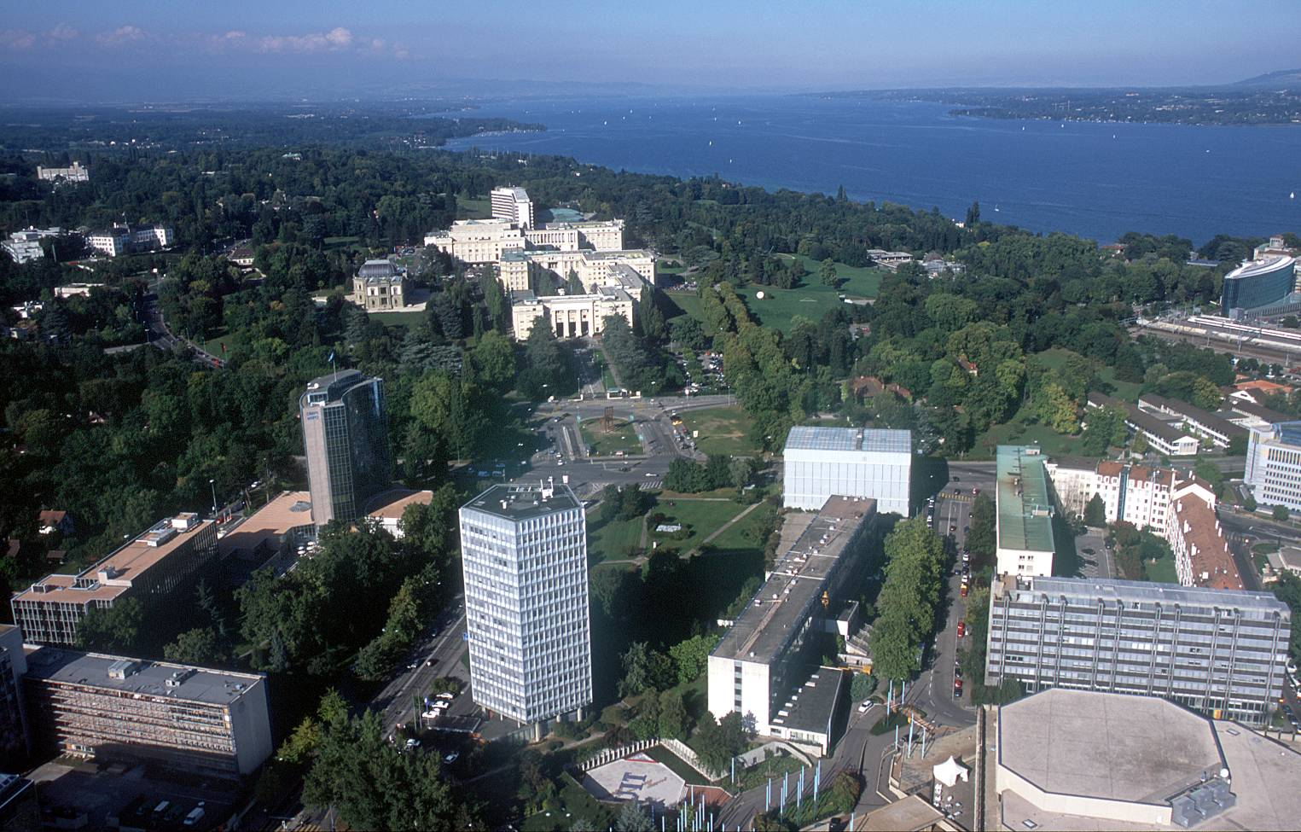
Malcolm.Johnson@itu.int

