Slide 1

ITU Telecommunication Standardization:
Accessibility to ICTs for persons with disabilities
Symposium of Telecommunications Regulators
XIII International Convention Informática
Havana, 11 February 2009
Malcolm Johnson
Director, TSB

Slide 2
ITU Structure
Plenipotentiary Conference
ITU Council
ITU-T
World Telecommunication Standardization Assembly
ITU-R
World Radiocommunication Conference
Radiocommunication Assembly
General
Secretariat
ITU-D
World Telecommunication Development Conference

Slide 3
ITU-T Structure
Workshops,
Seminars,
Symposia…
WTSA
World Telecommunication
Standardization Assembly
Telecommunication Standardization
Advisory Group
Focus
Groups
IPR
ad hoc
SG
Study Group
SG
Working Party
Focus Group
WP
WP
WP
Q
Q
Questions: Develop Recommendations
Q
Q

Slide 4
Free Recommendations
Since beginning of 2007, ITU-T Recommendations are available without charge for a trial period.
With only a small number of exceptions all
in-force ITU-T Recommendations are available in PDF form via a simple mouse click:
itu.int/ITU-T/publications/recs.html

Slide 5
ITU-T Study Groups
  SG 2 Service definition, numbering and routing, telecommunications for disaster relief/early warning, telecommunication management
  (Vice-Chairman: Mr Marcos Pérez García (Cuba))
  SG 3 Tariff and accounting principles including related telecommunication economic and policy issues
  SG 5 EMC and electromagnetic effects
  SG 9 Integrated broadband cable and TV networks
  SG 11 Signaling and protocols, intelligent networks and test specifications
  SG 12 Quality of service and quality of experience
  SG 13 Future networks, NGN, mobility management and fixed-mobile convergence
  SG 15 Access network transport, optical technology and optical transport networks
  SG 16 Multimedia, ubiquitous applications, accessibility for persons with disabilities
  SG 17 Security, identity management (IdM)

Slide 6
WTSA-08 Statistics
Five regional preparatory meetings (Brazil, Ghana, Uzbekistan, Syria, Viet Nam) in association with Regional Development Forums on Bridging the Standards Gap in collaboration with BR, BDT and Regional Offices
Resulted in regional common proposals from five regions
WTSA adopted 21 new Resolutions, revised 27 existing Resolutions, adopted two new Recommendations and revised
7 existing Recommendations
Total of 350 contributions
99 participating countries
Over 1000 attendees
13 Ministers/Vice-Ministers
VIPs spanning the world and the ICT industry sector

Slide 7
Bridging the Standards Gap
Resolution 44 recognises the efforts being made to meet
PP-06 Resolution 123
  Encourages developed countries to establish cooperation programmes with developing countries
  Suggests a separate expenditure line in ITU budget for bridging standardization gap
  Encourages voluntary contributions (so far only Korea, Nokia-Siemens, Cisco and Microsoft have contributed to the fund)
  More guidelines to explain ITU-T Recommendations and their application with emphasis on Recommendations having regulatory and policy implications
  Encourages remote participation (100 ITU-T meetings had remote participation in 2008);
Develop mechanism to measure results
Actions to be performed:
  Compile and maintaining a database containing information on new standardised technologies
  Organizing training courses on the application of specific Recommendations and on methods of examining compliance of manufactured products with these Recommendations

Slide 8
New Resolution on Accessibility
Resolution 70 encourages more work in the field of telecommunication/ICT accessibility for persons with disabilities
considering
  That the World Health Organization estimates that ten per cent of the world's population (more than 650 million people) are persons with disabilities, and that this percentage may increase
invites the Director of the Telecommunication Standardization Bureau
  To identify and document examples of best practice for accessibility
  To review the accessibility of ITU-T services and facilities
  To work collaboratively on accessibility-related activities with ITU-D, in particular developing programmes that enable developing countries to introduce services that allow persons with disabilities to utilize telecommunication services effectively
  To work collaboratively and cooperatively with other standardization organizations and entities… in the interest of ensuring that ongoing work … is taken into account, in order to avoid duplication
  To work collaboratively and cooperatively with disability organizations

Slide 9
ITU-T work on accessibility
Joint coordination activity on accessibility and human factors (JCA-AHF) coordinates standardization activities on accessibility and human factors issues
  Open to experts working in the field to improve access to the information society by people with varied capability of handling information and the controls for its presentation
Dynamic Coalition on Accessibility and Disabilities, under the Internet Governance Forum
Global Standards Symposium recognized that accessibility to telecom/ICT services is a major enabler to economic and social development……in part because a significant percentage of persons with disabilities are poor and live in developing countries
ITU-T SG16 lead SG on accessibility (Question 26)
Workshop planned in Geneva, October 2009

Slide 10
Accessibility landmarks
First international standards body to address accessibility issues - in 1991
1994 the international text telephone standard, Recommendation ITU-T V.18, was published
  A major landmark tying together text telephone protocols allowing different - previously incompatible - textphones in different countries to communicate
Since then, ITU-T’s accessibility experts have helped to incorporate accessibility needs into standards for:
  Multimedia
  Network interoperability
  Multimedia service descriptions
  Multimedia conferencing
  Next generation networks (NGN)

Slide 11
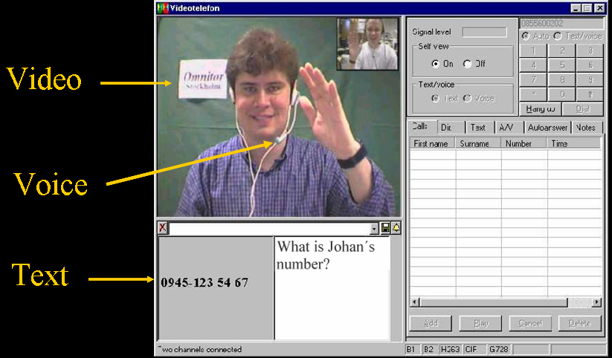
Total Conversation
Rec. ITU-T F.703
An audiovisual conversation service providing bidirectional symmetric real-time transfer of motion video, text and voice

Slide 12
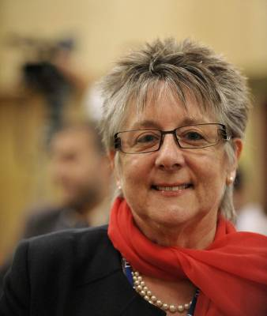
ITU recognizes dedication to accessibility cause
All new ITU-T Recommendations will be checked against accessibility criteria
2008: World Telecom & Information Society Day
  Helped raise awareness of the possibilities that ICTs can bring to all.
  Laureat: Andrea Saks
Andrea Saks

Slide 13

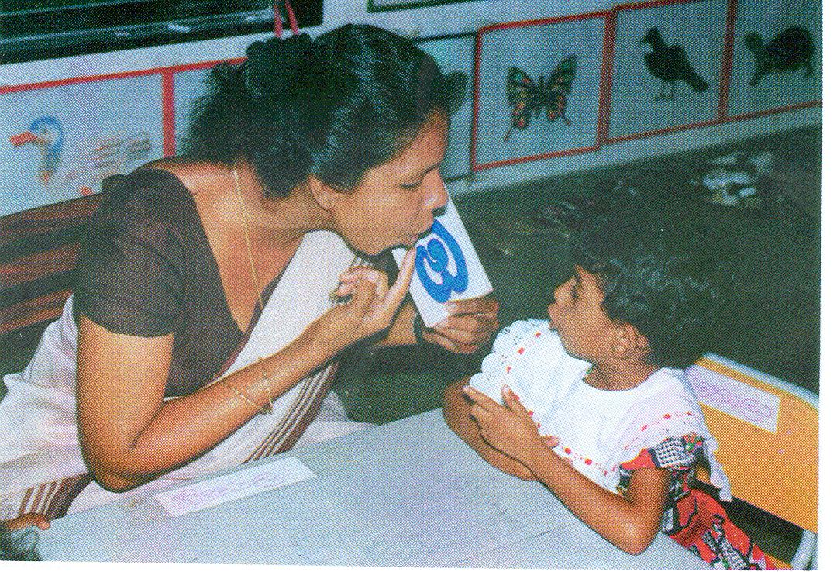
ITU-D Special Initiatives
Promoting ICT Accessibility for Persons with Disabilities
An Initiative out of WTDC-06 creating awareness and skills to mainstream disability issues.
Promoting equal ICT opportunities for PwDs.
Supporting member states meet obligations under Article 9 of the UN Convention for Rights of PwDs.
ITU-D and G3ict are developing an
on-line toolkit for training policy makers, regulators, other stakeholders:
Develop and mainstream ICT policies for PwDs
Share experiences and best practice
ITU-D also supports ICT projects for PwDs and provides workshops on ICTs issues for PwDs.
In addition,
ITU-D SG1-Q20, developed Guidelines for ICT accessibility for PwDs & collection of country level statistics on PwDs is in progress

Slide 14
Future ITU-D activities
Capacity building on policies and awareness on ICT accessibility issues via on-line toolkit
  Training policy makers and stakeholders
  Platform for best practice and electronic repository of policies on ICT accessibility
Projects on accessible ICTs in partnership with member states & other stakeholders

Slide 15
Some new Resolutions and a new ITU-T Recommendation
Resolution 58 to encourage the creation of national Computer Incident Response Teams (CIRTs) particularly for developing countries
Resolution 71 to encourage cooperation between ITU-T and academia, universities and their associated research establishments, and invite Council to consider reduced fee
Resolution 73 on ICTs and Climate Change encourages the membership to work towards reductions in greenhouse gas in line with the United Nations Framework Convention on Climate Change
Resolution 74 instructs Director TSB to propose to Council reduced ITU-T fee for Sector Members from developing countries based on ITU-D model, and that it include its consideration of this matter in preparation of PP-10
Recommendation ITU-T D.156 asks that developing countries examine appropriateness of a network externality premium on incoming international traffic from the operators of developed networks to the operators of developing-country networks to fund extending networks in developing countries

Slide 16
Internet related
Recommendation ITU-T D.50 asks that international Internet connection arrangements take into account the possible need for compensation for the value of elements such as traffic flow, number of routes, geographical coverage and cost of international transmission, and the possible application of network externalities.
Resolution 69 invites Members to refrain from taking any unilateral and/or discriminatory actions that could impede another Member State to access public Internet sites, within the spirit of Article 1 of the ITU Constitution and WSIS principles and to report any such incident to TSB.

Slide 17
IP address allocation and encouraging the deployment of IPv6
Resolution 64 instructs ITU-T Study Groups 2 and 3 to study the allocation and economic aspects of IP addresses taking account of the ITU workshop on IPv6 in September 2008
instructs the Director TSB in close collaboration with the Director BDT:
  to initiate a project to assist developing countries responding to their regional needs
  to establish a website that provides information about global activities related to IPv6
  to promote awareness of the importance of IPv6 deployment
further instructs the Director of TSB:
  to study the question of IPv6 address allocation and registration for interested members and, especially, developing countries
  to report to the 2009 session of the ITU Council

Slide 18
Conformance and interoperability testing
Resolution 76 requires ITU-T to develop conformance and interoperability testing Recommendations as quickly as possible
ITU-T in collaboration with the other sectors will:
  Assist developing countries in identifying training opportunities
  Assist developing countries in establishing regional or subregional conformity and interoperability test centres
Instructs the Director TSB in cooperation with BDT and BR to identify and prioritize the problems faced by developing countries
Based on results produce a report for Council 2009 on:
  i) the overall effect on ITU and manufacturers
  ii) legal, national and international regulatory implications
  iii) cost of setting up of facility
  iv) location of testing facility
  v) measures to be taken to build the necessary human-resource capacities
To carry out the necessary studies with a view to introducing the use of an ITU Mark including financial and legal implications for ITU-T and for ICT industries, and other concerns
Invites Council to report to PP-10

Slide 19
Actions
Increased number of study group meetings in the regions planned
New regional group meetings planned
Workshops in regions on implementation of WTSA-08 actions and application of ITU-T Recommendations in regions
Fellowships now available for all ITU-T study group meetings
New ITU-T Flagship Group for Latin America
Study Group 3 Regional Group for Latin America,
Lima, Peru 22 to 26 June 2009
ICT and Climate Change Symposium, Quito, Equator 9 to 11 July 2009 preceded on 8 July by a briefing on the ITU implementation of the WTSA-08 decisions
NGN-GSI and ITU-T SGs 11 and 13 Mar del Plata, Argentina
2 to 12 September preceded by the “Kaleidoscope” 31 August and 1 September 2009

Slide 20
Conclusions
ITU world’s pre-eminent global ICT standards body
Bridging the standardization gap recognised as essential to ITU’s mission to Connect the World
New team of chairmen and vice-chairmen from 33 countries
First SG15 meeting since WTSA-08 was completely paperless, had largest ever participation (367 delegates) largest ever number of contributions (336) consented 28 Recommendations including new high profile global standard on home networking:
  PC World (US) 13.12.08: “The powerful world standards organization …[ITU].. has reached agreement on G.hn a set of specifications that would encompass phone lines, power lines, and coaxial cable to provide HDTV room to room…”
Full list of WTSA Resolutions is at:
http://www.itu.int/publ/T-RES/e

