Slide 1
ITU-T
Empowering global
ICT development
Malcolm Johnson
Director, TSB, ITU

Slide 2

ITU-T Objectives
Develop and publish
standards for global ICT
interoperability
Identify areas for future
standardization
Provide an attractive and effective forum for the development of international standards
Promote the value of ITU standards
Disseminate information and know-how
Cooperate and collaborate
Provide support and assistance

Slide 3

ITU-T Key Features
Truly global public/private partnership
95% of work is done by private sector
Continuously adapting to market needs
Pre-eminent global ICT standards body

Slide 4

ITU-T Recommendations connect the world…
Without ITU-T standards you couldn’t make a telephone call from one side of the world to another.
Without ITU-T standards the
Internet wouldn’t function.
Notes:
The first thing you have to get right in any communications campaign is messaging. And I think these messages are pretty strong.

Slide 5

ITU Mark
Resolution 76
ITU created for
interoperability
Conformity assessment important in the context of WTO standardization commitments
Gives increased confidence in ICT
Assistance to developing countries
Experts group has been established

Slide 6

Industry Advisory Group:
Resolution 68 and GSS proposal:
  High-level industry
  executives
  Identify and coordinate
  priorities and subjects
  to minimize number of forums/consortia
  Consult first with
  developing countries
  Report to next WTSA

Slide 7
Draft Implementation of IAG
Composition: CTOs or equivalent from a representative sample of ITU-T Sector Members
No substitutes would be allowed
Each CTO may have one advisor
Meetings held at convenient locations
remote participation allowed
one day meeting once a year, dinner on the evening before;
Meeting configuration will be boardroom-style

Slide 8
Implementation of IAG (2)
TSB would provide the secretariat
discussion documents coordinated and developed by the advisors
Agenda items may be proposed by the Director or by any member
Each meeting would review actions taken on decisions of previous meetings.
Communiqués would be made public, but not reports of meetings

Slide 9
Technical Highlights

Slide 10
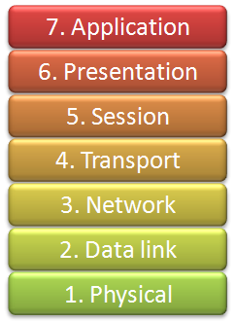
ITU-T’s work spans all layers

Slide 11
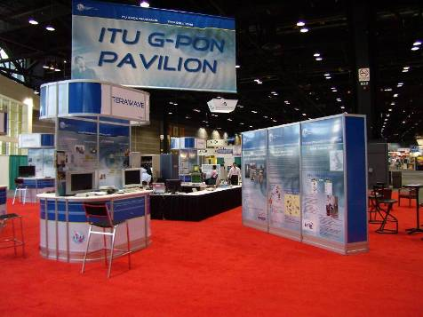
ITU-T provides Broadband Access
Copper:
  Hundreds of millions use ITU-T’s DSL
  Up to 200Mbit/s aggregate with VDSL 2
Cable:
  IPCablecom
Optical access:
  ITU-T’s GPON allows up to 2.5Gbit/s
  New types of optical fibre for access networks
GPON interoperability pavilion
Nxtcomm, Chicago, 2007

Slide 12

ITU-T puts the Super in Information Super Highway
Optical transport now to 100 Gbit/s
Carrier class Ethernet
Carrier class MPLS (MPLS-TP)
Evolution towards an All Optical Networks (AON)

Slide 13
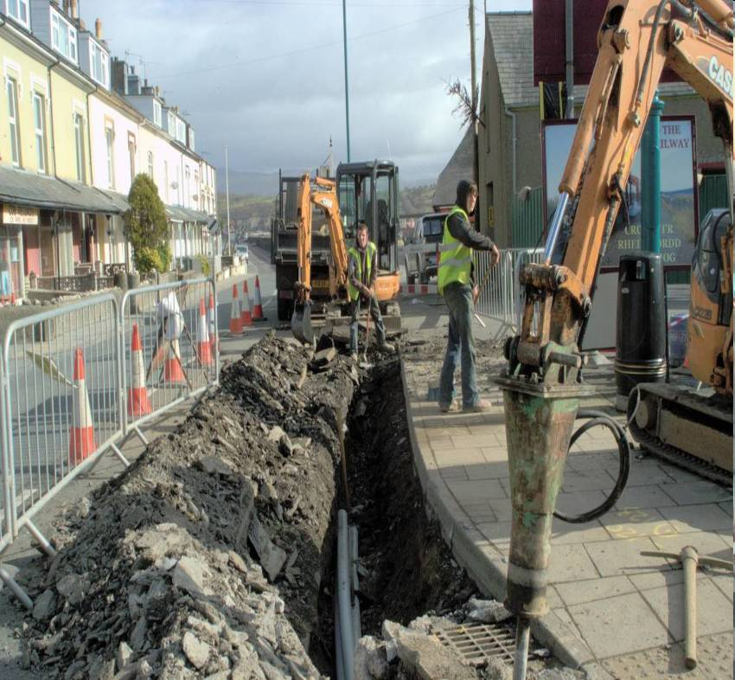
FTTx and NGN rollout
New standards will address need for new faster, cost effective and safer cable installation techniques
Reduction of excavation, the problem for traffic, and the generation of noise.

Slide 14


Next Generation Networks
Telecoms revolution:
From circuits to packets
Managed and secured
With Quality of Service
Saving money for customers
and service providers
IPTV standards well advanced

Slide 15

The network knocks at your door
Home Networking to
achieve interoperability
on a global scale
  Converged architecture
  and services
  Next generation
  set-top box
  PC World (US) 13.12.08: “The powerful world standards organization …[ITU].. has reached agreement on G.hn a set of specifications that would encompass phone lines, power lines, and coaxial cable to provide HDTV room to room…”

Slide 16

New multimedia system
Work in progress
Major improvement over SIP and H.323
Communication across any kind of application from any kind of device
H.325 separates the application logic and intelligence from the user’s control device / identity

Slide 17

ITU-T’s quantum leaps in speech, audio and video quality
Emmy award received on behalf of ISO, IEC & ITU
Call for technical contributions
for H.265
Extension of work on speech coding to wideband

Slide 18

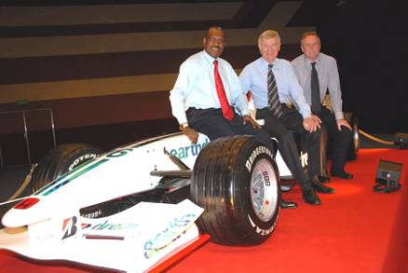
Intelligent Transport Systems: new work, new members
ITU, ISO and IEC and Geneva Motor Show
  Annual Event
New work:
  Wideband communication in cars
  Vehicle gateway protocol

Slide 19

Safety in the cyber world
Identity management
Security standards for:
  NGN,
  IPTV,
  Home networks,
  Ubiquitous sensor networks
  Mobiles
Traceback
Countering spam

Slide 20

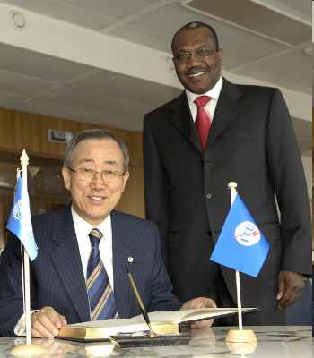
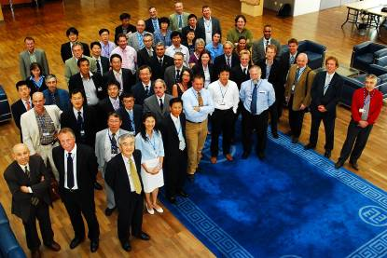
ICTs and Climate Change
Checklist to ensure new standards take climate change into account
Methodology to describe and estimate present and future user [energy] consumption of ICTs over their entire life-cycle
UN Secretary-General,
Ban Ki-moon: "ITU is one of the very important stakeholders in the area of climate change."
Participants in Focus Group ICT and Climate Change

Slide 21

Emergency Communications
Common Alerting Protocol (CAP)
  A consistent method of delivery for warning messages
Call priority schemes
  Giving priority in disaster zones to emergency calls
In Case of Emergency numbers
ITU has deployed satellite terminals to
help restore communications in the
aftermath of disasters around the world

Slide 22

Future networks
Focus Group
Collect and identify visions of future networks
First meeting
6-10 July Geneva

Slide 23
Outreach and attracting new work

Slide 24
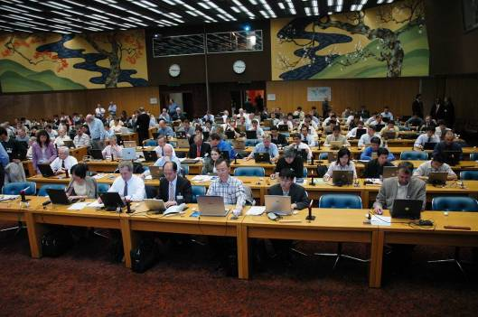
Workshops: New work, new blood, new friends
Outreach to non ITU audience
Can result in new work
  eg Identity Management
Partnerships: IETF, IEEE, OASIS, Grid Forum, ISO, IEC
2005-8 of 78 workshops 18 in PASC area.
Remote participation now possible
Future more workshops North America and Europe
Joint ITU and IETF workshop on NGN, 2005

Slide 25

Technology Watch: Scouting for future technologies …
Recent papers:
  Remote collaboration tools
  Ubiquitous Sensor Networks
  ICTs and Climate Change
  Telepresence
  High-performance video-conferencing
  Intelligent Transport Systems
  Lawful interception (LI)
  Next-Generation Networks (NGNs) and energy efficiency
Upcoming: ICTs and food security, network robotics, telebiometrics

Slide 26

…and future engineers
1st Kaleidoscope event 2008:
  140 contributions from academic institutions from around the world
2nd Kaleidoscope event:
  Innovations for Digital Inclusion
  September 2009,
  Mar del Plata, Argentina
Best papers proposed as new work
Published by IEEE
Sponsorship opportunities

Slide 27







ITU-T seeks collaboration
44 formal partnerships
World Standards Cooperation
  patent policy
  joint events
ITU-T and IEEE
  MoU
  Joint events
Global Standards Collaboration
  Endorsement of ITU climate change activity
ITU-T and 3GPP
  Clarification of process
ITU-T and IETF
  Management meetings
ITU-T and ICANN
  Board presence

Slide 28
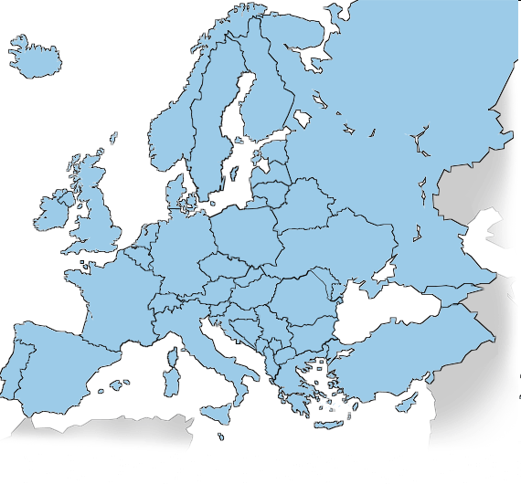
European outreach
Participation in:
  ETSI General Assembly
  EC ICT standardisation policy Steering Committee
  EC IPR Group
EC appointed liaison officer

Slide 29


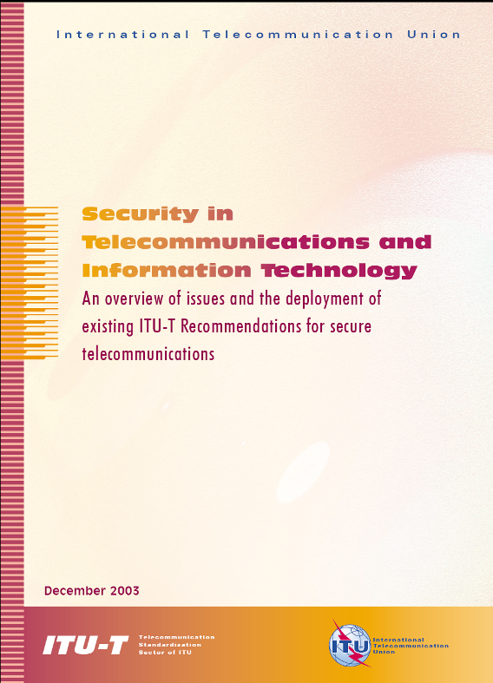
ITU-T uses traditional communications tools …

Slide 30
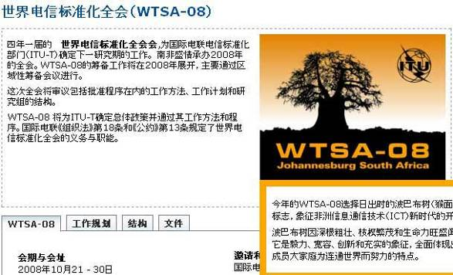
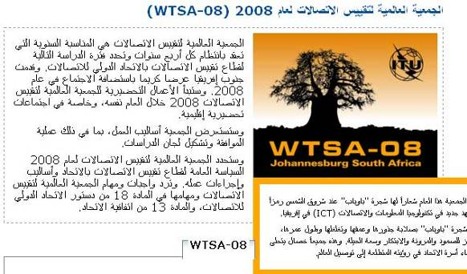
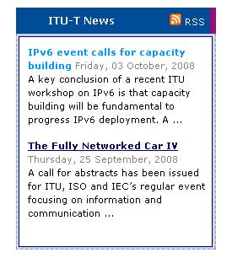
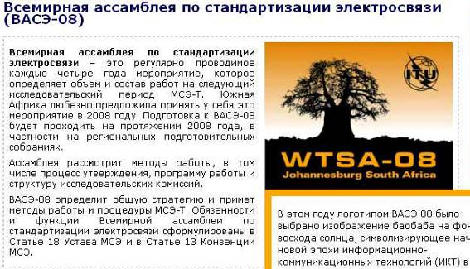

…has recently significantly updated its website …
New design
Translated pages
New pages for those new to ITU-T
Popular newsfeed
Search engine optimisation

Slide 31




… upped use of web 2.0 technologies …
ITU-T and Wikipedia. Many entries updated
Newsfeeds picked up in
media all around the world
Social bookmarking
ITU YouTube channel

Slide 32








… and feeds the press
Press Lunch, London June 2008 – Journalists from:
Led directly to BBC world service interview
(and other coverage)
More meet the press events planned for 2009

Slide 33

ITU Telecom World
Exhibition: 700 Exhibitors;
50,000 visitors
Ministerial Roundtable:
High level dialogue with industry leaders
VIP Programme: Brings together decision-makers for deal making
CTO roundtable
Online Networking: Connect with clients for onsite meetings
Media: 1,500 journalists; 450 organizations
Figures based on Telecom World 2006
Notes:
ITU TELECOM events offer a host of networking opportunities
VIP Programme and Lounge
Brings together decision-makers for deal making
Online Networking
Puts you in touch with your clients and partners before, during and after the event: make appointments and on-site meetings
Media Relations
Assists you with your public relations goals with comprehensive media visibility package
Gives you access to global media at onsite media centre

Slide 34
GSS and WTSA-08

Slide 35

First Global Standards Symposium
20 October 2008: 500 participants
Aggressive action needed to streamline standards work
Chaired by H.E. Mr Nguyen Thanh Hung, Vice-Minister, Ministry of Information and Communications, Viet Nam
Speakers included:
  Alan Bryden, SecGen, ISO and Enno Liess, VP, IEC
  Ministers, ambassadors, heads of regulatory authorities, senior executives from the private sector
Conclusions addressed:
  Bridging the standardization gap;
  Challenges in the new standards landscape, including climate change and accessibility;
  Strengthen collaboration among standards bodies.
Conclusions acted on by WTSA-08

Slide 36


WTSA-08
1st time chaired by a woman
  Lyndall Shope-Mafole, Director-General,
  South African Ministry of Comms
1st time in Africa
1st time preceded by
Global Standards Symposium
1st time academia invited
1st time side events held: accessibility;
climate change; and cybersecurity
1st time associated exhibition of new technologies
1st substantial restructuring of the Sector
1st time term limits on chairmanships applied:
  Virtually complete new team of chairmen and
  vice-chairmen including 22 from developing countries
Unprecedented media coverage
  Local and international: including 3 TV interviews, 3 radio interviews, and numerous printed articles and web coverage

Slide 37
WTSA-08
Conclusions
Strengthened Role as pre-eminent global
ICT standards body.
Bridging the standardization gap essential to Connect the World.
Streamlined and efficient structure
  Avoiding duplication and focusing on key objectives
Excellent team of new chairmen and vice-chairmen from 33 countries
Key Resolutions on:
  Human exposure to electromagnetic fields
  Encouraging the deployment of IPv6
  Computer Incident Response Teams
  ICTs and climate change,
  Accessibility to ICTs for persons with disabilities,
  Conformance and interoperability testing, a possible future ITU Mark
  Encouraging academic participation
  Sector members from developing countries
  Nomadic telecommunication services and applications

Slide 38




The only intergovernmental global standardization body
Participation in the ITU standards process gives
you direct influence over the technological
forces that are shaping the ICT industry.
Manufacturers gain access to global markets and enjoy economies of scale in production and distribution.
Users benefit from the assurance that equipment will integrate and work seamlessly with other systems.

Slide 39
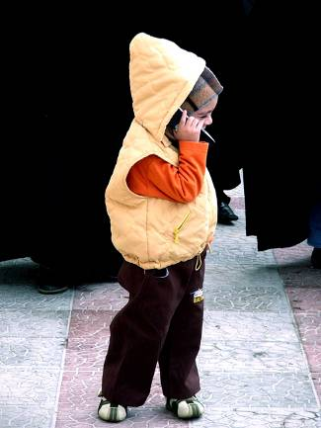




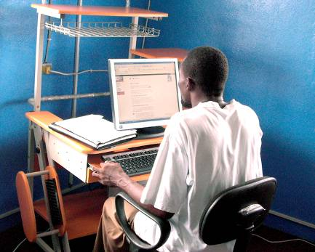
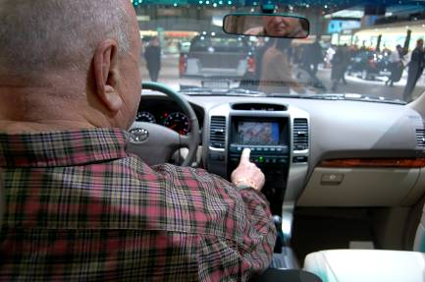

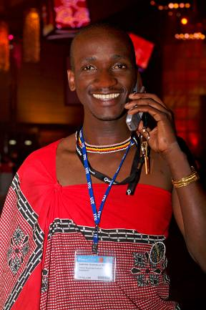

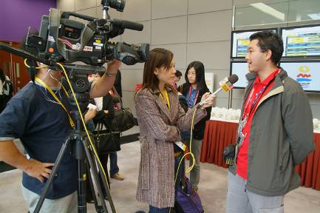
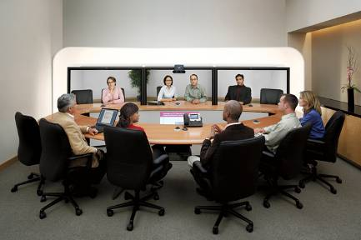
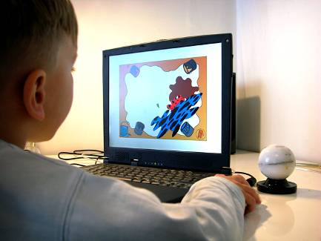
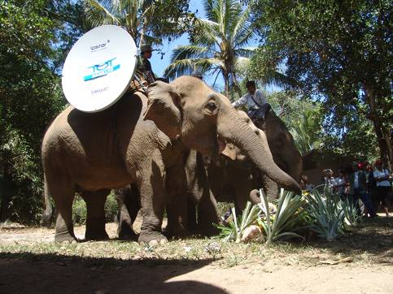
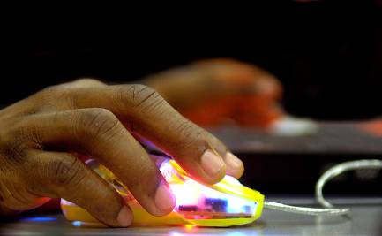

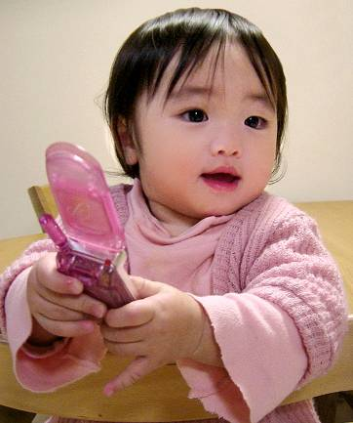
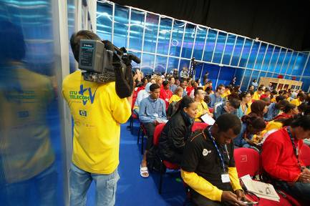
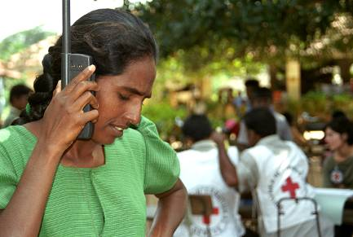
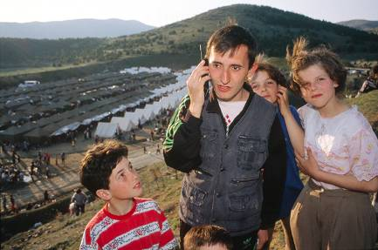
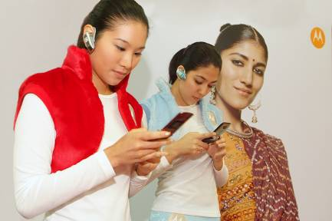
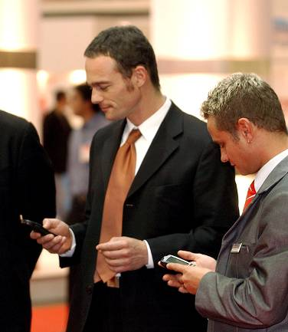
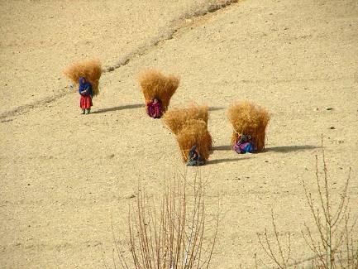
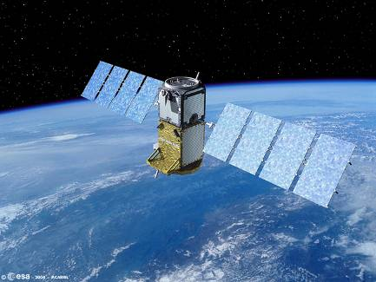


This is the world thanks to ITU
……a world without ITU
Now imagine……

Slide 40
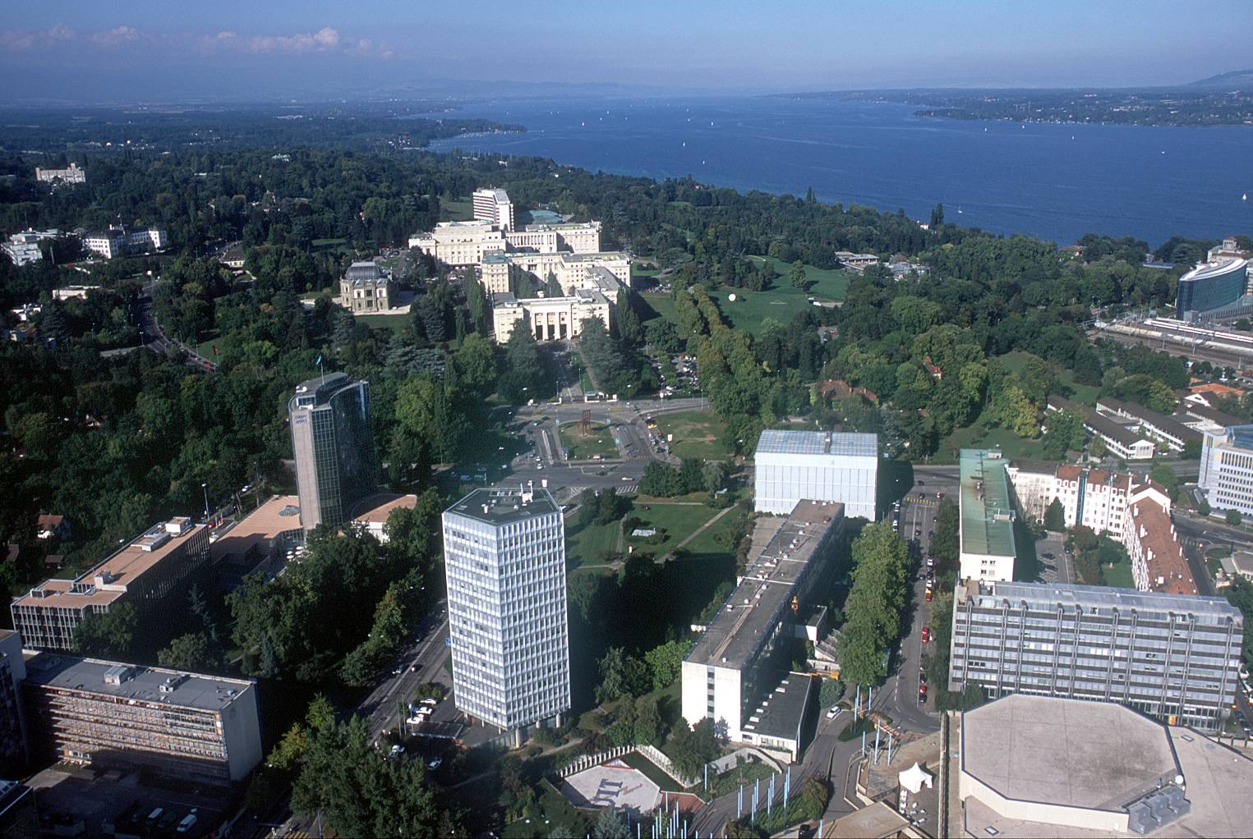
Malcolm.johnson@itu.int

