Slide 1
ITU-T
ICT Accessibility for ALL
Meeting with Mr. Dhaoui,
Officer-in-Charge Business, Investment and Technology Services Branch
& Ms. Haidara, Director,
Special Programmes and LDC Group UNIDO

Slide 2
Introduction to ITU
Founded in 1865, oldest specialized agency of the UN
Standards making one of the ITU’s first activities
191 Member States, 780 private sector entities
HQ Geneva, 11 regional offices, 760 staff / 80 nationalities
Named as one of the world’s ten most enduring institutions by Booz Allen
Five elected officials:
  Secretary-General
  Deputy Secretary-General
  Director of the Radiocommunication Bureau (BR)
  Director of the Telecommunication Standardization Bureau (TSB)
  Director of the Telecommunication Development Bureau (BDT)

Slide 3
ITU Structure
Plenipotentiary Conference
ITU Council
General
Secretariat
ITU-R
World/Regional Radiocomm Conference
Radiocomm
Assembly
ITU-D
World/Regional
Telecom Development Conference
ITU-T
World Telecom Standardization Assembly
TELECOM
Notes:
General Secretariat: Coordinates and manages the administrative and financial aspects of the Union’s activities
ITU-R: Coordinates radio communications, radio-frequency spectrum management and wireless services
ITU-D: Technical assistance and deployment of telecom networks and services in developing and least developed countries to develop communication services
ITU-T: Mission is to ensure an efficient and on-time production of internationally applicable high quality standards covering all fields of telecommunications
TELECOM:Brings together the top names from across the ICT industry as well as ministers and regulators and many more for a major exhibition, a high-level forum and a host of other opportunities.

Slide 4
ITU-T Structure
WTSA
World Telecommunication
Standardization Assembly
Workshops,
Seminars,
Symposia…
Telecommunication Standardization
Advisory Group
IPR
SG
Study Group
SG
Working Party
Focus Group
WP
WP
WP
Q
Q
Questions: Develop Recommendations
Q
Q
Q
Q

Slide 5

ITU-T Recommendations connect the world…
Without ITU-T standards you couldn’t make a telephone call from one side of the world to another.
Without ITU-T standards the
Internet wouldn’t function.

Slide 6
ITU-T Recommendations:
Not all standards are equal
Recommendations become mandatory if adopted in law
Private standards may confuse users and consumers
ITU’s broad range of stakeholders, and robust processes provide the basis for consensus across sectors and countries
Market-driven international standards, based on objective information and knowledge
Meet the needs and concerns of all relevant stakeholders

Slide 7
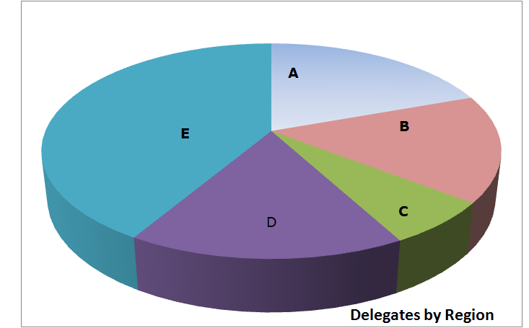
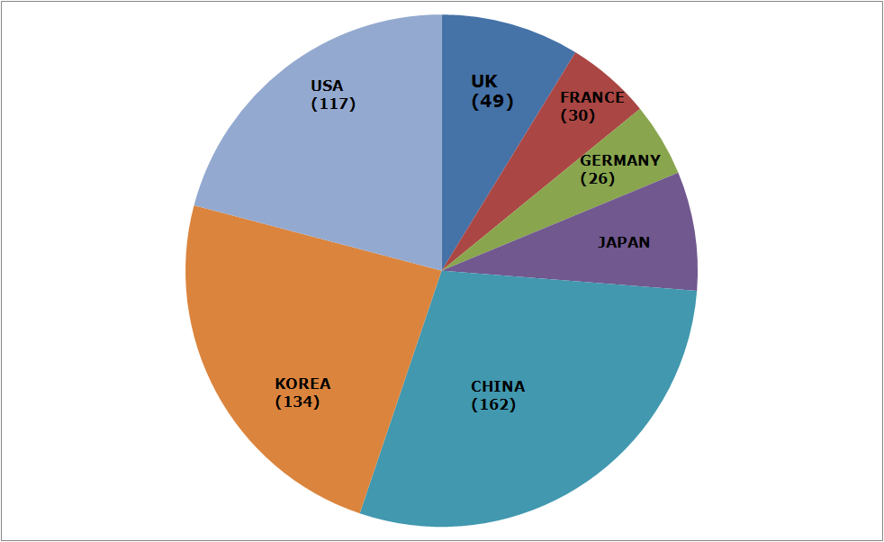
Member State Participation
Region A - The Americas (216)
Region B - Western Europe (178)
Region C - Eastern Europe and Northern Asia (73)
Region D – Africa (182)
Region E - Asia and Australasia (460)
Notes:
Member State delegates A216 B178 C73 D182 E460 TOTAL1109 UK49 FRANCE30 GERMANY26 JAPAN42 CHINA162 KOREA134 USA117

Slide 8
Strategic Objectives
Develop and publish timely global standards
Identify relevant areas for future standardization projects
Provide the most attractive forum for standardization in the interest of the membership
Promote value of ITU-T to attract increased membership
Disseminate information and know-how
Cooperate and collaborate with other Sectors and other entities
Provide support and assistance to the membership, in particular developing countries

Slide 9

ITU-T Key Features
Open, transparent, consensus based, fast working, public/private partnership
Technical standards developed by industry members, when consensus placed on website and if no comments after 4 weeks is in effect approved by 191 governments
ITU standards are therefore truly global, open standards, unlike those of many other standards bodies, fora or consortium that claim to produce global and open standards, available free of charge
Publicly available database of products and services meeting ITU standards
Organizing interoperability events to prove interoperability of different vendors equipment
Common IPR policy with ISO and IEC (FRAN)

Slide 10
Importance of Global Standards
Global Standards essential in a complex world
Standards make things easier
Essential for international communications and global trade
Drive competitiveness, for individual businesses and world economy
Help organisations with their efficiency, effectiveness, responsiveness and innovation
Lower prices and increase availability by reducing technical barriers and promoting compatibility between systems and networks
Manufacturers, network operators and consumers benefit

Slide 11
Standards proven economic tool
WTO trade report 2005
British Standards Institute (BSI): standards make annual contribution GBP 2.5 billion
German standards body (DIN): economic benefits standardization about 1% GDP
Canada: 17 % of labour productivity increase and nine per cent of growth of GDP 1981-2004
Standards have a significant effect on limiting the undesirable outcomes of market failure
The work of ITU has smoothed the more economical introduction of new technologies

Slide 12








ITU-T collaboration
44 formal partnerships
Vienna Agreement between the international standards orgs and their European regional counterparts
World Standards Cooperation
  Patent policy & Joint events
ITU-T and IEEE
  MoU & Joint events
Global Standards Collaboration
  Supports ITU as preeminent global ICT standards organization
ITU-T and 3GPP
ETSI
  Management meetings
ITU-T and IETF
  Management meetings
ITU-T and ICANN
  Management meetings
E-Business MoU: IEC, ISO, ITU and UN/ECE
Notes:
. Vienna Agreement between the international standardizing
Organizations and their European
regional counterparts.

Slide 13
Accessibility – some facts
More than 650 million people (=10%) with disabilities in the world (Source: UN)
80% of persons with disabilities live in low income countries (Source: UNDP)
Low income countries, 90% of children with disabilities do not have access to school (Source: UNESCO)
Among people living below the poverty level, 1 out of 5 is a person with disability (Source: World Bank)
ICTs are a powerful equalizer of abilities, empowering persons with disabilities to fulfill their potential, dreams and ambitions
UN Convention on the Rights of Persons with Disabilities obliges signatories to provide public information in formats appropriate to different kinds of disabilities

Slide 14
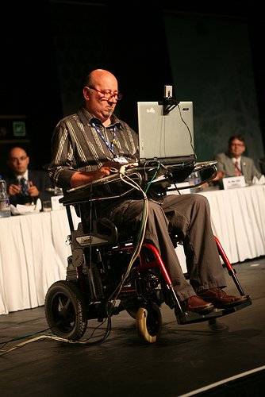
ITU and Accessibility
Champions principles Universal Design enshrined in the UN Convention on Rights of Persons with Disabilities
Includes accessibility features in all standards
Strong advocacy focus
Group to coordinate activities on accessibility
Dynamic Coalition on the Internet and Accessibility at the Internet Governance Forum (IGF)
Regular workshops

Slide 15
Why standardization and accessibility
Information handling capability varies for all ICT users
Everyone can benefit from accessibility standards
ITU-T’s accessibility work ensures that all newly developed standards contain the necessary elements to make services and features usable for people with as broad range of capabilities as possible
Standards should also describe suitable methods of media delivery for people with disabilities, and are therefore essential for the provision of services accessible for all

Slide 16
WTSA-08 Resolution on Accessibility
Resolution 70 encourages more work in the field of telecommunication/ICT accessibility for persons with disabilities
considering
  That the World Health Organization estimates that ten per cent of the world's population (more than 650 million people) are persons with disabilities, and that this percentage may increase
invites the Director of the Telecommunication Standardization Bureau
  To identify and document examples of best practice for accessibility
  To review the accessibility of ITU-T services and facilities
  To work collaboratively on accessibility-related activities with ITU-D, in particular developing programmes that enable developing countries to introduce services that allow persons with disabilities to utilize telecommunication services effectively
  To work collaboratively and cooperatively with other standardization organizations and entities… in the interest of ensuring that ongoing work … is taken into account, in order to avoid duplication
  To work collaboratively and cooperatively with disability organizations

Slide 17
ITU-T work on accessibility
Joint coordination activity on accessibility and human factors (JCA-AHF) coordinates standardization activities on accessibility and human factors issues
  Open to experts working in the field to improve access to the information society by people with varied capability of handling information and the controls for its presentation
Dynamic Coalition on Accessibility and Disabilities, under the Internet Governance Forum
Global Standards Symposium recognized that accessibility to telecom/ICT services is a major enabler to economic and social development……in part because a significant percentage of persons with disabilities are poor and live in developing countries
ITU-T SG16 lead SG on accessibility (Question 26)
Regular workshops – more than 10 in 2009

Slide 18
Accessibility landmarks
First international standards body to address accessibility issues - in 1991
1994 the international text telephone standard, Recommendation ITU-T V.18, was published
  A major landmark tying together text telephone protocols allowing different - previously incompatible - textphones in different countries to communicate
Since then, ITU-T’s accessibility experts have helped to incorporate accessibility needs into standards for:
  Multimedia
  Network interoperability
  Multimedia service descriptions
  Multimedia conferencing
  Next generation networks (NGN)

Slide 19
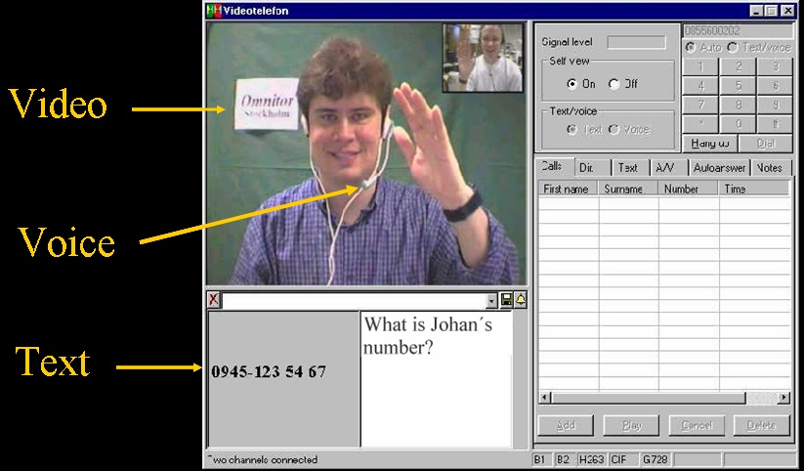
Total Conversation
Rec. ITU-T F.703
An audiovisual conversation service providing bidirectional symmetric real-time transfer of motion video, text and voice

Slide 20
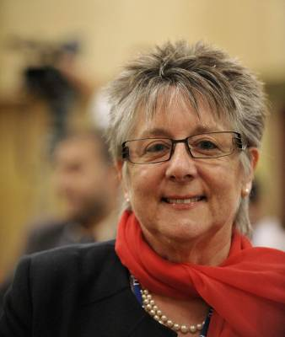
ITU recognizes dedication to accessibility cause
All new ITU-T Recommendations will be checked against accessibility criteria
2008: World Telecom & Information Society Day
  Helped raise awareness of the possibilities that ICTs can bring to all.
  Laureat: Andrea Saks
Andrea Saks

Slide 21

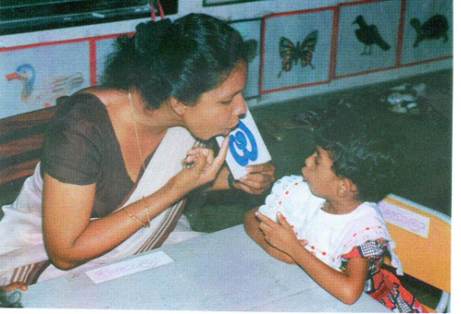
ITU-D Special Initiatives
Promoting ICT Accessibility for Persons with Disabilities
An Initiative out of WTDC-06 creating awareness and skills to mainstream disability issues.
Promoting equal ICT opportunities for PwDs.
Supporting member states meet obligations under Article 9 of the UN Convention for Rights of PwDs.
ITU-D/G3ict have developed a toolkit for training policy makers, regulators, other stakeholders: www.e-accessibilitytoolkit.org
Develop and mainstream ICT policies for PwDs
Share experiences and best practice
ITU-D also supports ICT projects for PwDs and provides workshops on ICTs issues for PwDs.
In addition,
ITU-D SG1-Q20, developed Guidelines for ICT accessibility for PwDs & collection of country level statistics on PwDs is in progress

Slide 22
Future ITU-D activities
Capacity building on policies and awareness on ICT accessibility issues via on-line toolkit
  Training policy makers and stakeholders
  Platform for best practice and electronic
  repository of policies on ICT accessibility
Projects on accessible ICTs in partnership with member states & other stakeholders

Slide 23
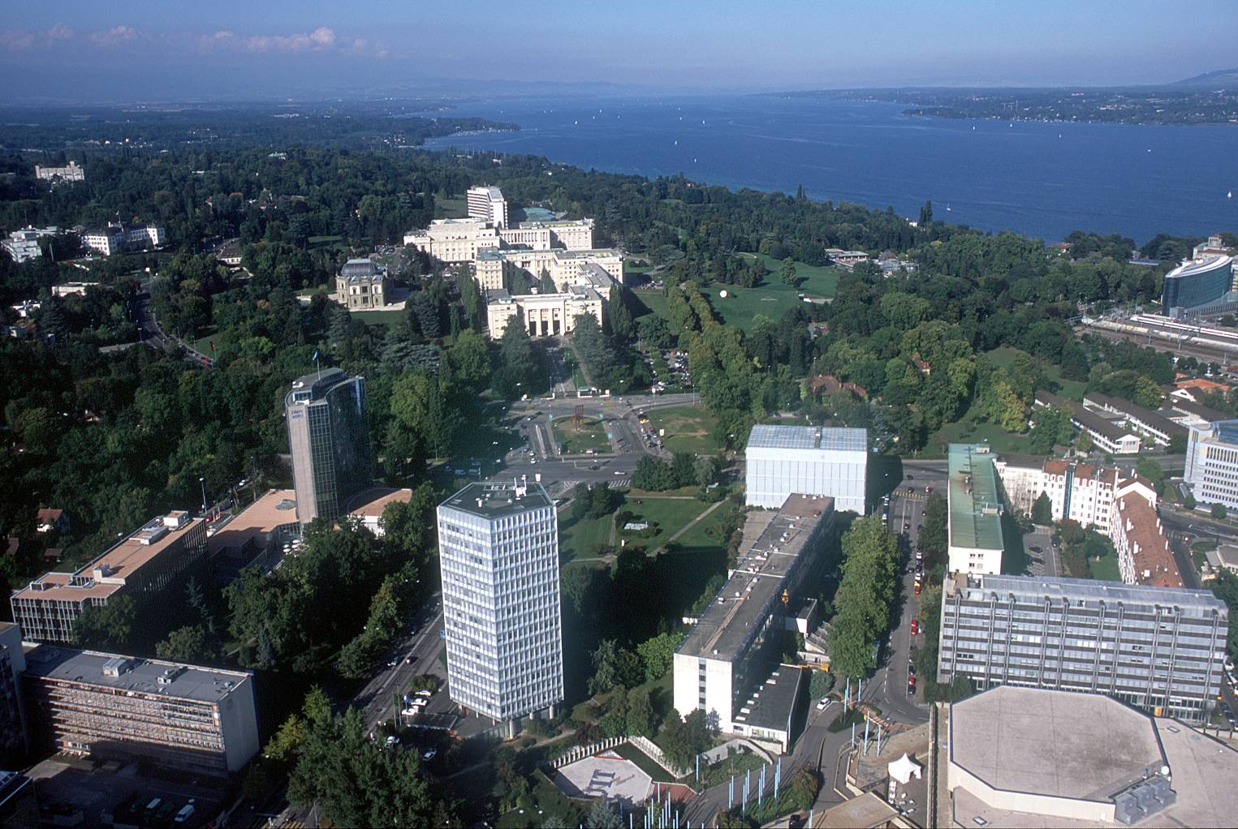
malcolm.johnson@itu.int

