Slide 1
ITU-T
ICTs and Climate Change
Meeting with Mr. Monga, Director, Energy and Climate Change Branch &
Mr. Leuenberger, Environmental Management Branch
(Cleaner Production Centres), UNIDO

Slide 2
Introduction to ITU
Founded in 1865, oldest specialized agency of the UN
Standards making one of the ITU’s first activities
191 Member States, 780 private sector entities
HQ Geneva, 11 regional offices, 760 staff / 80 nationalities
Named as one of the world’s ten most enduring institutions by Booz Allen
Five elected officials:
  Secretary-General
  Deputy Secretary-General
  Director of the Radio Bureau (BR)
  Director of the Telecommunication Standardization Bureau (TSB)
  Director of the Telecommunication Development Bureau (BDT)

Slide 3
ITU Structure
Plenipotentiary Conference
ITU Council
General
Secretariat
ITU-R
World/Regional Radiocomm Conference
Radiocomm
Assembly
ITU-D
World/Regional
Telecom Development Conference
ITU-T
World Telecom Standardization Assembly
TELECOM
Notes:
General Secretariat: Coordinates and manages the administrative and financial aspects of the Union’s activities
ITU-R: Coordinates radio communications, radio-frequency spectrum management and wireless services
ITU-D: Technical assistance and deployment of telecom networks and services in developing and least developed countries to develop communication services
ITU-T: Mission is to ensure an efficient and on-time production of internationally applicable high quality standards covering all fields of telecommunications
TELECOM:Brings together the top names from across the ICT industry as well as ministers and regulators and many more for a major exhibition, a high-level forum and a host of other opportunities.

Slide 4
ITU-T Structure
WTSA
World Telecommunication
Standardization Assembly
Workshops,
Seminars,
Symposia…
Telecommunication Standardization
Advisory Group
IPR
SG
Study Group
SG
Working Party
Focus Group
WP
WP
WP
Q
Q
Questions: Develop Recommendations
Q
Q
Q
Q

Slide 5

ITU-T Recommendations connect the world…
Without ITU-T standards you couldn’t make a telephone call from one side of the world to another.
Without ITU-T standards the
Internet wouldn’t function.

Slide 6
ITU-T Recommendations:
Not all standards are equal
Recommendations become mandatory if adopted in law
Private standards may confuse users and consumers
ITU’s broad range of stakeholders, and robust processes provide the basis for consensus across sectors and countries
Market-driven international standards, based on objective information and knowledge
Meet the needs and concerns of all relevant stakeholders

Slide 7
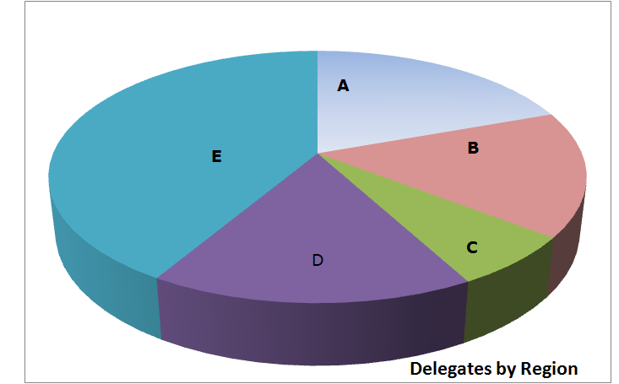
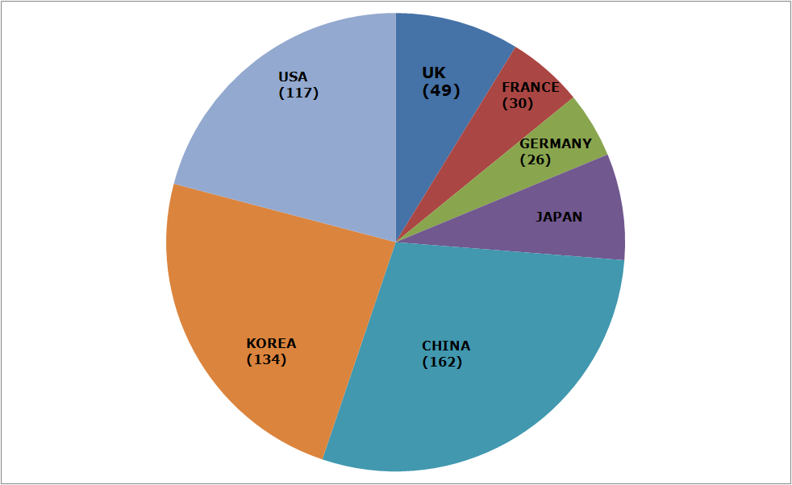
Member State Participation
Region A - The Americas (216)
Region B - Western Europe (178)
Region C - Eastern Europe and Northern Asia (73)
Region D - Africa (182)
Region E - Asia and Australasia (460)
Notes:
Member State delegates A216 B178 C73 D182 E460 TOTAL1109 UK49 FRANCE30 GERMANY26 JAPAN42 CHINA162 KOREA134 USA117

Slide 8
Strategic Objectives
Develop and publish timely global standards
Identify relevant areas for future standardization projects
Provide the most attractive forum for standardization in the interest of the membership
Promote value of ITU-T to attract increased membership
Disseminate information and know-how
Cooperate and collaborate with other Sectors and other entities
Provide support and assistance to the membership, in particular developing countries

Slide 9

ITU-T Key Features
Open, transparent, consensus based, fast working, public/private partnership
Technical standards developed by industry members, when consensus placed on website and if no comments after 4 weeks is in effect approved by 191 governments
ITU standards are therefore truly global, open standards, available free of charge, unlike those of many other standards bodies, fora or consortium that claim to produce global and open standards. Publicly available database of products and services meeting ITU standards
Organizing interoperability events to prove interoperability of different vendors equipment
Conform
Common IPR policy with ISO and IEC (FRAN)

Slide 10
Importance of Global Standards
Global Standards essential in a complex world
Standards make things easier
Essential for international communications and global trade
Drive competitiveness, for individual businesses and world economy
Help organizations with their efficiency, effectiveness, responsiveness and innovation
Lower prices and increase availability by reducing technical barriers and promoting compatibility between systems and networks
Manufacturers, network operators and consumers benefit

Slide 11
Standards proven economic tool
WTO trade report 2005
British Standards Institute (BSI): standards make annual contribution GBP 2.5 billion.
German standards body (DIN): economic benefits standardization about 1% GDP.
Canada: 17 % of labour productivity increase and nine per cent of growth of GDP 1981-2004.
Standards have a significant effect on limiting the undesirable outcomes of market failure.
The work of ITU has smoothed the more economical introduction of new technologies.

Slide 12








ITU-T collaboration
Vienna Agreement between the international standards orgs and their European regional counterparts.
World Standards Cooperation
  Patent policy & Joint events
ITU-T and IEEE
  MoU & Joint events
Global Standards Collaboration
  Supports ITU as preeminent global ICT standards organization.
ITU-T and 3GPP
ETSI
  Management meetings
ITU-T and IETF
  Management meetings
ITU-T and ICANN
  Management meetings
E-Business MoU: IEC, ISO, ITU and UN/ECE
44 formal partnerships
Notes:
. Vienna Agreement between the international standardizing
Organizations and their European
regional counterparts.

Slide 13
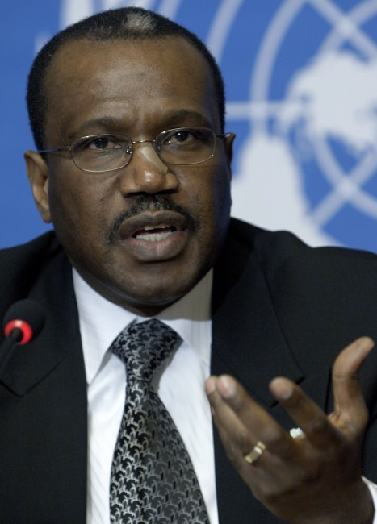
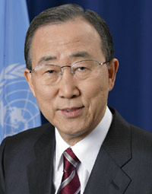
ITU and Climate Change
“Climate Change is a global challenge that the
world cannot lose”.
Dr Hamadoun I. Touré
ITU Secretary-General, 13 November 2008
“Climate change is the defining challenge of our era. ITU’s work to cut greenhouse gas emissions, develop standards and use ‘e-environment’ systems can speed up the global shift to a low-carbon economy”.
Ban Ki-moon
United Nations Secretary-General, 12 November 2008
Notes:
Let me now conclude my presentation with two quotes:
Quoting UN Secretary-General Ban Ki-moon, "We have to protect against cyberthreats, especially when they target children. I welcome the ITU’s ‘Child Online Protection’ initiative and urge all States to support it."
Finally, ITU would like to thank the organizers of the WCIII for inviting ITU to speak at this event and I look forward to further exchanges on how we can best collaborate to achieve our common objectives.
Thank you.

Slide 14

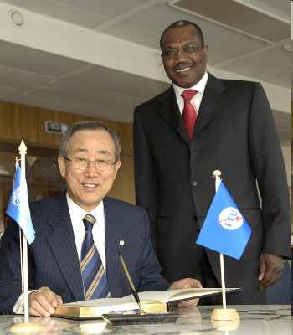
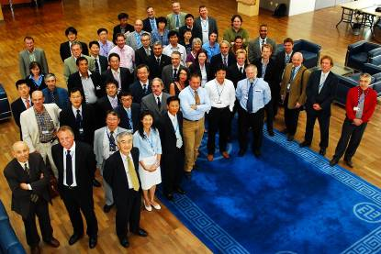
Smarter standards for greener systems & services
Focus Group of 20 organisations developed basis for methodology to estimate GHG emissions from ICTs Sector over their entire life-cycle
UN Secretary-General,
Ban Ki-moon: "ITU is one of the very important stakeholders in the area of climate change."
Participants in Focus Group ICT and Climate Change

Slide 15

ITU and COP
Ongoing role in UNFCCC process
  Promotion of role of ICTs in reducing GHGs
Side events and press conference in Barcelona and Copenhagen
    Partners: WWF, WIPO, WMO, GeSI, OECD, UNFCCC, Analysys Mason, Cisco, Microsoft, NTT, Government representatives from Japan, Ecuador
ISeeT Kiosk – Daily briefings from high level ICT business people
High level meetings

Slide 16
Standardization (1)
Developing a methodology to measure impact of ICTs on climate change (see later slide)
Identifying priority sectors where ICTs can reduce emissions (e.g. smart buildings, intelligent transport systems)
The promotion of NGNs (reducing power consumption by up to 40%)
Lifecycle analysis and disposal/recycling of ICTs
All new standards are now checked for energy efficiency

Slide 17

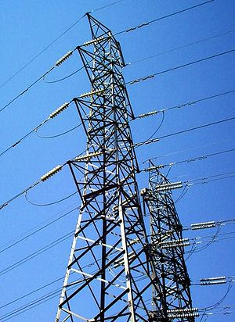
Standardization (2)
Standardization work in the field of Intelligent Transport Systems, Smart Grid, e-waste, sensor-based networks based on RFID & telemetry

Slide 18

Universal charger
Delivers 50% reduction in standby energy consumption, eliminates 51,000 tonnes of redundant chargers, and cuts GHG emissions by 13.6 million tonnes annually

Slide 19
Methodology
Common methodology for measuring ICT carbon footprint of ICT Sector ~ 3%
Methodologies to estimate impact of ICTs on reducing emissions in other industry sectors ~ 15%
Without, it will be impossible to provide meaningful comparisons.
Helps to establish the business case to go green.

Slide 20
Reports, symposia, working methods
TECHWATCH Reports on CC and positive impact of new technologies
  Next Generation Networks, Intelligent Transport Systems, etc.
Major Symposia on ICTs and CC
  2008: Kyoto and London
  2009: Quito and Seoul (virtual event)
ITU-T pioneering energy efficient work methods
  Paperless meetings, on-line work tools, virtual symposia.
ITU-T leading Dynamic Coalition on Internet and Climate Change as part of the Internet Governance Forum

Slide 21
Radiocommunication
Monitor climate change by:
  Provides spectrum and orbital resources for satellite remote-sensing
  Providing key climate data via radio-based applications (e.g. RFIDs)
  Work closely with WMO

Slide 22
Development
E-environment Toolkit for policymakers gives principles and guidelines for the development of applications and services in the area of the environment.
Will help countries to assess the contribution that ICTs can make to reduce GHG emissions

Slide 23
ITU Resolutions on Climate Change
WTSA-08, Resolution 73, resolves that CC is a high priority in ITU
WTPF (April 2009), Opinion 3, instructs promotion of Res. 73.
GSC-14 (July 2009), Resolution, encourages related collaboration, etc.
ITU Council (Oct. 2009), Resolution 1307, unanimously decided its importance and active participation in UNFCCC including COP-15 in Copenhagen

Slide 24
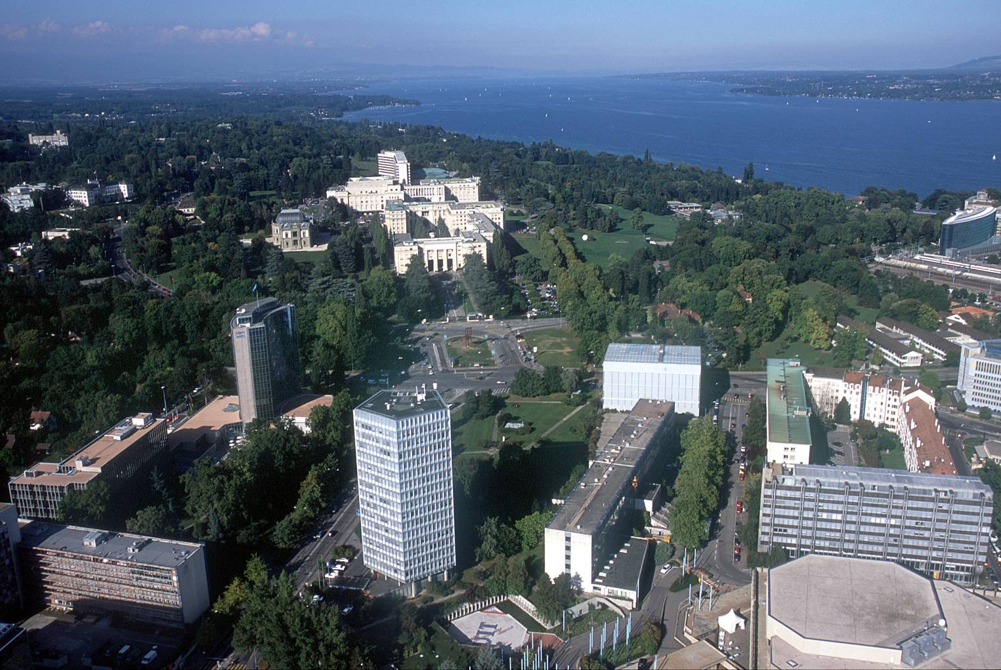
malcolm.johnson@itu.int

