Slide 1
ITU-T
ICT Conformity and Interoperability
Meeting with Mr. Goonatilake, Director, Trade Capacity Building Branch &
Mr. Alcorta, Director, Development Policy and Strategic Research Branch, UNIDO

Slide 2
Introduction to ITU
Founded in 1865, oldest specialized agency of the UN
Standards making one of the ITU’s first activities
191 Member States, 780 private sector entities
HQ Geneva, 11 regional offices, 760 staff / 80 nationalities
Named as one of the world’s ten most enduring institutions by Booz Allen
Five elected officials:
  Secretary-General
  Deputy Secretary-General
  Director of the Radio Bureau (BR)
  Director of the Telecommunication Standardization Bureau (TSB)
  Director of the Telecommunication Development Bureau (BDT)

Slide 3
ITU Structure
Plenipotentiary Conference
ITU Council
General
Secretariat
ITU-R
World/Regional Radiocomm Conference
Radiocomm
Assembly
ITU-D
World/Regional
Telecom Development Conference
ITU-T
World Telecom Standardization Assembly
TELECOM
Notes:
General Secretariat: Coordinates and manages the administrative and financial aspects of the Union’s activities
ITU-R: Coordinates radio communications, radio-frequency spectrum management and wireless services
ITU-D: Technical assistance and deployment of telecom networks and services in developing and least developed countries to develop communication services
ITU-T: Mission is to ensure an efficient and on-time production of internationally applicable high quality standards covering all fields of telecommunications
TELECOM:Brings together the top names from across the ICT industry as well as ministers and regulators and many more for a major exhibition, a high-level forum and a host of other opportunities.

Slide 4
ITU-T Structure
WTSA
World Telecommunication
Standardization Assembly
Workshops,
Seminars,
Symposia…
Telecommunication Standardization
Advisory Group
IPR
SG
Study Group
SG
Working Party
Focus Group
WP
WP
WP
Q
Q
Questions: Develop Recommendations
Q
Q
Q
Q

Slide 5

ITU-T Recommendations connect the world…
Without ITU-T standards you couldn’t make a telephone call from one side of the world to another.
Without ITU-T standards the
Internet wouldn’t function.

Slide 6
ITU-T Recommendations:
Not all standards are equal
Recommendations become mandatory if adopted in law
Private standards may confuse users and consumers
ITU’s broad range of stakeholders, and robust processes provide the basis for consensus across sectors and countries
Market-driven international standards, based on objective information and knowledge.
Meet the needs and concerns of all relevant stakeholders

Slide 7
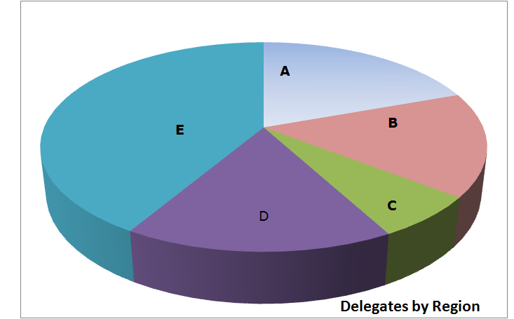
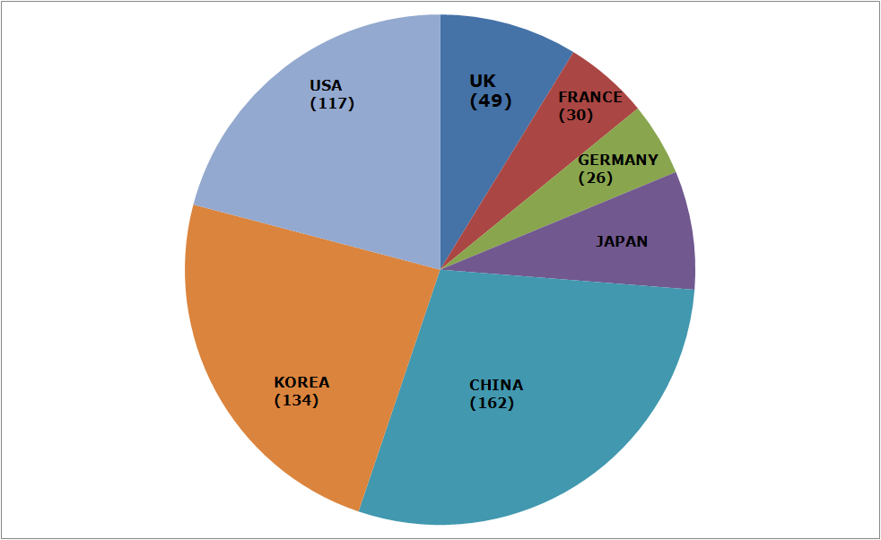
Member State Participation
Region A - The Americas (216)
Region B - Western Europe (178)
Region C - Eastern Europe and Northern Asia (73)
Region D - Africa (182)
Region E - Asia and Australasia (460)
Notes:
Member State delegates A216 B178 C73 D182 E460 TOTAL1109 UK49 FRANCE30 GERMANY26 JAPAN42 CHINA162 KOREA134 USA117

Slide 8
Strategic Objectives
Develop and publish timely global standards
Identify relevant areas for future standardization projects
Provide the most attractive forum for standardization in the interest of the membership
Promote value of ITU-T to attract increased membership
Disseminate information and know-how
Cooperate and collaborate with other Sectors and other entities
Provide support and assistance to the membership, in particular developing countries

Slide 9

ITU-T Key Features
Open, transparent, consensus based, fast working, public/private partnership
technical standards developed by industry members, when consensus placed on website and if no comments after 4 weeks is in effect approved by 191 governments
ITU standards are therefore truly global, open standards, unlike those of many other standards bodies, fora or consortium that claim to produce global and open standards, available free of charge
Publicly available database of products and services meeting ITU standards
Organising interoperability events to prove interoperability of different vendors equipment
Common IPR policy with ISO and IEC (FRAN)

Slide 10
Importance of Global Standards
Global Standards essential in a complex world
Standards make things easier
Essential for international communications and global trade
Drive competitiveness, for individual businesses and world economy
Help organisations with their efficiency, effectiveness, responsiveness and innovation
Lower prices and increase availability by reducing technical barriers and promoting compatibility between systems and networks
Manufacturers, network operators and consumers benefit

Slide 11
Standards proven economic tool
WTO trade report 2005
British Standards Institute (BSI): standards make annual contribution GBP 2.5 billion.
German standards body (DIN): economic benefits standardization about 1% GDP.
Canada: 17 % of labour productivity increase and nine per cent of growth of GDP 1981-2004.
Standards have a significant effect on limiting the undesirable outcomes of market failure.
The work of ITU has smoothed the more economical introduction of new technologies

Slide 12








ITU-T collaboration
44 formal partnerships
Vienna Agreement between the international standards orgs and their European regional counterparts.
World Standards Cooperation
  Patent policy & Joint events
ITU-T and IEEE
  MoU & Joint events
Global Standards Collaboration
  Supports ITU as preeminent global ICT standards organization.
ITU-T and 3GPP
ETSI
  Management meetings
ITU-T and IETF
  Management meetings
ITU-T and ICANN
  Management meetings
E-Business MoU: IEC, ISO, ITU and UN/ECE
Notes:
. Vienna Agreement between the international standardizing
Organizations and their European
regional counterparts.

Slide 13

INTEROPERABILITY
The world’s communication network is arguably mankind’s most complex engineering project.
The 7-As
anywhere, anytime, anybody, for anything, with any equipment for any data-voice-video using any network-type
Couldn’t have been done without ITU standards for interoperability

Slide 14
Why ITU-T WTSA-08 Resolution 76
Major concerns were raised at WTSA-08, especially from developing countries, due to lack of performance and of compliance to conformity requirement and interoperability
Market invaded by counterfeit products
Need of developing countries to be assisted in deploying testing facilities and in capacity building opportunities in the regions
No record of products conforming to ITU standards
No proof of interoperability

Slide 15
ITU’s Conformity and Interoperability Programme
Four Action Lines:
Creation of a conformity database
Organisation of interoperability events
Develop human resources capacity through workshops
Assist establishment of test facilities in developing countries

Slide 16
Conformity assessment
  Industry issues:
    Increasing business opportunities
    Time to market, costs for testing
    Increase of market outreach thanks to Mutual Recognition Agreements and Arrangements
  End users issues:
    Requirements for Quality of Service
    Interoperability and legacy to existing infrastructure
    Costs for non conformity & non interoperability

Slide 17
The ITU Pilot Conformity Database
Voluntary and free.
Open to all ITU members. Non-members may participate on a case by case basis
For The vendor: Visibility in the marketplace
For Customers: Increased trust
Testing by 1st, 2nd, 3rd party accredited laboratories
Or 3rd party accredited certifiers
Plus Supplier’s Declaration of Conformity (SDoC)

Slide 18
Supplier’s Declaration of Conformity (ISO 17050-1)
Company inputs data directly into database
Product category & Name of product
ITU-T standard(s)
Laboratories accredited in accordance with ISO standards (normally by ILAC)
3rd party accredited certifier (normally by IAF)
Acceptance of liability for the Supplier’s Declaration of Conformity

Slide 19

The ITU Conformity Programme
Successful Testing / certification
ITU checks
Supplier’s
Declaration
of Conformity
Vendor
C-1234567
Product ID
ITU Pilot Conformity DATA BASE
C-1234567
Product
Tech Specs
Promo
Package

Slide 20
ITU-T Recs &
test suites
Route 2
1st 2nd or 3rd party accredited lab
(ISO/IEC 17025)
Route 1
Test lab (certification body responsibility)
Conformity Assessment / Certification
Supplier’s
conformity route
decision
Implementation
of the ITU Conformity
Programme
Test results
(ITU-T X.290)
Test results
(ITU-T X.290)
Accredited
(ISO/IEC Guide 65) Certification body Evaluation
1st party
Evaluation
Supplier’s Conformity
Declaration
(ISO/IEC 17050)
Conformity
Certificate issued by Certification
Body
ITU CIP services
Supplier’s Request to ITU
ITU Conformity Database

Slide 21
Supplier’s Declaration / Certification – Risk relationship
RISK
High
3rd party
Certification
Moderate
Supplier’s
Declaration
Low
Need of 3rd party independent testing

Slide 22
Interoperability initiatives
TSB organizing calendar of interoperability events in collaboration with relevant SDOs/forums/consortia
Possible hot topics:
    Home Networking; VDSL; GPON

Slide 23

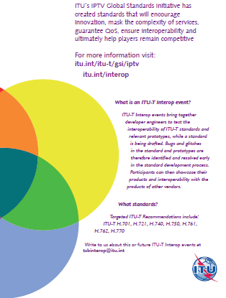
IPTV Interop event

Slide 24
ITU-T Interop Event on IPTV, Geneva, 20-23 July 2010
Study Groups developed a consistent set of technical specifications or standards under the umbrella of the IPTV Global Standards Initiative (IPTV-GSI).
The first IPTV Interop event will demonstrate the state of maturity and industry adoption of ITU-T standards for IPTV.
Manufacturers of set top boxes, content servers and other equipment are invited to showcase their products and test for interoperability

Slide 25
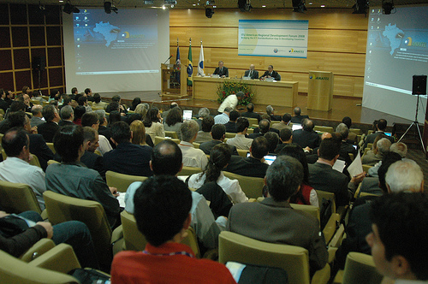
TSB studies in progress with…
Experts and External
Organizations
IEC, ISO,
Regulators,
Laboratories,
Training institutions
Governments
UNIDO, WTO
Accreditation bodies (ILAC, IAF, BIPM)
Private sector, members and non-members of ITU

Slide 26
ITU-T Study Groups/JCA
SGs will prepare ITU-T Recommendations in view of conformity assessment and interoperability testing
SGs will maintain a list of Recommendations where test suites are available
Joint Coordination Activity on Conformity and Interoperability Testing (JCA-CIT)
Facilitates information sharing and collaboration between ITU-T Study Groups and relevant outside bodies such as ETSI, ISO and OMA.
  Seeking input with regard to the implementation of tasks stated in WTSA-08 Resolution 76
  Development of a common understanding of Conformance vs. Interoperability testing
  Developing a roadmap for the implementation of the four action lines agreed by Council-09 and taking into account a draft action plan

Slide 27
Regional Consultation Meetings 2010
Americas – 6 July, Quito, Ecuador
Africa – 30 July, Nairobi, Kenya
Asia Pacific – 16-17 September, Sydney, Australia
Continue the discussion to better implement the four action lines adopted by Council 2009.
Improve the ITU pilot conformity database to meet the requirements of all the stakeholders in the spirit of the WTSA-08 Resolution 76 addressing the needs of developing countries on this subject.

Slide 28
Contents:
Consultation meetings
Why Conformity and Interoperability ?
Resolution 76: a short review
The action lines decided by ITU Council-09
Impact on developing countries: Benefits of the ITU C&I Programme, costs of lack of conformity and/or interoperability
Impact on industry, testing, MRAs, associated costs, time to market
Improvements to the ITU pilot database
Encouraging interoperability testing
Audience
Industry / Vendors
Administrations
Operators/service providers
Standards developers
Regulators
Laboratories
Civil society

Slide 29
Capacity building and test centers
The ITU-T Secretariat (TSB) is implementing proposals on human capacity building in close collaboration with the ITU-D Secretariat (BDT):
  Hold workshops and tutorials on conformity assessment and interoperability on the BDT project on International Telecommunication Testing Center.
The ITU-T will assist in the establishment of test facilities in developing countries
A project is in progress to establish a test center in Tanzania
Looking for cooperation UNIDO

Slide 30

malcolm.johnson@itu.int

