Slide 1
ITU
ICTs and Climate Change
Meeting with UNFCCC
6 May 2010

Slide 2
Introduction to ITU
Founded in 1865, oldest specialised agency of the UN
Founded to ensure interoperability of international communications
Remains key function of ITU
191 Member States, 780 private sector entities
HQ Geneva, 11 regional offices, 760 staff / 80 nationalities
Named as one of the world’s ten most enduring institutions by Booz Allen
Five elected officials:
  Secretary-General
  Deputy Secretary-General
  Director of the Radio Bureau (BR)
  Director of the Telecommunication Standardization Bureau (TSB)
  Director of the Telecommunication Development Bureau (BDT)

Slide 3

ITU-T Standards (Recommendations) connect the world…
Over 3000 standards
Basis for the international telecommunications networks
Increasing extending to all aspects of ICTs
Without ITU standards the
Internet wouldn’t function.

Slide 4
Not all standards are equal
Recommendations become mandatory if adopted in law
Private standards may confuse users and consumers and do not ensure interoperability
ITU’s broad range of stakeholders, and robust processes provide the basis for consensus across sectors and countries
Market-driven international standards, based on objective information and knowledge
Meet the needs and concerns of all relevant stakeholders

Slide 5
Strategic Objectives
Bridge the digital divide
Build on broadband
Manage the spectrum and geostationary satellite orbit
Develop and publish timely global standards
Identify relevant areas for future standardization projects
Disseminate information and know-how
Capacity building
Projects to support and assist the membership, in particular developing countries

Slide 6

Key Features
Open, transparent, consensus based, fast working, public/private partnership
Technical standards developed by industry members, when consensus placed on website and if no comments after 4 weeks is in effect approved by 191 governments
ITU standards are therefore truly global, open standards, unlike those of many other standards bodies, forums or consortium that claim to produce global and open standards, available free of charge
Publicly available database of products and services meeting ITU standards
Organizing interoperability events to prove interoperability of different vendors equipment
Common IPR policy with ISO and IEC (FRAN)

Slide 7
Importance of Global Standards
Global Standards essential in a complex world
Standards make things easier
Essential for international communications and global trade
Drive competitiveness, for individual businesses and world economy
Help organizations with their efficiency, effectiveness, responsiveness and innovation
Lower prices and increase availability by reducing technical barriers and promoting compatibility between systems and networks
Manufacturers, network operators and consumers benefit

Slide 8

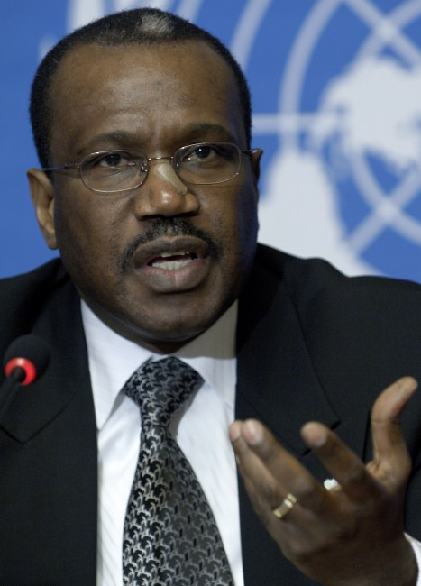
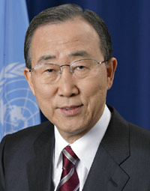
ITU and Climate Change”
“Climate Change is a global challenge that the
world cannot lose”.
Dr Hamadoun I. Touré
ITU Secretary-General, 12 November 2008
“Climate change is the defining challenge of our era. ITU’s work to cut greenhouse gas emissions, develop standards and use ‘e-environment’ systems can speed up the global shift to a low-carbon economy”.
Ban Ki-moon
United Nations Secretary-General, 12 November 2008
Notes:
Let me now conclude my presentation with two quotes:
Quoting UN Secretary-General Ban Ki-moon, "We have to protect against cyberthreats, especially when they target children. I welcome the ITU’s ‘Child Online Protection’ initiative and urge all States to support it."
Finally, ITU would like to thank the organizers of the WCIII for inviting ITU to speak at this event and I look forward to further exchanges on how we can best collaborate to achieve our common objectives.
Thank you.

Slide 9
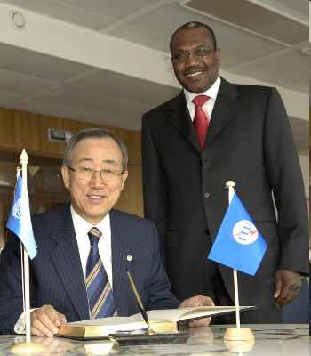
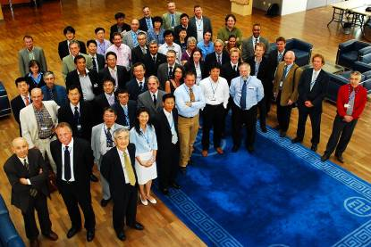
Methodology to describe and estimate present and future user [energy] consumption of ICTs over their entire life-cycle
Smarter standards for greener systems & services
UN Secretary-General,
Ban Ki-moon: "ITU is one of the very important stakeholders in the area of climate change."
Participants in Focus Group ICT and Climate Change

Slide 10
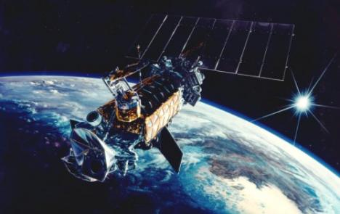
Data Monitoring
ITU facilitates climate monitoring:
  Conducting and managing studies on remote-sensing needs
  Providing key climate data via radio-based applications
  Active monitoring of key climatic variables
  Close collaboration with WMO

Slide 11
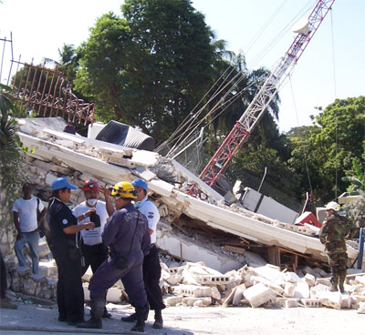
Adaptation
Support to get telecoms up and running after disasters
    Recent examples Haiti and Chile
E-Environment Toolkit will help countries to assess the contribution that ICTs can make to reduce GHG emissions
Common alerting protocol
Common number allocated to UNOCHR

Slide 12
Mitigation
Reducing energy consumption
The promotion of Next Generation Networks (reducing power consumption by up to 40%)
Recycling, e-waste, lifecycle analysis
All new standards are now checked for energy efficiency
ITU-T Study Group 5 on Environment and Climate Change

Slide 13
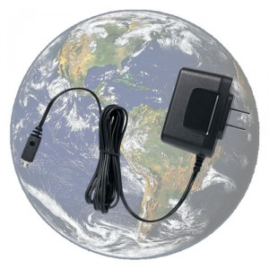
ITU-T Recommendation L.1000: Universal charger
Delivers 50% reduction in standby energy consumption, will eliminate up to 82,000 tonnes of redundant chargers, and cuts GHG emissions by at least 13.6 million tonnes annually

Slide 14

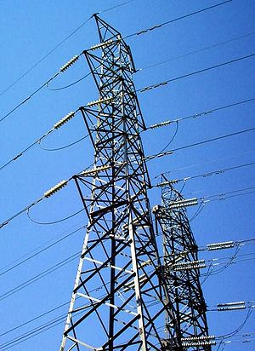
New Technology
Identifying priority sectors where ICTs can reduce emissions
  Smart grid (new Focus Group)
  Smart buildings
  Intelligent transport systems
  Remote working technologies
  Sensor-based networks

Slide 15

Common Methodology
Common methodology for measuring ICT carbon footprint
Without, it will be impossible to provide meaningful comparisons
Helps to establish the business case to go green
Over 20 organisations participate in the ITU group

Slide 16
Joint UNFCCC/ITU Project?
The Environmental Protection Agency (EPA) in Ghana has opened a dialogue with Vodafone Ghana
  Review Vodafone Ghana's operation to assess environmental impacts and ways and contribute to appropriate mitigation actions.

Slide 17
Awareness Raising
TECHWATCH Reports on CC and positive impact of new technologies
  Next Generation Networks, Intelligent Transport Systems, etc.
Major Symposia on ICTs and CC
  2008: Kyoto and London
  2009: Quito and Seoul (virtual event)
  2010: Egypt
ITU-T pioneering energy efficient work methods
  Paperless meetings, on-line work tools, virtual symposia
ITU-T leading Dynamic Coalition on Internet and Climate Change as part of the Internet Governance Forum

Slide 18
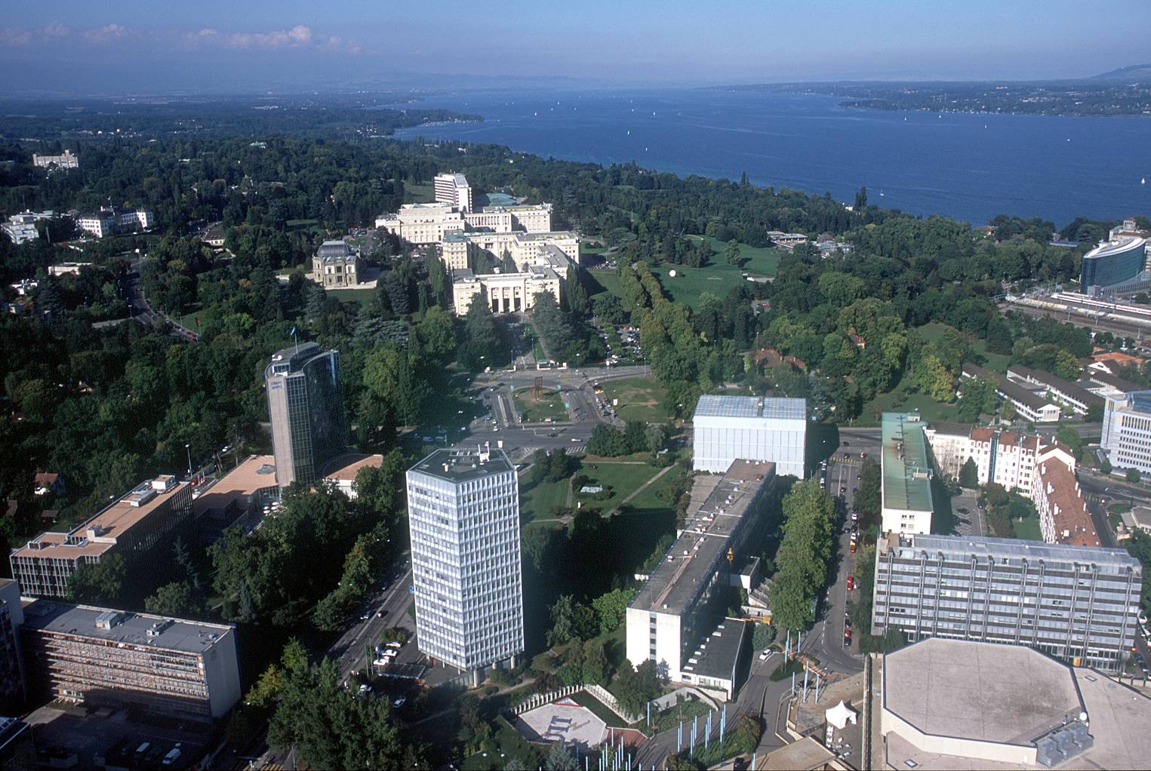
malcolm.johnson@itu.int

