Slide 1
ITU-T
Empowering global
ICT development
XVI Meeting of Permanent Consultative Committee I: Telecommunications / Information and Communication Technologies (PCC.I)
Ushuaia, Tierra del Fuego, Argentina
May 11 to 14, 2010.

Slide 2
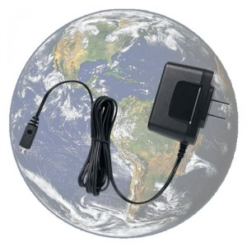
2009: A year of highlights
Study Groups
Despite financial crisis many study groups saw increased participation
Remote participation on the rise
  120 e-meetings
First global standard for a fully networked home
  ITU-T Rec. G.9960; ex G.hn
Universal charger for mobile phones
Methodology to measure the impact of ICTs on climate change with the involvement of 20 other organizations
Handbooks on Optical fibres, cables and systems, converged networks, and the security manual

Slide 3
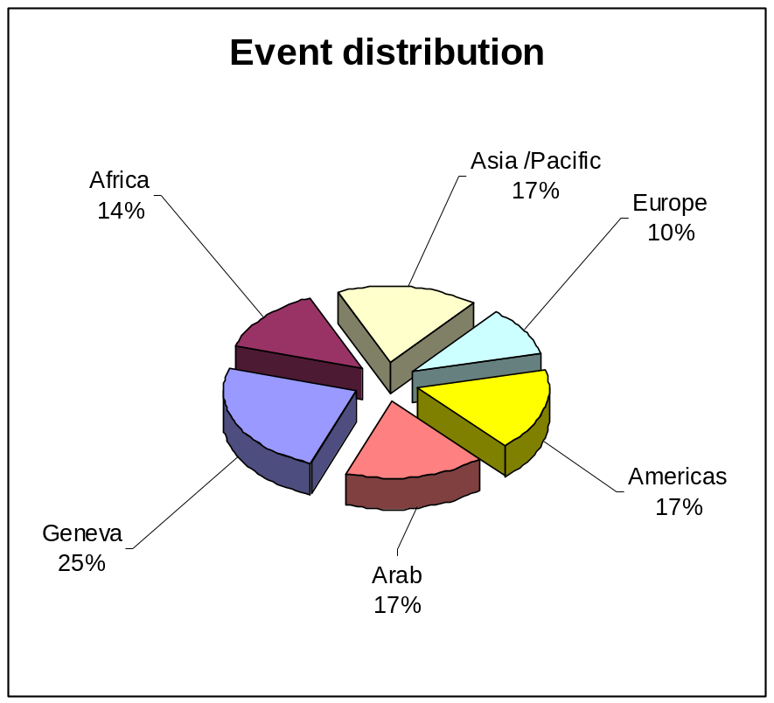

2009: A year of highlights
Workshops
30 events, 2500 participants
  Implementation of WTSA-08 decisions
  Bridging the standardization gap
  ICTs and climate change
  Cybersecurity
  NGN
  Accessibility
First fully virtual ITU symposium on ICTs and climate change
  Organised together with the KCC and TTA
5th Fully Networked Car

Slide 4
Recent Activities in the Region
ITU-T Study Group 5 Buenos Aires, Argentina 12-16 April 2010
ITU-T Workshop on "Interactions of Voiceband Signal Processing Functions and their End-to-End Coordination" Germantown, Maryland, USA, 21 April 2010
Seminar on ITU-T hot topics for standardization and Kaleidoscope event: Innovations for Digital Inclusion Mar del Plata, Argentina,
31 August - 01 September 2009
ITU-T Study Groups 11 and 13 and IPTV-GSI Mar del Plata, Argentina
2-12 September 2009
ITU panel “Globalization of Standardization and Making the International Telecommunication Union (ITU) Accessible” at the 18th Biennial TDI Conference “Where Access begins” Washington DC, USA, 30 July - 1 August 2009
ITU Symposium on ICTs and Climate Change and Forum on "Implementation of decisions of the World Telecommunication Standardization Assembly
(WTSA-08)“ Quito, Ecuador, 7-10 July 2009
Regional Seminar on the economic and financial aspects of telecommunications for Member Countries of the Study Group 3 Regional Group for Latin America and Caribbean (SG3RG-LAC) (former TAL Group) Lima, Peru, 23 - 24 June 2009

Slide 5
Region’s Chairmen and Vice-Chairmen
Bruce Gracie, Chairman TSAG, Industry Canada, Canada
Stephen J. Trowbridge, VC TSAG, Alcatel-Lucent, USA
Marcos Pérez García VC, SG2, Empresa de Telecomunicaciones de Cuba, S.A. (ETECSA), Cuba
Steven D. Lind, VC SG 2, AT&T, USA
Leslie Joseph Martinkovics, VC, SG3, Verizon, USA
Héctor Mario Carril, VC SG5, Secretaria de comunicaciones, Argentina
Arthur Webster, Chairman SG 9, US Department of Commerce, USA
Charles A. Dvorak, Chairman SG 12, AT&T, USA
Júlio Cesar Fonseca, VC SG15, Regional focus group coordination, ANATEL, Brazil
Mark T. Neibert, VC SG16, Ygomi, USA
Antonio Guimaraes, VC SG17, ANATEL, Brazil

Slide 6
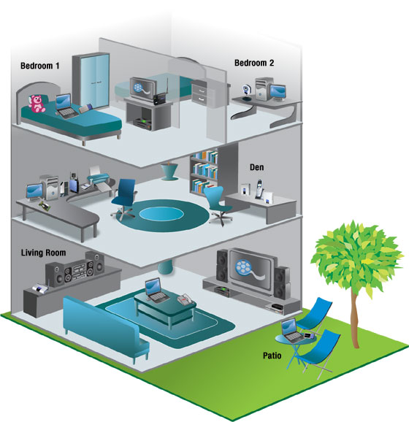
The network knocks at your door
Home Networking to
achieve interoperability
on a global scale
  PC World (US) 13.12.08:
  “The powerful world
  standards organization
  …[ITU].. has reached
  agreement on G.hn a set of specifications that would encompass phone lines, power lines, and coaxial cable to provide HDTV room to room…”
Now: G.hn for Smart Grid

Slide 7
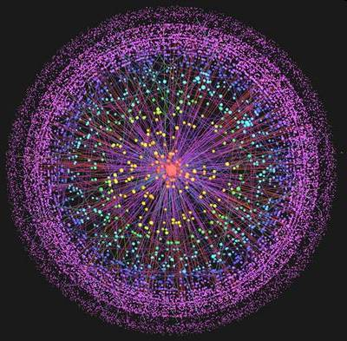
Future networks
Focus Group
Collect and identify visions of future networks
Next Meetings:
Geneva; Brazil; India
Report will be presented to Council Dedicated Group on Internet Governance

Slide 8

ITU-T’s quantum leaps in speech, audio and video quality
Video codec H.264 in HDTV, iPhone, Blu-ray, 3G, etc
2008 Primetime Emmy award
Call for technical contributions
for next generation
Extension of work
on speech coding:
  Wider bandwidths, richer user experience

Slide 9
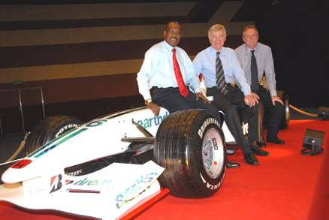
Intelligent Transport Systems
ITU, ISO and IEC and Geneva Motor Show
  Annual Event
New work:
  Wideband communication in cars
  Vehicle gateway protocol

Slide 10
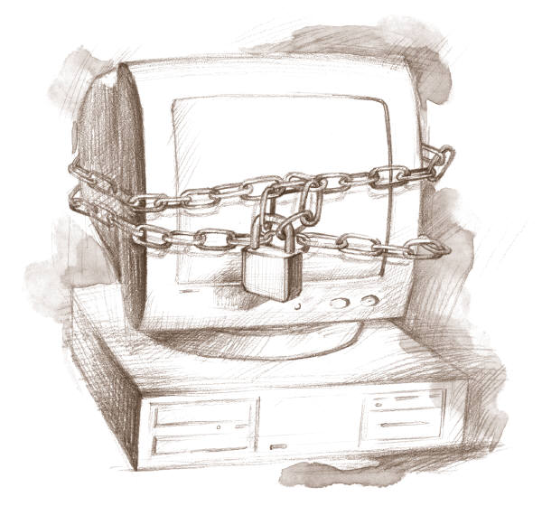
Safety in the cyber world
Study Group 17
identity management (IdM)
object identifiers (OID)
Security standards for:
  NGN
  IPTV
  Home networks,
  Ubiquitous sensor networks
  Mobiles
  Traceback
  Countering spam (EVCert)
Road map of security standards: itu.int/ITU-T/studygroups/com17/ict/
Cybersecurity Information Exchange Framework (CYBEX)
Security Workshop, Geneva 6-7 December 2010

Slide 11
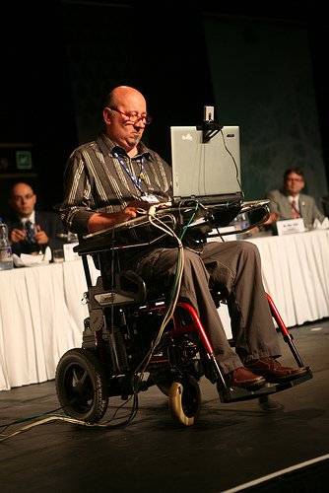
Accessibility
Champions principles Universal Design enshrined in the UN Convention on Rights of Persons with Disabilities
Includes accessibility features in all standards
Strong advocacy focus
Group to coordinate activities on accessibility
ITU led Dynamic Coalition on the Internet and Accessibility at the Internet Governance Forum (IGF)
Proposed new Focus Group on Interoperability of Accessibility protocols

Slide 12

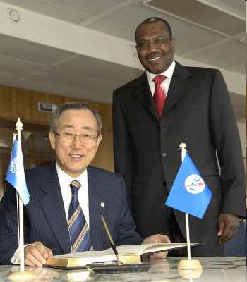
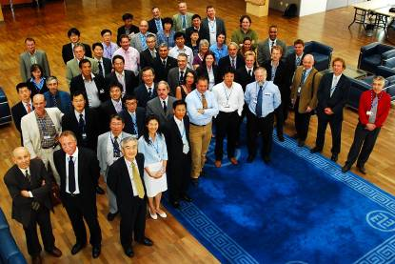
ICTs and Climate Change
Focus Group on ICTs and Climate Change
ITU led Dynamic Coalition on Internet and Climate change at the Internet Governance Forum (IGF)
Participation in COP15
Establishing close liaison with UNFCCC
UN Secretary-General,
Ban Ki-moon:
"ITU is one of the very important stakeholders in the area of climate change."
Participants in Focus Group ICT and Climate Change

Slide 13
Environment and Climate Change
ITU-T Study Group 5:
Reducing energy consumption
The promotion of Next Generation Networks (reducing power consumption by up to 40%)
Recycling, e-waste, lifecycle analysis
All new standards are now checked for energy efficiency

Slide 14
Universal charger
ITU-T Recommendation L.1000
Delivers 50% reduction in standby energy consumption, will eliminate up to 82,000 tonnes of redundant chargers, and cuts GHG emissions by at least 13.6 million tonnes CO2 annually

Slide 15

Common Methodology
Common methodology for measuring ICT carbon footprint
Without, it will be impossible to provide meaningful comparisons
Helps to establish the business case to go green
Over 20 organisations participate in the ITU group
Standards on life cycle environmental impact of ICTs goods and services, and ICT projects, November 2010

Slide 16
Economic and policy issues
Study Group 3
SG 3 deals with international tariff and charging
Recommendations on charging and accounting for International Internet Connectivity
Recommendations on charging and accounting for international mobile telephony
Guidelines for resolution of disputes regarding charging and accounting
Development of charging and accounting/settlement mechanisms

Slide 17

Technology Watch: Scouting for future technologies …
Recent papers:
  Remote collaboration tools
  Ubiquitous Sensor Networks
  ICTs and Climate Change
  Telepresence
  High-performance video-conferencing
  Intelligent Transport Systems
  Lawful interception (LI)
  Next-Generation Networks (NGNs) and energy efficiency
  Mobile applications
  Batteries for portable ICT devices
Upcoming: ICTs and food security, network robotics, telebiometrics
New Briefing Reports published in ITU News

Slide 18



















Chief Technology Officer (CTO) meeting
Nineteen major CTOs
Recognition of need for review of standardization landscape
Results will be presented at next meeting, Paris, 29 October.

Slide 19

Next generation electricity
Chief Technology Officer Group highlighted Smart Grid as a priority area
Focus Group on Smart Grid will
  Identify impacts on standards development
  Investigate ITU-T study items
  Familiarize ITU-T with emerging attributes of smart grid
  Encourage collaboration between ITU-T membership and utilities

Slide 20

In the cloud
WTPF participants highlighted Cloud as a priority area
Focus Group on Cloud Computing will
  Identify potential impacts on ITU-T standards development
  Investigate future study items
  Analyze how interoperability can be assured
  Familiarize ITU-T with emerging attributes and challenges of cloud computing

Slide 21

Kaleidoscope 2010
Pune, India, 13-15 December 2010
Exhibition by local universities
Best paper awards $10,000
Proceedings → IEEE Xplore
online library
New this year:
  Standards Corner (tutorial)
  Jules Verne’s Corner
  (SciFi writers and dreamers)
Additional info: itu-kaleidoscope.org/2010
Associated events: Focus Group on Future Networks
Third IPTV Interoperability event

Slide 22

Council 2009/10 Decisions
  Adopted budget allowing TSB to implement its work programme and WTSA-08 Action Plan & approved TSB Reorganization
  Endorsed recommendation to introduce new membership categories for academia and reduced fee for SME companies from developing countries.
  Endorsed recommendation to set up new group on IPv6, and preparations for WCIT to revise ITRs
  Agreement to hold WTSA/WCIT back to back
  Endorsed recommendations on conformity and interoperability

Slide 23
Admission of Sector Members from Developing countries
ITU Council supports proposal to reduce cost to 1/16 of the Sector Member contributory unit = CHF 3,975
Proposal to be reviewed at PP’10
Admission of academia, universities and their associated research establishments
ITU Council supports proposal to reduce cost to 1/32 of the Sector Member contributory unit = CHF 1,987
Academia Member would not participate in approval process of Recommendations. Proposal to be reviewed at PP’10

Slide 24

ITU and IPv6
Massive deployment of Internet-related resources=depletion of IPv4 addresses.
ITU actively promoting IPv6 deployment
New ITU-T/D Group established two CGs
Next meeting 1-2 September
Open participation

Slide 25
The International Telecommunication Regulations
ITRs catalyzed global telecoms liberalization and facilitated Internet
Adopted to:
  Provide a basis for the provision & operation of international telecommunication services
  To designate responsibilities of Admins and Operators
  To provide general principles, even for commercially-negotiated arrangements
Revision under discussion since PP98
WTSA and WCIT 5-30 November 2012
ITRs: Abrogate, revise or update? New issues?

Slide 26

Conformity and interoperability
Conformity assessment benefits manufacturers, service providers, users and regulators and supports sustainable development.
Conformity gives confidence and facilitates access to world markets.
All successful SDOs have testing specifications; conformance testing to determine compliant products; and interoperability testing.

Slide 27
ITU’s Conformity and Interoperability Programme
Four Action Lines:
Creation of a conformity database
Organisation of interoperability events
Develop human resources capacity through workshops and tutorials
Assist establishment of test facilities in developing countries

Slide 28
The ITU-T “Pilot”
Conformity Database
Will provide a source of what products have been successfully tested to ITU-T Recommendations.
Pilot conformity database follows ISO/IEC 17000-series: Requires the issue of a Supplier’s Declaration of Conformity (SDoC) (ISO/IEC 17050)
Voluntary and free, open to ITU members. Non-members may participate on a case by case basis
Testing
  1st, 2nd, 3rd party accredited labs conformity assessment
  3rd party accredited certifiers

Slide 29

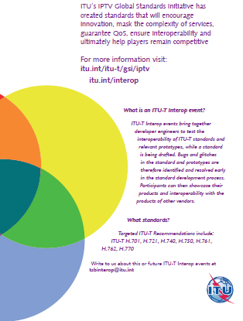
IPTV Interop events

Slide 30
Capacity Building
Develop expertise in conformity and interoperability testing
In collaboration with BDT
Plan to organise tutorials at established test centres around the world
Joint workshops planned with UNIDO

Slide 31
Establishment of conformity test centres in developing countries
Need to build partnerships with relevant organisations:UNIDO, ISO (CASCO), IEC, IAF and ILAC
UNIDO has a programme to assist in establishment of accreditation bodies and conformity test centres in developing countries
UNIDO offer of collaboration

Slide 32
Regional Consultation Meetings 2010
Americas – 6 July, Quito, Ecuador
Africa – 30-31 July, Nairobi, Kenya
Asia Pacific – 16-17 September – Australia
Continue the discussion to better implement the four action lines adopted by Council 2009.
Improve the ITU-T pilot conformity database to meet the requirements of all the stakeholders in the spirit of the WTSA-08 Resolution 76 addressing the needs of developing countries on this subject.

Slide 33
Business Plan
Council endorsed need to develop a business plan for the long term implementation of the programme
Need to first determine the demand for each of the action lines
Amend programme in light of further consultations

Slide 34

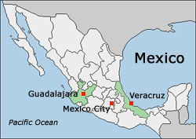
Plenipotentiary Conference 2010
4 to 22 October 2010
The key event at which ITU Member States decide on ITU’s future role of the organization.
Sets the Union's general policies, adopts four-year strategic and financial plans and elects the senior management team, the members of Council and the members of the Radio Regulations Board.

Slide 35
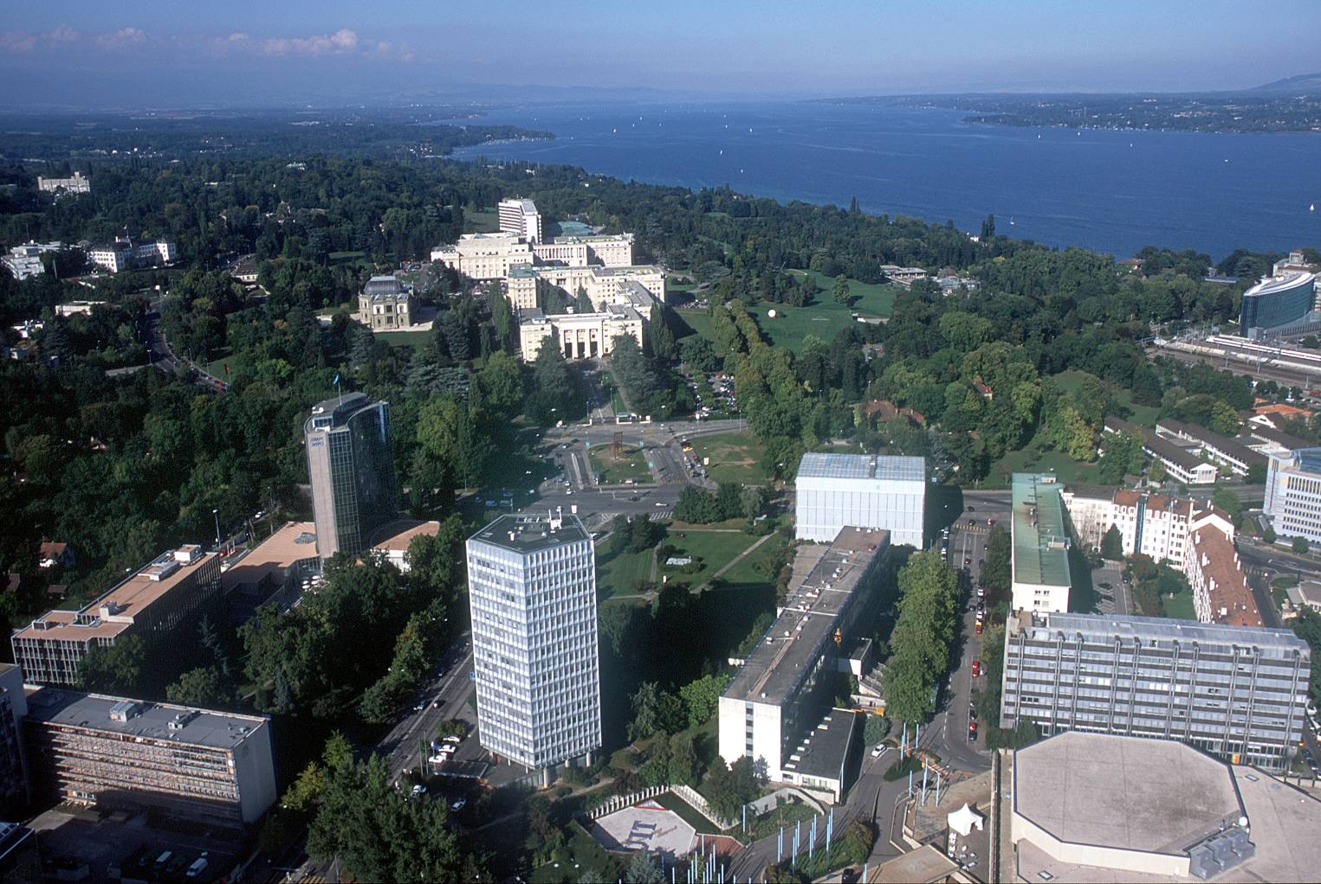
malcolm.johnson@itu.int

