Slide 1
WELCOME
TO
ITU-T

Slide 2
ITU’s
Telecommunication Standardization Sector (ITU-T)
Malcolm Johnson
TSB Director
ITU
Pune, India
17 December 2010

Slide 3
The INTERNATIONAL TELECOMMUNICATION UNION
ITU is the UN agency for telecommunication and information & communication technologies (ICTs)
World’s governments and regulatory bodies work together with private sector and academia to bring the benefits of ICTs to the citizens of the world

Slide 4
ITU STRUCTURE
3 Sectors:
Standardization (ITU-T): promotes enabling technical, policy and regulatory frameworks to boost ICT development
Radiocommunication (ITU-R): coordinates the shared global use of radio spectrum and geostationary satellite orbit
Development (ITU-D): works to improve telecommunication infrastructure in the developing world

Slide 5
ITU-T STRATEGIC GOALS
  To develop interoperable, non-discriminatory international standards (ITU-T Recommendations)
  To assist in bridging the standardization gap between developed and developing countries
  To extend and facilitate international cooperation among international, regional and national standardization bodies

Slide 6
ITU-T
WHAT DO WE DO?

Slide 7

CLIMATE CHANGE
Enhance the use of ICTs to measure and reduce greenhouse gas emissions across economic and social activities
Reduce greenhouse gas emissions in ICT sector line with UNFCCC goals
Increase information on the role of ICTs in combating climate change
Notes:
-COP 15 16 and

Slide 8

CONFORMANCE and INTEROPERABILITY
ITU Interop – interoperability testing programme
Conformity assessment programme
Human resources capacity building
Assistance in the establishment of test facilities in developing countries

Slide 9

INTERNET Issues
Internet Protocol-based networks
Transition from IPv4 to IPv6
Collaboration between ITU and ICANN, the RIRSs, IETF, ISO and W3C
Technical issues of telecommunication networks to support the Internet

Slide 10

CYBERSECURITY
Strengthen the confidence and security in the use of ICTs: e-business, Identity Management Global Standards Initiative, etc.
Address existing and future threats and vulnerabilities in ITU-T study groups work
Strengthen cybersecurity and combat cyber threats
Notes:
RIM recently became ITU-T Sector member to benefit from ITU-T work on ITU-T Rec X.509 : Information technology - Open Systems Interconnection
Bank of America recently became ITU-T Sector member to benefit from ITU-T work on identity management

Slide 11

BRIDGING THE STANDARDIZATION GAP
Regional groups and flagship groups
Organization of workshops and seminars in the regions
Fellowships for participation in all ITU-T study groups and TSAG
SG vice-chairmen from developing countries

Slide 12

ACCESSIBILITY
Enhance Telecommunication/ICT accessibility for persons with disabilities, including age-related disabilities
Provide accessibility to ICTs, and to ITU facilities and services, for participants with visual, hearing or physical disabilities
Establish a voluntary fund to assist disabled participants

Slide 13
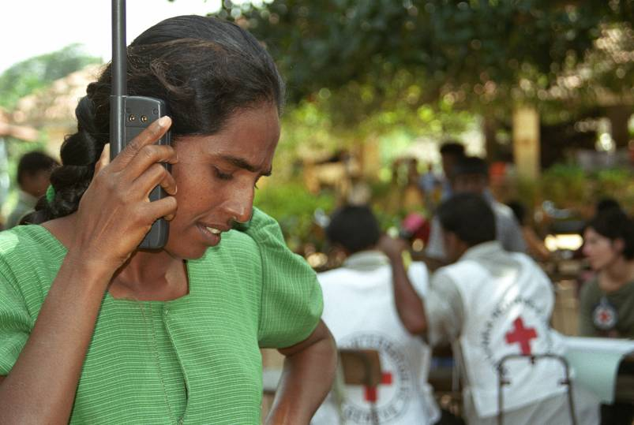
EMERGENCY COMMUNICATIONS
Common alerting protocol (CAP)
Consistent approach for the transmission of warning or alerting messages
Call prioritization for emergency calls in a disaster area
Emergency call numbers

Slide 14
WHY
JOIN ITU-T ?

Slide 15
Stay tuned to the latest technological developments
ITU-T carries out pioneering standards work in:
    Numbering resources
    Security of networks and of transmissions
    Broadband
    Optical networks
    Home networking
    Video coding and multimedia codecs

Slide 16
Anticipate the next revolutionary technology
ITU-T new work focuses on:
    Cloud computing
    Smart grid
    Intelligent transport systems
    Future networks
    Internet of Things

Slide 17
Break into new markets
Simultaneous acceptance of ITU-T standards by 192 member countries avoids going through cumbersome licensing procedures in multiple different markets
Approval of your technology as an ITU-T standard means a guarantee of faster market entry and deployment
Know in advance which other technologies are compatible and interoperable with your products and services

Slide 18
Connect with the world’s top ICT community
ITU-T meetings are a great way of connecting with new colleagues and competitors
Over 700 private sector members of ITU each with same rights and obligations
Several thousand experts from all over the world regularly participating in ITU work
Forge valuable contacts for anticipating market trends or problem-solving

Slide 19
Enjoy fast standards-making
Fastest approval process in ICT standards world
Open standards developed by industry members and respecting clear intellectual property policies
Global standards agreed through consensus
Coordination and complementary working with other standards development to achieve objective of interoperable, non-discriminatory, international standards

Slide 20
Become an ITU-T Member now
Join as an ITU-T Sector Member and get full access to all of ITU-T’s Study Groups, conferences and assemblies.
    Minimum annual fee: CHF 31,800
Join as an ITU-T Associate and get access to one Study Group only.
    Annual fee: CHF 10,600
    (CHF 1 approx $1)
    (CHF 1 approx $1)

Slide 21
Academia: bring your ICT ideas to life
New ITU-T membership category for
    Academia
    Universities
    Research institutes

Slide 22
Discover ITU-T activities designed for Academia
ITU-T Kaleidoscope academic conferences brings academia from all over the world together with industry to discuss future ICT networks and services
ITU-T Technology Watch surveys the ICT environment to identify emerging technologies and relies on members’ contribution to produce the TechWatch Reports
ITU-T runs an Internship Programme for students who wish to improve their skills and gain experience working in an international environment and learning about standardization work

Slide 23
Step into ICT leaders’ world
Access key standards and other information sources, facilities and databases
Access 192 governments/regulatory bodies from developed and developing countries
Seek out potential new sources of income and finance - eg patenting, or funding possibilities by major companies

Slide 24
Raise your profile on a global scale
Raise the profile of your academic institution and make practical use of your ideas
Raise the profile of your work with the opportunity of publication
See the advancement of your ICT innovations through worldwide recognition and adoption of global standards

Slide 25
Become a key player in ITU-T
Participate in ITU-T Study Groups and other ITU-T meetings on standards development
Influence global standards by submitting contributions, leading work, and taking part in consensus building
Boost your CV by becoming an Editor or Rapporteur of a Study Group
Access decision-making bodies of ITU-T and other high profile networking events

Slide 26
Enjoy special membership fee
Indian Universities/institutes can benefit from a reduced fee as Academia from developing countries
    Membership fee: CHF 1,987.50
    (regular membership fee CHF 3,975)
    (CHF 1 approx $1)

Slide 27
THANK YOU!
WE LOOK FORWARD TO WORKING TOGETHER FOR A SAFER, CLEANER, MORE EFFICIENT WORLD

