Slide 1
ITU-T
TSB Director’s Report: Highlights of 2010
Malcolm Johnson,
8 February 2011

Slide 2

PP-10: ITU-T Success
  Director TSB Malcolm Johnson reelected
  Approved strategic Plan for 2012-2015
  Approved financial Plan for 2012-2015
  ITU-T Vision: “ITU-T provides a unique worldwide venue for standardization of telecommunications and ICTs”
  Approved “Conformance and Interoperability” continuing the implementation of the recommendations of the TSB Director endorsed by Council 2009
  Approved its first Resolution (175) on accessibility: “Telecommunication/ICT accessibility for persons with disabilities, including age-related disabilities”
  PP-10 also confirmed on a permanent basis the current policy on free online access to ITU-T Recs

Slide 3
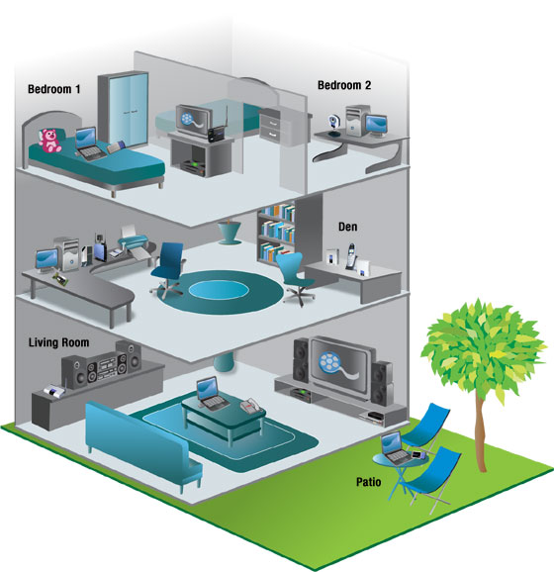
2010: A year of highlights
Study Groups
Many study groups saw increased participation, especially from developing countries
145 ITU-T Recommendations approved
Remote participation on the rise
  346 e-meetings
  769 online attendees
G.hn for Smart Grid

Slide 4
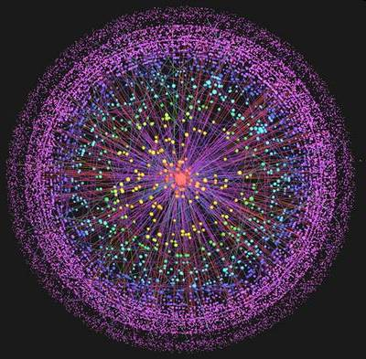
Focus Groups
Two new Focus Groups in April 10:
Focus Group on Smart Grid
Focus Group on Cloud Computing
FG CarCOM works on sub-system level requirements in car communication and requirements/testing of frontends used for speech recognition in cars.
Focus Group on Future Networks concluded its work December 10
Proposal for new FG on Driver Distraction

Slide 5
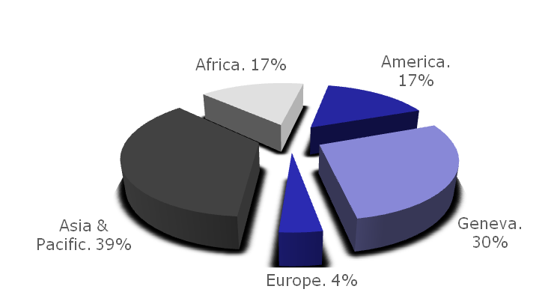

Workshops
23 events, 3100 participants
  Bridging the standardization gap
  E-health
  Cybersecurity
  Regional ITU Consultation on Conformance Assessment and Interoperability
  Green ICTs
  Accessibility
Fifth symposium on ICTs and climate change, Egypt
6th Fully Networked Car

Slide 6

Strong Support for Conformance and Interoperability Testing
WTSA Resolution 76 (Johannesburg 2008)
WTDC Resolution 47 (Rev. Hyderabad 2010)
PP Resolution 177 (Guadalajara 2010)
ITU-T to implement without delay Council-09 endorsed:
  Conformity assessment programme
  Interoperability programme
  Human resources capacity building
  Assistance in the establishment of test facilities in developing countries
ITU-T IPTV Interoperability Events
Geneva, Singapore, Pune
Regional ITU Consultations Quito, Nairobi, Sydney

Slide 7























Chief Technology Officer (CTO) meeting
Twenty-three major CTOs...
...called for immediate steps to streamline and modernize the standards landscape

Slide 8

Four Technology Watch
Reports Issued
Decreasing Driver Distraction
ICT as an enabler for smart water management
Using submarine communications networks to monitor the climate
Standards and e-health

Slide 9

Bridging the
Standardization Gap
One of the three strategic goals of ITU-T
Focus on human resource capacity building
Tutorials (role play) on standardization – Malaysia and India
Major two week event:
Tutorial on Optical Fibre Cables and Systems, Rwanda
Tool for Assessing Standards Capability (TASC)
BSG Fund for 2011: CHF 239,000
ITU-T Sector membership fee for Sector Members from developing countries with annual per capita income of less than USD 2 000 according to the UNDP classification:
CHF 3,975
PP-10 agreed that academia and universities can participate in the work of ITU at a reduced fee: CHF 1987,50 for universities from developing countries

Slide 10

Accessibility
30 events since last TSAG
PP-10 approved a new Resolution 175 Telecommunication/ICT accessibility for persons with disabilities, including age-related disabilities
ITU to provide accessibility to ICTs, and to ITU facilities and services, for participants with visual, hearing or physical disabilities
Voluntary fund to assist disabled participants

Slide 11


ICTs and Climate Change
PP-10 approved new Resolution 182 on climate change and the protection of the environment
A strong mandate for
ITU-T to show leadership
Methodology to measure impact of ICT on CC
Universal charger

Slide 12
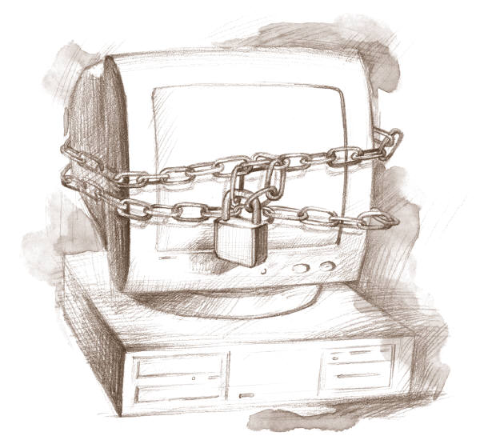
Safety in the cyber world
SG 17: 150 active work items
Rev. Res 130 Strengthening the role of ITU in building confidence and security in ICTs
Res 181 Definitions and terminology relating to building confidence and security in ICTs
  ITU-T: To intensify work in ITU-T study groups
  ITU-T: To address existing and future threats and vulnerabilities
ITU to work towards a possible MoU to strengthen cybersecurity
Cybersecurity Information Exchange Framework (CYBEX)

Slide 13
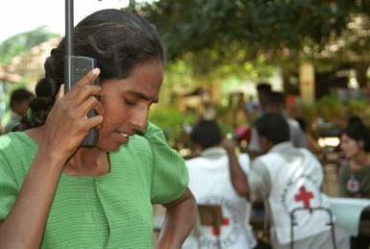
Emergency Communications
Work done in particular by Study Groups 2, 11, 13, 16, 17
ITU-T is assisting the World Meteorological Organization (WMO) in the organization of the third of a series of workshops promoting the adoption of X.1303 CAP (Common Alerting Protocol)
ITU has deployed satellite terminals to
help restore communications in the
aftermath of disasters around the world... Including recently in Haiti, Pakistan and Indonesia

Slide 14






Liaison and collaboration
World Standards Cooperation
  Fully Networked Car
  WSC Academia Week
  Newsletter published
GSC-15 took place in 30 August – 2 September 2010 in Beijing
ITU-T and IETF
  Leadership meeting
ITU-T & ISO/IEC JTC1
  Leadership meeting
Update MoU with ETSI
TSB Board Member ICANN

Slide 15

Involving future engineers
PP-10 agreed that academia and universities can participate in the work of ITU at a reduced fee (CHF 1987 developing, CHF 3975 developed)
3rd Kaleidoscope event: Beyond the Internet? Innovations for future networks and services Pune, India, December 2010
Fully Networked Human? , South Africa, December 2011

Slide 16

ITU-T/TSB Tools
Establishment of the liaison statements database
Enhanced work programme interface
Meeting documents sync application
XML extraction tool associated with terminology insertion to the ITU Terms and Definitions Database
Upgraded WiFi infrastructure
Improved facilities for hybrid and remote meetings

Slide 17
Essence of Internet Resolutions
ITU “to explore ways and means for greater collaboration between ITU and relevant organizations including, but not limited to, ICANN, the RIRSs, IETF, ISO and W3C on the basis of a reciprocity
… to increase the role of ITU in Internet governance …”
Director TSB to review the current structure and possibly propose a new study group or group to work on technical issues of telecommunication networks to support the Internet

Slide 18
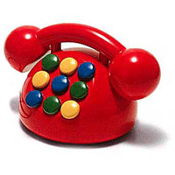
Child Helpline
New Resolution 179 on ITU's role in child online protection instructs TSB Director
  To encourage ITU-T Study Group 2 to continue exploring the option of introducing a single globally harmonized telephone number in the future

Slide 19
Human exposure to and measurement of electromagnetic fields
New Resolution 176 instructs the Director of BDT in collaboration with the Directors of BR and TSB:
  To organise regional seminars and workshops
  To encourage Member States to cooperate in sharing expertise and Resources

Slide 20

NGN Deployment in Developing Countries
Resolution 137 Instructs the Directors of the three Bureaux
  “to continue and consolidate their efforts on NGN and future networks (see the work of the ITU-T SG 13 Focus Group on future networks) deployment studies and standards development activities, particularly those designed for rural areas …”

Slide 21
ITRs and the World Conference on International Telecommunications (WCIT)
PP-10 confirmed Council’s decision to hold a World Conference on International Telecommunications (WCIT) back-to-back with WTSA (October/November 2012)
WTSA will again be preceded by a 1-day Global Standards Symposium
WCIT will consider new and emerging issues for updating International Telecommunication Regulations within its scope and purpose

Slide 22
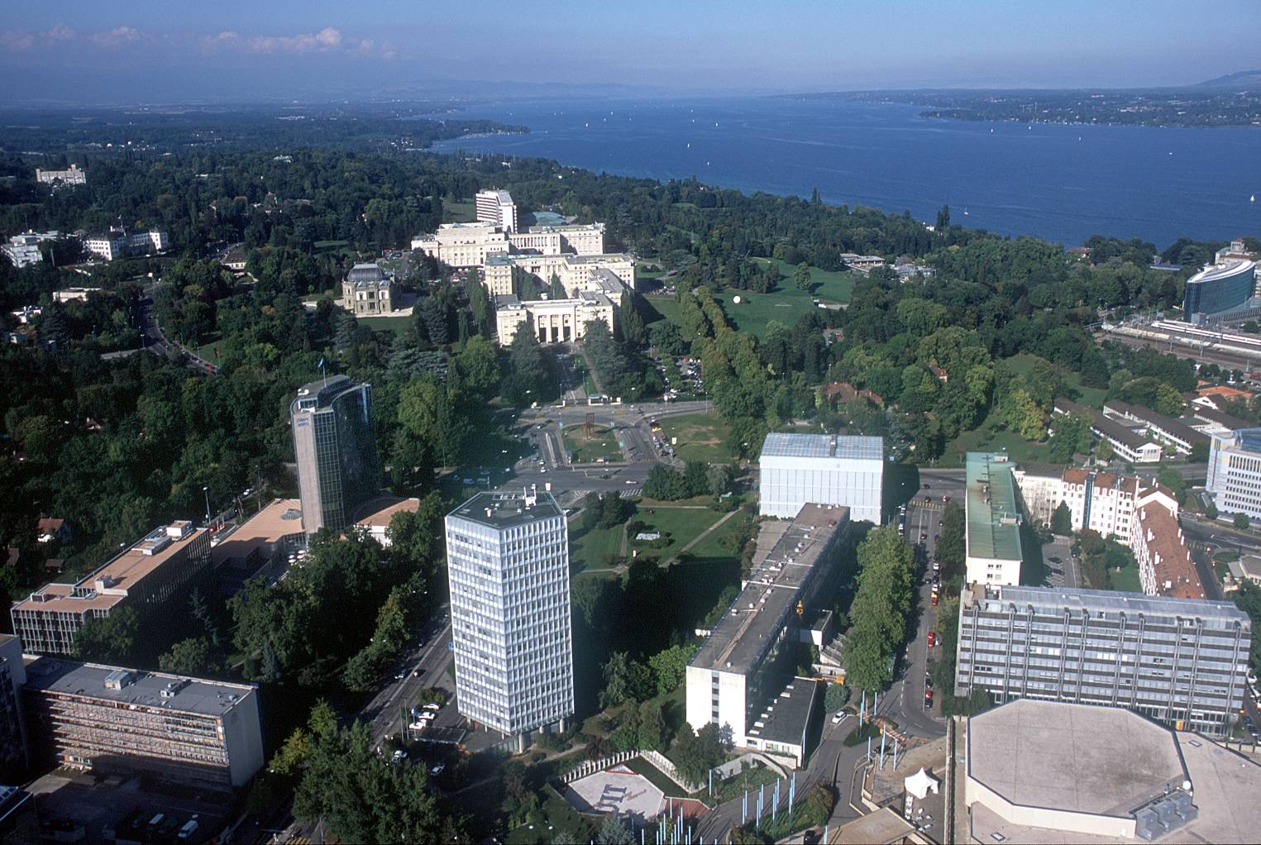
malcolm.johnson@itu.int

