Slide 1
IPTV Overview
Presented by Paul Ashun
TV Platforms Group
© BBC 2008

Slide 2
IPTV Overview
Chapters:
  What is IPTV (as opposed to internet TV) ?
  What is VOD (as opposed to IPTV)
  Middleware and Video
  Common IPTV Models
  Demos / Examples
  Other factors
  7. Questions
© BBC 2008

Slide 3
What is IPTV
(and what is
internet TV)
© BBC 2008

Slide 4
1a - What is IPTV
Still evolving
Digital TV delivered using technologies used for computer network. Internet Protocols (http, rtsp, igmp)
A TV like ‘quality of service’ (always on, reliable)
Can be ‘live’ or pre-recorded (on-demand)
Usually over a managed/closed network
Eg. Virgin TV, Tiscali TV, BT Vision
© BBC 2008

Slide 5
1b - What is Internet TV
Digital TV delivered using technologies used for computer network. Internet Protocols (http, rtsp, igcmp)
No guaranteed ‘quality of service’
Usually delivered via open-internet / un-managed network
Eg. YouTube, BBC iPlayer on browser/PC
© BBC 2008

Slide 6
1c – Managed Networks
Control over
  bandwidth allocation
  contention ratio
  content
}
Controlled
‘quality of service’
© BBC 2008

Slide 7
1d – Open Internet (Unmanaged networks)
}
  Variable bandwidth
  Higher contention ratio (20:1)
  Less control over content
Little control over
‘quality of service’
© BBC 2008

Slide 8
1e – Open Internet (Unmanaged networks)
The BBC is working to ensure quality of service with ISPs. This will possibly change the definition of IPTV through the consensus that the quality of service is good over the open internet
© BBC 2008

Slide 9
Open Internet
Managed Network
YouTube
Virgin
VOD
TV iPlayer
(on Virgin)
PC
iPlayer
Tiscali TV
BT Vision
FreeSat
Orange TV
© BBC 2008

Slide 10
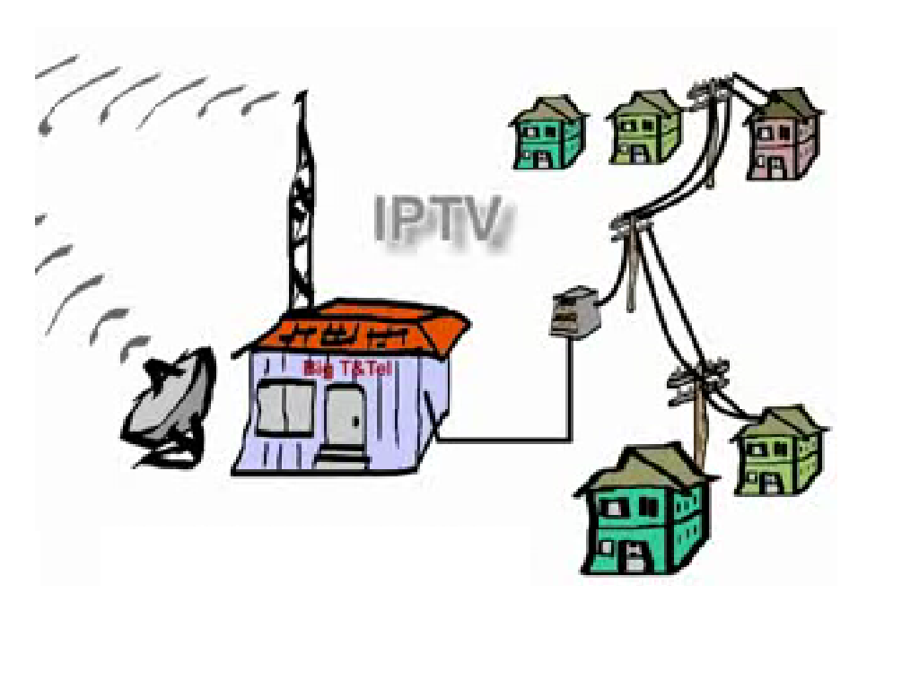
How to capture/create IPTV
Copper wire /
fibre
Head end to
Capture TV
Compression/
Encoding/
Encryption
© BBC 2008

Slide 11

IPTV over the network cloud
Mobile
Device
Wifi / wimax
Computer
ADSL
Network
ADSL
Hybrid fibre coax
Set-top Box
Cable Set-top Box
Freesat
Tiscali
BT Vision
[Orange TV]
Protocols
- http
- rtsp
- igmp
Virgin
© BBC 2008

Slide 12
Why IPTV and not Broadcast
Two-way data flow (video on demand)
Greater personalisation / tailored advertising
Combined features
  Voice over IP
  Messaging/Recommendations
  Chat around content
© BBC 2008

Slide 13
IPTV- Key Protocols
HTTP
RTSP
IGMP
Request
Firefox, Internet Explorer
(hyoer-text-
transfer-protocol)
Response
play
pause
Real Player, Windows Media Player
(streamed video)
(real time streaming
protocol)
record
- connecting to multicast stream (TV channel)
- changing from one channel to another
(internet group
management
protocol)
© BBC 2008

Slide 14
What is
VOD
© BBC 2008

Slide 15
2a - What is VOD
Select and watch video content (usually over a network)
Either content is streamed or downloaded with/to the application
Apps have a subset of VCR functionality including RWD, Pause, FFWD etc.
Push VOD – delivered to set top box from broadcaster
© BBC 2008

Slide 16
2b - What is VOD
Not necessarily over IP. Eg. Push VOD
Push VOD – delivered to set top box from broadcaster
Eg. BBC iPlayer, YouTube, BBC Archive, Rimokon quiz, Tiscali, BT vision
© BBC 2008

Slide 17
Middleware
And
Video Codecs
© BBC 2008

Slide 18
3a – Middleware
  Set-top box software that allows us to write applications
  Affect application capabilities
© BBC 2008

Slide 19
3b – Middleware
Middleware
  MHEG – (Freeview / Freesat)
  Liberate – (Virgin)
  ICTV/other – (once trialled by Tiscali; used by US web sites)
  HTML/JavaScript (KIT/Proprietary operators)
  Mediaroom (BT Vision)
© BBC 2008

Slide 20
3c – Codecs
Compression/Decompression
File extension specifies codec used to compress/decompress
Lossy/Lossless
© BBC 2008

Slide 21
3d – Codecs
Codecs
  H.264
  MPEG4
  MPEG2
  WMV9
© BBC 2008

Slide 22
H.264
1. Up to 50% in bit rate savings: Compared to H.263v2 (H.263+) or MPEG-4 Simple Profile, H.264 permits a reduction in bit rate by up to 50% for a similar degree of encoder optimization at most bit rates.
2. High quality video: H.264 offers consistently good video quality at high and low bit rates.
3. Error resilience: H.264 provides the tools necessary to deal with packet loss in packet networks and bit errors in error-prone wireless networks.
4. Network friendliness: Through the Network Adaptation Layer, H.264 bit streams can be easily transported over different networks.
© BBC 2008

Slide 23
IPTV/Internet TV Platforms/Operators
OPERATOR | MIDDLEWARE | CODEC | DELIVERY NETWORK | MANAGED NETWORK
Tiscali | (client-side Java) | h.264 | ADSL | YES
BT Vision | Mediaroom | h.264 | ADSL | YES
Virgin | Liberate (Seac-change) | Mpeg 2 | Hybrid fibre co-ax | YES
Freesat | MHEG 1.06 turbo | Not implemented | Any – dependent on isp | NO
Freeview (other than BT vision) | MHEG | Dependant on ISP | Any – dependent on isp | NO
© BBC 2008

Slide 24
Common
IPTV/VOD
models
© BBC 2008

Slide 25
6a – Common models
Server Side Video / Client Side Application
Server
(contains video)
Disadvantages
Slower to load video
Longer round trip to server
battling against bandwidth
Advantages
Greater capacity for video
on servers than set-top/pc
Instructions for video
(play, ff, rw, pause)
are sent to server
Streamed Video
Set Top Box
Contains:
- application code previously downloaded
© BBC 2008

Slide 26
6b – Common models
Server Side Video / Server Side App
Server
(contains video and app)
Disadvantages
Slower to load video/app
Longer round trip to server
battling against bandwidth
/contention ratio
Advantages
Greater capacity for video
Larger app size for
more functionality
Instructions for video
(play, ff, rw, pause)
AND to navigate the app
are sent to server
Streamed Video
AND
Streamed Application
Set Top Box
contains:
- no storage in the box
© BBC 2008

Slide 27
6c – Common models
Client Side App / Client Side Video
Set Top Box/PVR
Disadvantages
Inability to leverage server
for capacity.
Advantages
Quick seamless transitions
between video and scenes.
Store app locally and take
box from a to b (i.e. to
a friends house)
contains:
  application code previously downloaded
  video previously downloaded
© BBC 2008

Slide 28
6d – Common models
Peer-to- Peer Video / Client Side Application
video
video
video
video
Set Top Box/PVR
Disadvantages
Longer round trip to through network
Advantages
Leverage other PC/set-tops with the same video
for speedy download
contains:
  application code previously downloaded
  video streamed from other pcs/boxes
© BBC 2008

Slide 29
Middlewares on devices
IPTV
PC
MOBILE
STB
Liberate
ICTV
BROWSER
APP
MHEG 1.06
MHEG Turbo
Joost
Bablegum
Mozilla
IE
Windows Media Player
MEDIA ROOM
Flash
Real Player
© BBC 2008

Slide 30
Other
Factors
© BBC 2008

Slide 31
7 – Other Factors
Digital Rights Management (DRM)
Security (logging in / privacy)
Messaging
Mobile Devices
Authoring
Video Delivery
Games consoles
User experience & design
© BBC 2008

Slide 32
IPTV Overview
Thanks for your time
Any Questions ?
© BBC 2008

