Slide 1
Screenshots with the ArcGIS API for JavaScript & html2Canvas
Ryan Libed
Notes:
Esri Corporate Template-Dark v3.4
16:9 version – January 29, 2017
For more templates, sample files, and icons, see https://compass.esri.com/resources/presentations/Pages/Main.aspx
To add footer text in Windows
On the Home tab, under Insert, click Text, and then click Header and Footer.
Click the Slide tab, select the Footer check box, and then type the footer text that you want.
Click either Apply or Apply to All.
To add footer text on a Mac
On the View menu, select Header and Footer.
Select the Footer check box and then type the footer text that you want.
Click either Apply or Apply to All.
If footers don't appear on the slides
If footers don't appear on title slides, in the Header and Footer dialog box make sure the Don't show on title slide check box is not selected.
If the footers are missing from other slides, the placeholders for these items might have been removed from specific slide layouts or the slide master.

Slide 2
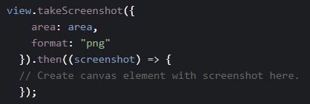
ArcGIS API for JavaScript 4.x – takeScreenshot()
2019 Esri Developer Summit – SpeedGeeking

Slide 3
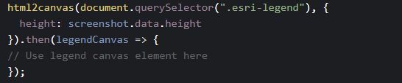
html2Canvas
2019 Esri Developer Summit – SpeedGeeking

Slide 4
Demo
Custom screenshot widget

Slide 5
Thank you!
Visit link below to get access to this PowerPoint presentation, a ‘How-To’ blog, and a GitHub repository to the custom screenshot widget
https://github.com/rslibed/DevSummit2019
Additional links
ArcGIS API for JavaScript ‘takeScreenshot’ Sample Code: https://developers.arcgis.com/javascript/latest/sample-code/sceneview-screenshot/index.html
html2Canvas: http://html2canvas.hertzen.com/

