Slide 1

Predicting Student Performance with Machine Learning
MGTA 452: Collecting and
Analyzing Large Data
Abhishek Nigam
December 4, 2024

Slide 2

Contents
Introduction
Objectives
Understanding the Data
Regression Model
Applications
Conclusion

Slide 3
Introduction
An EdTech company has been experiencing a decline in student’s exam scores.
To address this issue, the EdTech company aims to analyze the extensive student data it has collected over the years. The goal is to provide data-driven recommendations for improving student performance and enabling them to achieve outstanding scores.

Slide 4
Objectives
Identify Key Performance Drivers: Analyze and pinpoint the critical factors contributing to student success, providing actionable insights to refine instructional methods and optimize resources.
Predict Exam Performance: Utilize socio-economic, behavioral, and academic data to accurately forecast student performance, enabling targeted support and strategic improvements in course content.
Develop a Personalized Intervention Tool: Create a solution for the EdTech company’s course that offers tailored recommendations and resource allocation for students. This tool will enable personalized guidance, enhancing student satisfaction and success rates, which can attract new students to the company’s course.

Slide 5
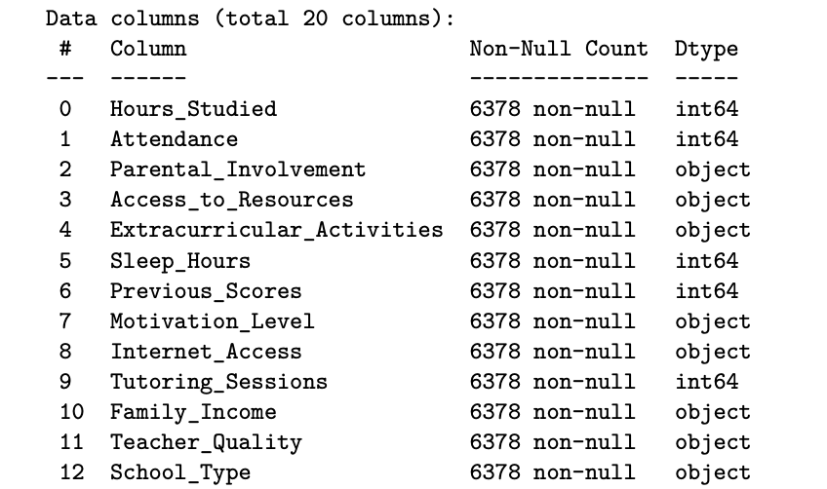
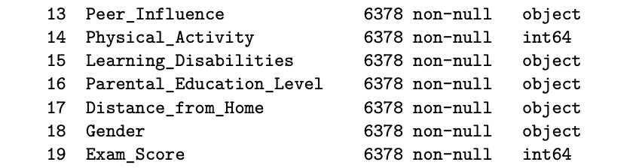
Understanding the Data
1. Dataset and Features:
The dataset “StudentPerformanceFactors.csv” includes features like Parental Involvement, Access to Resources, Hours Studied, Attendance, and Previous Scores.
Target variable: Exam_Score (student performance).
Categorical variables such as were encoded to converted them into binary variables (One-Hot Encoding)
Numerical variables were scaled using Standard Scaling to adjust mean and variance.
Dataset Source: kaggle.com

Slide 6
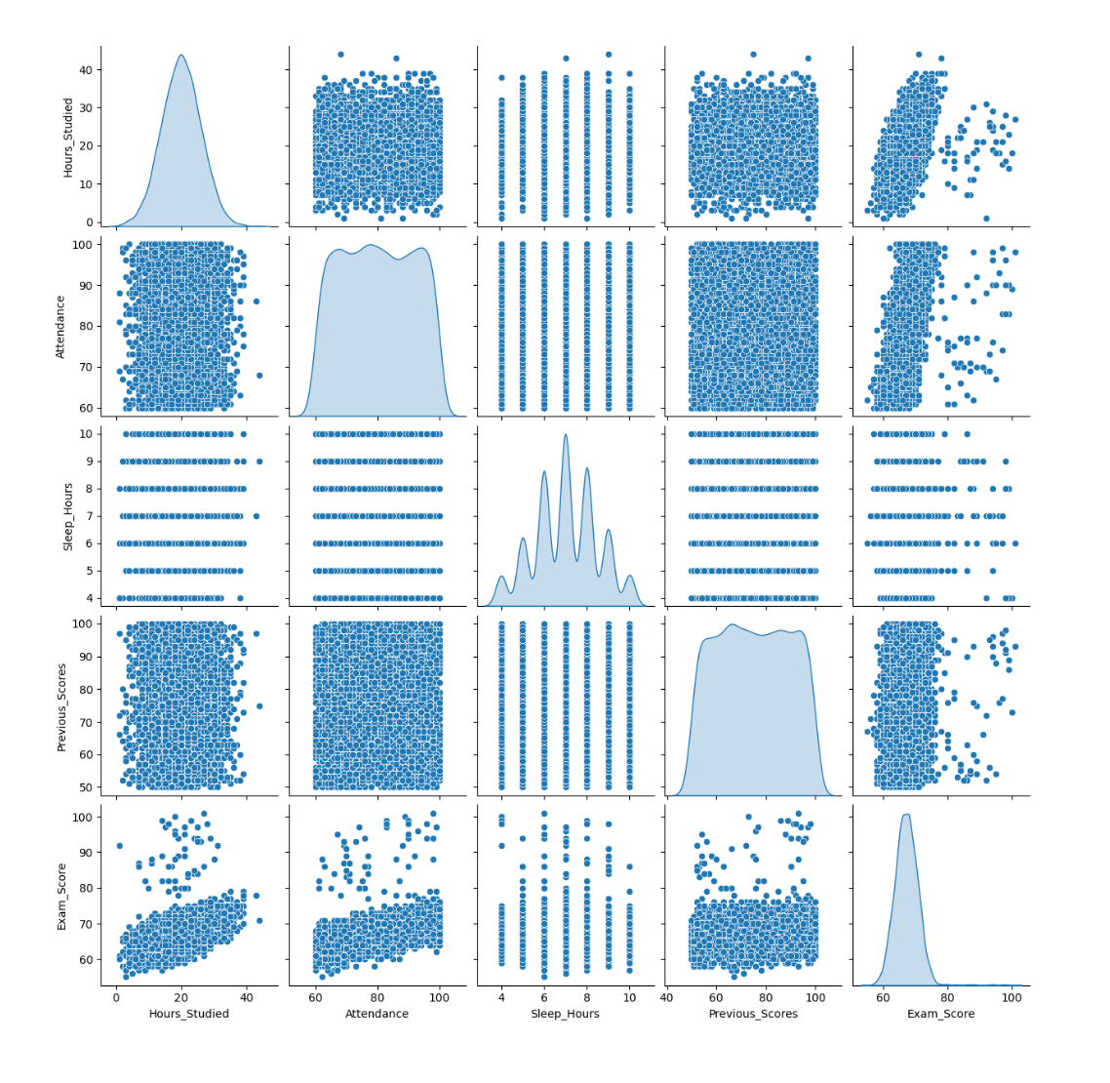
Relationships and distributions of the numerical features to identify patterns, correlations, and trends that may impact the target variable “Exam_Score”.
The pairplot reveals positive relationships between features like Hours_Studied, Attendance, and Previous_Scores with Exam_Score, while also highlighting feature distributions and potential outliers.

Slide 7
Regression Model
Model Development: A Linear Regression model was trained on 80% of the data and tested on the remaining 20%.
Feature Importance: Factors such as Hours Studied, Previous Scores, and Attendance have the highest influence on exam scores.
Regression Equation: The model's equation highlights the contribution of each factor, allowing educators to focus on areas with the greatest impact.
Model Accuracy: The Mean Absolute Error (MAE), Mean Squared Error (MSE), Root Mean Squared Error and R squared show that the prediction accuracy is good.
Mean Absolute Error (MAE): 1.05
Mean Squared Error (MSE): 5.27
Root Mean Squared Error (RMSE): 2.30
R-Squared (R²): 0.66
Residual Plot: No clear pattern or trend is seen. No Heteroscedasticity observed.
Multicollinearity: VIF of most of the variables is < 5.

Slide 8
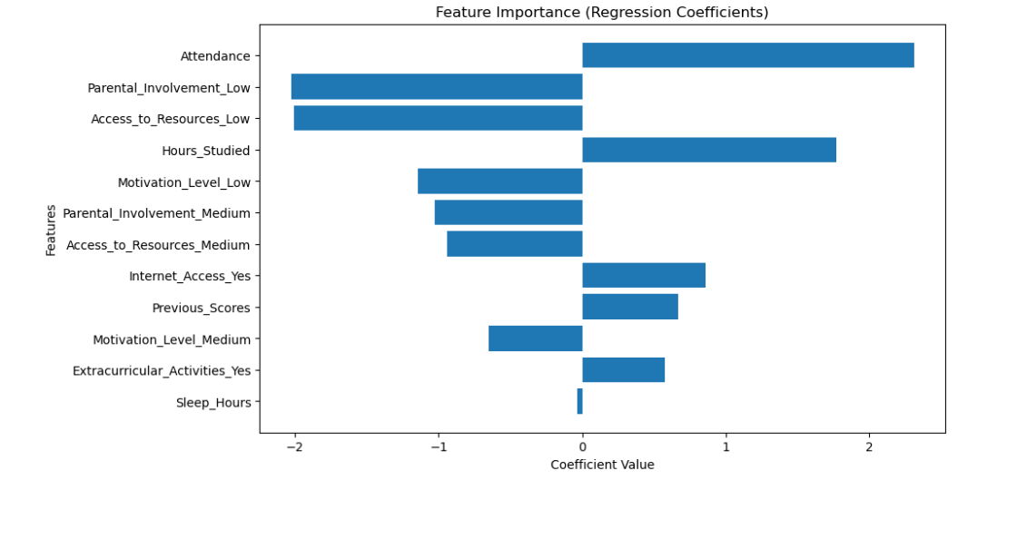
Feature Importance Plot
Interpretation:
This plot reveals the most impactful features.
It shows how important each feature is based on its regression coefficient.
Features with higher coefficients have a stronger impact on the target variable.

Slide 9
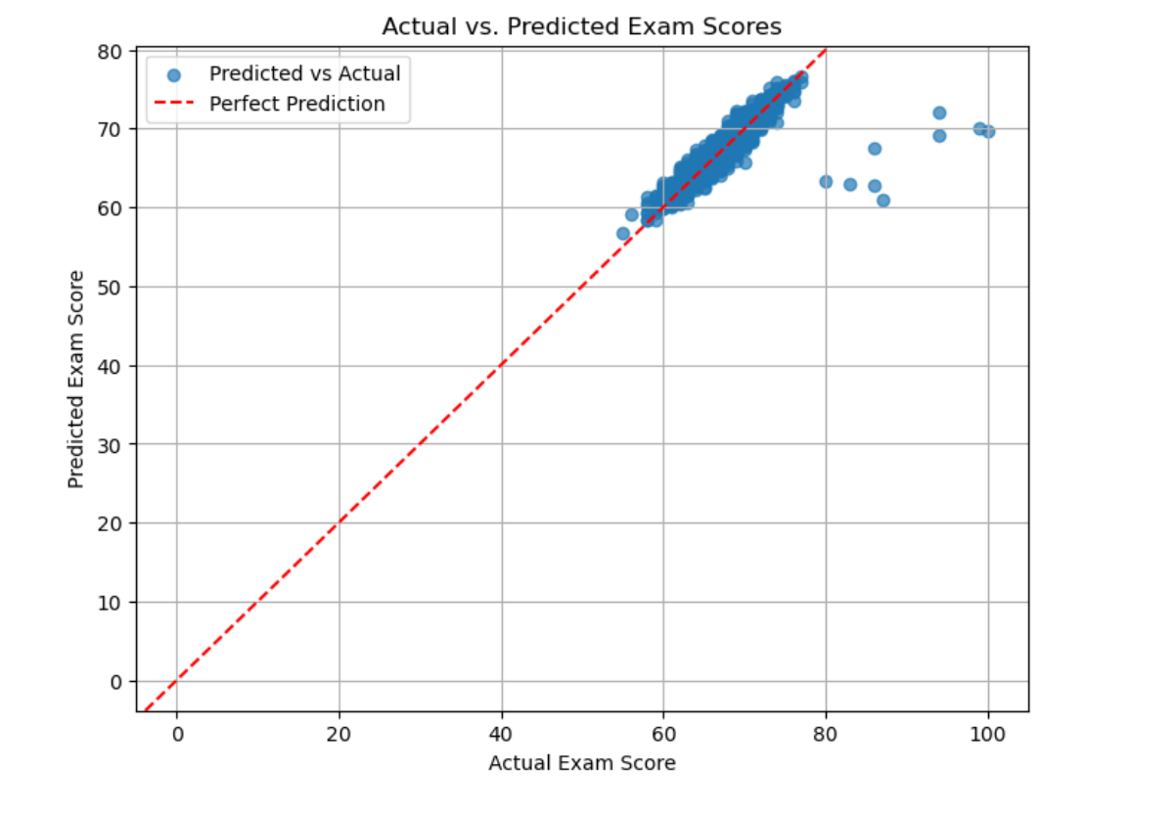
Comparing the actual and predicted exam scores to assess the model’s accuracy.
Interpretation:
Shows how important each feature is based on its regression coefficient.
Features with higher coefficients have a stronger impact on the target variable.
A tighter clustering around the red diagonal indicates better predictions.
Quantify model performance using RMSE.

Slide 10
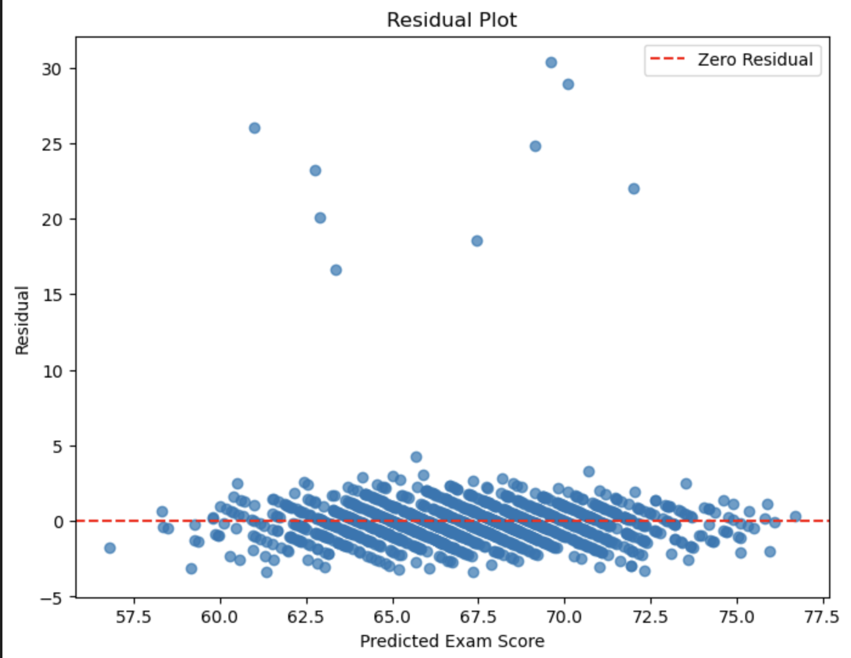
Residuals are distributed randomly around zero, indicating a well-fitted model.
Interpretation:
Residuals represent the difference between actual and predicted values.
In this model residuals are randomly distributed around zero.
Indicating the linear regression model is appropriate.

Slide 11
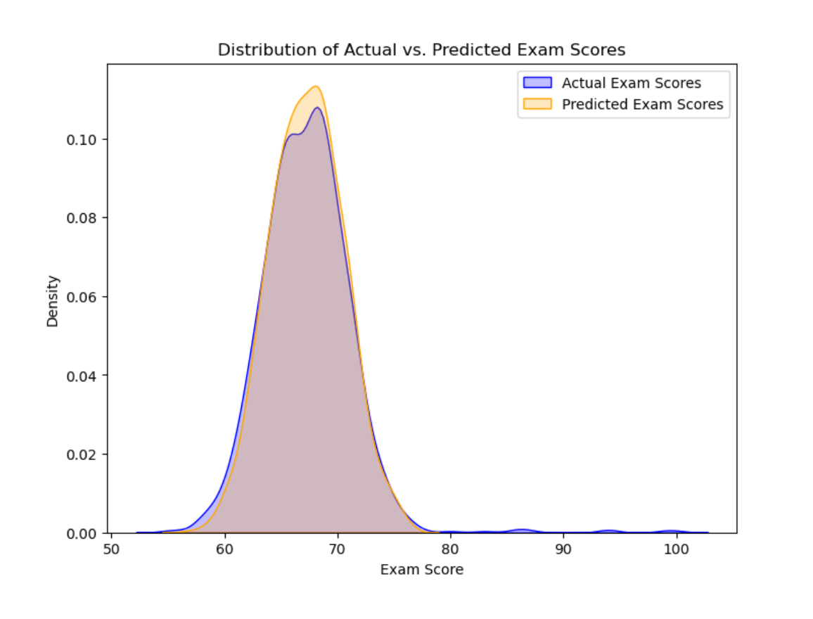
Distribution of Actual vs Predicted Exam Scores
Interpretation:
Compares the actual and predicted exam scores to assess the model’s accuracy.
Determine whether the model captures the distribution of actual scores accurately.
Visualize how well the model predicts Exam_Score by comparing actual values against predicted values.

Slide 12
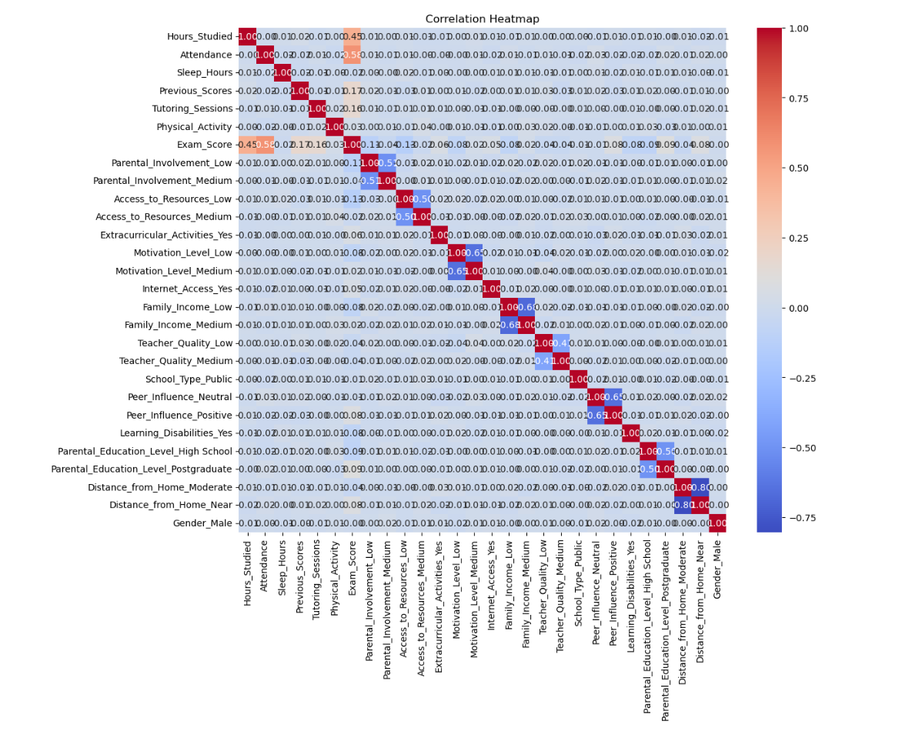
Multicollinearity among features
Interpretation:
Visualizes correlations between features and the target variable.
No strong correlations between the top variables utilized for the regression

Slide 13
The model can be used to make a custom prediction tool with recommendations
Custom Prediction Function:
A custom prediction function allows the EdTech company to input student-specific data (e.g., hours studied, attendance, etc.) and receive a predicted exam score, aiding personalized interventions.
Based on the output, the company can:
Increase the students’ attendance by using various marketing campaigns.
Develop personalized student plans to boost hours of studying for student who require morse tutoring
Integrate the output of the tool into learning management systems, so that students can view predicted scores as work on their performance.

Slide 14
Conclusion
This project successfully demonstrates how machine learning can be applied to predict and analyze student exam performance. It provides valuable insights into the factors influencing academic success, supporting data-driven decisions in education.
By using this model the EdTech company can provide personalized study plans to their students to help them achieve outstanding scores in exams.

