Slide 1
ETL Overview

Slide 2
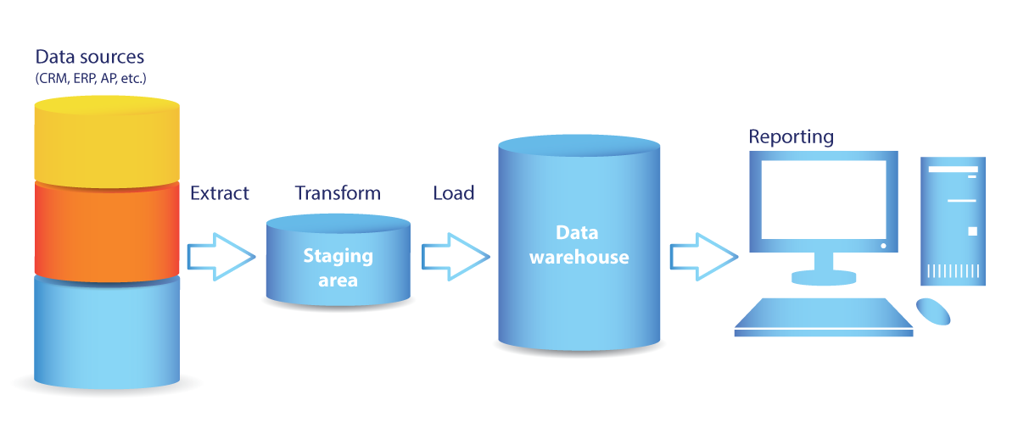
ETL (Extract, Transform, and Load)
A process for extracting data from data sources into staging areas where the data are transformed and then loaded into an analytics oriented data storage.
Notes:
9

Slide 3
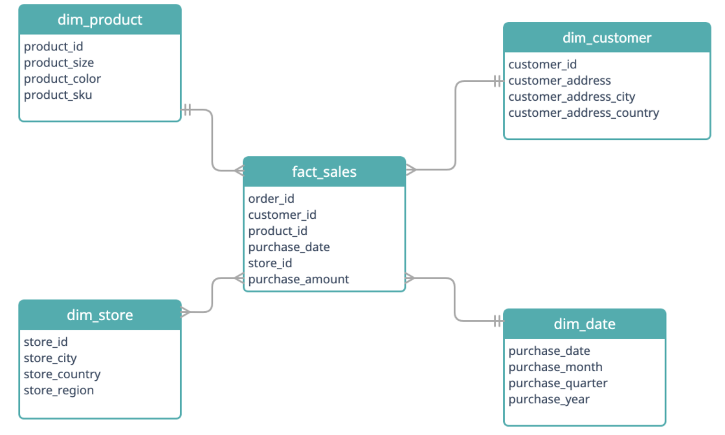
Star and Snowflake Schemas
Data warehouse typically stores denormalized data structured using a Star or Snowflake Schema
Star Schema
Notes:
9

Slide 4
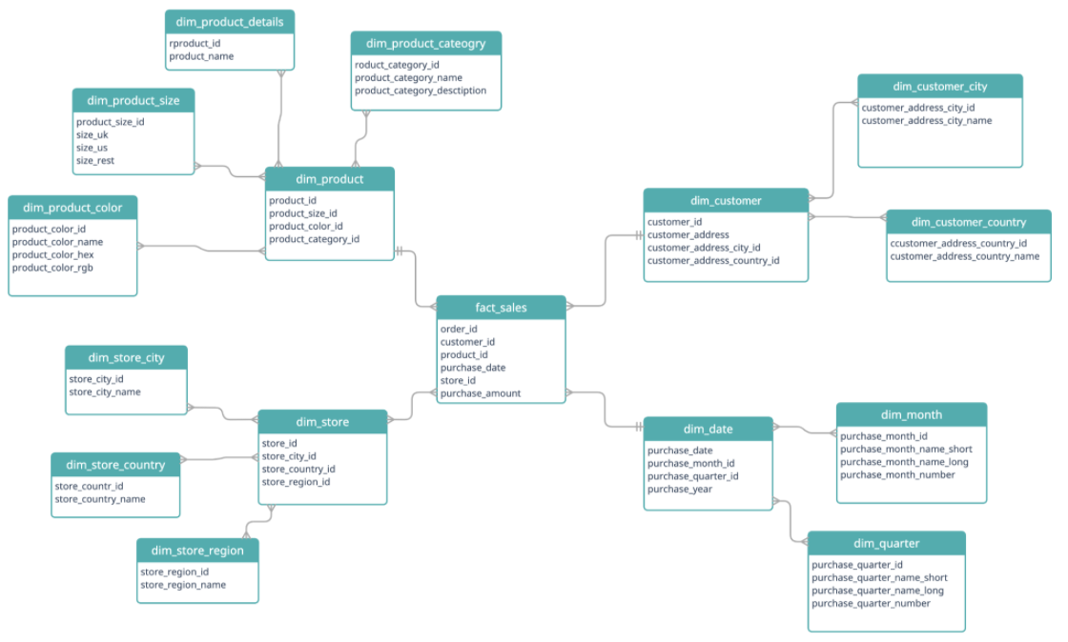
Star and Snowflake Schemas
Snowflake Schema
Notes:
9

Slide 5
Transformation
In these systems, a major step during transformation is focused on denormalizing the data to fit the date warehouse schema.
Other transformation tasks include data cleaning, data aggregation, data blending, changing data types, etc.
Notes:
9

Slide 6
Increasing Amount and Complexity
Additional data sources (social network, internet of things, web analytics, weather data, etc.)
Additional data types, e.g., semi-structured and unstructured data, increased
ETL processes becoming extremely complex
Both storage and compute resources approach their limits
ELT is increasingly common
ETL still useful, but typically for “smaller” databases with fewer data sources and more complex transformation requirements
Notes:
9

Slide 7
LEGACY data landscape
Data Sources
BI / Analytics
ETL
OLTP Databases
EDW
Datamarts
Enterprise Applications
Third-Party
Web Apps
Other
Data Lake
or Hadoop

Slide 8
Modern data landscape
Data Sources
BI / Analytics
ETL or ELT
OLTP Databases
EDW
Logical Datamarts
Enterprise Applications
Third-Party
Web Apps
Other
Data Lake
or Hadoop

Slide 9
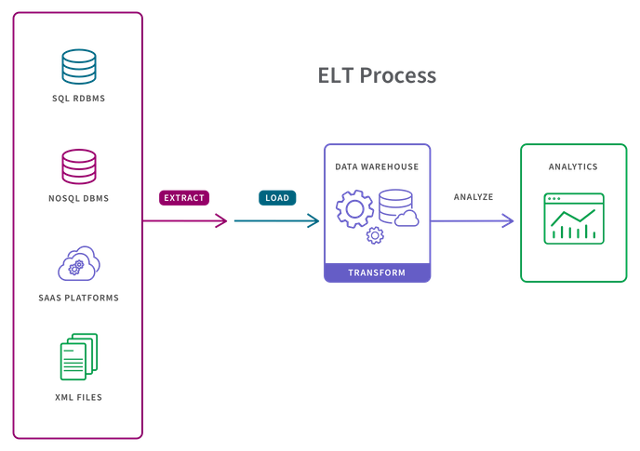
Extract, Load, and Transform
Data are extracted and loaded into data storage in its raw format. More limited transformation is done inside the data storage and then on an as-needed basis
Notes:
9

Slide 10
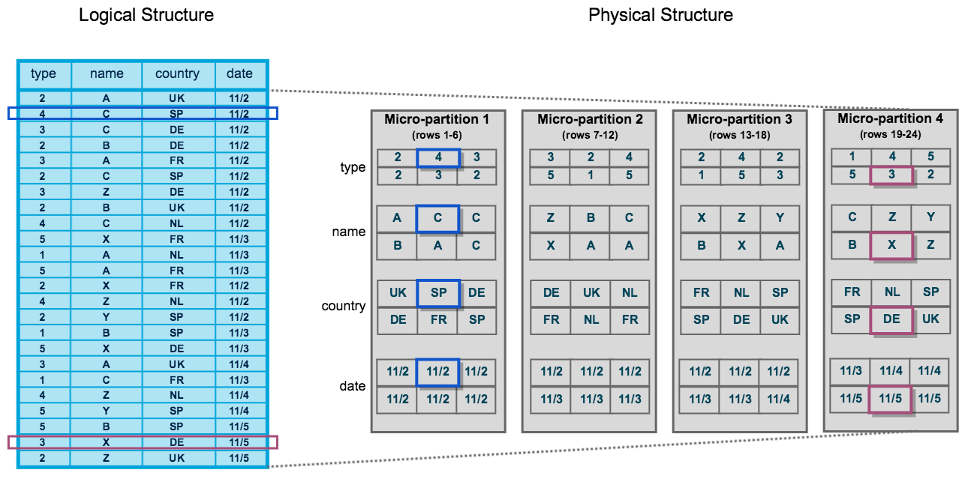
Extract, Load, and Transform
Snowflake stores rows in micro-partitions. Snowflake keeps meta-data about the micro-partitions including the range of values for each column in the partition.
When searching, the meta data is used to select micro-partitions to access
Notes:
9
Micro Partitions and Column Store
By storing rows in micro partitions by column within the micro-partition, and keeping meta-data including range of values for all columns stored in the partition, when a query is executed not all partitions have to be accessed (this is referred to as pruning). After the meta-data has been used to identify partitions that contain the search values, these partitions are read and then searched. The column store allows for faster searching (and further pruning) of this data as only the column involved in the search has to be examined. Assuming values from other columns are also required (not for searching but in the result), after matching elements have been identified, the keys for these values can be used to find corresponding elements for the other needed columns (that have already been placed in memory as the entire micro-partition was read, which makes it quick to access other column elements that correspond to the keys identified in the search).
Compression
Further, columns are also compressed individually within micro-partitions, e.g., instead of storing 11/2 6 times in micro-partition 1, it can be stored once and a list of 6 keys can be stored with the one value. This reduces storage and makes it quicker to search the column.

Slide 11
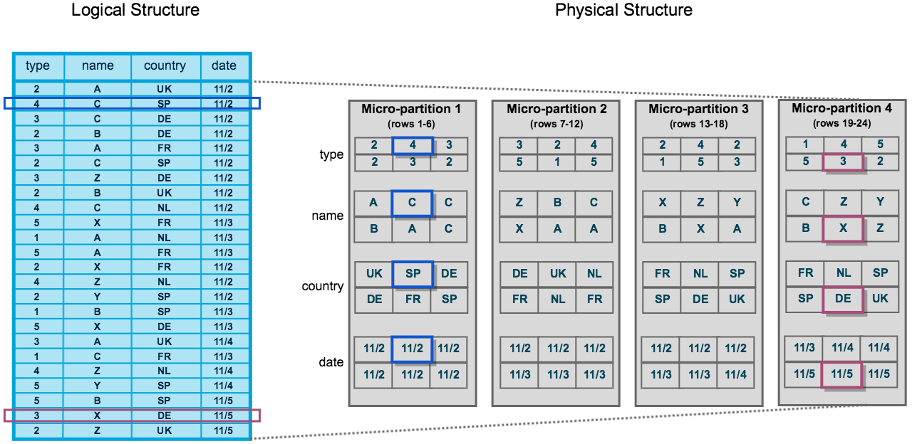
Extract, Load, and Transform
The data in the micro-partitions are stored in a column oriented structure.
Column storage enables efficient scanning of individual columns (only columns referenced by a query are scanned)
Columns are compressed individually within micro-partitions, e.g., instead of storing the date '11/2' 6 times in micro-partition 1, 11/2 can be stored once and have a list of row keys
Notes:
9

Slide 12
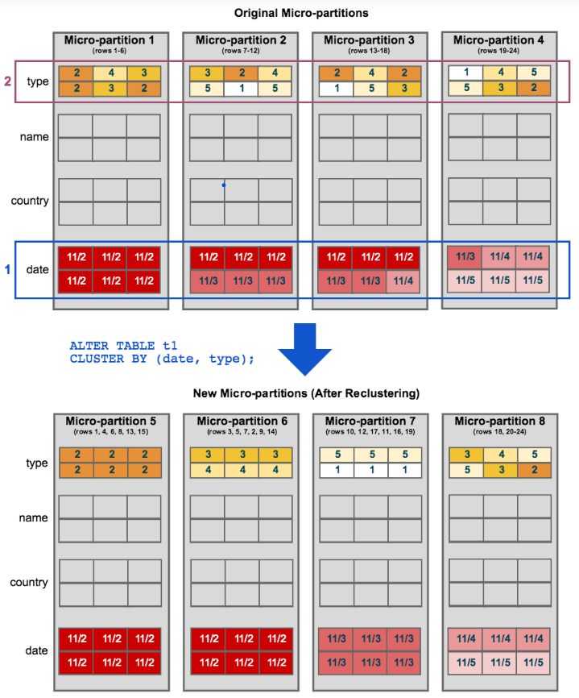
Extract, Load, and Transform
Data Clustering
Snowflake typically orders the stored data along a clustering key, which Snowflake identifies automatically (it can also be done manually if needed).
Effective clustering results in fewer micro-partitions needing to be access when the data are scanned.
Notes:
9

