Slide 1

Measuring What Actually Drives Kikoff's Growth
UC San Diego Rady MSBA — Capstone 2026 · Executive Summary
Yash Tiwari · Chunjiang Liu · Shivang Bhatt · Yoko He May 2026
Notes:
Executive summary of the Kikoff Marketing Mix Model capstone — built by the UC San Diego Rady MSBA team. Six slides covering problem, approach, what we built, current findings, and path to final delivery.

Slide 2

Platform Attribution Costs Kikoff Precision on $112M in Annual Spend
The Problem
What Breaks at Scale
What We're Solving
$112.87M in modeling-window spend
Last-touch credits the final click, not the cause
Each platform self-reports ROAS — all overclaim
Pulling Meta spend repeatedly hurts growth within a week
Yet platform dashboards show flat attributed conversions
Budget decisions rest on incomplete attribution signals
Causal attribution at channel x platform level
Diminishing-return curves per channel for budget reallocation
Defensible model anchoring the next planning cycle
2
Notes:
Kikoff spends roughly $112M annually across more than ten marketing channels. Current attribution relies on last-touch and platform-reported numbers — both of which overclaim. The operational signal that gave the team conviction this matters: every time Meta spend is pulled back, growth slows within a week, yet platform dashboards don't show that swing. Closing that gap is what the model exists to do.

Slide 3
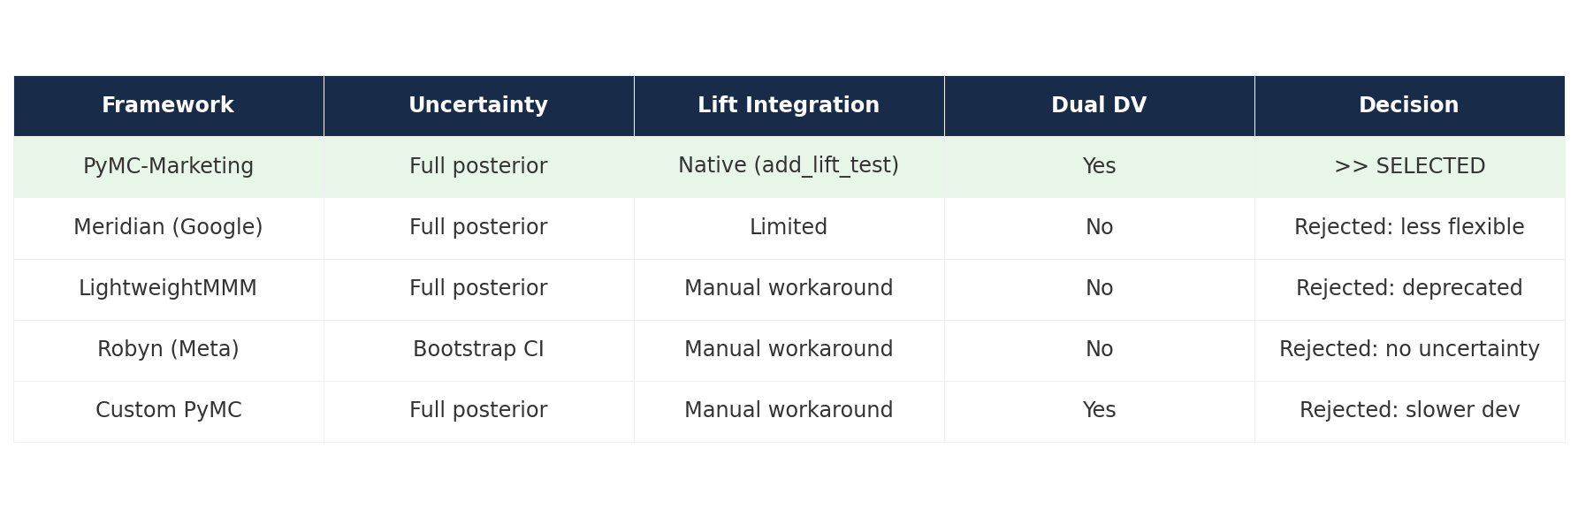
Full-Channel Bayesian MMM with Time-Limited Lift-Test Priors
What we built:
• Bayesian MMM — not linear regression
• All 19 paid channels in one model (no subsets)
• Two parallel models: Conversions + 3-year LTV
Why these choices:
• Bayesian gives full posterior uncertainty per channel
• Full-channel avoids omitted-variable bias
• Dual DV separates volume from value
Lift-test priors:
• Meta, TikTok, CTV holdout tests injected as priors
• Applied ONLY within test windows — not retroactively
• Sigma calibrated per Conversion Lift Study standards
5 frameworks evaluated — PyMC-Marketing selected for flexibility, native lift integration, and dual-DV support
3
Notes:
Three methodological commitments anchor the model. First, Bayesian — we need full posterior uncertainty per channel, not a point estimate, because most channels will end up at medium or low trust. Second, full-channel scope — modeling a subset would absorb other channels' effects into included channels' coefficients. Third, dual DV — conversions and 3-year LTV carry different decisioning signals, so we fit both in parallel. PyMC-Marketing won the framework evaluation on flexibility, native lift integration, and a clean fallback path.

Slide 4
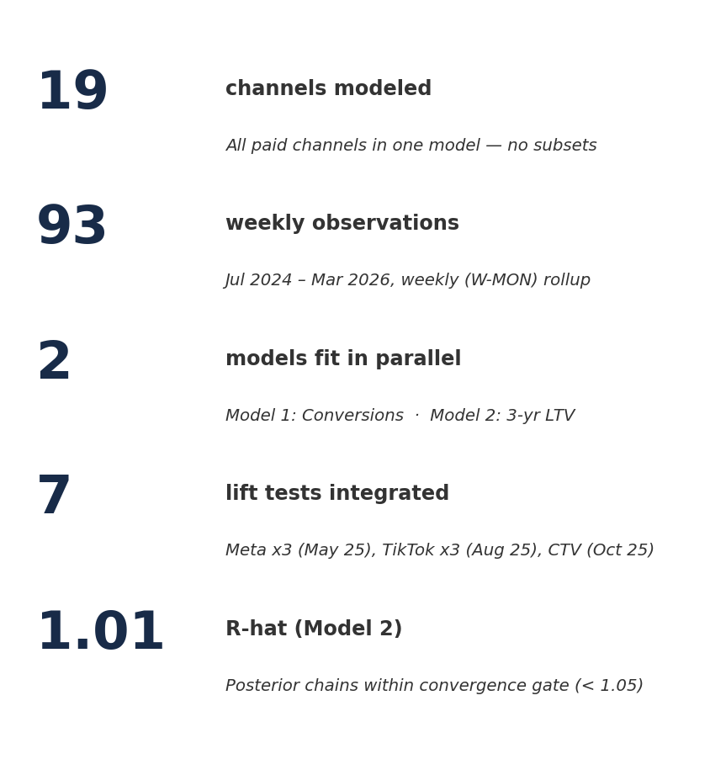
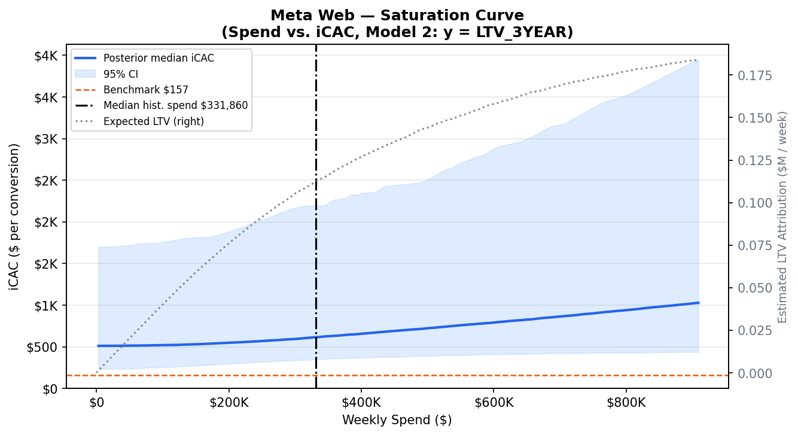
Two Models Fit on All 19 Channels — Live Dashboard with Confidence Bands
Meta Web saturation curve — 94% HDI band, vertical line at median weekly spend
Live dashboard ▸
capstonekikoff-cni9u6vowxfcgwy8ddmbtw.streamlit.app
4
Notes:
Phase 2 execution. The model is fit and the dashboard is live. Both models — Conversions and 3-year LTV — run on all 19 channels at weekly granularity across 93 weeks. Seven lift tests are integrated as windowed priors, applying only within each test's own date range. The saturation curve shown on the right is the kind of output the client uses for budget decisioning — spend on the X-axis, incremental CAC on the Y-axis, posterior band shaded, and a vertical line marking current weekly spend. This is one of eight chart types live in the Streamlit dashboard, hosted at the URL shown — updates automatically as the model is recalibrated and new outputs are pushed.

Slide 5
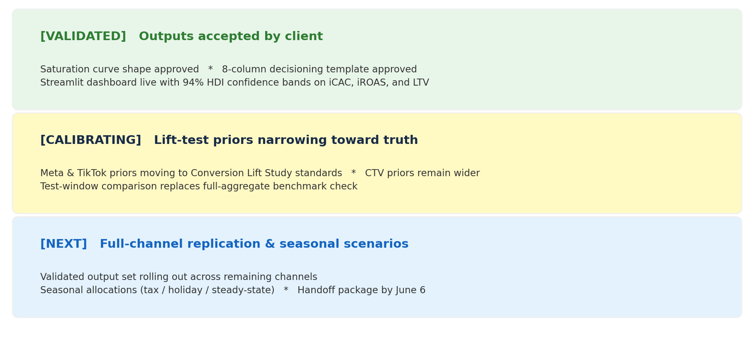
Saturation Shape & Decisioning Layer Approved; Calibration Tightening Next
Explore every chart referenced here on the live dashboard:
capstonekikoff-cni9u6vowxfcgwy8ddmbtw.streamlit.app
5
Notes:
Three-row read on current state. First, what's validated: the client signed off on the saturation curve shape and on the 8-column decisioning template, both reviewed live in the dashboard walkthrough. Second, what's calibrating: lift-test sigmas on Meta and TikTok are moving from an initial heuristic to Conversion Lift Study standards, which will tighten posterior contributions for those channels; CTV's sigma stays wider because its CSV provides a true confidence interval. Benchmark comparisons are also shifting from full-history aggregates to test-window-specific reads, since that's where the lift test's truth applies. Third, what's next: roll the validated output set out across all channels and start the seasonal-scenario work. Every chart referenced is live on the dashboard URL at the bottom.

Slide 6
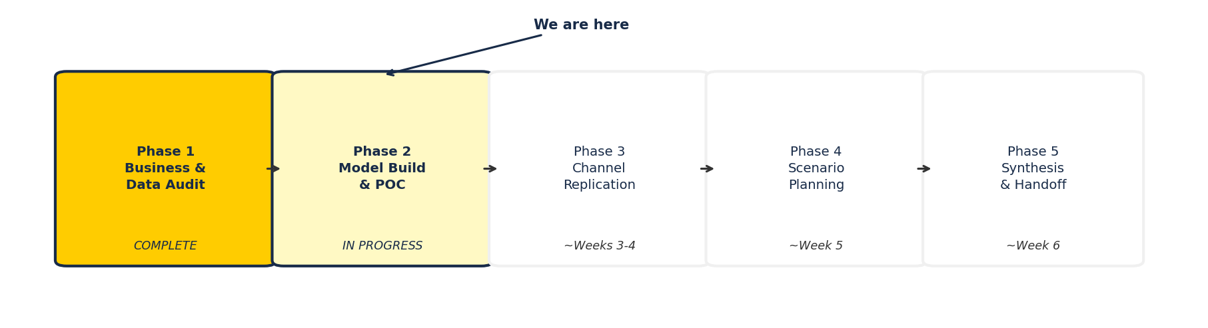
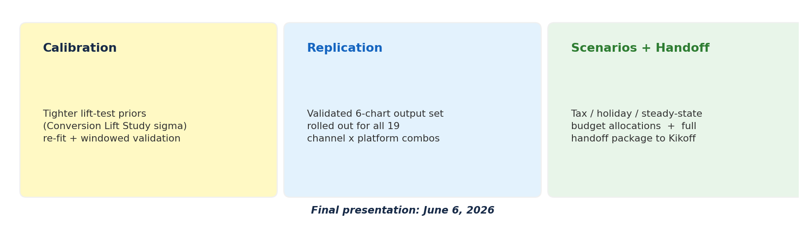
Three Workstreams Carry Us to Final Delivery on June 6
6
Notes:
Closing read. Phase 1 — data foundation and framework selection — is complete. Phase 2 — model build, dashboard, decisioning template — is in flight and validated in form. Three workstreams remain between now and June 6: calibration (tightening lift-test priors and re-fitting), replication (rolling the validated output set across all 19 channel x platform combinations), and scenario planning plus handoff. The model architecture is locked, the deliverable shape is locked, and the path to the final presentation is concrete.

