Slide 1

Measuring What Actually Drives Kikoff's Growth
UC San Diego Rady MSBA — Capstone 2026
Yash Tiwari · Chunjiang Liu · Shivang Bhatt · Yoko He May 2026
Notes:
Hi everyone — thank you for being here. I'm Yash Tiwari, and I'm here with my teammates Chunjiang Liu, Shivang Bhatt, and Yoko He. We're the Kikoff capstone team from the UC San Diego Rady MSBA program, and today we'll be walking you through our progress on building a Media Mix Model for Kikoff.

Slide 2

Four Sections, One Story: From Data to Budget Decisions
1. Business Context & Data Foundation
Who is Kikoff, what problem we're solving, and what data we're working with
2. Methodology & Deliverables
What we're building, how we selected our framework, and what we evaluated
3. Findings to Date
Key EDA results, data quality resolutions, and early modeling signals
4. Next Steps
Three concrete milestones between now and the final deliverable
2
Notes:
Here's a quick roadmap of what we'll cover. We'll move from the business context and data foundation, through our methodology and deliverables, into our findings to date, and close with recommendations and next steps. Each of us will take a section.

Slide 3

Meet the Team
3
Notes:
A quick introduction. [Coordinate live — each person introduces themselves in one sentence as they're named: name, concentration or prior role, and what they owned on this project.]

Slide 4
Platform Attribution Costs Kikoff Precision on $112M in Annual Spend
The Problem
Key Pivots
Where We Stand
$112M annual spend — zero causal attribution
Each platform self-reports ROAS — all overclaim
Last-touch credits the final click, not the cause
Channel → channel × platform
Single DV → conversions + LTV
Linear regression → Bayesian with priors
✓ Framework: PyMC-Marketing — approved
✓ 13 channels locked, taxonomy clean
✓ Phase 1 complete — all 5 gates passed
4
Notes:
Kikoff spends roughly $100 million annually across more than ten marketing channels. The challenge is that their current approach relies heavily on last-touch and platform-reported attribution — meaning they know someone converted, but not which combination of marketing activity actually caused it.

Slide 5
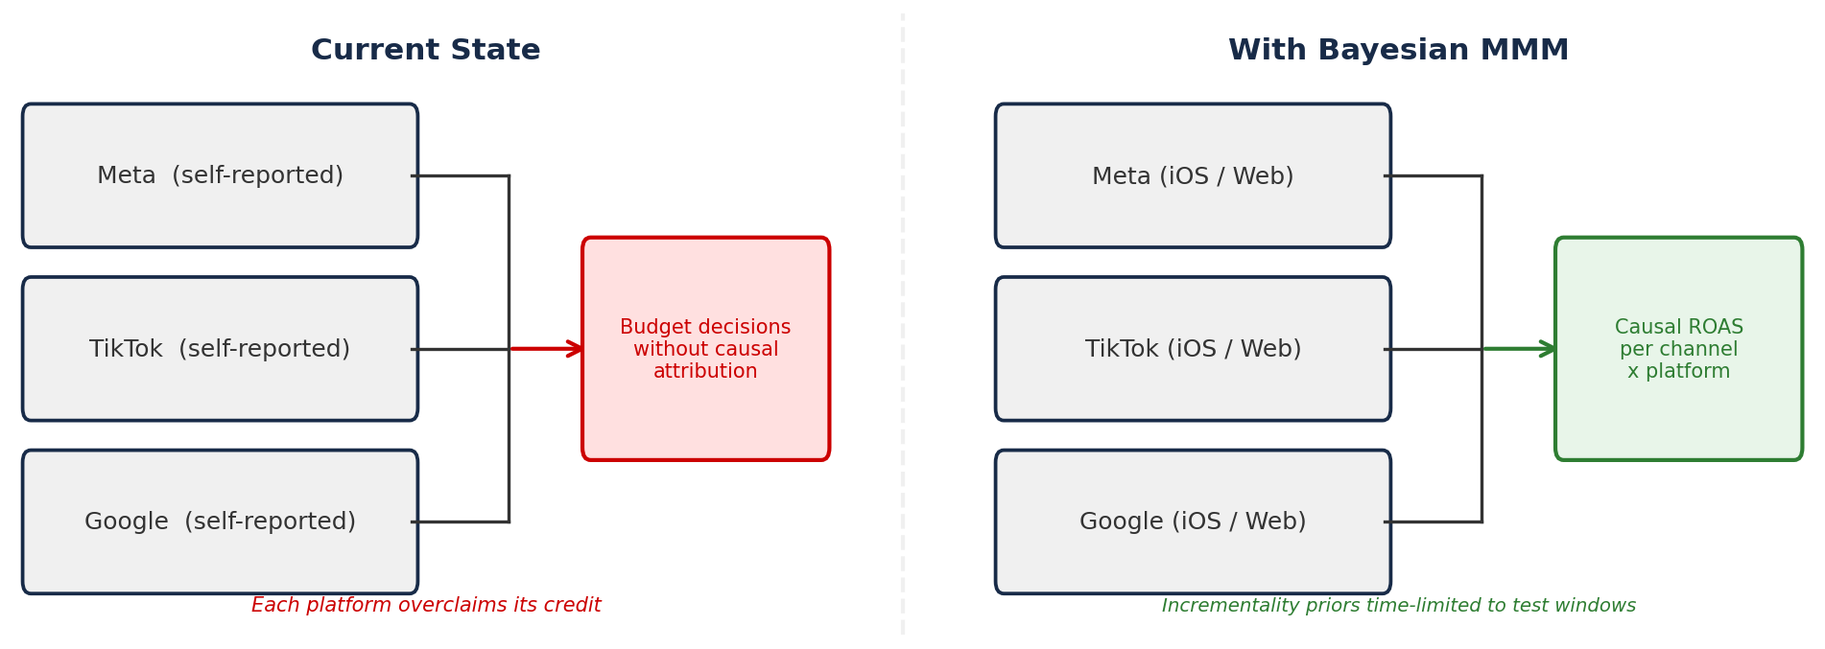
Last-Touch Attribution Gives Credit to the Wrong Channels
Current state:
• Last-touch gives all credit to the final ad clicked
• Each platform self-reports ROAS — all overclaim
Desired state:
• Causal attribution at channel × platform level
• Diminishing returns visible per channel
Constraints:
• Bayesian required (linear regression ruled out)
• Incrementality priors time-limited to test windows
• Dual DV: conversions and LTV modeled separately
5
Notes:
Kikoff is a fintech company focused on credit-building and financial wellness subscriptions. The problem they're trying to solve is one that many consumer brands face at scale: as marketing spend grows, traditional attribution methods break down.

Slide 6
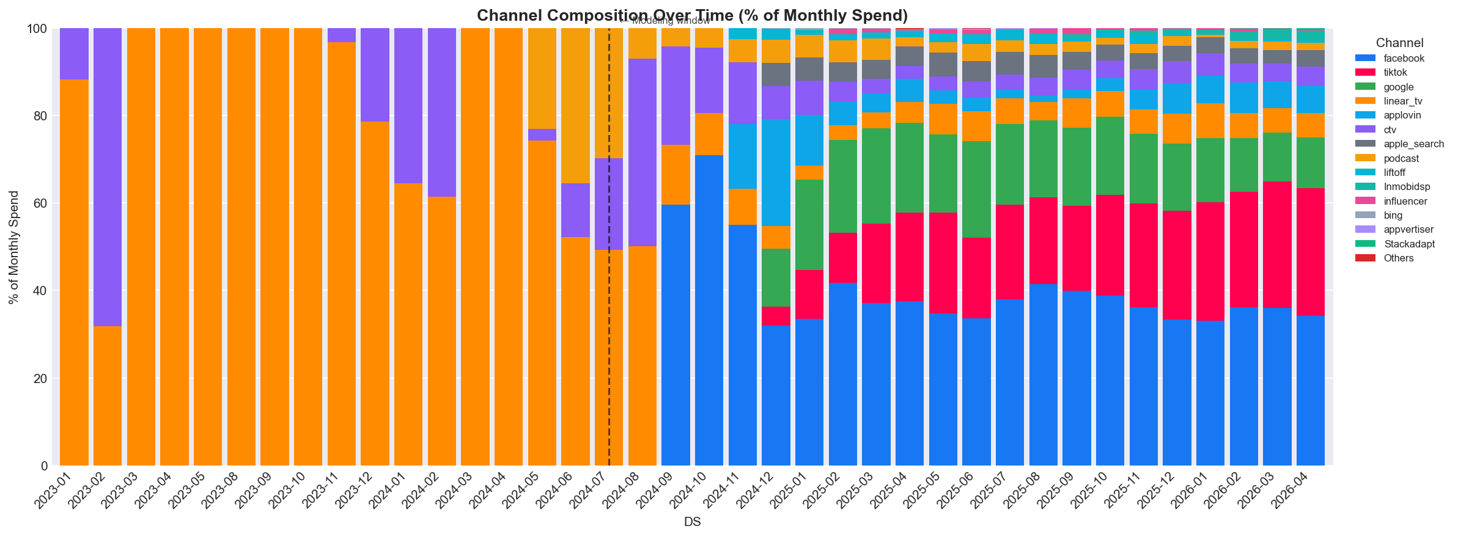
21 Months, 13 Channels, 4 Incrementality Tests — After 5 Quality Fixes
Spend data:
• Daily · 15 source groups → 13 canonical channels
• Q3 2024 – Mar 2026 (639 rows · 28 cols · 0 null LTV)
Outcome data:
• Daily conversions + model-predicted LTV
• Mean 2,560 conversions/day · peak 4,354
Incrementality tests:
• TikTok · Meta ×2 (incl. Jan 2026 partial) · CTV geo
5 quality issues resolved:
• Platform typos · LTV anomaly windows (|z| max = 0.85)
• Null rows · DSP mismatch · Idle/Others erroneous data removed
6
Notes:
We have three datasets. First: daily spend broken down by source group and platform — iOS, Android, and Web. Second: daily outcomes — conversion counts and model-predicted lifetime value. Third: a CSV of historical incrementality tests covering TikTok, two Meta tests, and a CTV test.

Slide 7
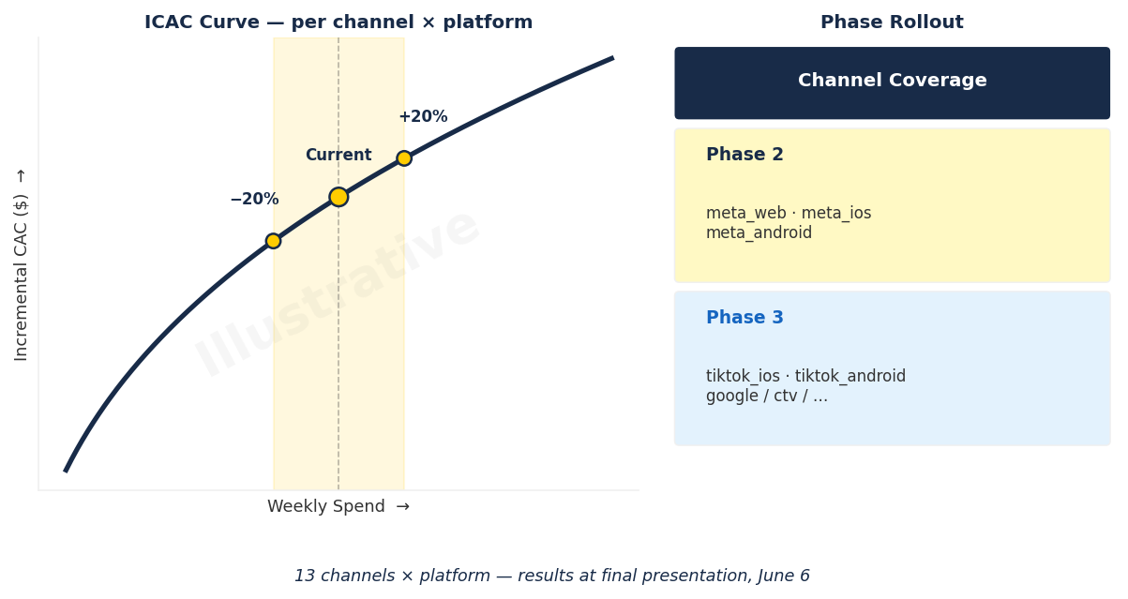
The Deliverable: ICAC and ROAS Curves That Anchor the Next Budget Cycle
Primary outputs:
• ICAC + ROAS curves per channel × platform
• Efficiency at current, +20%, −20% spend levels
Saturation curves:
• Where diminishing returns kick in per channel
• Marginal ROI guardrails for budget reallocation
Seasonal scenarios:
• Tax season · holiday · steady-state allocations
• Budget recommendations with spend-move %
Output format →
7
Notes:
Our primary outputs are all at the channel-by-platform level. First: incremental contribution estimates — for each channel-platform combination, how much of observed conversions and LTV is attributable to that spend, net of everything else.

Slide 8
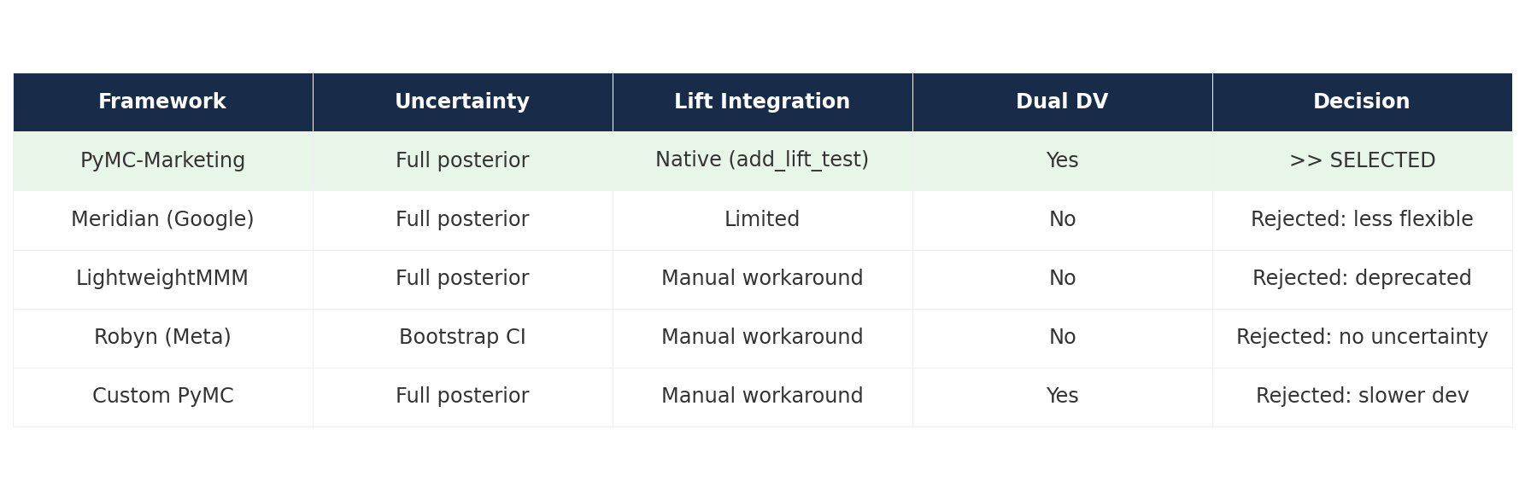
PyMC-Marketing Won on Flexibility, Integration, and Fallback
5 frameworks evaluated — decision locked and sponsor-approved:
8
Notes:
We evaluated five modeling frameworks — Meridian, LightweightMMM, Robyn, a custom PyMC build, and PyMC-Marketing. We selected PyMC-Marketing for its flexibility, its native support for incrementality priors, and a clean fallback path to raw PyMC if needed.

Slide 9
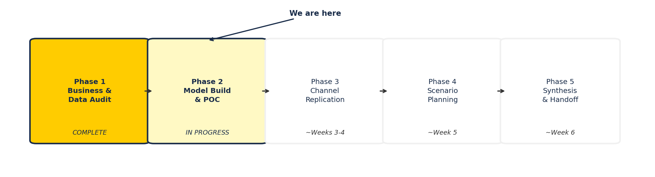
Five Phases, Phase 1 Done — Meta Model POC Active Now
Phase 1 complete · Phase 2 begins now · Phases 3–5: replication → scenarios → handoff
9
Notes:
We're working in five phases. Phase 1 — business understanding and data audit — is essentially complete. We've locked the taxonomy, selected the framework, and addressed the data quality issues.

Slide 10
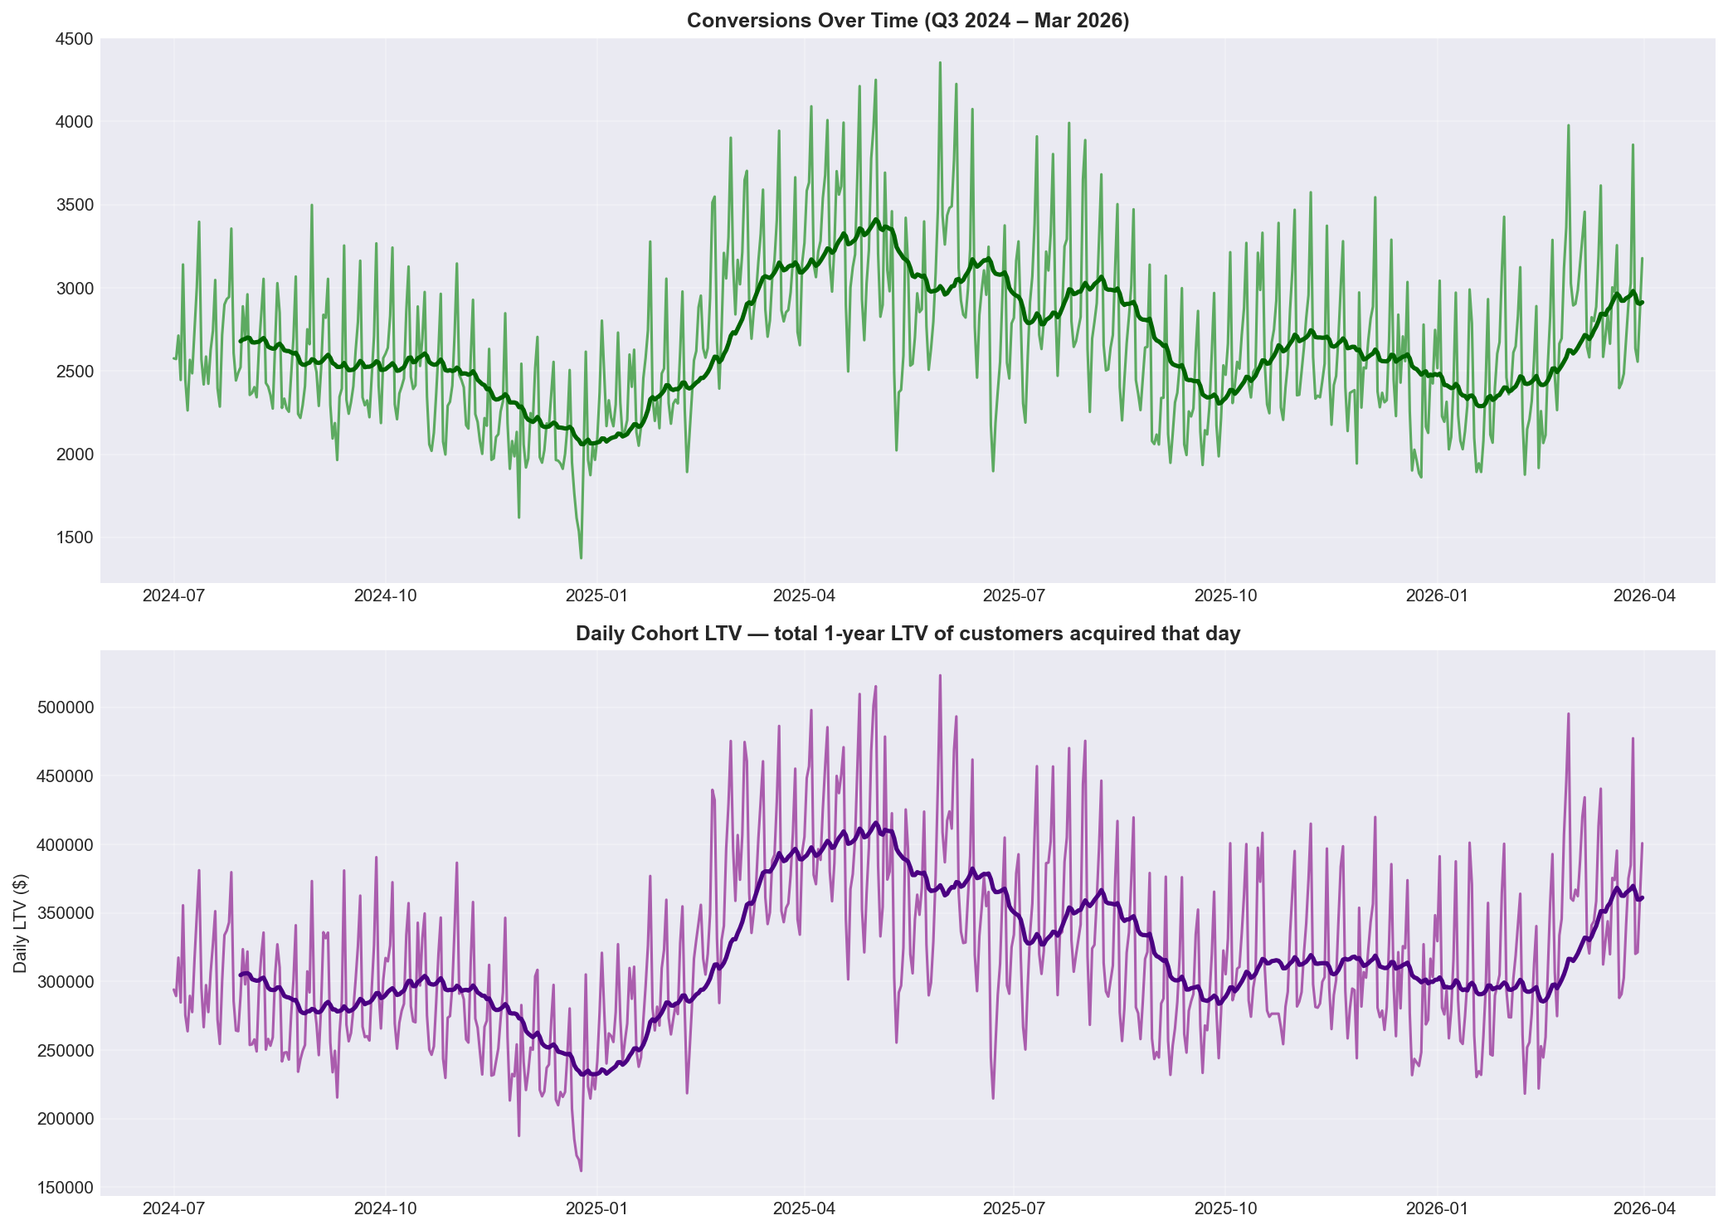
Meta, TikTok, Google Drive 73% of Spend — Tax Season Peaks Are Real
$112.87M
total spend in modeling window
73.2%
share from Meta · TikTok · Google
4,354
peak conversions/day (2025-05-30)
0.45
spend–conversion correlation (lag analysis, full date range)
10
Notes:
On the data review: spend and outcome data are now merged at daily granularity, and the modeling window is confirmed as Q3 2024 through March 2026. Meta, TikTok, and Google account for roughly two-thirds of total spend. Seasonality is clear in the data — tax season shows a lift.

Slide 11
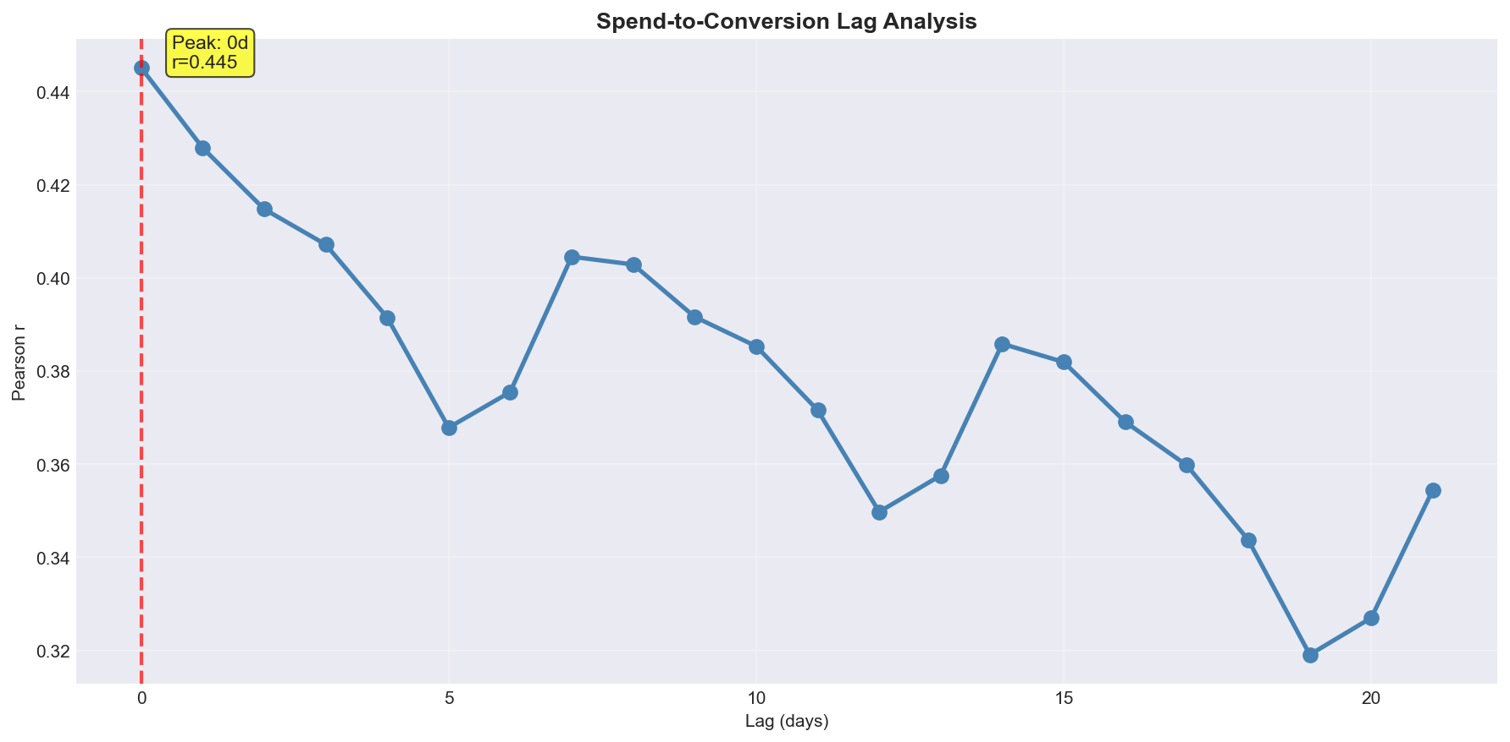
Adstock + Saturation + Bayesian Priors = Causal Attribution
Adstock (carry-over):
• Ad effects decay across days — decay rate estimated per channel
• Data: peak correlation at lag 0 — decay will be short (see →)
Hill saturation:
• Diminishing returns curve shape fit per channel
• Tells us when more spend stops buying proportional growth
Incrementality priors:
• Meta, TikTok, CTV holdout test results injected as priors
• Applied ONLY within test windows — not retroactively (D004)
11
Notes:
Two transformations happen before the data enters the model. First, adstock — advertising has a carry-over effect. An ad someone sees today doesn't just influence today's decision; some fraction of that influence carries into tomorrow and the day after. Second, saturation — also called the Hill transformation — captures diminishing returns.

Slide 12
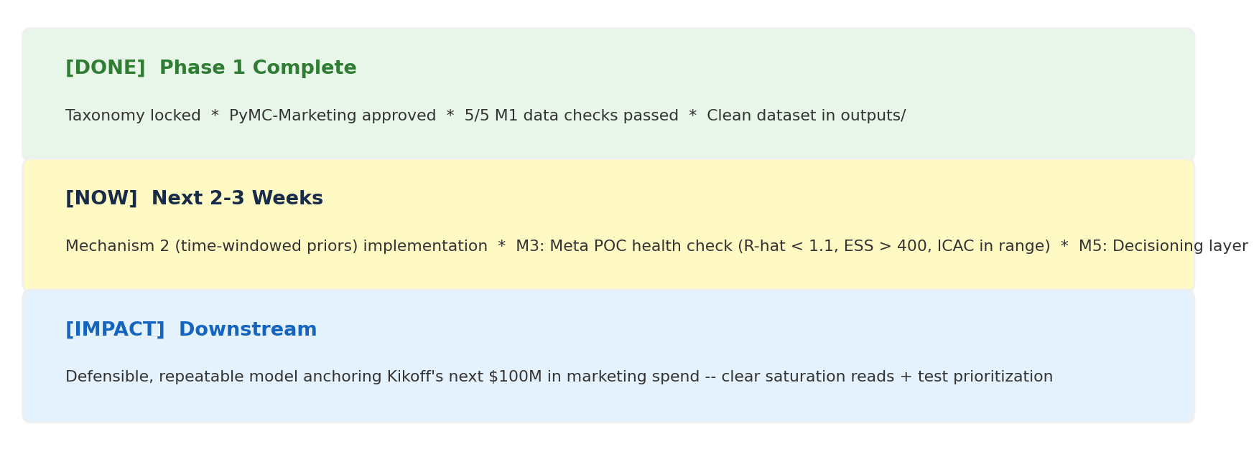
Three Milestones Separate Us from Kikoff's New Budget Model
12
Notes:
To close: we came in with a broad mandate to measure causal channel contribution. Over the past several weeks, we refined that into a concrete specification — channel-by-platform, dual outcomes, Bayesian with time-limited incrementality priors — completed the data foundation, and selected the framework. All of that is locked and sponsor-approved, ahead of schedule.

Slide 13
Questions?
Yash Tiwari · Chunjiang Liu · Shivang Bhatt · Yoko He
Notes:
Thank you. We're happy to take questions.

Slide 14
Appendix: Supporting Detail
Roadmap:
A-R1. Project phases — scope, outputs, status
A-R2. Phase 2 milestones — what each one means
Data & EDA:
A1. Full SOURCE_GROUP → channel mapping with spend shares
A2. DSP vendor spend distribution (StackAdapt + Appvertiser)
A3. Channel mix composition over time
A4. Total daily spend trend
A5. Spend vs. conversions scatter
A6. LTV per conversion over time
A7. Seasonality index
Methodology & Reference:
A8. Framework comparison matrix — full detail
A9. Incrementality test summary — iCAC, CI, conviction
A10. Data quality register — findings and resolutions
A11. MMM concept primer
Slide References:
A-R1 → next slide
A-R2 → slide after A-R1
EDA charts → A-EDA-1 through A-EDA-3
A
Notes:
Reference only.

Slide 15
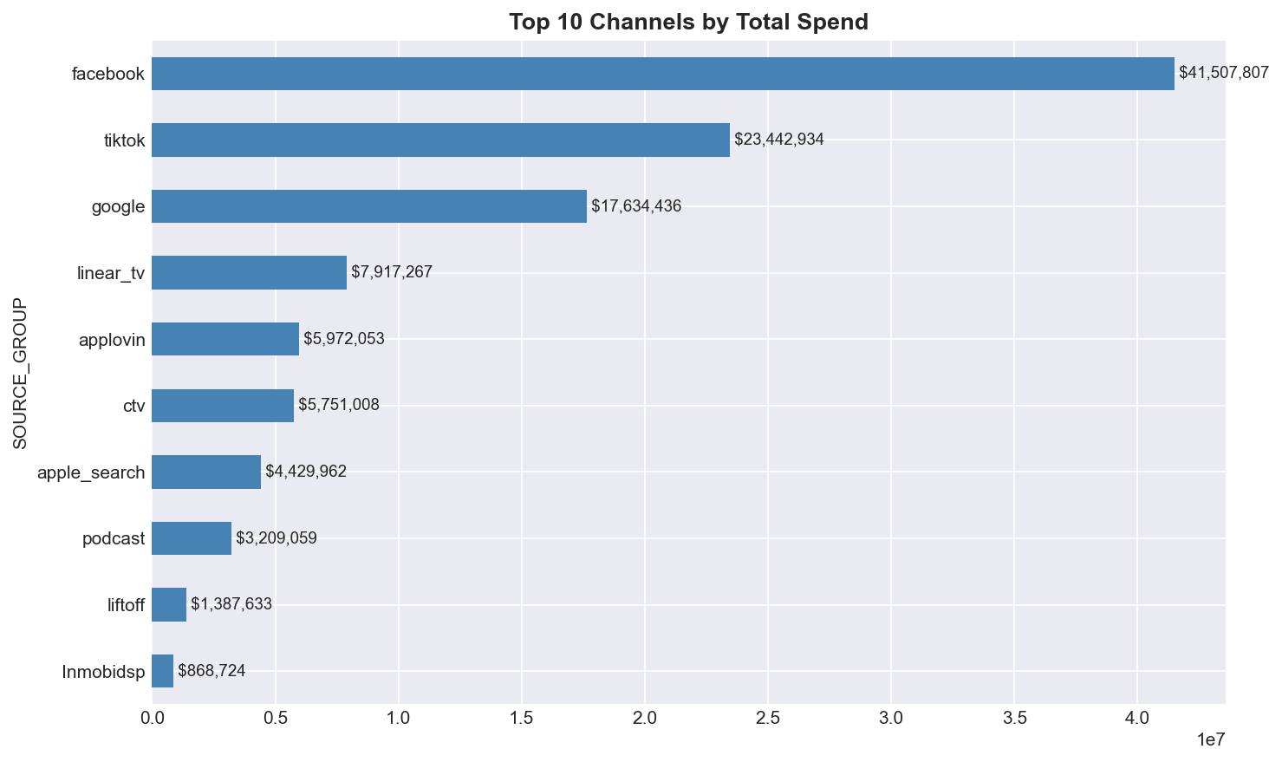
Channel Spend: Top 10 Channels Drive the Model
A-EDA-1
Notes:
Top 10 source groups by total spend in modeling window. Meta (Facebook), TikTok, and Google together account for ~73% of total.

Slide 16
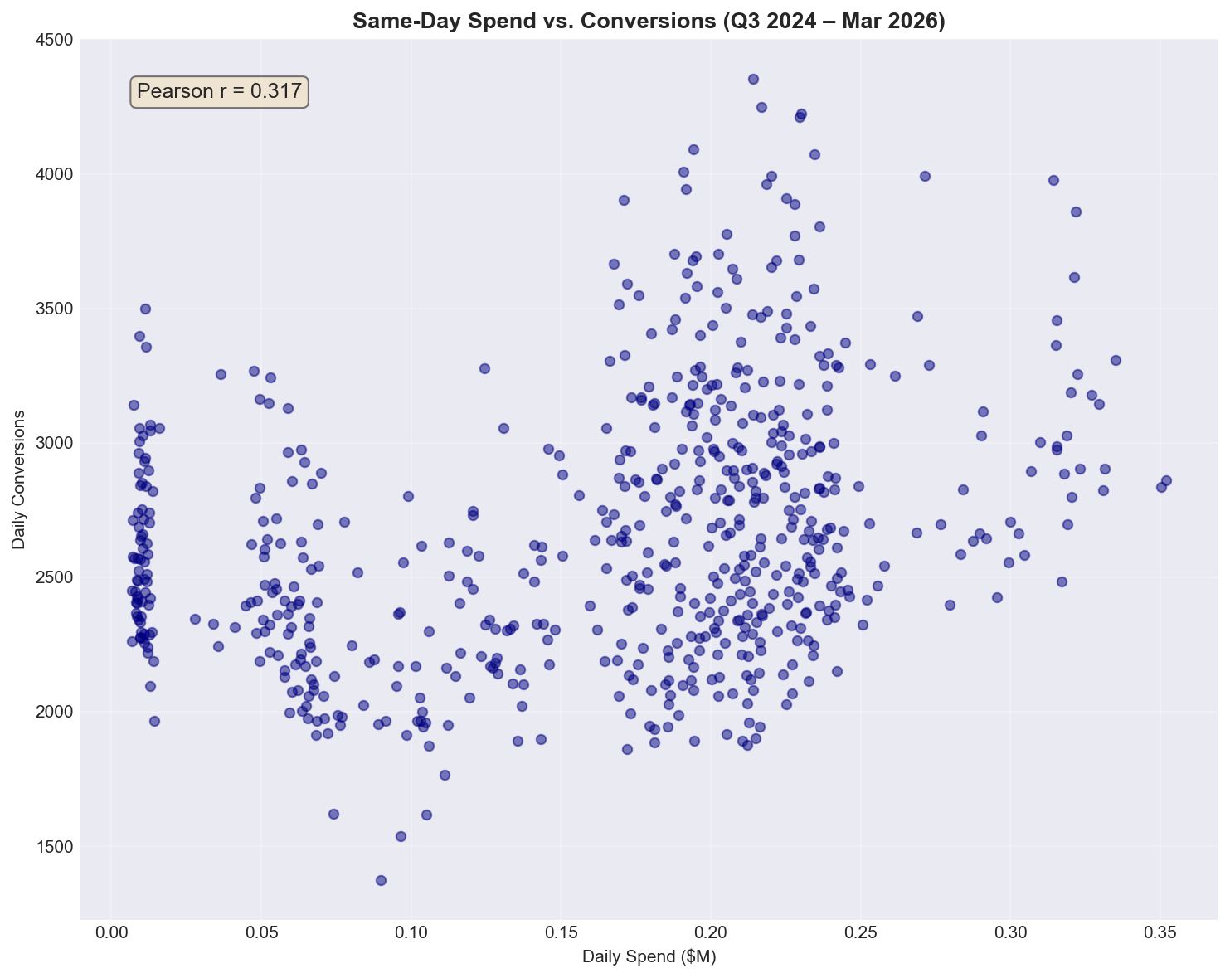
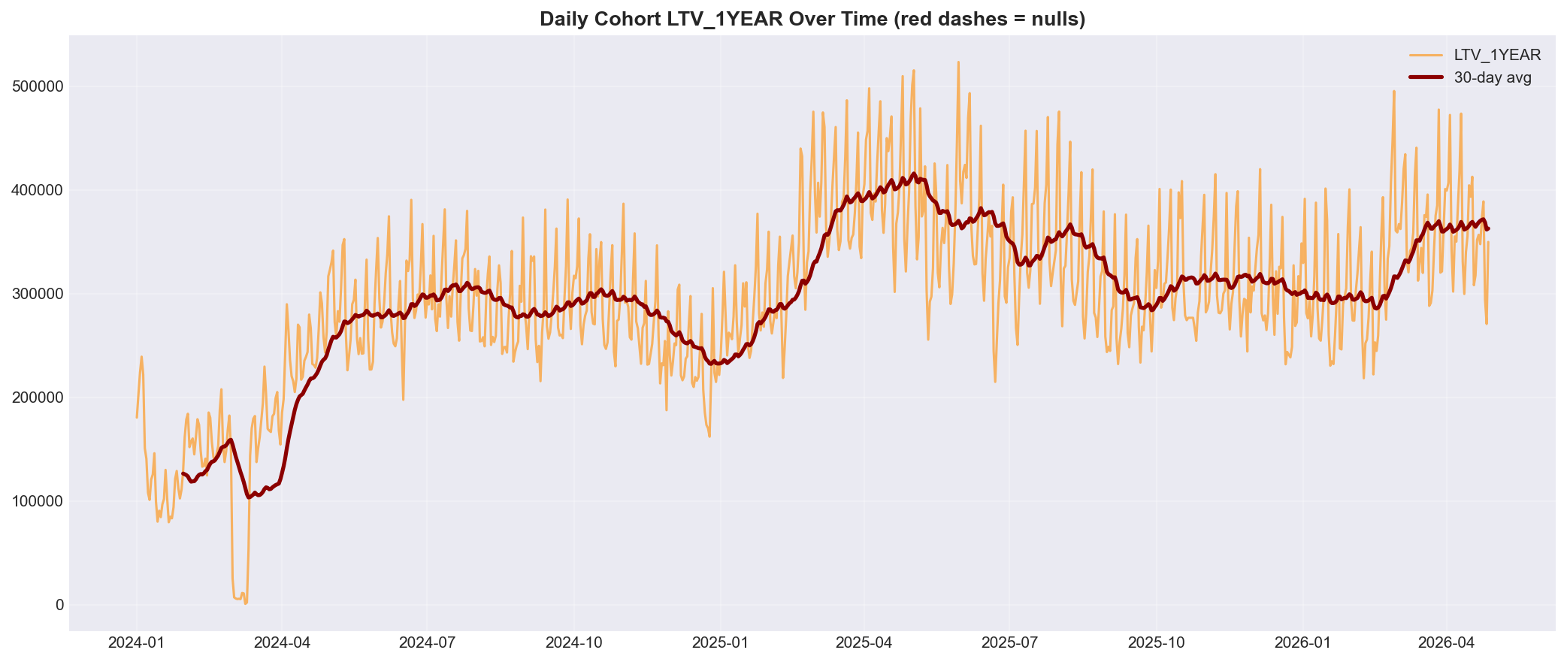
Spend & Conversion Relationship Holds Across Channels
r = 0.317 · modeling window · same-day (lag analysis r = 0.45, full date range — see slide 11)
A-EDA-2
Notes:
Left: spend vs conversions scatter, r=0.317 (modeling window, same-day). Lag analysis r=0.45 (full date range, at lag 0) is shown on slide 11. Right: LTV per conversion over time shows mean reversion after anomaly windows were corrected.

Slide 17
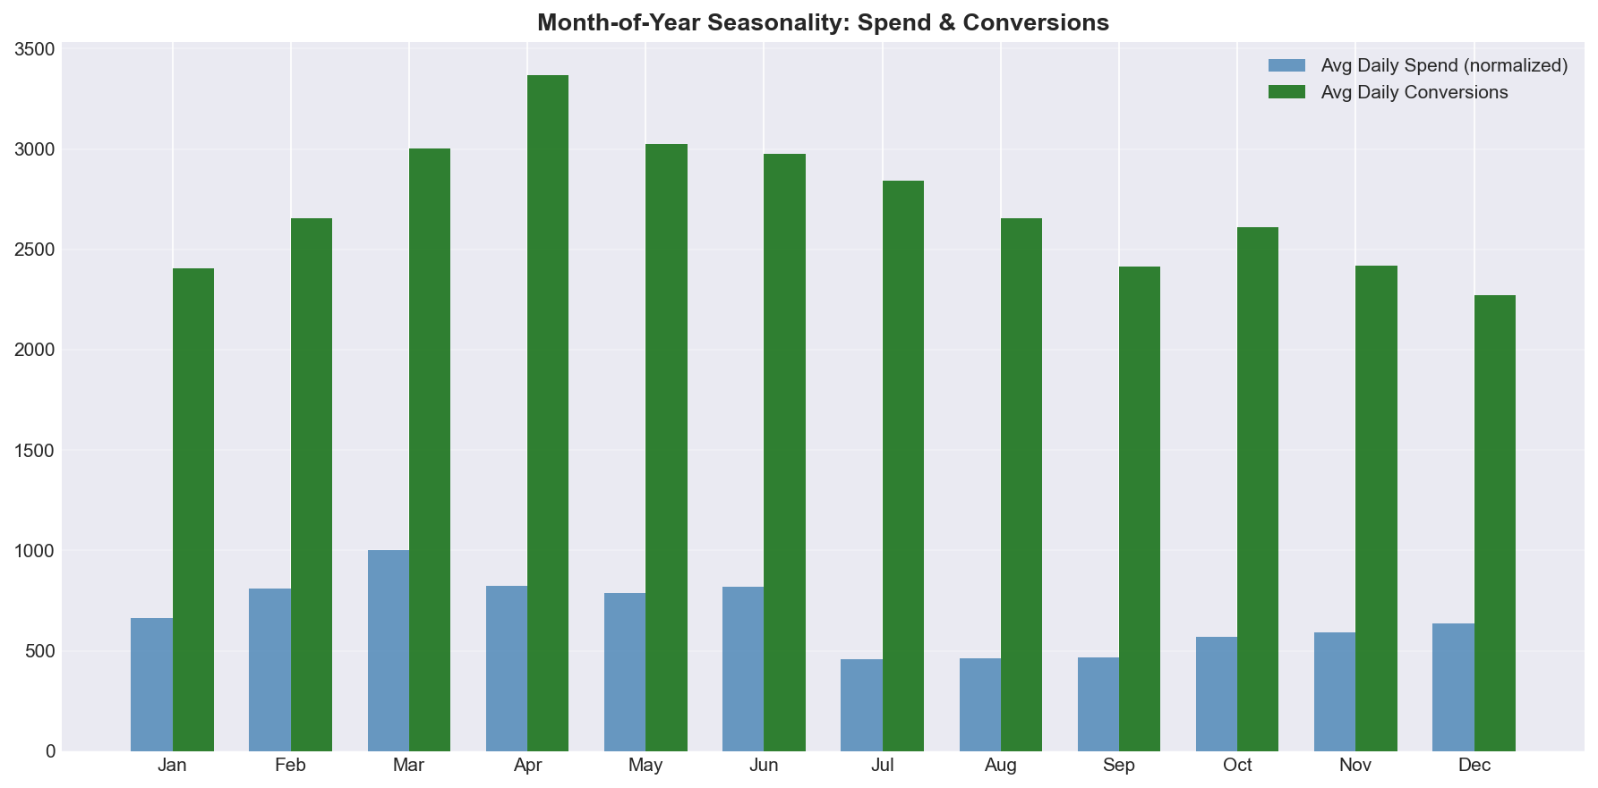
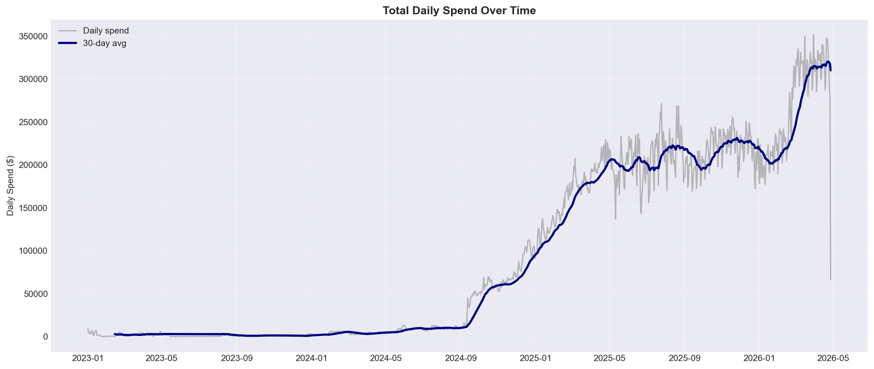
Seasonality Is Real — Tax Season and Mid-Year Show Distinct Patterns
A-EDA-3
Notes:
Left: monthly seasonality index — clear peaks in tax season (Jan-Apr). Right: total daily spend trend showing growth in modeling window.

Slide 18
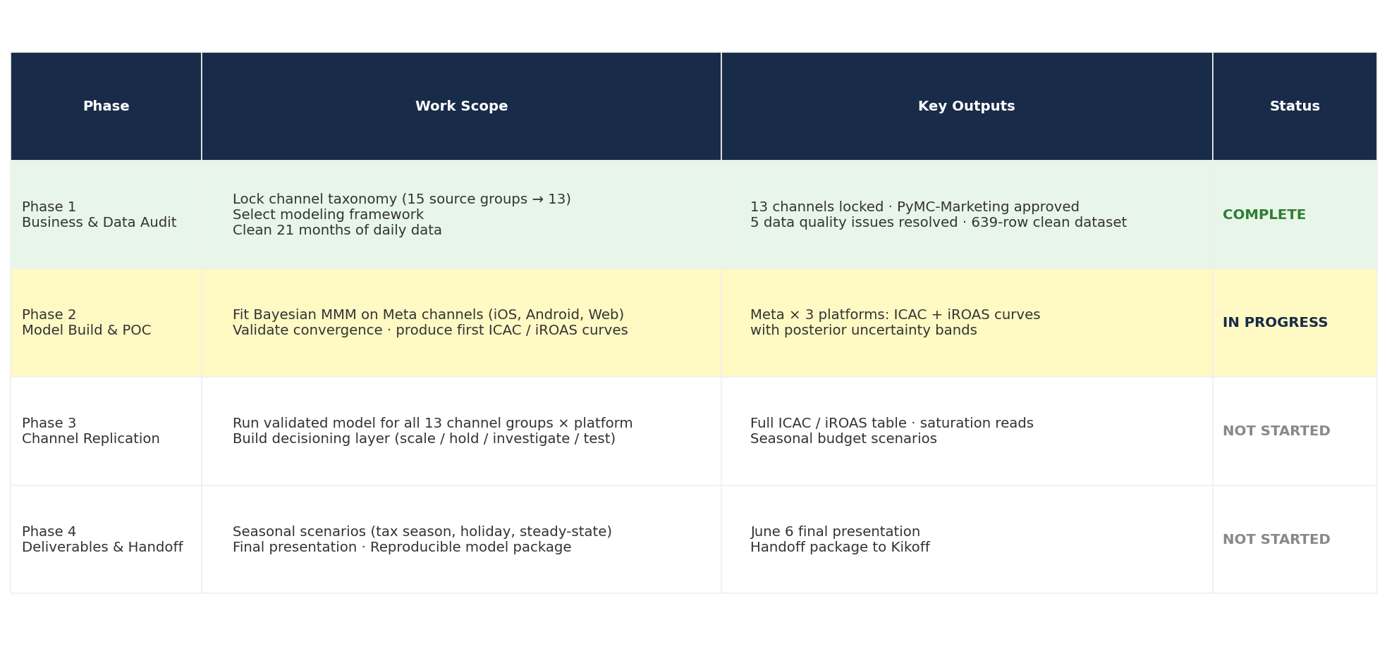
Four Phases: Data Foundation → Model → Replicate → Deliver
Green = complete · Yellow = in progress · White = not started
A-R1
Notes:
Full project arc: 4 phases from business understanding through final handoff. Phase 1 complete, Phase 2 in progress now.

Slide 19
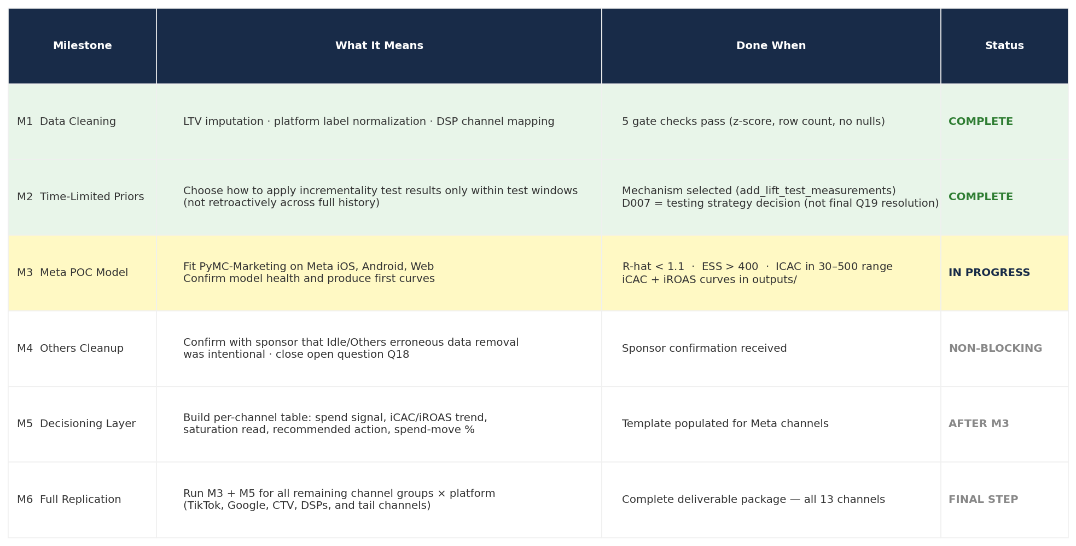
Phase 2 Has Six Milestones — M1 and M2 Complete, M3 Active
Green = complete · Yellow = in progress · White = queued
A-R2
Notes:
Phase 2 milestone breakdown. M1 (data cleaning) and M2 (time-limited prior mechanism) are complete. M3 (Meta POC model) is the current active milestone.

