Slide 1

Marketing Mix Modeling for Kikoff
Rady School of Management · MSBA Capstone · 2026
Chunjiang Liu | Shivang Bhatt | Yash Tiwari | Yoko He
Sponsor: Abheek Sinha, Kikoff · Supervisor: Keith

Slide 2

Overview
1
Who are we?
7
Results & Findings to Date
2
Executive Summary
8
Analytics Strategy
3
Business Problem & Organization
9
Recommendations
4
Data Overview
10
Conclusion & Next Steps
5
Deliverables & Evaluation Criteria
11
Q&A
6
Solution Path
12
Appendix
2

Slide 3

3

Slide 4
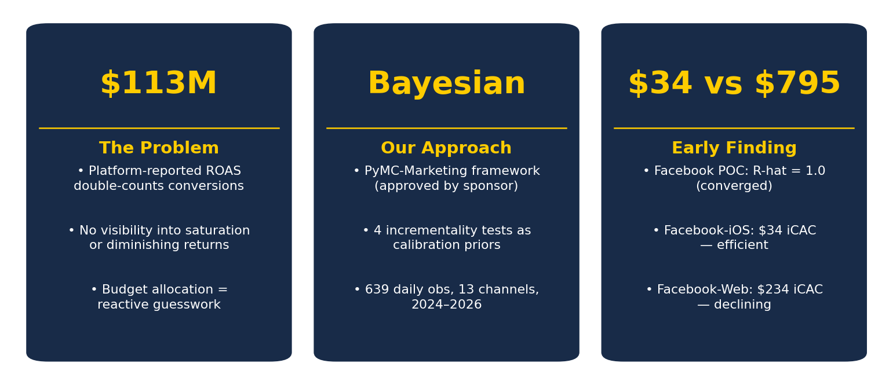
Phase 1 Complete, POC Converged — Facebook-iOS Is Efficient; Web and Android Are Not
4

Slide 5
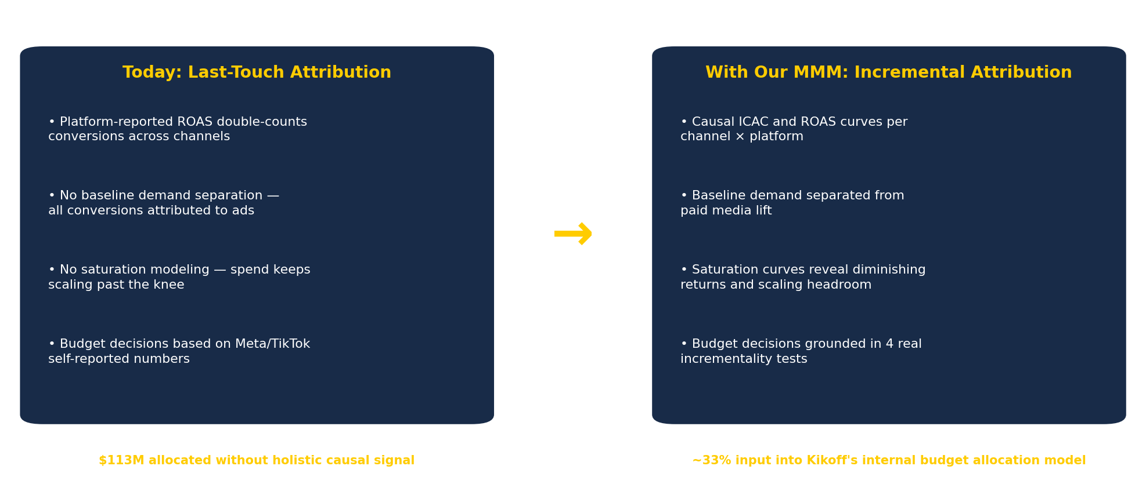
Kikoff Invests $113M Annually With No Holistic Attribution
5

Slide 6
Daily Spend and Outcomes Across 13 Channels — 5 Quality Issues Resolved
639
13
$132K
2,560
Daily observations 2024-07-01 to 2026-03-31
Modeled channels Meta, TikTok, Google + 10 more
Avg daily spend ($0–$300K+ range)
Mean daily conversions (peak: 4,354 on 2025-05-30)
Data Issue
Action Taken
Result
LTV anomalies
Imputation for 2025-10-21–24 window
✓ |z| max = 0.85
Platform typos
"iso"→iOS; "web and app"→web
✓ PASS
DSP channel mapping
15 SOURCE_GROUPs → 13 canonical ch.
✓ PASS
StackAdapt row count
341 rows in window (threshold: >30)
✓ PASS
Date filter
2024-07-01 to 2026-03-31 enforced
✓ PASS
6

Slide 7
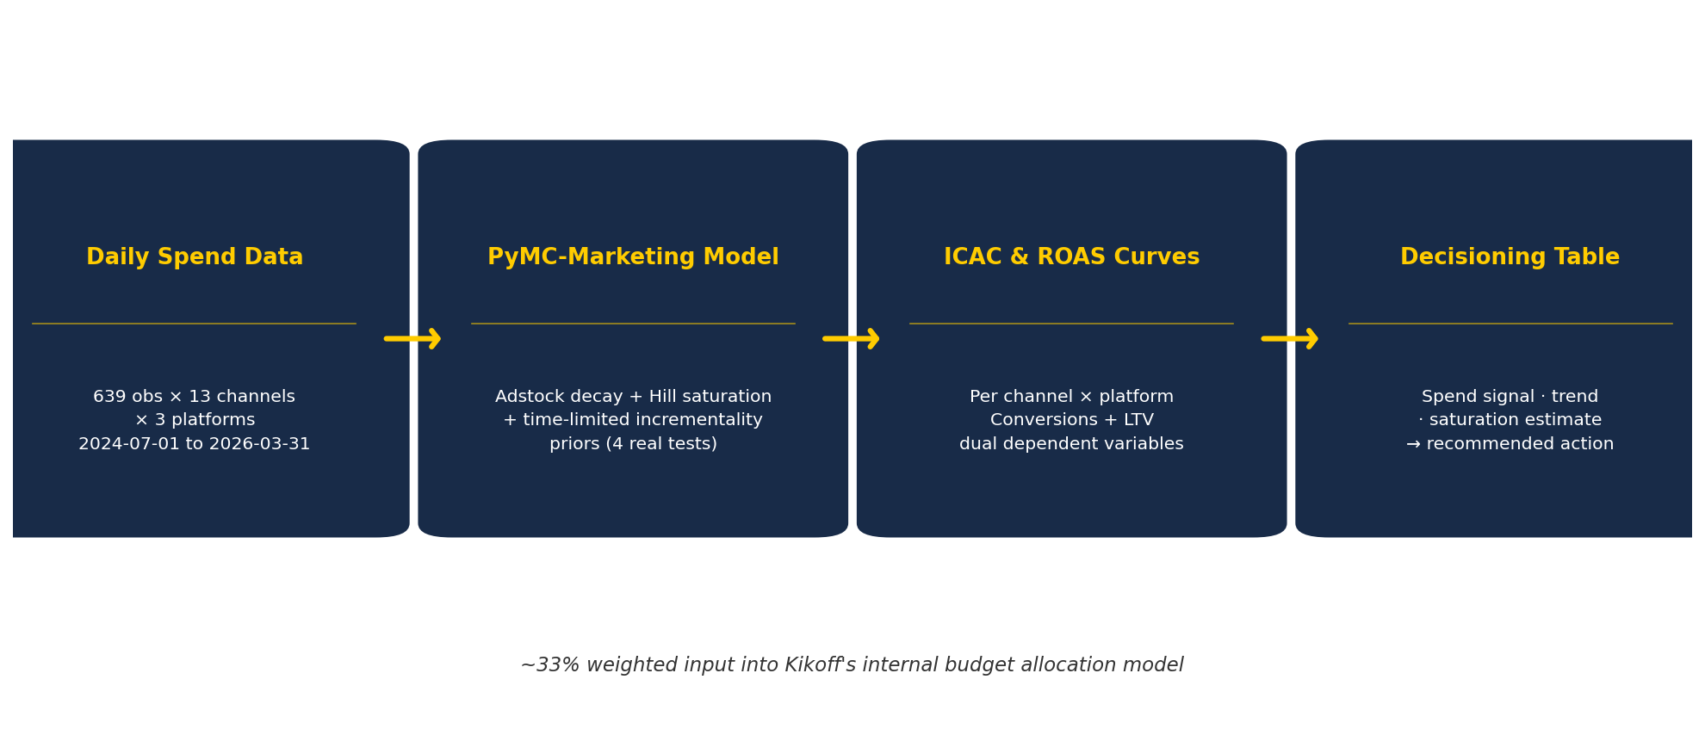
We're Building ICAC and ROAS Curves That Turn Spend Into Decisions
7

Slide 8
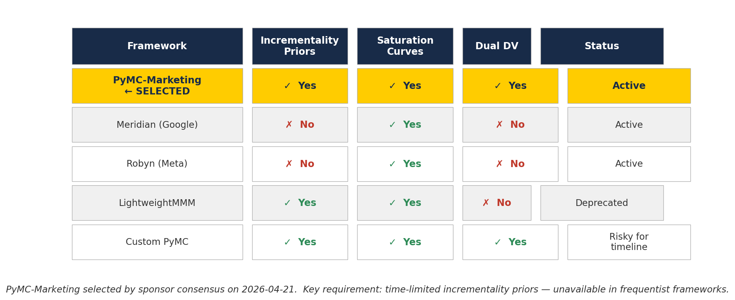
Evaluation Criteria: How We Selected Our Modeling Framework
8

Slide 9
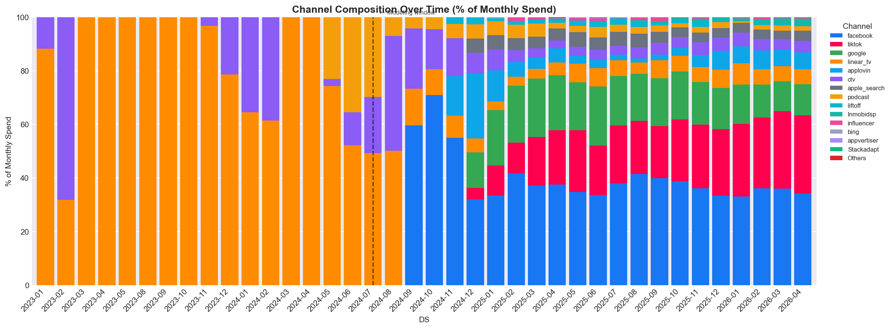
Results & Findings to Date — Channel Spend Concentration
Facebook: $41.5M (37%) TikTok: $23.4M (21%) Google: $17.6M (16%)
Top 3 channels = 73% of $113M total spend | 10 channels share remaining 27%
9

Slide 10
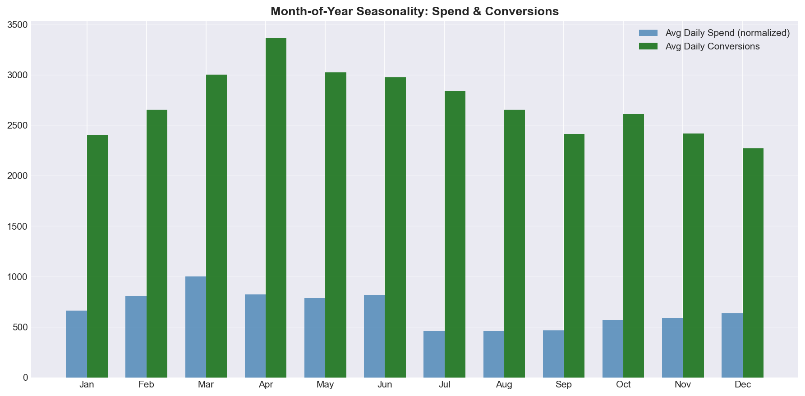
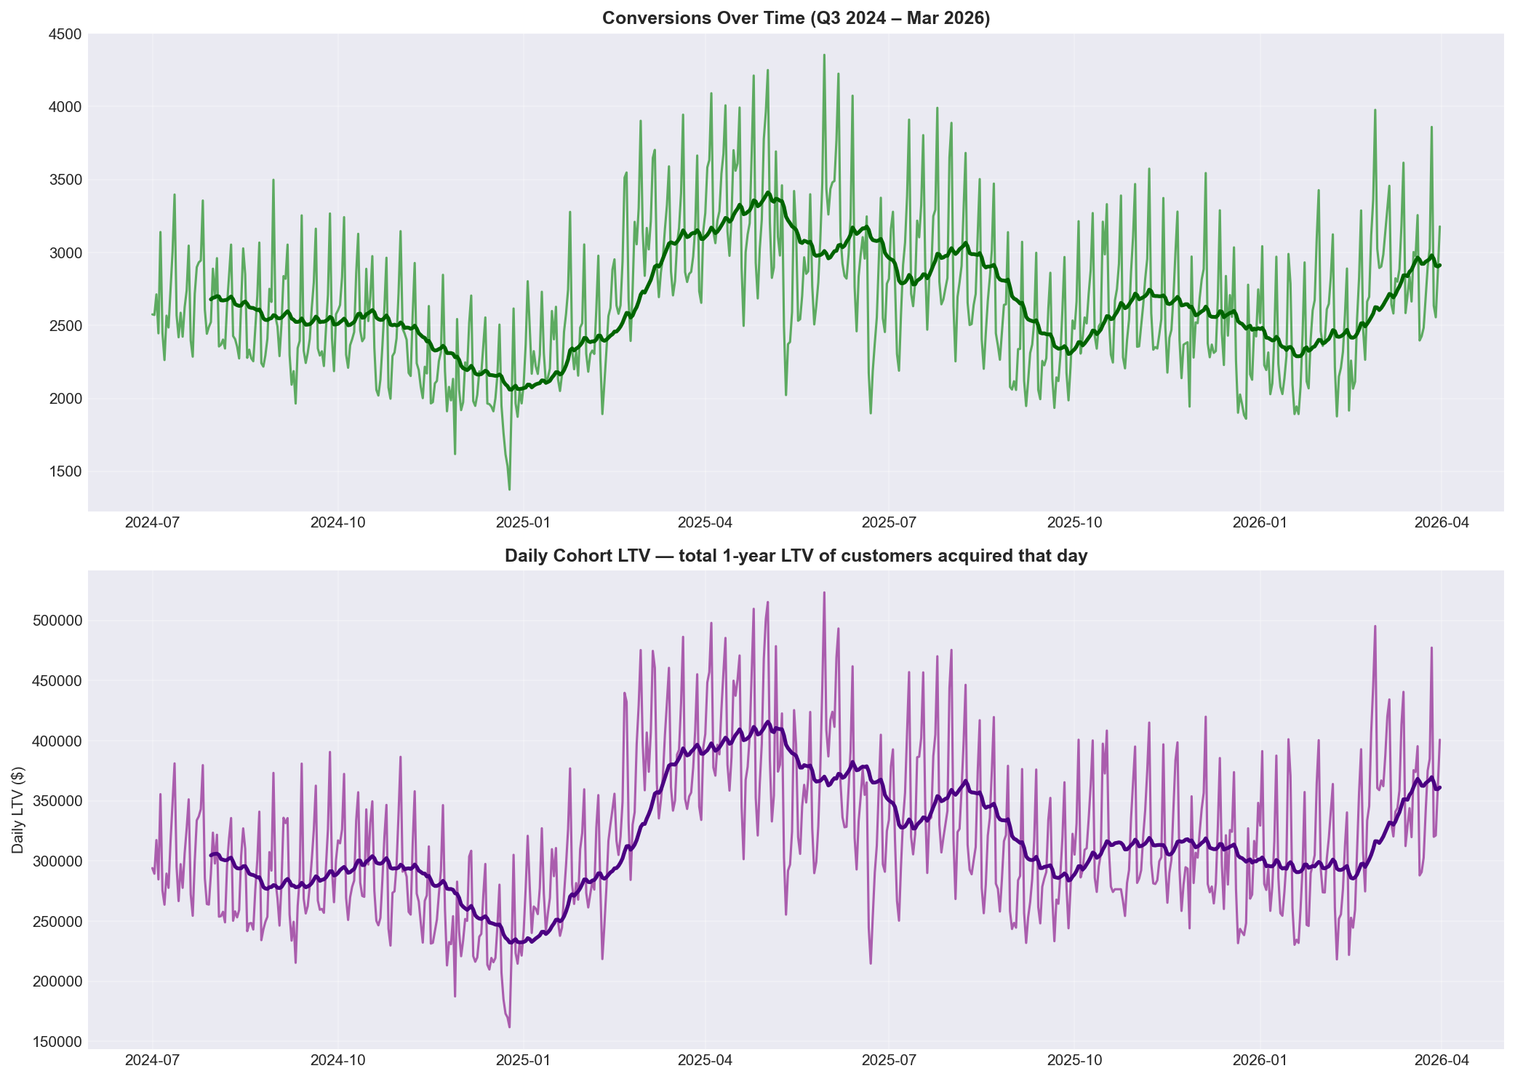
Results & Findings to Date — Seasonality and Conversion Patterns
• Conversions peak in tax season (March–April); trough Nov–Dec — consistent with credit product demand cycle
• Spend-to-conversion lag = 0 days (r = 0.45) — media effects materialize quickly; adstock decay is short
10

Slide 11
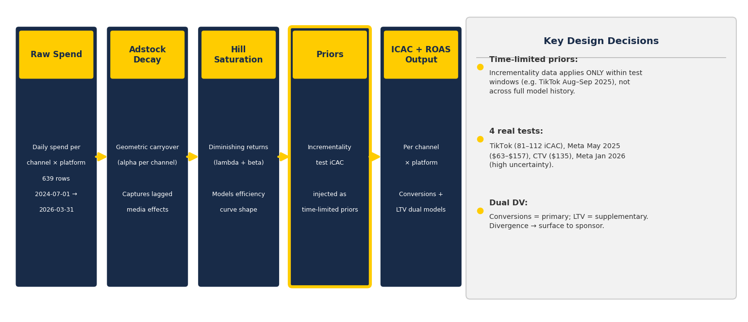
Analytics Strategy: PyMC-Marketing Pipeline
11

Slide 12
How Model Outputs Become Budget Decisions — The Decisioning Framework
Signal
Action
What We're Building
• Is iCAC improving, flat, or declining over time?
• ✓ Scale — iCAC declining, iROAS > 1.5x, below saturation
• ICAC + ROAS response curves per channel × platform
• Is current spend approaching the saturation point?
• ⏸ Hold — iCAC flat or marginal, near saturation
• Saturation read: where diminishing returns kick in
• Is iROAS above or below the efficiency threshold?
• ⚠ Investigate — iCAC rising rapidly or iROAS < 1x
• Seasonal modifiers: tax season / holiday / steady-state
• How does performance vary across iOS / Web / Android?
• 🔬 Test — no incrementality data; run holdout before scaling
• Full decisioning table — all 13 channels by June 6
Model run in progress — full ICAC/ROAS results will be presented at the final presentation
12

Slide 13
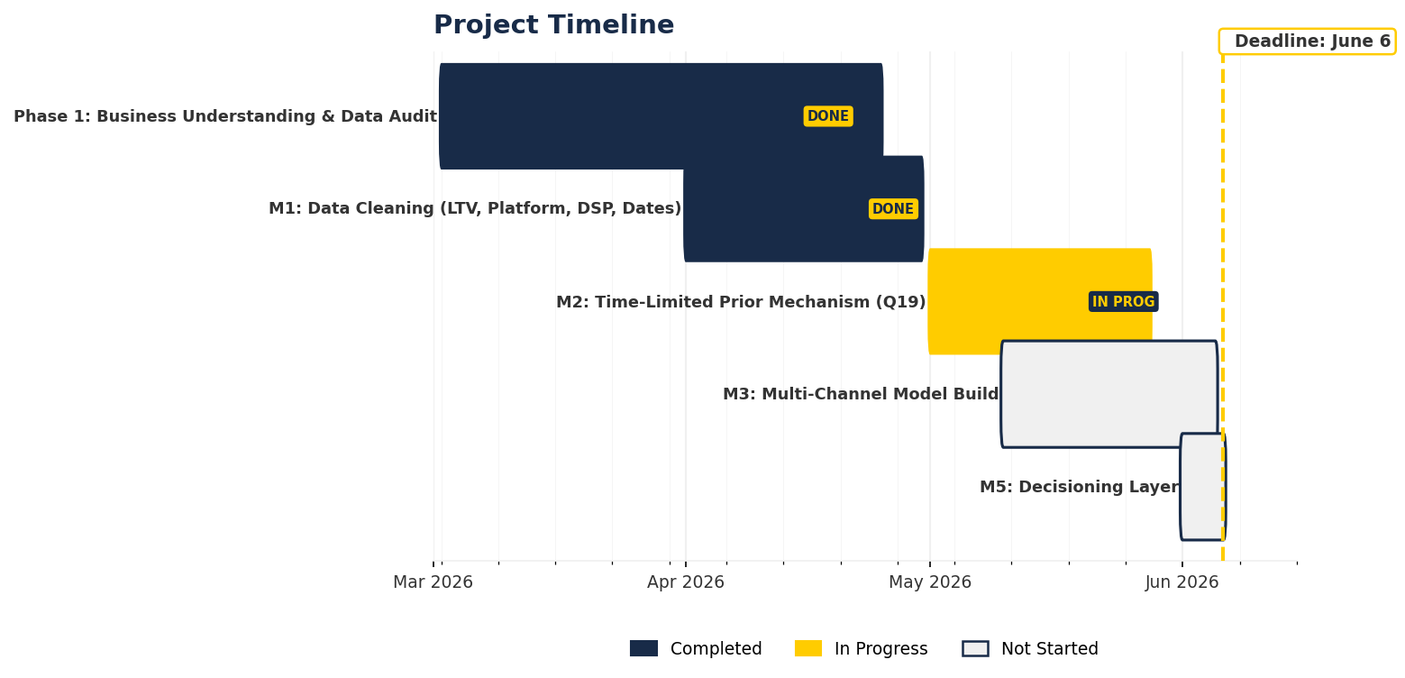
Phase 2 Is Running — Full Decisioning Package Delivered by June 6
13

Slide 14
Questions?

Slide 15
Appendix
Supporting charts, tables, and model diagnostics

Slide 16
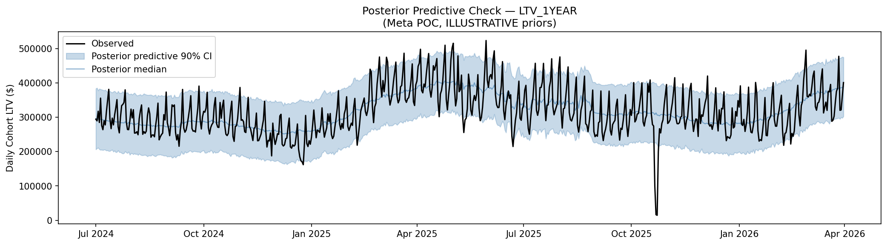
Appendix A1 — Model Fit: Posterior Predictive Check
Blue band = 94% HDI of posterior predictive distribution · Orange line = observed conversions · Good overlap = adequate model fit
A1

Slide 17
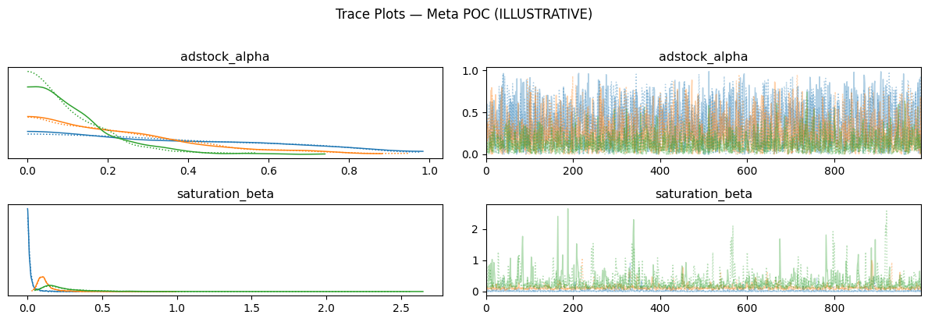
Appendix A2 — MCMC Convergence: Trace Plots
R-hat max = 1.0 (pass < 1.1) · ESS min = 578 (pass > 400) · Chains well-mixed — no divergences
A2

Slide 18
Appendix A3 — Channel Taxonomy (13 Modeled Channels)
SOURCE_GROUP
Canonical Channel
Model Treatment
facebook
Meta
iOS / Android / Web
google
Google Search
iOS / Android / Web
tiktok
TikTok
iOS / Android / Web
applovin
DSP: Applovin
Separate
liftoff
DSP: Liftoff
Separate
Inmobidsp
DSP: InMobi
Separate
Stackadapt + Appvertiser
DSP: Combined
Grouped (D004)
linear_tv
Linear TV
Separate
ctv
CTV
Separate
podcast
Podcast / Audio
Separate
apple_search
Apple Search Ads
Separate
influencer
Influencers
Separate
bing
(excluded)
Dropped — too small
Others
(excluded)
Erroneous data removed
A3

Slide 19
Appendix A4 — Incrementality Tests Used as Model Priors
Channel
Window
Test Design
iCAC Values
TikTok
Aug–Sep 2025
User-level holdout (high conviction)
iOS $108.83 / Android $81.68 / Web $112.12
Meta May 2025
May 2025
3-cell design (reach restricted)
iOS $135.48 / Android $63.06 / Web $156.89
Meta Jan 2026
Jan 2026
Cancelled — use with wide CI
iOS $1,350 / Android $154.52 / Web $239.75
CTV
Oct–Nov 2025
Geo holdout (lower conviction)
All platforms: $135
A4

Slide 20
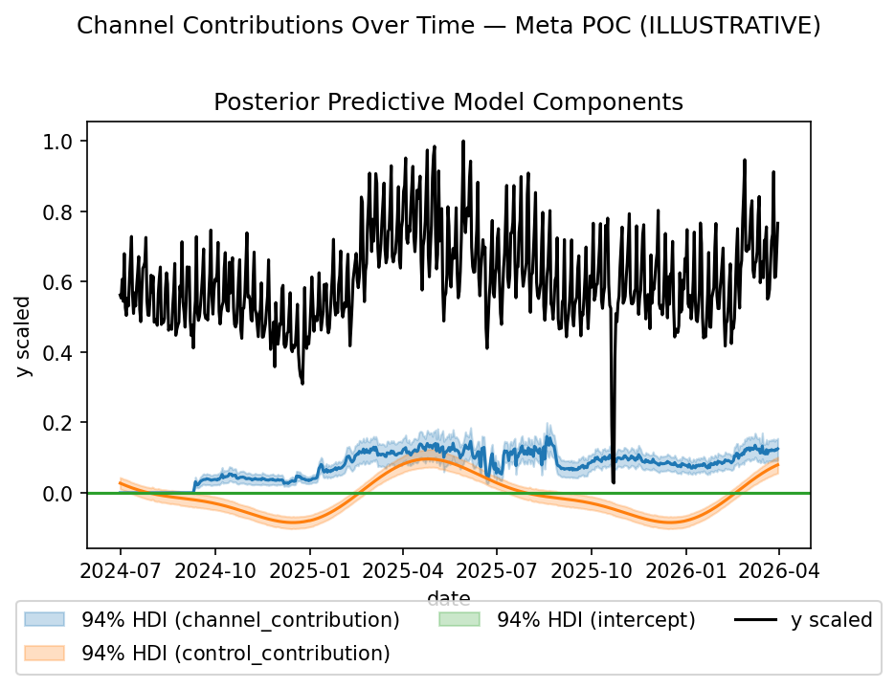
Appendix A5 — Channel Contributions (Facebook POC)
A5

Slide 21
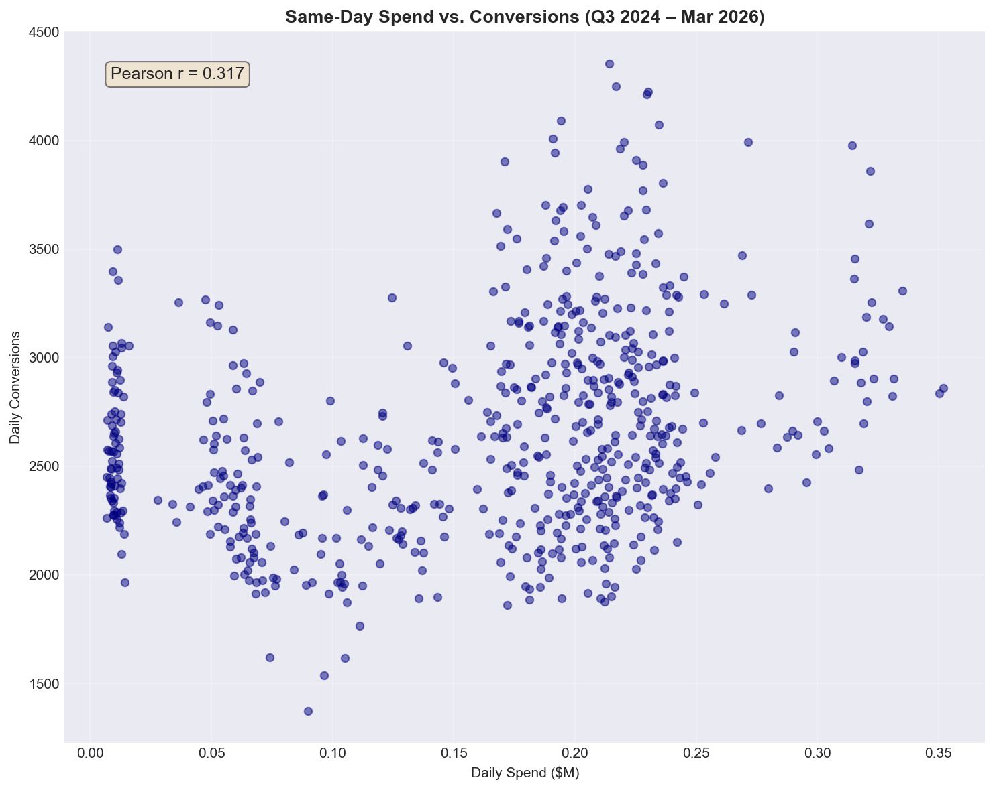
Appendix A6 — Spend vs. Conversions Scatter
A6

