Slide 1

Learning Curve “Gotchas”
AngularJS Utah Meetup: January 14, 2014
https://github.com/rsnapp/presents-angular-gotchas

Slide 2

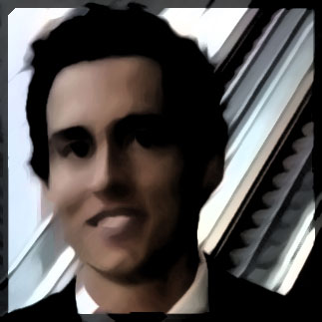
About Us
Travis Barney
Twitter: @travenasty
Rich Snapp
http://www.linkedin.com/in/richsnapp

Slide 3


Work @
Connecting shoppers with brand advocates through authentic conversations.
Code in HTML5 (CSS3 + JS), Python, Mongo, and C.
goto: needle.com/careers

Slide 4

Why Angular?
Designer Friendly Extend HTML – Declare behavior
Full-Featured Framework Easy to step into, use only what you need.
Separate Concerns Well-defined patterns, best practices.
Learn by Example Open Source, with a vibrant community.

Slide 5
Resources & Tools
docs.angularjs.org Version specific API documentation
github.com/angular Read the source Luke
yearofmoo.com Blog full of ng-goodness
Twitter.com/AngularJS_News Stories worth following
github.com/ngbp/ngbp
Example project structure
Yeoman Painless scaffolding + generators
generator-angular: live-reload, ngmin, autoprefixer
generator-karma: jasmine, phantomjs
generator-radian: cofee, jade, sass
Grunt Task runner
Bower Package management
npm Node Package Manager
yo angular:route foo
grunt build
bower install
npm install –g yo

Slide 6
angular.module
(“name”) // get
(“name”, [deps. …]) // set
“Data”
.value ‘Singleton’ object/primitive
.constant Injectable to .providers
“Logic”
.factory return {…};
.service new svc();
.provider new pro().$get();
“View”
.directive DOM element compile + link hooks.
.controller Glue between Model and View.
.filter Transformations: i18n, sorting, currency, etc.
“App”
.config “Decorate” components, declare routes.
.run Kick start application, can inject instances or constants.

Slide 7
Two-way binding

Slide 8
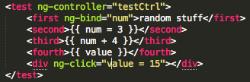
Uses implicit $watches
expect($scope.$$watchers.length)
.toBe(4);
$scope.$watch('num', function() {});
expect($scope.$$watchers.length).toBe(5);

Slide 9
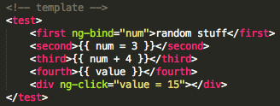

View is updated by $digest
expect(view.find('first').html())
$scope.$digest();
expect(view.find('first').html())
.toBe('random stuff');
.not.toBe('random stuff');
expect(view.find('first').html()).toBe(‘2’);

Slide 10
You must $apply yourself (outside of Angular land)
expect(view.find('fourth').html()).toBeFalsy();
view.find('fourth').on("click", function() {
$scope.value = 10;
});
view.find('fourth')[0].click();
expect(view.find('fourth').html())
.toBeFalsy();

Slide 11
You must $apply yourself (outside of Angular land)
expect(view.find('fourth').html()).toBeFalsy();
view.find('fourth').on("click", function() {
$scope.value = 10;
$scope.apply();
});
view.find('fourth')[0].click();
expect(view.find('fourth').html())
.toBe(‘10’);

Slide 12
You must $apply yourself (outside of Angular land)
expect(view.find('fourth').html()).toBeFalsy();
browserTrigger(view.find('div'), "click");
expect(view.find('fourth').html())
.toBe('15');

Slide 13
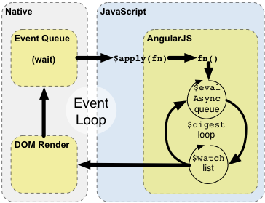
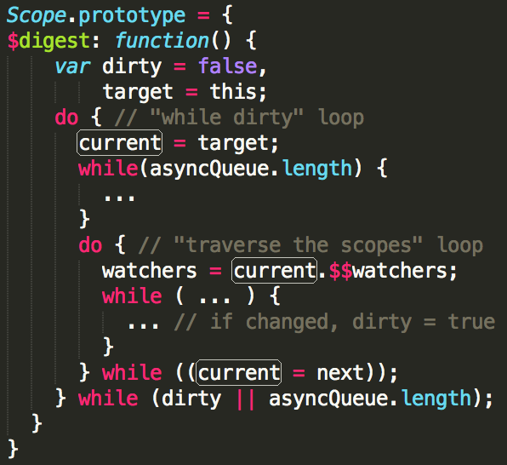
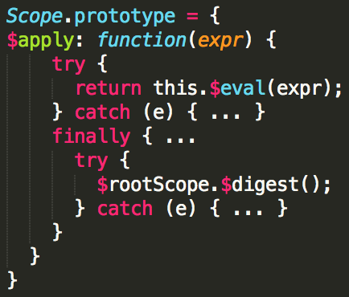
$apply and $digest

Slide 14

Uses dirty checking
$scope.guy = {};
var watch = jasmine.createSpyObj('watch',
['obj', 'property', 'deepObj']);
$scope.$watch('guy', watch.obj);
$scope.$watch('guy.name', watch.property);
$scope.$watch('guy', watch.deepObj, true); // use angular.equals()
$scope.$digest();
watch.obj.reset();
watch.property.reset();
watch.deepObj.reset();
$scope.$apply(function() {
$scope.guy.name = 'fred';
});
expect(watch.obj)
expect(watch.property)
expect(watch.deepObj)
.not.toHaveBeenCalled();
.toHaveBeenCalled();
.toHaveBeenCalled();

Slide 15
$digest loop
var digestCount = 0;
$scope.test = 1;
$scope.$watch('test', function() {
if($scope.test < 4) {
$scope.test++;
}
});
$scope.$watch(function() {
digestCount++;
});
$scope.$digest();
expect(digestCount)
.toBe(4);

Slide 16
$digest infinite loop
$scope.getPeople = function() {
return [
{name: "john"},
{name: "fred"}
];
};
$compile(template)($scope);
expect(function() {
$scope.$digest();
})
.toThrow();

Slide 17
$digest loop
var people = [
{name: "john"},
{name: "fred"}
];
$scope.getPeople = function() {
return people;
};
view = $compile(template)($scope);
$scope.$digest();
expect(view.find('person').length)
.toBe(2);

Slide 18

Use the dot
$scope.people = [
{name:”fred”},
{name: “john”}
];
$scope.personOfDay = “fred”;
expect(view.find("div").length).toBe(2);
expect(view.find("pod").html()).toBe("fred");
browserTrigger(view.find("button.john.pod"), "click");
expect(view.find("pod").html())
.toBe("fred");

Slide 19

Use the dot
$scope.people = [
{name: ”fred”},
{name: “john”}
];
$scope.personOfDay = {
current: “fred”
};
expect(view.find("div").length).toBe(2);
expect(view.find("pod").html()).toBe("fred");
browserTrigger(view.find("button.john.pod"), "click");
expect(view.find("pod").html())
.toBe(“john”);

Slide 20
I promise this is the end
var link = “https://github.com/angular/angular.js/” +
“commit/117f4ddba96a12224d878cbf9c6846f4c9954971”
fix($parse): deprecate promise unwrapping and make it an opt-in
This commit disables promise unwrapping and adds
$parseProvider.unwrapPromises() getter/setter api that allows developers
to turn the feature back on if needed. Promise unwrapping support will
be removed from Angular in the future and this setting only allows for
enabling it during transitional period.

Slide 21
Questions?

