Slide 1
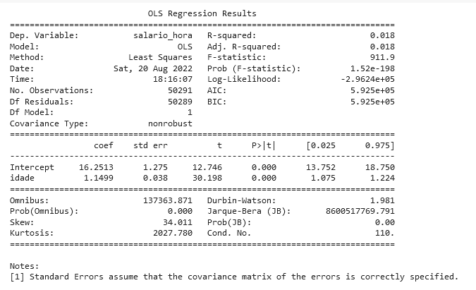


R – squared value: 18 % variation in Y= ‘salario_hora’ can be explained by X = ‘idade’.
Dependent variable: Dependent variable is one that is going to depend on other variables. In this regression analysis Y is our dependent variable because we want to analyse the effect of X on Y.
Ordinary Least Squares(OLS): This model gives best approximate of true population regression line. The principle of OLS is to minimize the square of errors ( ∑e_{i}² ).
Adjusted R-squared is important for analyzing multiple dependent variables’ efficacy on the model.
The optimal model is selected based on the highest R2 and minimum AIC and BIC.
F-statistic: it test tells the goodness of fit of a regression
Number of observations: The number of observation is the size of our sample, i.e. N = 150.
Is it accurate that your variables’ effect is 0?
it is telling us 0.00..198x..0152% chance of this.
Akaike information criterion (AIC);
Bayesian information criterion (BIC)
A lower AIC or BIC value indicates a better fit.A good model is the one that has minimum AIC among all the other models.
Degree of freedom(df) of residuals: number of independent observations on the basis of which the sum of squares is calculated.
D . f = N – K
N = sample size(no. of observations)
K = number of variables + 1
D.f Residuals = 50291 – (1+1) = 50289
t – statistics: normal distribution; b1 ∼ N(B1, σb12): H0 : B2 = 0 ( variable X has no influence on Y); H1 : B2 ≠ 0 (X has significant impact on Y)
t = (16.2513 – 0) /1.275 = 12.746
Confidence intervals:reject the null hypothesis
alpha is 0.05
Durbin-Watson is a measurement of homoscedasticity, or an even distribution of errors throughout our data. Heteroscedasticity would imply an uneven distribution, for example as the data point grows higher the relative error grows higher. Ideal homoscedasticity will lie between 1 and 2.
Omnibus e Prob(Omnibus): skewness and kurtosis
Jarque-Bera (JB) e Prob(JB): skewness and kurtosis
standard deviation
Standard error of intercept term (b1):
Standard error of coefficient term(b2):
Cond. No. = if hight means multicollinearity
Notes:
https://www.geeksforgeeks.org/interpreting-the-results-of-linear-regression-using-ols-summary/
https://medium.com/swlh/interpreting-linear-regression-through-statsmodels-summary-4796d359035a

