Slide 1
Serverless Programming with ES6
Building and Deploying AWS Lambda Functions
Scott Nestor – 09/2017

Slide 2
Welcome
Goals for this session
Shared learning
I’m a node.js newbie … please share your knowledge as we proceed through the session!
There were some pre-requisites, housekeeping slides to follow
Let’s go …

Slide 3
ES6 and node.js
ECMAScript 2015 (ES6) - a significant evolution of the language.
Compatible with most modern browsers (http://kangax.github.io/compat-table/es6/)
Node.js – Server side JavaScript using Chrome V8
Node.js is an extremely performant, event based platform that is ideal serverless implementations
https://nodejs.org/dist/latest-v6.x/docs/api/

Slide 4
Node.js - A Brief Discussion
“Threaded concurrency is a leaky abstraction” - Ryan Dahl (https://youtu.be/ztspvPYybIY)
I/O is extremely fast
Single threaded ”event loop” vs. multiple threads
Blocking operations can be performed asynchronously via callbacks (key concept)
A brief “Un-packing” – The JS call stack and functional immutability [whiteboard]
Notes:
1) A single call stack
2) Multi-threading emulates concurrency but is expensive (context switching and memory)
3) Un-packing whiteboard – a) Call stack & blocking operations, b) Immutable arrays

Slide 5
Node.js Housekeeping
Install node.js
Editor/IDE preferably with language auto-completion (tip: A great VS Code extension is Node.js Modules Intellisense
Clone the SLAC example code & misc.
$ node –version
v6.11.2
$ git clone https://github.com/rsnestor/slac.git

Slide 6
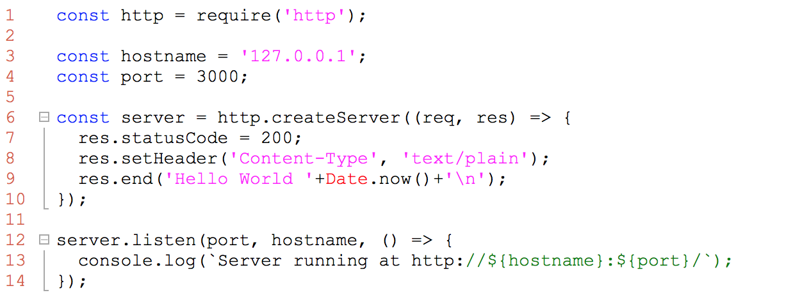
Node.js Getting Started
Notes:
Code (the node “boilerplate” hello world):
1. Module dependency (http)
2. Constants
3. Anonymous function
4. No parm anonymous callback
Execution:
1. curl or browser

Slide 7
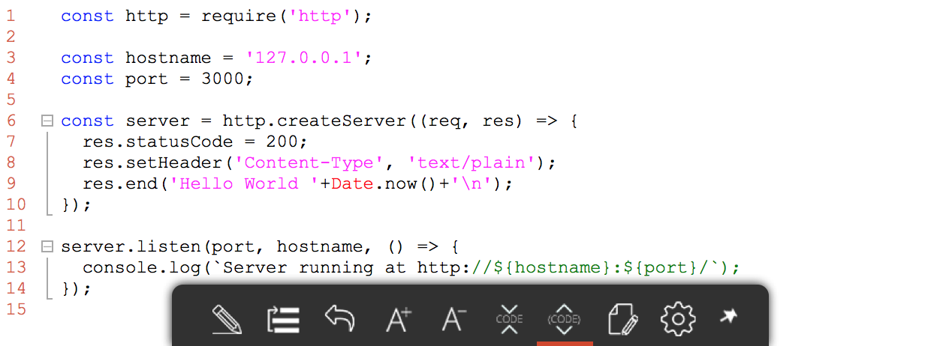
ES6 Basics - Functions
Notes:
Code:
1. Get method callback with response object
2. Event triggers (on "data", on "end")
3. Nested functional implementations
Execution:
1. curl or browser

Slide 8
ES6 Basics – Collections (Map)
Notes:
Code:
1. Get method callback with response object
2. Event triggers (on "data", on "end")
3. Nested functional implementations
Execution:
1. curl or browser

Slide 9
ES6 Async - Callback
Notes:
Code:
1. Get method callback with response object
2. Event triggers (on "data", on "end")
3. Nested functional implementations
Execution:
1. curl or browser

Slide 10
ES6 Async – Promise
Notes:
Code:
1. Get method callback with response object
2. Event triggers (on "data", on "end")
3. Nested functional implementations
Execution:
1. curl or browser

Slide 11
Serverless Architectures
Autonomous functional execution on demand – Function as a Service FaaS
Microservices? (https://12factor.net/)
In AWS, lambda instanceOf serverless function
Many languages supported including Java, Python, and JavaScript (node.js)
Benefits – Cost, Scalability, Flexibility
Constraints – Execution caps, Response time with JVM dependent languages
Notes:
Cost – based on transactional volume, not infrastructure
Flexibility – functions can be re-deployed independently
A single call stack

Slide 12
The Serverless Framework
Open source build and deployment tool
Support for multiple public cloud providers (Google, Azure, and AWS)
Multi-language support
Abstracts configuration and deployment orchestration details
Supports the integration with several cloud services including event/messaging, database, and storage
Notes:
A single call stack

Slide 13
Serverless Housekeeping
AWS Account
User serverless_admin with IAM policy AmazonAPIGatewayInvokeFullAccess
External wifi “hotspot”
The serverless framework installed
$ sudo npm i serverless -g
$ serverless --help

Slide 14
Serverless Hello World!
$ serverless --help
. . .
$ serverless create --template aws-nodejs --path aws-node-foo-svc1
$ serverless deploy
$ serverless invoke -f hello –l
Simple npm install (use root for global)
Many service runtime templates (python, node, java, scala, etc.)
Re-deploy functions independently
Local invocation of functions for testing before deployment
Notes:
1) Create node template and examine serverless.yml and handler.js
2) If serverless "not found" ensure node_modules/serverless/bin is in your $PATH -OR- npm install serverless --global (with root)
3) Alternatively you can create "aws-java-maven"
4) If deploy fails, check credentials for "serverless" profile
5) Take a look at the Cloud Formation file created under .serverless
6) Observe the service packaging on S3 and update to the CloudFormation stack
7) Modify the code and re-deploy the function only: "serverless deploy function -f hello"
** Create/deploy Java svc as well. Compare local and deployed sizes. Compare execution time.

Slide 15
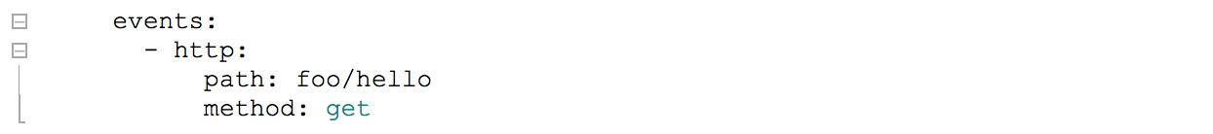
Serverless AWS Events
Event configuration abstractions available for: API Gateway, DynamoDB, IoT, S3, and others
Several HTTP Endpoint configuration options for API Gateway: lambda-proxy, lambda, http-proxy, http, and mock
LAMBDA-PROXY (default) passes the http request to your code. No need to configure each endpoint separately in API Gateway.
Notes:
1) Update serverless.yml with http (path & method) and re-deploy the service
2) Examine the input event in the response. Comment in the handler and re-deploy "serverless deploy function -f hello"
3) Copy URL to ajax html (slac) and test

Slide 16
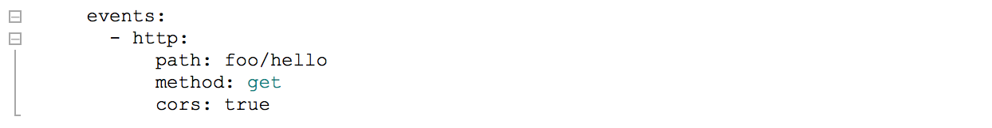
Lambda-proxy and CORS
Why didn’t this work?
Notes:
1) Update serverless.yml with cors and test ... why didn't it work?

Slide 17
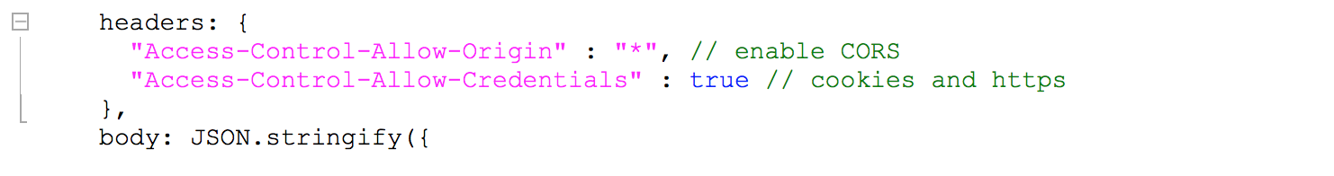
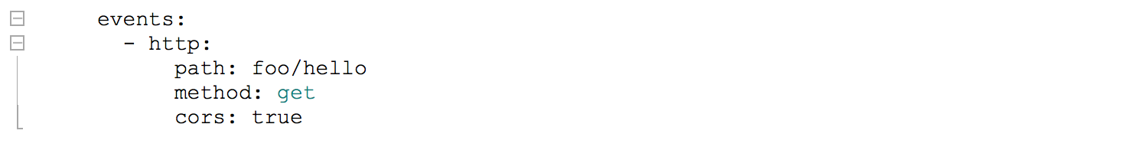
Lambda-proxy and CORS
Why didn’t this work?
Notes:
1) Modify code handler and re-test

Slide 18
serverless.yml – AWS details
serverless.yml (yaml) - configuration defines cloud provider deployment details, functions and their event triggers, and resource dependencies
Provider configuration can include iamRoleStatements for dependencies that require additional permissions. You can use CloudFormation syntax (yuck).
VPC config (security groups and subnets) are supported at the service and function level (overrides)
Environment variables and tags are supported
AWS KMS keys can be specified using awsKmsKeyArn

Slide 19
serverless.yml – Resources
AWS infrastructure dependencies are configured as a Resource in serverless.yml (e.g., DynamoDB, S3)
The serverless framework uses a standard naming convention within the CloudFormation templates it generates: {Function Name}{Cloud Formation Resource Type}{Resource Name}{SequentialID or Random String}
Example: Mapping lambda events to DynamoDB uses {normalizedFunctionName}EventSourceMappingDynamodb{tableName}

Slide 20
CRUD Endpoints for DynamoDB
Create a DynamoDB table (note: env prop for tbl name)
Configure the proper IAM roles
Map APIs to functions
TODO – Implement update handler
$ cd examples/aws-node-rest-api-with-dynamodb
$ npm install (uuid)
$ serverless deploy
. . .
$ curl –X POST https://[XXXXX]/dev/loans/ --data ‘{"loan": {"upb": 250000, "amort": "FRM", "term": 30 }}'
$ curl https://[XXXXX]/dev/loans/<id>
$ curl –X DELETE https://[XXXXX]/dev/loans/<id>
Notes:
Examine serverless.yml … note the CloudFormation DeletionPolicy (default is snapshot, which keeps a ”deleted” copy)
Examine handlers (loans/*.js)
After executing API, take a look at the DB

Slide 21
SMS Event via Twilio
Create a Twilio account & phone# => http://twilio.com
Update serverless.yml with SID, AUTH and phone#
Update event.json (optional)
Update frontend/index.html and deploy (optional)
$ cd examples/aws-node-twilio-send-text-message
$ npm install (twilio)
$ serverless deploy
. . .
$ serverless invoke -f sendText --path event.json
Notes:
If send problems, you can test twilio account directly via curl:
curl 'https://api.twilio.com/2010-04-01/Accounts/AC00ac799d0fe719223627d0c58ff6f59a/Messages.json' -X POST --data-urlencode 'To=+17039807058' --data-urlencode 'From=+12408470836' --data-urlencode 'Body=Twilio curl' -u {SID}:{AUTH}

Slide 22
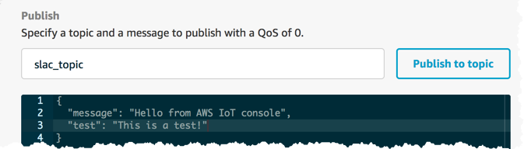
IoT Event Triggers
$ serverless deploy
. . .
$ serverless logs --function log
Notes:
1) After deployment: IoT [Get Started] > Test > Publish “slac_topic”

Slide 23
Open Session
Explore additional examples [and demo]
Notes:
1) After deployment: IoT [Get Started] > Test > Publish “slac_topic”

