Slide 1
Serverless Programming with ES6
Building and Deploying AWS Lambda Functions
Scott Nestor – 09/2017

Slide 2
ES6 and node.js
ECMAScript 2015 (ES6) - a significant evolution of the language.
Compatible with most modern browsers (http://kangax.github.io/compat-table/es6/)
Node.js – Server side JavaScript using Chrome V8
Node.js is and extremely performant, event based platform that is ideal serverless implementations

Slide 3
Node.js - A Brief Discussion
“Threaded concurrency is a leaky abstraction” - Ryan Dahl (https://youtu.be/ztspvPYybIY)
I/O is extremely fast
Single threaded ”event loop” vs. multiple threads
Multithreading emulates concurrency but is expensive (context switching and memory)
Blocking operations can be performed asynchronously via callbacks (key concept)

Slide 4
Node.js Housekeeping
bash-3.2$ node –version
v6.11.2
Install node.js
Editor/IDE preferably with language auto-completion (tip: A great VS Code extension is Node.js Modules Intellisense
Clone the SLAC repo (https://github.com/rsnestor/slac.git)

Slide 5
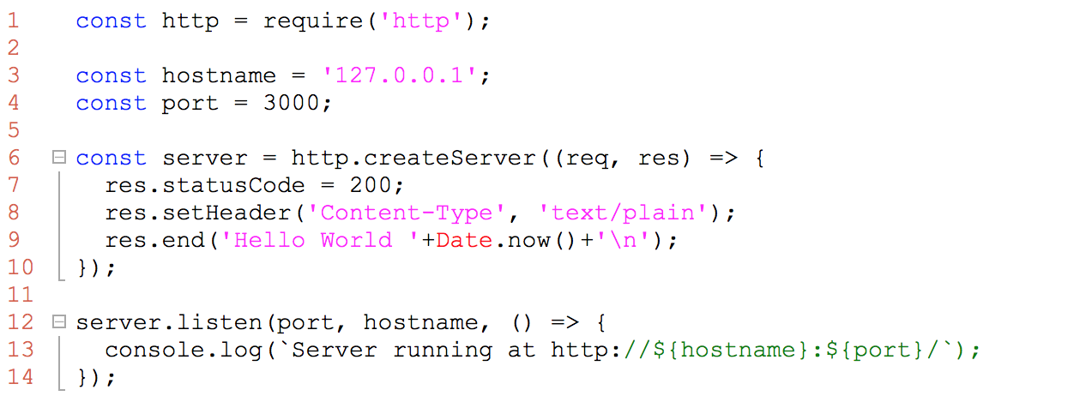
Node.js Getting Started
Notes:
Code:
1. Module dependency (http)
2. Constants
3. Anonymous function
4. No parm anonymous callback
Execution:
1. curl or browser

Slide 6
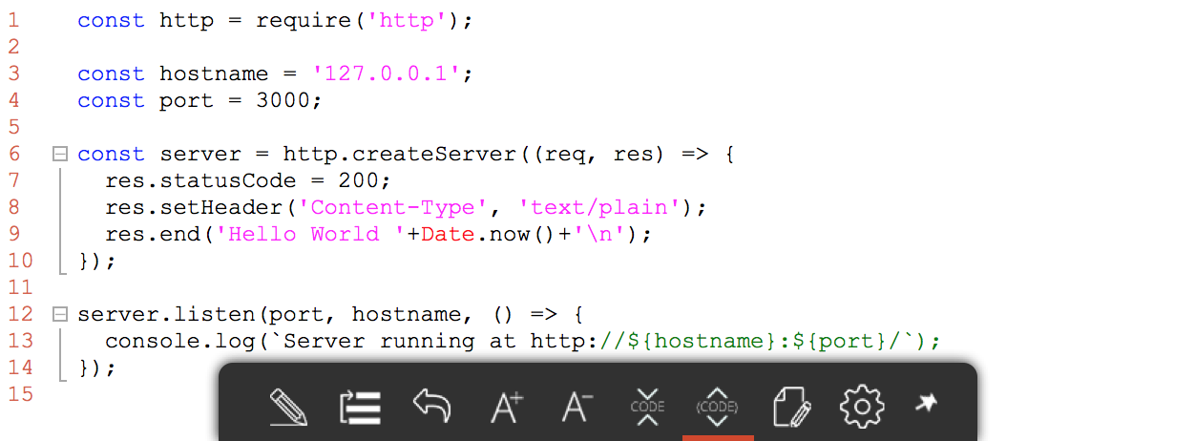
Node.js Client Example
Notes:
Code:
1. Module dependency (http)
2. Constants
3. Anonymous function
4. No parm anonymous callback
Execution:
1. curl or browser

