Slide 1
Serverless Programming with ES6
Building and Deploying AWS Lambda Functions
Scott Nestor – 09/2017

Slide 2
ES6 and node.js
ECMAScript 2015 (ES6) - a significant evolution of the language.
Compatible with most modern browsers (http://kangax.github.io/compat-table/es6/)
Node.js – Server side JavaScript using Chrome V8
Node.js is and extremely performant, event based platform that is ideal serverless implementations

Slide 3
Node.js - A Brief Discussion
“Threaded concurrency is a leaky abstraction” - Ryan Dahl (https://youtu.be/ztspvPYybIY)
I/O is extremely fast
Single threaded ”event loop” vs. multiple threads
Multi-threading emulates concurrency but is expensive (context switching and memory)
Blocking operations can be performed asynchronously via callbacks (key concept)
Notes:
A single call stack

Slide 4
Node.js Housekeeping
bash-3.2$ node –version
v6.11.2
Install node.js
Editor/IDE preferably with language auto-completion (tip: A great VS Code extension is Node.js Modules Intellisense
Clone the SLAC repo (https://github.com/rsnestor/slac.git)

Slide 5
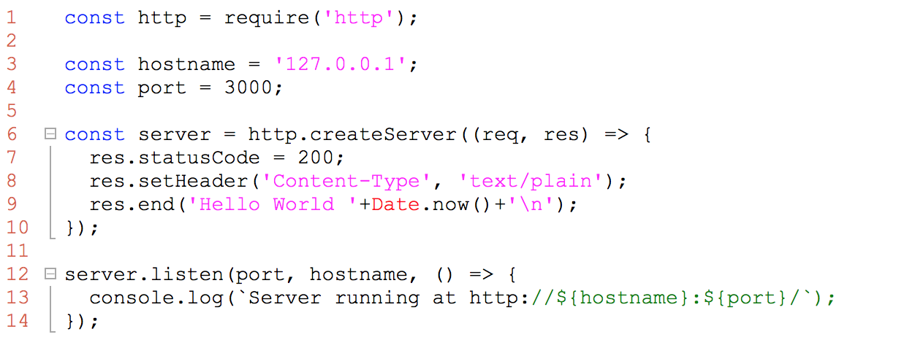
Node.js Getting Started
Notes:
Code:
1. Module dependency (http)
2. Constants
3. Anonymous function
4. No parm anonymous callback
Execution:
1. curl or browser

Slide 6
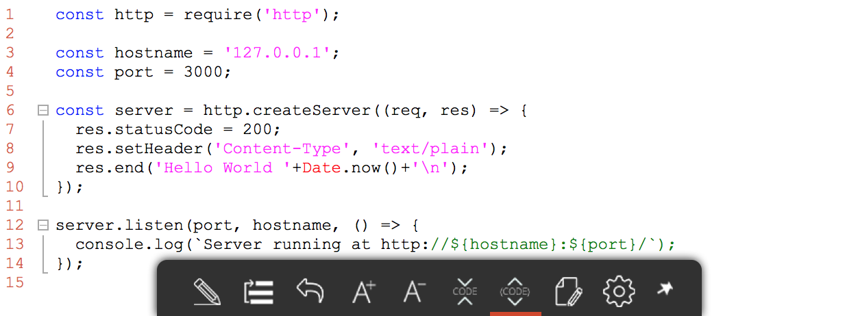
Node.js Client Example
Notes:
Code:
1. Get method callback with response object
2. Event triggers (on "data", on "end")
3. Nested functional implementations
Execution:
1. curl or browser

Slide 7
Serverless Architectures
Autonomous functional execution on demand
Microservices? (https://12factor.net/)
In AWS, lambda instanceOf serverless function
Primary languages supported are Java, Python, and JavaScript (node.js)
Notes:
A single call stack

Slide 8
The Serverless Framework
Open source build and deployment tool
Support for multiple public cloud providers (Google, Azure, and AWS)
Multi-language support
Abstracts configuration and deployment orchestration details
Supports the integration with several cloud services including event/messaging, database, and file I/O
Notes:
A single call stack

Slide 9
Serverless Hello World!
$ serverless --help
. . .
$ serverless create --template aws-nodejs --path aws-node-foo-svc1
$ serverless deploy
$ serverless invoke -f hello –l
Simple npm install (use root for global)
Many service templates options (py, node, java)
Re-deploy functions independently
Local invocation of functions for testing before deployment
Notes:
1) Create node template and examine serverless.yml and handler.js
2) If serverless "not found" ensure node_modules/serverless/bin is in your $PATH -OR- npm install serverless --global (with root)
3) Alternatively you can create "aws-java-maven"
4) If deploy fails, check credentials for "serverless" profile
5) Modify the code and re-deploy the function only: "serverless deploy function -f hello"
** Create/deploy Java svc as well. Compare local and deployed sizes. Compare execution time.

Slide 10
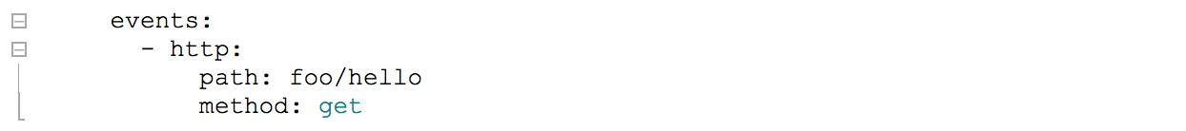
Serverless AWS Events
Event configuration abstractions available for: API Gateway, DynamoDB, IoT, S3, and others
Several HTTP Endpoint configuration options for API Gateway: lambda-proxy, lambda, http-proxy, http, and mock
LAMBDA-PROXY (default) passes the http request to your code. No need to configure each endpoint separately in API Gateway.
Notes:
1) Update serverless.yml with http (path & method) and re-deploy the service
2) Examine the input event in the response. Comment in the handler and re-deploy "serverless deploy function -f hello"
3) Copy URL to ajax html (slac) and test

Slide 11
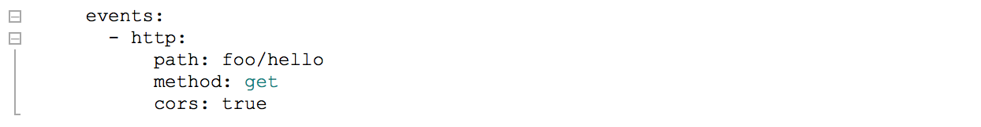
Lambda-proxy and CORS
Why didn’t this work?
Notes:
1) Update serverless.yml with cors and test ... why didn't it work?

Slide 12
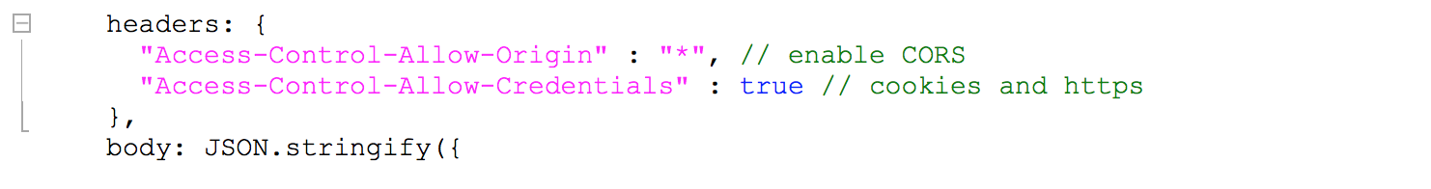
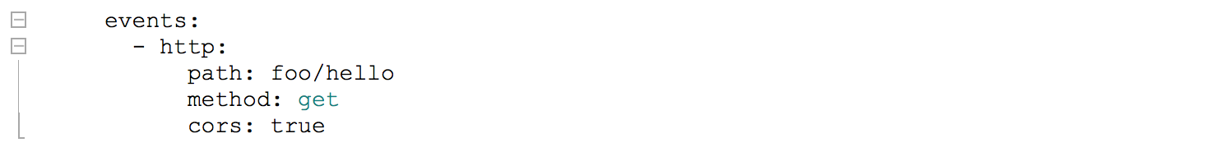
Lambda-proxy and CORS
Why didn’t this work?
Notes:
1) Modify code handler and re-test

