Slide 1
An Introduction to the Official Formal Specification
of the RISC-V Instruction Set Architecture
Rishiyur S. Nikhil, PhD ¹
CTO and co-founder, Bluespec, Inc.
(nikhil@bluespec.com)
3rd RISC-V Meeting, March 30-31, 2021, France
¹ Chaired the RISC-V Foundation’s Technical Committee that selected/developed the ISA Formal Spec

Slide 2
Introduction
The RISC-V ISA Formal Spec is intended to be the official and definitive specification of the RISC-V ISA (Instruction Set Architecture)
I.e., it is the “ultimate truth” against which the (functional) correctness of all implementations should be measured
  Hardware implementations
  Simulators and emulators
  Compilers
Disclaimer: These are not official positions of RISC-V International Association. Any inaccuracies here are solely the responsibility of the speaker.

Slide 3
What is an “ISA Formal Spec”?
It is a description of each instruction, written in a formal language (not English prose)
Describes:
  Architectural machine state
  Bit encoding of instructions
  The “meaning” of each opcode, i.e., “what does this instruction do?”
  (Nice to have:) An assembly syntax
  All the different allowed parameterizations
  All the different allowed non-deteriminisms
    Including, in particular, interactions with RISC-V Weak Memory Models
We also want the formal language to have these properties:
  Have simple unambiguous semantics (so that instruction semantics are clear)
  Be easily machine readable and manipulable (so we can connect to formal tools, perform formal analyses and transformations, etc.)
  Be executable (so we can use the formal spec directly as a “correct” simulator)
  Be approachable and understandable every day by working engineers
A RISC-V ISA simulator written in C/C++ would satisfy some, but not all of these requirements.

Slide 4
The RISC-V ISA Formal Spec is written in Sail ¹
Developed by Prof. Peter Sewell’s group at U.Cambridge, UK
Sail is purpose-designed to describe ISAs
  Has also been used to describe ISAs of ARM, MIPS, parts of PowerPC and x86
  Has been deliberately designed to be similar to traditional ISA specs (written with English prose and sometimes also with pseudo-code), with great effort to make it familiar to and easily usable by working engineers:
    All aspects of an instruction (bit encoding, fields, execution semantics, assembly syntax) are in a textually contiguous group
The Sail implementation (i.e., code that processes Sail code) is written in OCaml
  Back-ends produce simulators in C and OCaml
  Back-ends connect to other formal tools: Coq, Isabelle, HOL4
Public repository for Sail: https://github.com/rems-project/sail
¹ Sail is just a name, not an acronym

Slide 5
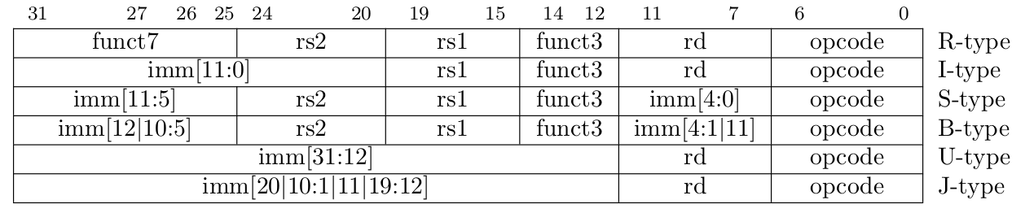
Example: Sail spec for LUI and AUIPC instructions
The text spec document for the RISC-V ISA shows that RISC-V instructions are encoded in a few formats:
The LUI (“Load Upper Immediate”) and AUIPC (“Add Upper Immediate to PC”) instructions have the “U-type” encoding format. The two instructions are distinguished by the 7-bit “opcode” field. The 20-bit immediate value is loaded (LUI) or added to the current PC and loaded (AUIPC) into the destination register (named with a 5-bit index “rd”) after suitable alignment, sign-extension, etc.

Slide 6
Example: Sail spec for LUI and AUIPC instructions: encoding
The Sail code first defines an AST (Abstract Syntax Tree) for the U-type format:
enum uop = {RISCV_LUI, RISCV_AUIPC}
union clause ast = UTYPE : (bits(20), regidx, uop)
Declared elsewhere as bits(5)
Then, a bit-encoding for the 7-bit ‘opcode’ part of the instruction:
mapping encdec_uop : uop <-> bits(7) = { RISCV_LUI <-> 0b0110111,
RISCV_AUIPC <-> 0b0010111 }
bit-concatenation
Then, the bit-encoding for whole instruction:
mapping clause encdec = UTYPE(imm, rd, op) <-> imm @ rd @ encdec_uop(op)
The AST
The bit representation

Slide 7
Example: Sail spec LUI and AUIPC: execution semantics
The execution semantics is defined by a function on the AST (on a global architectural state):
Pattern-matching
(this clause of ‘execute’ only applies on UTYPE ASTs)
function clause execute UTYPE(imm, rd, op) = {
let off : xlenbits = EXTS(imm @ 0x000);
let ret : xlenbits = match op {
RISCV_LUI => off,
RISCV_AUIPC => get_arch_pc() + off };
X(rd) = ret;
RETIRE_SUCCESS
}
Register-write
Declaring type of
a local variable
Pattern-matching
Other types of instructions
may have exceptions (traps)
Sign-extension operator
(to XLEN width)
Here the specs for LUI and AUIPC are given together since they share much structure,
but this is a stylistic choice based on readability; they can be given individually.

Slide 8
Example: Sail spec LUI and AUIPC: assembly syntax
The assembly syntax is defined by a mapping between the ASTs and strings:
mapping utype_mnemonic : uop <-> string = { RISCV_LUI <-> "lui",
RISCV_AUIPC <-> "auipc" }
mapping clause assembly =
UTYPE(imm, rd, op)
<-> utype_mnemonic(op) ^ spc() ^ reg_name(rd) ^ sep() ^ hex_bits_20(imm)
AST
String
String concatenation
string space
string separator
(e.g., comma)

Slide 9
Sail: “Scattered” definitions
In most programming languages, a data type declaration must contain all its “clauses”:
union ast = UTYPE : (bits(20), regidx, uop)
| BTYPE : (bits(13), regidx, regidx, bop)
| ...
In Sail, the clauses can be “scattered” across the program text:
union scattered ast
union scattered ast = UTYPE : (bits(20), regidx, uop)
union scattered ast = BTYPE : (bits(13), regidx, regidx, bop)
Similarly, functions and mappings can also be “scattered”.
Thus, the program text can group together the clauses for each opcode, so the spec is organized just like a traditional ISA spec, with all aspects of each opcode grouped into its own section.
LUI, AUIPC
ast spec
encdec spec
execute spec
assembly spec
BEQ, BNE, BLT,
BGE, BLTU, BGEU
ast spec
encdec spec
execute spec
assembly spec

Slide 10
Adding new instructions (e.g., custom instructions)
This “all aspects of an instruction together” makes it easy to add new instructions
as new Sail code without disturbing Sail code for existing instructions.
Existing instruction code can be used as an “example” or “template” for adding new instructions.
LUI, AUIPC
ast spec
encdec spec
execute spec
assembly spec
BEQ, BNE, BLT,
BGE, BLTU, BGEU
ast spec
encdec spec
execute spec
assembly spec

Slide 11
Sail: Types and Type-checking
Sail is a strongly typed, statically type-checked language
Types include
  enums (e.g., enum bop = {BEQ, BNE, BLT, BGE, BLTU, BGEU} )
  algebraic types (like UTYPE and BTYPE, shown earlier)
    (algebraic types are also known as “tagged unions”)
  tuples (like the 3-tuple component of a UTYPE, shown earlier)
  bit-vectors (like bits(20), shown earlier)
    bit-vector sizes are part of the type, and are type-checked: it is impossible to accidentally pass a bit-vector of the wrong size
  functions, and so on
Types can be polymorphic (e.g., a function operating on different bit-vectors of different sizes)

Slide 12
A more complex example: Sail ‘execute’ spec for LOAD (1)
The LOAD group of instructions encompass:
an rs1 source register for the address, and a 12-bit immediate offset to the address
an rd destination register for the loaded value
different sizes: byte (8b), halfword (16b), word (32b), doubleword (64b)
whether the loaded value should be zero- or sign-extended into rd
“acquire” and “release” annotations (for weak-memory models)
function clause execute(LOAD(imm, rs1, rd, is_unsigned, width, aq, rl)) = {
let offset : xlenbits = EXTS(imm);
match ext_data_get_addr(rs1, offset, Read(Data), width) {
Ext_DataAddr_Error(e) => { ext_handle_data_check_error(e); RETIRE_FAIL },
Ext_DataAddr_OK(vaddr) =>
… (continued) …
Argument indicating this is a ‘read’ to
‘data memory’ (not instruction mem)
Sign-extend
12b offset
Compute address
to be loaded
Trap actions
Pattern-match on whether addr computation
failed or succeeded with (virtual) address vaddr

Slide 13
A more complex example: Sail ‘execute’ spec for LOAD (2)
The spec can be configured to model traps
on misaligned addresses
… (continuing) …
if check_misaligned(vaddr, width)
then { handle_mem_exception(vaddr, E_Load_Addr_Align()); RETIRE_FAIL }
else match translateAddr(vaddr, Read(Data)) {
… (continued) …
Trap actions
Compute the physical address from the
virtual address (if virtual memory is currently active).
The function also models TLBs (Translation-Lookaside Buffers)
because these are potentially architecturally visible,
needing the SFENCE.VMA instruction.

Slide 14
A more complex example: Sail ‘execute’ spec for LOAD (3)
Virtual-to-physical
translation can fail
… (continuing) …
else match translateAddr(vaddr, Read(Data)) {
TR_Failure(e, _) => { handle_mem_exception(vaddr, e); RETIRE_FAIL },
TR_Address(addr, _) =>
match (width, sizeof(xlen)) {
(BYTE, _) =>
process_load(rd, vaddr,
mem_read(Read(Data), addr, 1, aq, rl, false),
is_unsigned),
(HALF, _) =>
process_load(rd, vaddr,
mem_read(Read(Data), addr, 2, aq, rl, false),
is_unsigned),
… (and so on for WORD and DWORD) …
Physical address
Do the actual read from the memory model
Move memory value into register rd

Slide 15
Configuration options (“implementation-defined”)
RISC-V permits a number of “implementation-defined” options:
In the unprivileged ISA. Examples:
  RV32I vs. RV64I
  Each of the optional extensions: M (integer multiply/divide), A (atomics), FD (single-and-double-precision floating point), C (compressed), … and more in the future
  Whether or not a LOAD/STORE traps if the address is misaligned
And many more in the privileged ISA: Examples:
  Many CSRs (Control and Status Registers) have “write-any, read-legal” (WARL) fields.
  An implementation can define how an illegal write-value is transformed into a legal read-value.
  A (“accessed”) and D (“dirty”) bits in a PTE (Page Table Entry) can be maintained in the implementation or raise a trap.
The Sail spec is easy to configure for a specific set of choices, at the moment with some editing of Sail source files.
A more systematic way of specifying all officially-allowed implementation choices, and automatically incorporating this into the Sail spec, is under development.

Slide 16
From individual instructions to programs (sequences of instructions)
Sequential semantics is easy (and is adequate for many uses).
Concurrent semantics (modeling concurrency of pipelines, superscalarity, out-of-order, speculation, multi-harts (Hardware Threads) etc. is more complex and subtle because of Weak Memory Models, which allow certain kinds of non-determinism to become visible in the semantics.

Slide 17
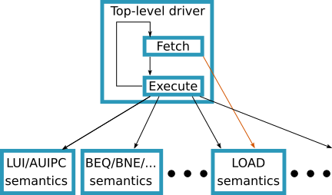
Sequential semantics (simple) → sequential simulator
To create a simple one-instruction-at-a-time sequential simulator from the formal spec, we simply write a Sail top-level fetch-execute loop that invokes per-instruction semantic functions.

Slide 18
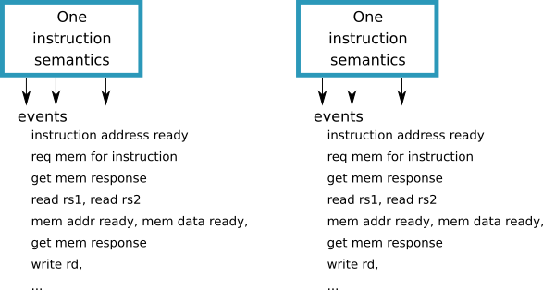
Concurrent semantics and Weak Memory Models
Implementations have various kinds of concurrency: pipelineing, speculation, superscalarity, out-of-order execution, and multi-harts (multi-thread, multi-core; hart = “hardware thread”).
With instruction concurrency and weak memory models, we can no longer treat each instruction execution as an atomic action (as in the simple sequential semantics).
Execution of an instruction involves a series of events,
and the events of concurrent instructions can interleave,
exposing non-deterministic behavior.
(Hence the need for instructions like FENCE, FENCE.I, SFENCE.VMA)

Slide 19
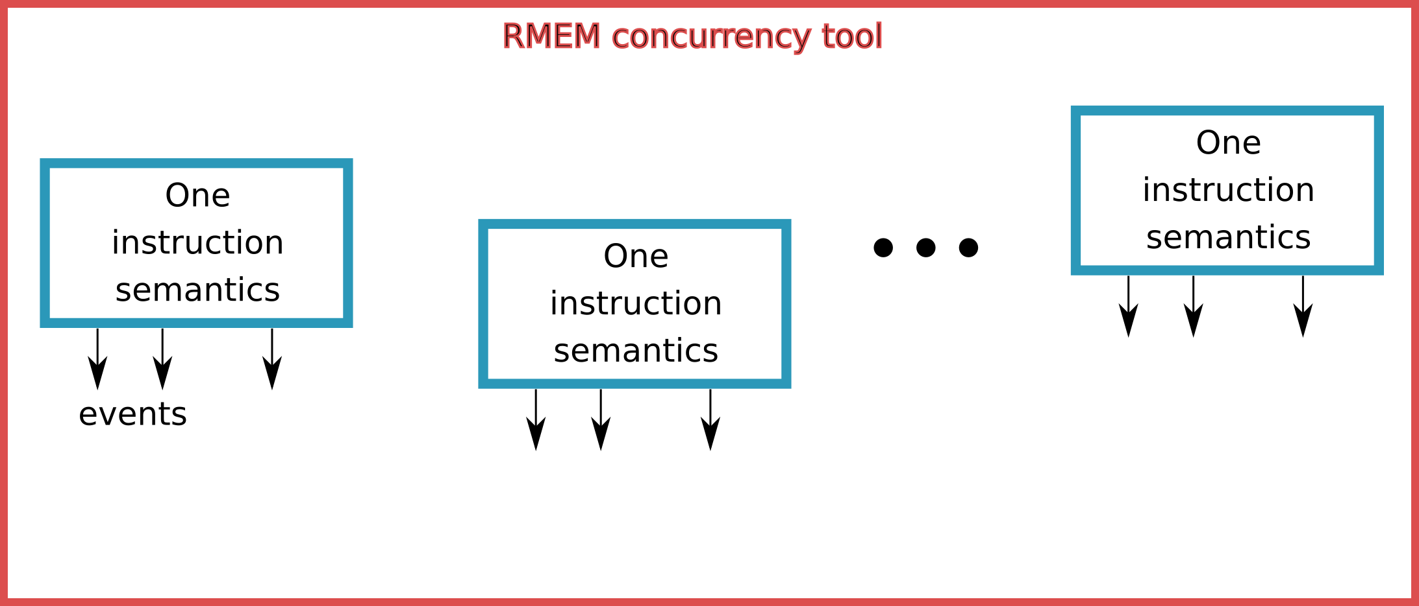
Instruction concurrency and Weak Memory Models
The Sail formal spec can be used to model the full range of allowed non-determinisms.
The semantics are written in terms of an “API” for basic actions, such as reading/writing a register, address calculation, reading/writing from memory, etc.
For sequential semantics, these are implemented in the natural, intuitive way.
For concurrent semantics, these can also announce/record the “events” during an instruction’s execution.
An alternative top-level can interleave events from concurrent instructions.
The Sail project includes the REM concurrency tool which has been used to specify the RISC-V Weak Memory Model(s), and which can interact with the instruction semantics.

Slide 20
Using the RISC-V ISA Formal Spec
There are many ways to use the ISA Formal Spec
It is ready for some uses now, in everyday activities
Some are more researchy, but open the door for future formal assurance about designs (correctness, security, ...)

Slide 21
Use-case: As an everyday document to consult
I hope this will be the most common use-case for the ISA Formal Spec.
Every engineer who works with RISC-V (hardware CPU designer, hardware CPU verification engineer, compiler writer targeting RISC-V, simulator writer, …) should
  Bookmark the Formal Spec link in their browser
  Consult the Formal Spec to clarify any doubts about any RISC-V instruction
Anyone teaching the RISC-V ISA, and anyone learning the RISC-V ISA, should use the Formal Spec as an integral part of their activity.
In other words, people should use the Formal Spec as often and naturally as a traditional text ISA spec.

Slide 22
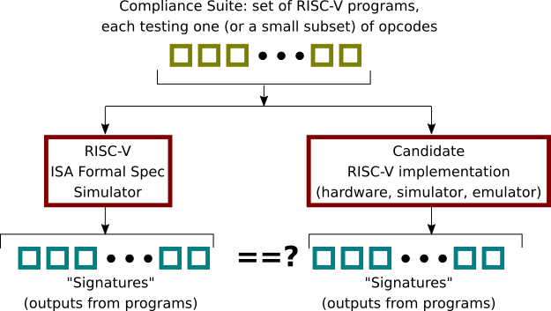
Use-case: “Golden Reference” for Compliance Suite
This may be the next most common use-case for the ISA Formal Spec.
Before a commercial implementation can claim that it “is a RISC-V implementation”, it must pass the RISC-V Compliance Suite.
In general, the ISA Formal Spec simulator can be seen as a “golden reference model” during verification of functional correctness of any RISC-V implementation.

Slide 23
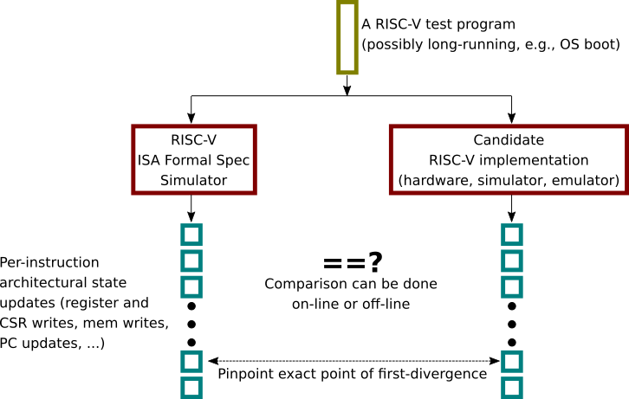
Use-case: “Tandem Verification”
Tandem Verification uses the ISA Formal Spec as a golden reference in a more fine-grain (instruction-by-instruction) manner, so that faulty behavior can be pinpointed precisely.

Slide 24
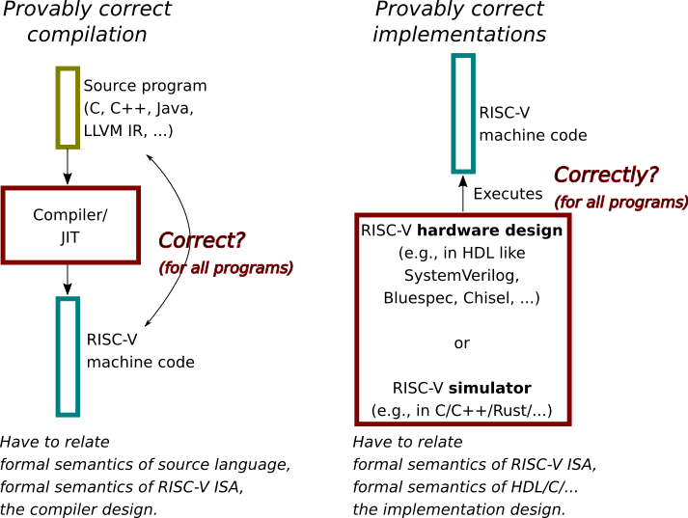
Use-cases: Formal proofs of correctness/equivalence
Several research groups are pursuing these ideas.

Slide 25
RISC-V ISA Formal Spec: Status and Plans
The Formal Spec currently covers:
Unprivileged RV32I, RV64I
Extensions M (int mult/div), A (atomics) FD (single-, double-precision float), C (compressed)
  FD currently use capture all RISC-V-specific aspects (floating point registers, CSRs, load/store) but invoke Berkeley “Softfloat” for actual computation; this should change in future
Privileged spec with M, S and U privileges, Sv32, Sv39 and Sv48 virtual memory
The simulator has been used to boot Linux, FreeBSD, Sel4, FreeRTOS.
The generated simulator via C is fast enough to boot Linux/FreeBSD in a few seconds/minutes.
Ongoing work to improve accessibility:
Integration in-line with existing unprivileged and privileged text spec documents
General documentation, tutorials, outreach
Ongoing work:
Integration with RISC-V Compliance Suite
Formalization of “implementation choices”
Every new ISA extension will require an extension to the ISA Formal Spec
Please feel free to join in!

Slide 26
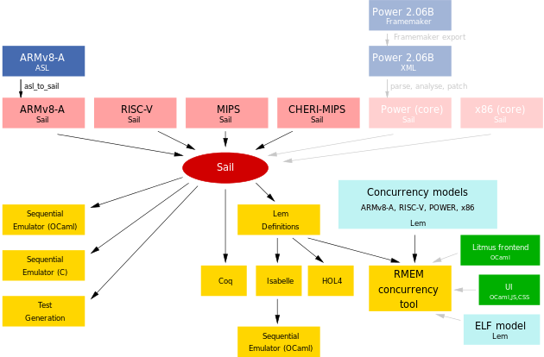
The ecosystem around the RISC-V ISA Formal Spec and Sail
Many ISAs have been coded in Sail
The Sail implementation has many back-ends to produce simulators (in C and OCaml) and to connect to other formal tools
(picture from: https://github.com/rems-project/sail )

Slide 27
Thank you!
Questions?
Useful links:
https://github.com/rems-project/sail-riscv
The actual RISC-V ISA Formal Spec, written in Sail
https://github.com/rsnikhil/RISCV_ISA_Spec_Tour
These slides; longer 3-hour introduction and reading-tour of the actual spec code; instructions on how to download and build an executable version of the spec; how to execute the spec on the RISC-V Compliance Suite
https://github.com/riscv/riscv-compliance
The official RISC-V “ISA Compliance Suite” (in development)
For those interested in Sail itself, and its compiler (written in Ocaml) to C, Ocaml, Coq, ...
https://github.com/rems-project/sail

