Slide 1
COMMUNITY SERVICE PROJECT
Passengers Monitoring
System
Team Members
R. Sai Nithin 20481A5448
A. Khadar Jilani 20481A5401
V. Kondala Rao 20481A5461
D. Soma Venkat 20481A5413
Co-Ordinator
Mr. K. Ashok Reddy sir
Assistant professor, Department of Artificial Intelligence and Data Science

Slide 2

INTRODUCTION
The use of Public Transportation can be increased by the developing the Technology in the Transportation system. In the smart world the technology must very useful to live the life of the huma being in a peaceful way.
In this project we mainly discuss about the Bus Transportation System

Slide 3
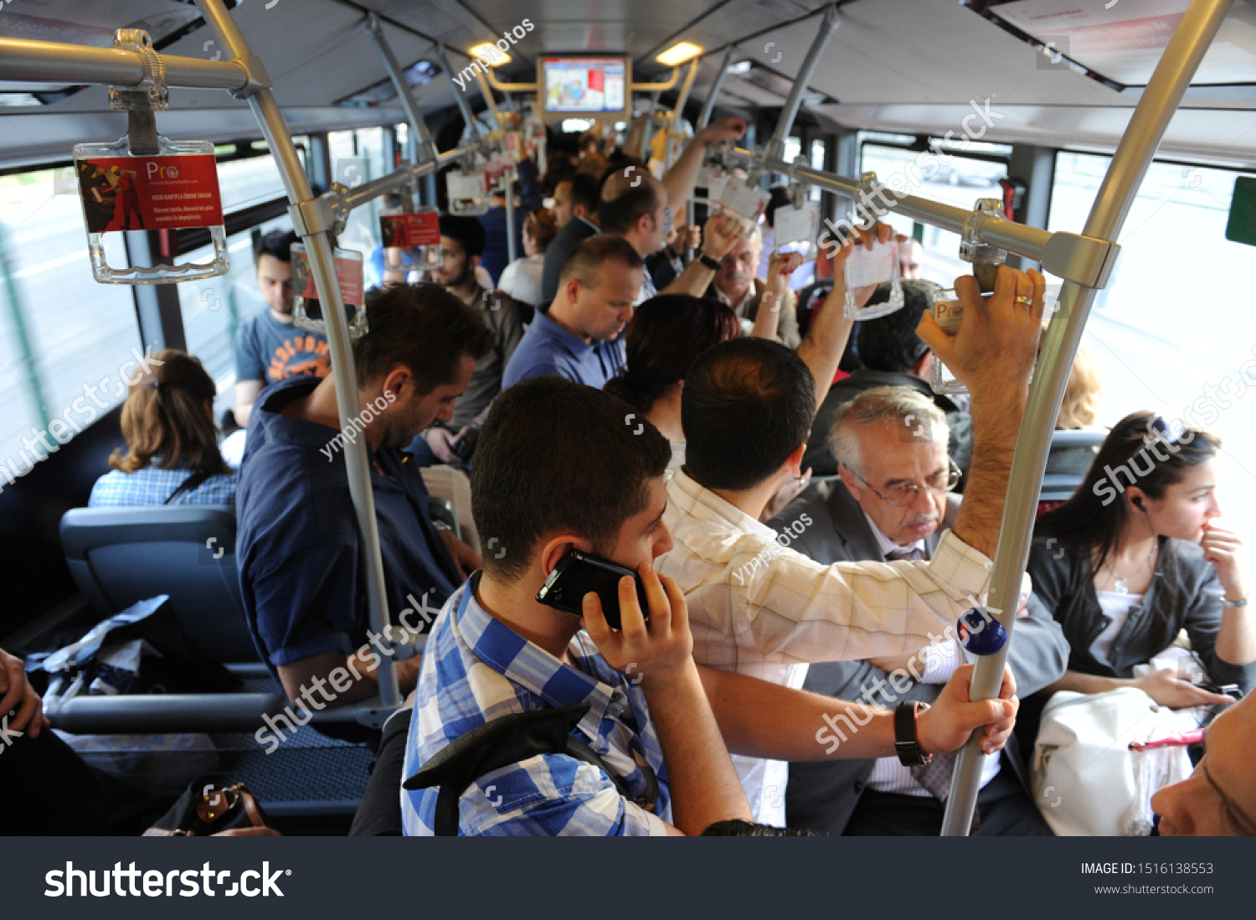

PROBLEM STATEMENT
The main problem faced by the authorities of transportation department and passengers is not knowing the availability of the seats and number of passengers using the Transportation facility. The typical transportation system where includes various corruption and also added that public do not get their enough good transport system for their comfort.

Slide 4
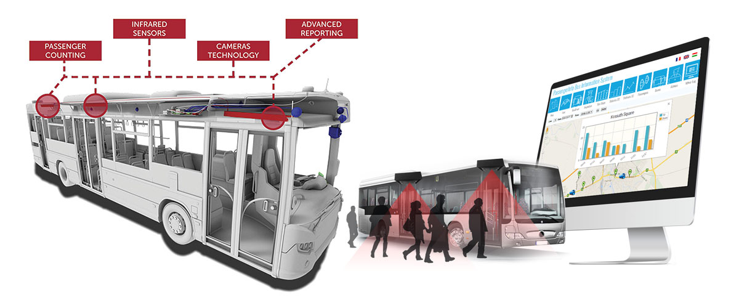
OBJECTIVES OF THE PROJECT
The main Objectives of the Passengers Monitoring System are
➢ Passengers Count in the bus at that Time.
➢ Increase in user satisfaction.
➢ Utilize the maximum capacity of a passenger vehicle
➢ Monitor live occupancy to follow social distancing and ensure safety.
➢ Route optimization

Slide 5
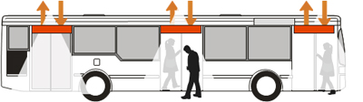
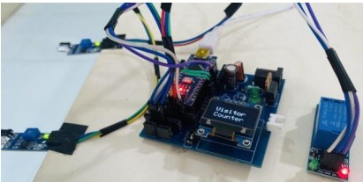
PROPOSED METHOD
In this project, we will make a Bidirectional Passengers Counter with an Automatic Light Control as a proto type System using Arduino. This project is based on a pair of Infrared Sensor that detects interrupt when it detects an obstacle. The pair of IR sensors can detect the visitor from both directions, i.e., the number of entering passengers and the
number of exiting passengers, which is placed at the entrance gate of the bus.
Using this IOT based device, it is user friendly and has exceptional features like showing availability of seats, number of passengers are on the bus etc.…
The light control system is automatic based on the passenger’s presence.

Slide 6
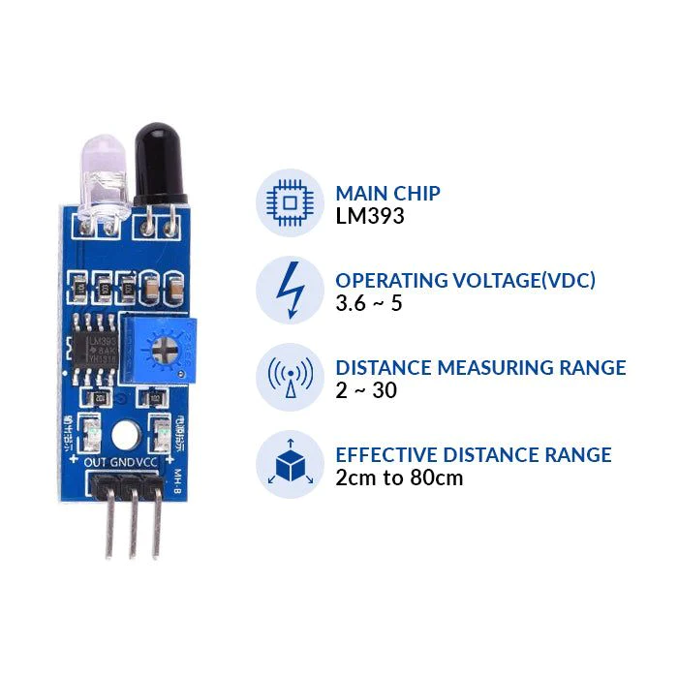
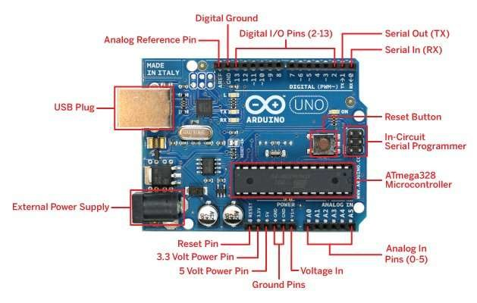
COMPONENTS REQUIRED
➢ Infrared Sensor
The main element of this project is the IR Sensor which works as a Human Detector. Whenever the IR sensor detects an interrupt, it counts the person and adds it to the previous value. IR Sensor module has the great adaptive capability of the ambient light. It has an infrared transmitter and a receiver.
➢ Arduino Uno Board
Arduino Uno is a low-cost, flexible, and easy-to-use programmable open-source microcontroller board that can be integrated into a variety of electronic projects. This board can be interfaced with other Arduino boards, Arduino shields, Raspberry Pi boards and can control relays, LEDs, servos, and motors as an output.

Slide 7
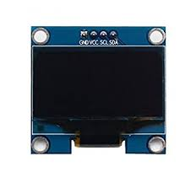
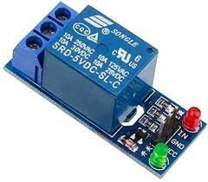
➢ OLED Display
Properties:
Driver IC: SSD1306
Resolution: 128 x 64
Visual Angle: >160°
Input Voltage: 3.3V ~ 6V
Only Need 2 I/O Port Control
Pixel Colour: Blue
➢ Relay Module
Relay is an electromechanical device that uses an electric current to open or close the contacts of a switch. The single-channel relay module is much more than just a plain relay, it comprises of components that make switching and connection easier and act as indicators to show if the module is powered and if the relay is active or not.

Slide 8
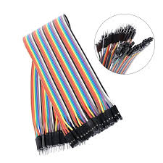
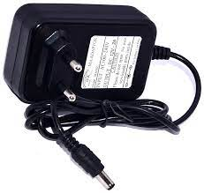
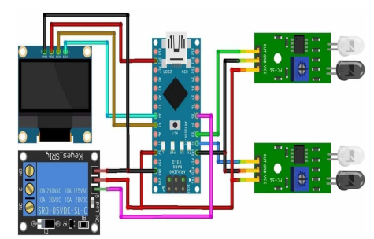
➢ Power Supply
➢ Connecting Wires
CIRCUIT DIAGRAM

Slide 9






FLOW CHART
Passenger’s IN
Repeat the process if
passengers entering.
Passenger’s entering
into the BUS.
Initially count=0
Sensor1
Sensor2
Increase in count of Passengers
Display the count
Failed
Failed
Display the previous count

Slide 10

Passenger’s OUT
Repeat the process if
passengers leaving the bus.
Display the count
Decrease in count of Passengers
Sensor1
Sensor2
Passenger’s leaving the Bus.
Initially count>0
Failed
Failed
Display the Previous count

Slide 11
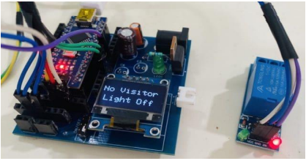
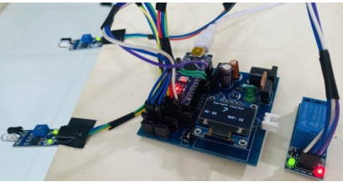
RESULTS AND DISCUSSION
After uploading the visitor counter code to Arduino Board, the device is ready for installation. You can use a 5V DC Adapter to Power on the Device. The device has a pair of IR Sensor module. One of the IR Sensors needs to be placed at the entrance of the bus, i.e., inside top of the bus door and outside top of the bus door.
When no passengers inside the bus, the light turns off and the OLED Display will indicate no visitors are present inside the bus.
When someone makes an entry, the visitor is added and OLED Display, displays the number of incoming visitors. At this instance, the light automatically turns ON.

Slide 12

THANK YOU

