Slide 1
FunctionS

Slide 2
NEED OF FUNCTIONS
In case of large scale programs , it is difficult to Identify the flow of data and subsequently hard to understand.
The solution is to divide big program into small modules and repeatedly call these modules.
With the help of functions, an entire program can be divided into small independent modules, each module is called a function.
This improves the code’s readability as well as flow of execution as small modules can be managed easily.

Slide 3
FUNCTIONS
A function is a block of organized, reusable code that is used to perform a single, related action.
Functions provide better modularity for the applications.
Functions provide a high degree of code reusing.

Slide 4
RULES FOR DEFINING FUNCTION IN PYTHON
Function blocks begin with the keyword def followed by the function name and parentheses ( ).
Any input parameters or arguments should be placed within these parentheses.
The code block within every function starts with a colon (:) and is indented.
The statement return [expression] exits a function, optionally passing back an expression to the caller.
A return statement with no arguments is the same as return None.

Slide 5
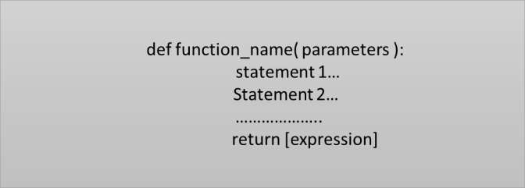
Function Syntax
Input Parameter is placed within the parenthesis() and also define parameter inside the parenthesis.
The keyword def introduces a function definition.
The code block within every function starts with a colon(:) .
Return statement exits a function block. And we can also use return with no argument.

Slide 6
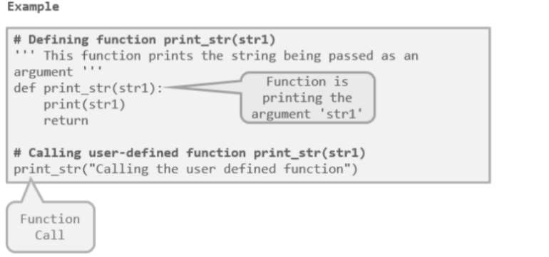

Slide 7
Simple Program on Functions
def Demo(): print('Welcome to the Concepts of Functions') Demo() #Call to Function Demo. Output: Welcome to the Concepts of Functions

Slide 8
Program on Arguments and Parameters
Q. Write a program to calculate maximum of two numbers by making use of arguments and parameters.
def FindMax(num1,num2): if num1 > num2: print(num1, 'is greater than ',num2) elif num2 > num1: print(num2,' is greater than ', num1) else: print(' Both are equal') FindMin(20,40) Output: 40 is greater than 20

Slide 9
PASSING ARGUMENTS TO FUNCTIONS
In programming, there are two ways in which arguments can be passed to functions :-
Pass by Value:
Function creates a copy of the variable(Object in Python) passed to it as an argument.
The actual object is not affected.
Object is of immutable type,because immutable objects cannot be modiﬁed.
Pass by Reference:
The actual object is passed to the called function.
All the changes made to the object inside the function affect its original value.
Object is mutable type, as mutable objects can be changed, the passed objects are updated.

Slide 10
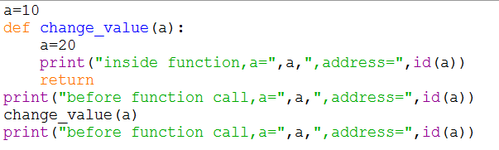

EXAMPLES OF PASSING IMMUTABLE ARGUMENTS
OUTPUT:
New memory address of ‘a’
inside the function.
Actual variable ‘a’ is not changed.

Slide 11
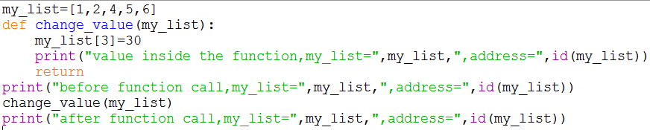
EXAMPLES OF PASSING MUTABLE ARGUMENTS
Value of my_list is changed after function call.
Address is same

Slide 12
Passing List to a Function
List is a mutable object.
Contents of List can be changed easily therefore list is said to be mutable object.
Thus Programmer can pass list to function and perform various operations on it.
Example:
def Print_Contents_List(L): for x in range(0,len(L)): L[x]=L[x]+10 print(L[x], end=' ') L1 = [10,20,30,40,50] Print_Contents_List(L1) #Pass List L1 print(L1) Output: 20 30 40 50 60 [20, 30, 40, 50, 60]

Slide 13
FUNCTION ARGUMENTS

Slide 14
Positional Arguments
Positional arguments must be passed as in exact order i.e. the way they are defined.
The 1st argument in the call statement is assigned to the first parameter listed in the function definition.
Similarly, the second argument in the call statement is assigned to the second parameter listed in the function definition and so on.

Slide 15
Program: Demonstrate use of Positional Arguments.
Write a program to pass arguments name and age to a function Display.
Thus, the first argument binds to the first parameter and second argument binds to the second parameter. This style of matching up arguments and parameter is called “positional argument style” or “positional parameter style”.
def Display(Name,age): print("Name = ",Name,"age = ",age) Display("John",25) Display(40,"Sachin") Output: Name = John age = 25 Name = 40 age = Sachin

Slide 16
Keyword Arguments
An alternative to positional argument is keyword argument.
Programmer can pass a keyword argument to a function by using its corresponding parameter name rather than its position.
Syntax of keyword arguments is as follows:
Name_of_Function(pos_args,keyword1=value,keyword2=value2………)

Slide 17
Program: Demonstrate use of Keyword Arguments
Write a program to pass arguments name and age to a function Display.
def Display(Name,age): print("Name = ",Name,"age = ",age) Display(25,Name="John") #Call function using keyword arguments Output: Name = John age = 25

Slide 18
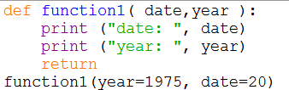

KEYWORD ARGUMENTS
Keyword arguments are related to the function calls.
Using keyword arguments in a function call, the caller identifies the arguments by the parameter name.
Allows to skip arguments or place them out of order, the Python interpreter use the keywords provided to match the values with parameters.
Caller identifies the keyword argument by the parameter name.
Calling of the argument Order
doesn’t matter .
Output:

Slide 19
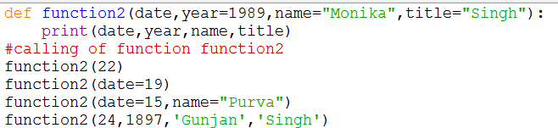

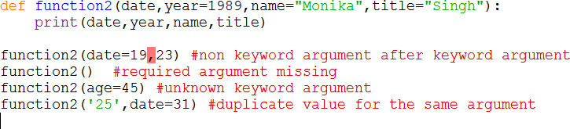
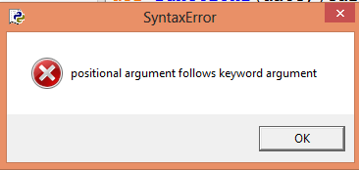
KEYWORD ARGUMENTS
Example 1:
Output:
Example 2:
Output:

Slide 20
Parameters with Default Values
Parameters within the function definition can have default values.
Default value to an parameter can be given by using assignment (=) Operator.
Following Program demonstrate the use of default values in function definition.
Note:
Syntax Error: Non default argument follows default argument
def greet(name,msg=“! How are you?"): print(" Hello ",name,msg) greet(“Jaswinder“) Output: Hello Jaswinder! How are you?

Slide 21
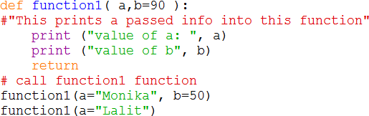

DEFAULT ARGUMENT VALUES
Default Argument- argument that assumes a default value if a value is not provided in the function call for that argument.
The default value is evaluated only once.
In this code, argument ‘b’ has given a default value. ie(b=90)
Output:
When the value of ‘b’ is not passed in function ,then it takes default argument.

Slide 22
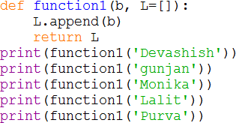
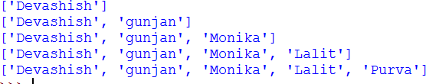
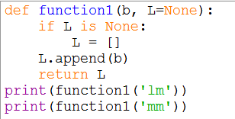

DEFAULT ARGUMENTS
The default value is evaluated only once. This makes a difference when the default is a mutable object such as a list, dictionary, or instances of most classes.
Output:
if we don’t want the default value to be shared between subsequent calls,
Output:

Slide 23
ARBITRARY ARGUMENT LISTS
Variable-Length Arguments: more arguments than we specified while defining the function.
These arguments are also called variable-length arguments .
An asterisk (*) is placed before the variable name that holds the values of all non keyword variable arguments.
This tuple remains empty if no additional arguments are specified during the function call.
Syntax :
This is called arbitrary argument and asterisk sign is placed before the variable name.
def function_name([formal_args], *var_args_tuple ):
statement1…… statement 2……
return [expression]

Slide 24
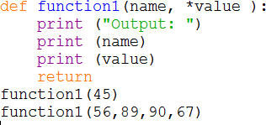
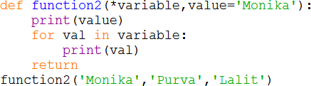
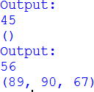
ARBITRARY ARGUMENT LISTS
EXAMPLE 1:
EXAMPLE 2:
Any formal parameter which occur after the *args parameter are keyword-only arguments.
If formal parameter are not keyword argument then error occurred.
Output:
Output: Monika
Monika
Purva
Lalit

Slide 25
ARBITRARY ARGUMENT LISTS
The special syntax **kwargs in function definitions in python is used to pass a keyworded, variable-length argument list.
We use the name kwargs with the double star. The reason is because the double star allows us to pass through keyword arguments (and any number of them).
A keyword argument is where you provide a name to the variable as you pass it into the function.
One can think of the kwargs as being a dictionary that maps each keyword to the value that we pass alongside it. That is why when we iterate over the kwargs there doesn’t seem to be any order in which they were printed out.

Slide 26
# Python program to illustrate
# **kwargs for variable number of keyword arguments
def myFun(**kwargs):
for key, value in kwargs.items():
print ("%s = %s" %(key, value))
myFun(first =‘19', mid =‘September ', last=‘2023')
Output:
Last=2023 mid= September first=19

Slide 27
The return statement
The return statement is used to return a value from the function.
It is also used to return from a function i.e. break out of the function.
Example:
def minimum(a,b): if a<b: return a elif b<a: return b else: return "Both the numbers are equal" min=minimum(85,100) print(‘Minimum value is: ’, min) Output: Minimum value is : 85

Slide 28
Returning Multiple Values
In python, it is possible to return multiple values.
Syntax to return multiple values is as follows
return Value1,Value2,Value3
import math def Sq_Cub_Srt(a,b,c): return a**2, b**3, math.sqrt(c) S,C,Sq = Sq_Cub_Srt(2,3,4) print('Square = ',S) print('Cube = ',C) print(‘Sqrt = ',Sq) Output Square = 4 Cube = 27 Sqrt = 2.0

Slide 29
Namespaces in Python
Namespace is a container that holds a set of identifiers such as variable names, function names, class names etc. and their corresponding objects.
Namespaces are used to organise and manage the names of variables and other entities in code to avoid naming conflicts and to provide a clear scope for each identifier.
There are several types of namespaces :
Built-in namespace ( e.g. print() , input() functions in python)
Local namespace
Global namespace

Slide 30
The Local and global Scope of Variable
The variables and parameters that are initialized within a function, including parameters are said to exist in that function’s local scope.
A variables that exist in local scope are called as “local variables”.
Where as the variables that are assigned outside functions are said to exist in the global scope.
Therefore the variables that exist in global scope are called as “global variables”.

Slide 31
Example on Scope of Variables
p = 20 #global variable p def Demo(): q = 10 #Local variable q print('The value of Local variable q:',q) #Access global variable p within this function print('The value of Global Variable p:',p) Demo() # Access global variable p outside the function Demo() print('The value of global variable p:',p)
Note: Local variables cannot be used in Global Scope

Slide 32
Example on Scope of Variables
p = 20 #global variable p def Demo(): global p p = 10 print('The value of variable p:',p) #Access global variable p within this function print('The value of Global Variable p:',p) Demo() #Access global variable p outside the function Demo() print('The value of global variable p:',p)

Slide 33
LAMBDA EXPRESSIONS
Small functions can be created with the lambda keyword also known as Anonymous function.
Used wherever functions object are required.
These functions are called anonymous because they are not declared in the standard manner by using the def keyword. .
Syntax :
lambda [arg1 [,arg2,.....argn]] : expression

Slide 34
Example:
Following is the example to calculate the cube of a number using simple concepts of a function
def func(a):
return a*a*a
print(func(3))
Output: 27
Following is the example to calculate the cube of a number using lambda function
>>> cube = lambda a: a*a*a
>>> print(cube(3))
Output: 27

Slide 35
Example:
Following is the example to show how lambda form of function works:
sum = lambda arg1, arg2,arg3: arg1 + arg2+arg3;
print "Value of total : ", sum( 10, 20,30 )
print "Value of total : ", sum( 20, 20,34 )
This would produce following result:
Value of total : 30
Value of total : 40
Following is the example to sum three numbers using simple concepts of a function
def sum(a,b,c):
return a+b+c
print(sum(10,20,23))

Slide 36
LAMBDA EXPRESSIONS
# Using lambda with map to square a list of numbers
numbers = [1, 2, 3, 4, 5]
squared = list(map(lambda x: x**2, numbers))
print(squared)
# Output: [1, 4, 9, 16, 25]

Slide 37


LAMBDA EXPRESSIONS
EXAMPLE:
The function returns the multiplication of two arguments.
Lambda function is restricted to a single expressions.
Output:

