Slide 1
FunctionS

Slide 2
NEED OF FUNCTIONS
In case of large scale programs , it is difficult to Identify the flow of data and subsequently hard to understand.
The solution is to divide big program into small modules and repeatedly call these modules.
With the help of functions, an entire program can be divided into small independent modules, each module is called a function.
This improves the code’s readability as well as flow of execution as small modules can be managed easily.

Slide 3
FUNCTIONS
A function is a block of organized, reusable code that is used to perform a single, related action.
Functions provide better modularity for the applications.
Functions provide a high degree of code reusing.

Slide 4
RULES FOR DEFINING FUNCTION IN PYTHON
Function blocks begin with the keyword def followed by the function name and parentheses ( ).
Any input parameters or arguments should be placed within these parentheses.
The code block within every function starts with a colon (:) and is indented.
The statement return [expression] exits a function, optionally passing back an expression to the caller.
A return statement with no arguments is the same as return None.

Slide 5
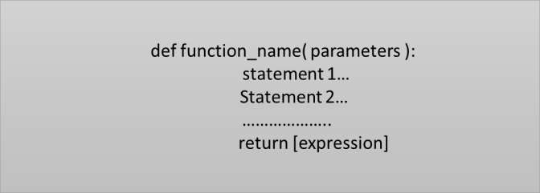
Function Syntax
Input Parameter is placed within the parenthesis() and also define parameter inside the parenthesis.
The keyword def introduces a function definition.
The code block within every function starts with a colon(:) .
Return statement exits a function block. And we can also use return with no argument.

Slide 6
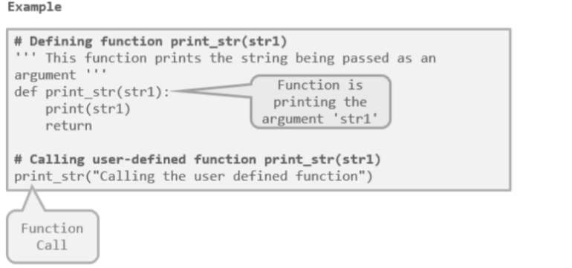

Slide 7
Simple Program on Functions
def Demo(): print('Welcome to the Concepts of Functions') Demo() #Call to Function Demo. Output: Welcome to the Concepts of Functions

Slide 8
Program on Arguments and Parameters
Q. Write a program to calculate maximum of two numbers by making use of arguments and parameters.
def FindMax(num1,num2): if num1 > num2: print(num1, 'is greater than ',num2) elif num2 > num1: print(num2,' is greater than ', num1) else: print(' Both are equal') FindMin(20,40) Output: 40 is greater than 20

Slide 9
PASSING ARGUMENTS TO FUNCTIONS
In programming, there are two ways in which arguments can be passed to functions :-
Pass by Value:
Function creates a copy of the variable(Object in Python) passed to it as an argument.
The actual object is not affected.
Object is of immutable type,because immutable objects cannot be modiﬁed.
Pass by Reference:
The actual object is passed to the called function.
All the changes made to the object inside the function affect its original value.
Object is mutable type, as mutable objects can be changed, the passed objects are updated.

Slide 10
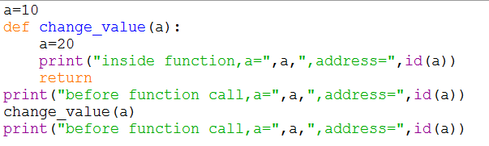

EXAMPLES OF PASSING IMMUTABLE ARGUMENTS
OUTPUT:
New memory address of ‘a’
inside the function.
Actual variable ‘a’ is not changed.

Slide 11
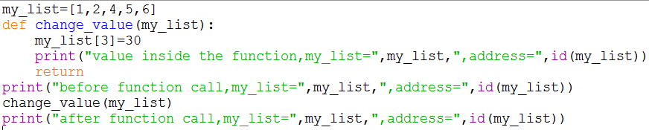
EXAMPLES OF PASSING MUTABLE ARGUMENTS
Value of my_list is changed after function call.
Address is same

