Slide 1
Introduction to Python Programming

Slide 2
Introduction to Python programming
High level, interpreted language
Object-oriented
Simple language which is easier to learn
Free and open source
Portability
Extensible and embeddable
Standard large library

Slide 3
General purpose
Python is used in engineering field to develop Web Application(like: Django and Bottle)
Used by data scientists to analyse large amount of data (NumPy)
To develop graphical user Interfaces (Pygame, Panda3D), network security and many more applications.
Image processing applications can be developed using scikit-image library
Develop IOT applications using Arduino and Raspberry pi

Slide 4
Created by Guido van Rossum in 1991
Why the name Python?
Not after a dangerous snake.
Rossum was fan of a comedy series from late seventies.
The name "Python" was adopted from the same series "Monty Python's Flying Circus".

Slide 5
Python features
no compiling or linking | rapid development cycle
no type declarations | simpler, shorter, more flexible
automatic memory management | garbage collection
high-level data types and operations | fast development
object-oriented programming | code structuring and reuse, C++
embedding and extending in C | mixed language systems
classes, modules, exceptions | "programming-in-the-large" support
dynamic loading of C modules | simplified extensions, smaller binaries
dynamic reloading of C modules | programs can be modified without stopping

Slide 6
Python features
universal "first-class" object model | fewer restrictions and rules
run-time program construction | handles unforeseen needs, end-user coding
interactive, dynamic nature | incremental development and testing
access to interpreter information | metaprogramming, introspective objects
wide portability | cross-platform programming without ports
compilation to portable byte-code | execution speed, protecting source code
built-in interfaces to external services | system tools, GUIs, persistence, databases, etc.

Slide 7
Internal working of python
Syntax checker and Translator
Python code
Byte code
Python Virtual Machine(PVM)
Input
Program Output

Slide 8
STEPS
STEP1: Python interpreter reads a python code and verify it for syntax error. If it finds any error, immediately halts the translation and shows an error message.
STEP2: If there is no error; interpreter translate a code into byte code
STEP3: Byte code is sent to the PVM. Here again the byte code is executed on PVM. If error found then the PVM halts and show the error message.

Slide 9
Python Implementations
The standard implementation of Python is called CPython. It is written in C.
There are different implementations such as Jython, IronPython, Stackless and PyPy.
Jython: It was originally known as Jpython. It is used to run programs on Java platform (https://www.jython.org)
IronPython: It is an open source implementation of Python for the .Net framework. A major used of this is to embed .net applications. (https://www.ironpythonPython.net)
Stackless Python: When a program is run on stackless Python then program is split into multithreads. (www.stackless.com)
PyPy: Here Python interpreter is written in Python itself. It focuses on speed, efficiency and compatibility. It is 4.4 times faster than Cpython. (www.pypy.org)

Slide 10
Assignment 1
Discuss the Advantages and Disadvantages of different implementations of Python.
Compare Python with C , C++ and Java.
Submit it by 18th Oct 2021
Anjali.garg73@gmail.com
9914513435

Slide 11
Installation of Python in Windows
Go to Download Python page on the official site (https://www.python.org/downloads) and click Download Python
3.8.4 (You may see different version name also)
When the download is completed, double-click the file and follow the instructions to install it.
When Python is installed, a program called IDLE is also installed along with it. It provides graphical user interface to work with Python.

Slide 12
Open IDLE, Write the following code below and press enter.
print("Hello, World!")
To create a file in IDLE, go to File > New Window (Shortcut: Ctrl+N).
Write Python code and save (Shortcut: Ctrl+S) with .py file extension like: hello.py or your-first-program.py
print("Hello, World!")
Go to Run > Run module (Shortcut: F5) and you can see the output.

Slide 13
First Python Program
# first program ‘first.py’ to add two numbers
a=2
b=3
sum=a+b
#print('sum =',sum)
print( 'sum of {0} and {1} is {2}'.format(a,b,sum))
Python 3.7.3 (v3.7.3:ef4ec6ed12, Mar 25 2019, 21:26:53) [MSC v.1916 32 bit (Intel)] on win32
Type "help", "copyright", "credits" or "license()" for more information.
>>>
=============== RESTART: C:/Users/home/Desktop/python/first.py ===============
sum = 5
sum of 2 and 3 is 5
>>>

Slide 14
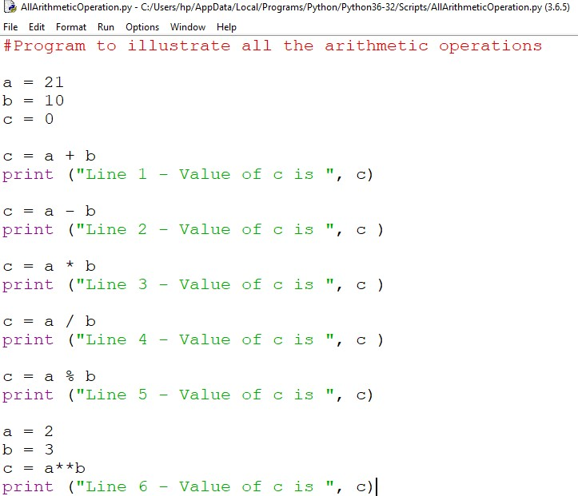
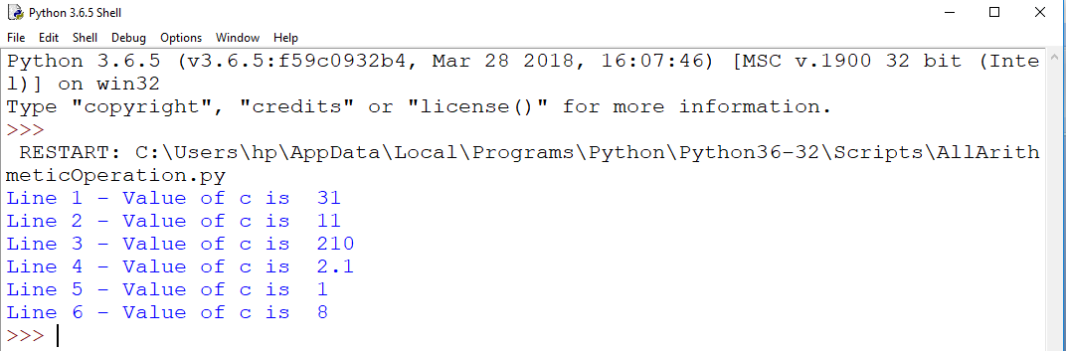
Second Program

Slide 15
Few Important Things to Remember
To represent a statement in Python, newline (enter) is used.
Use of semicolon at the end of the statement is optional (unlike languages like C/C++)
In fact, it's recommended to omit semicolon at the end of the statement in Python
Instead of curly braces { }, indentations are used to represent a block

Slide 16
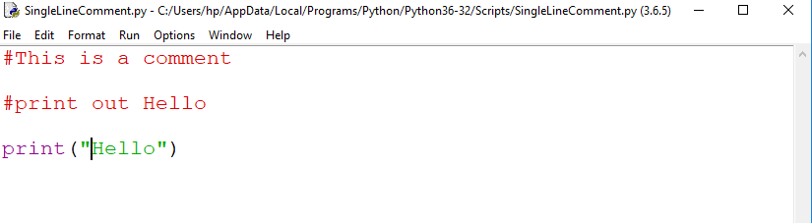
Commenting in Python
To make the code much more readable.
Python Interpreter ignores comment.
Python single line comment preceded by a hash symbol (#)
Three consecutive single quotation marks ‘’’ are used to give multiple comments (or) paragraph comments.

Slide 17
Comments
Single Line Comments
●
●
Starts with # symbol
Comments are non-executable statements
#To find sum of two numbers
a = 10 #Store 10 into variable 'a'

Slide 18
Comments
Multi Line Comments
Version-1
#To find sum of two numbers
#This is multi-line comments
#One more commented line
●
Version-2
4 """
This is first line
This second line
Finally comes third 8 """
Version-3
4 '''
This is first line
This second line
Finally comes third 8 '''

Slide 19
Token
Python Tokens
Keywords
Variables / Identifiers
Operators
Literals
Delimiters

Slide 20
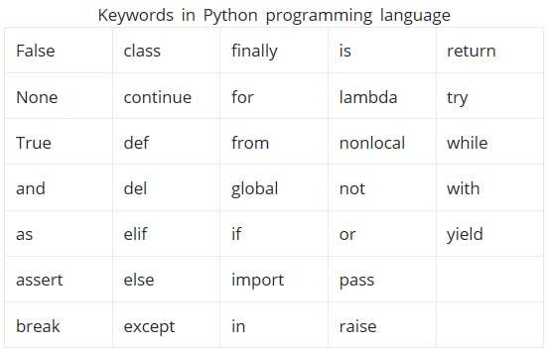
Python Keywords
Keywords are the reserved words in Python
Keywords are case sensitive

Slide 21
Python Identifiers
Name given to entities like class, functions, variables etc. in Python
Rules for writing identifiers
Can be a combination of letters in lowercase (a to z) or uppercase (A to Z) or digits (0 to 9) or an underscore (_)
myClass, var_1 and print_this_to_screen, this_is all are valid examples
Cannot start with a digit (1variable is invalid, but variable1 is perfectly fine)
Keywords cannot be used as identifiers
Cannot use special symbols like !, @, #, $, % etc. in our identifier
Can be of any length.

Slide 22
Things to care about
Python is a case-sensitive language.
A1 and a1 are not the same.
Multiple words can be separated using an underscore, this_is_a_long_variable
Can also use camel-case style of writing, i.e., capitalize every first letter of the word except the initial word without any spaces
camelCaseExample

Slide 23
Operator
Python contains various operators
Arithmetic + - * / % **
Relational == != <> <= >=
Logical and not or
Bitwise & ~ | ^ << >>

Slide 24
Delimiter
It is symbol that perform special role in python like grouping, punctuation and assignment
() [] {}
, :. = ;

Slide 25
Literals
Literals are numbers or strings or characters appear in the program.
Example:
78 – Integer literal
21.32- floating point literal
‘q’- character literal
“Hello” – String literal

Slide 26
Literals
Literal is a raw data given in a variable or constant. In Python, there are various types of literals they are as follows:
Numeric literals
String literals
Boolean literals
Special literals

Slide 27
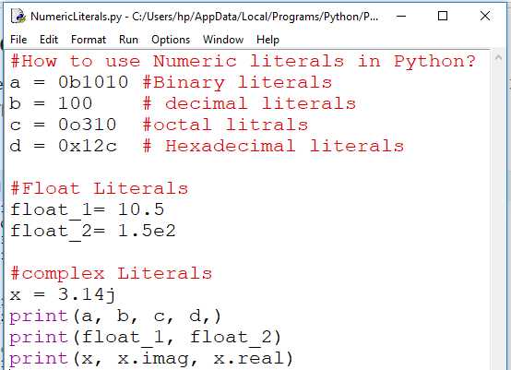
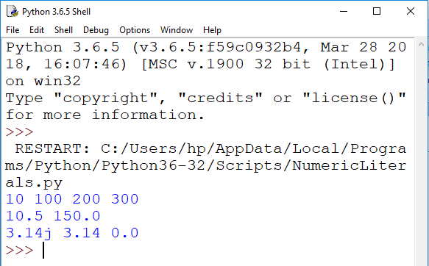
Numeric Literals
c

Slide 28
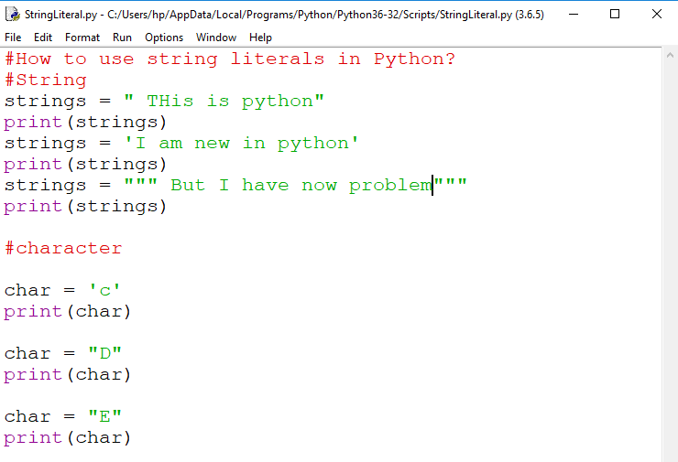
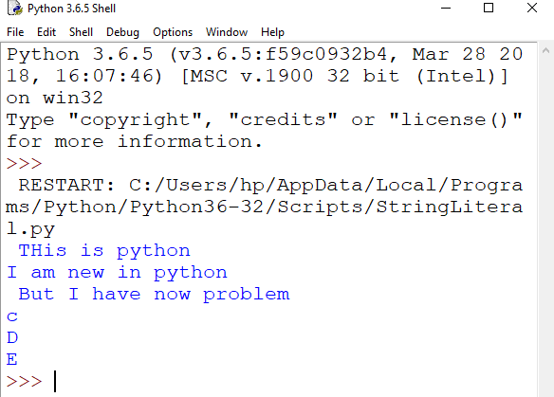
String Literals

Slide 29
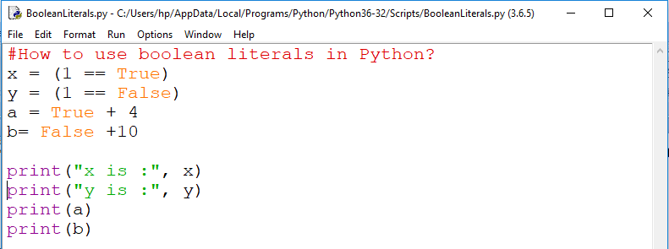
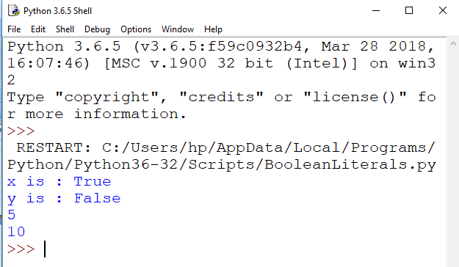
Using boolean literals

Slide 30
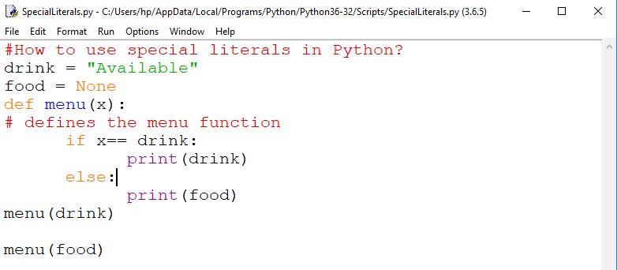
Special literal(None)

Slide 31
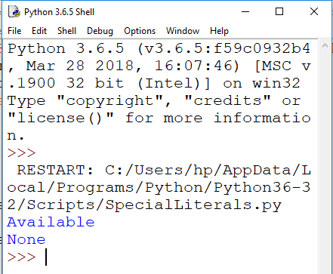

Slide 32
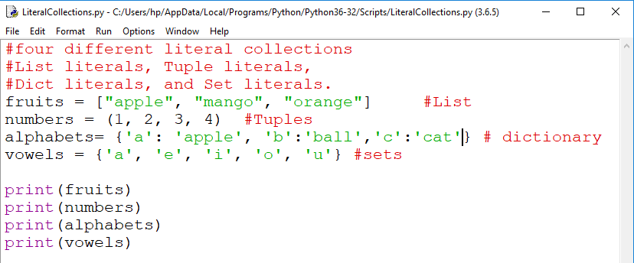
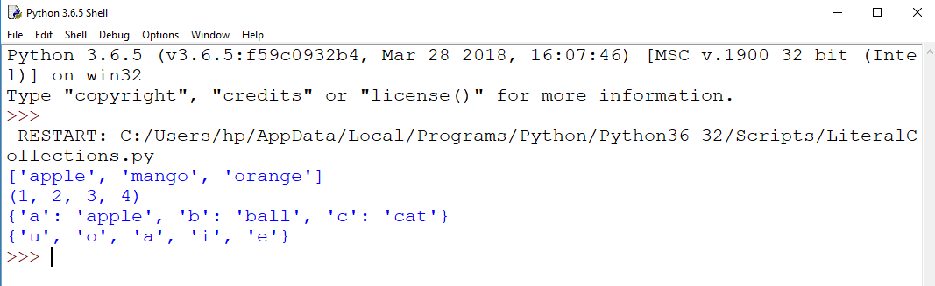
Literals Collection

Slide 33
Python Statement
Instructions that a Python interpreter can execute are called statements.
Two types
Single line statement:
For example, a = 1 is an assignment statement
Multiline statement:
In Python, end of a statement is marked by a newline character.
So, how to make multiline statement?

Slide 34
Technique1:
make a statement extend over multiple lines with the line continuation character (\).
For example:
a = 1 + 2 + 3 + \
4 + 5 + 6 + \
7 + 8 + 9

Slide 35
Technique2:
make a statement extend over multiple lines with the parentheses ( )
For example:
a = (1 + 2 + 3 +
4 + 5 + 6 +
7 + 8 + 9)

Slide 36
Technique3:
make a statement extend over multiple lines with the brackets [ ] and braces {
}.
For example:
Colors=[ ‘red’,
‘blue’,
‘green’]

Slide 37
We could also put multiple statements in a single line using semicolons, as follows
a=1; b=2; c=3

Slide 38
Python Indentation
Most of the programming languages like C, C++, Java use braces { } to define a block of code
Python uses indentation
A code block (body of a function, loop etc.) starts with indentation and ends with the first un-indented line

Slide 39
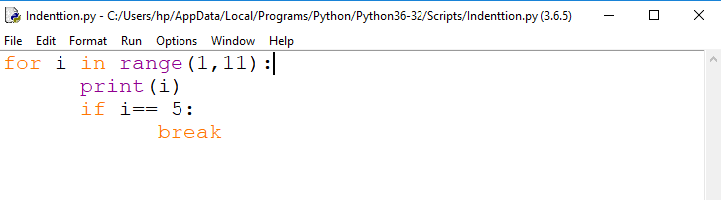
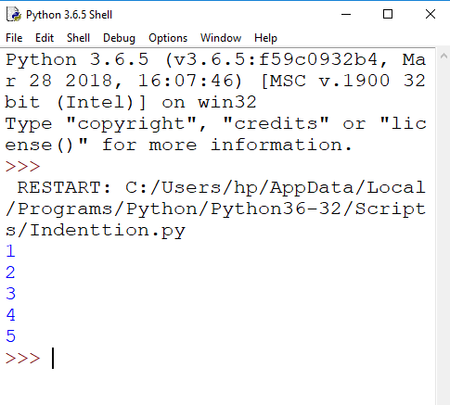

Slide 40
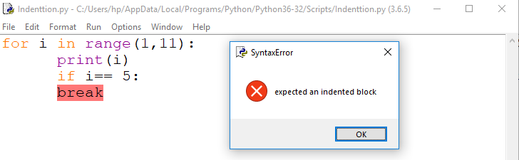
Error due to incorrect indentation

Slide 41
Python Variable
a variable is a named location used to store data in the memory.
Alternatively, variables are container that hold data which can be changed later throughout programming

Slide 42
Declaring Variables
In Python, variables do not need declaration to reserve memory space.
The "variable declaration" or "variable initialization" happens automatically when we assign a value to a variable.
We use the assignment operator = to assign the value to a variable.

Slide 43
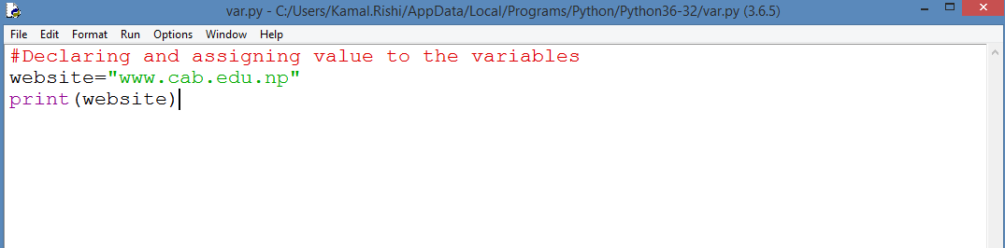
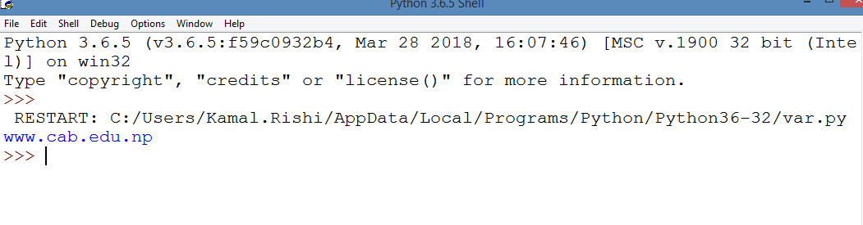
Assigning Values to variables

Slide 44
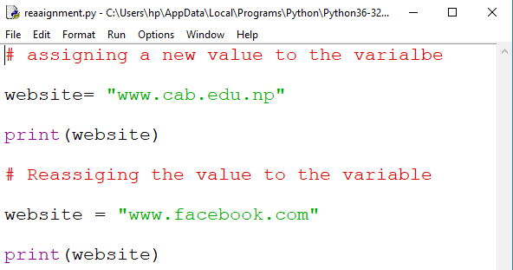
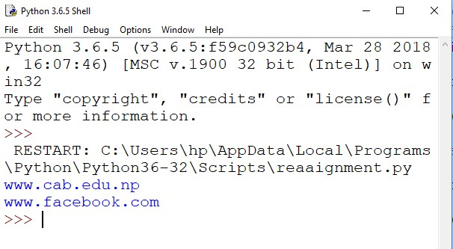
Changing value of a variable

Slide 45
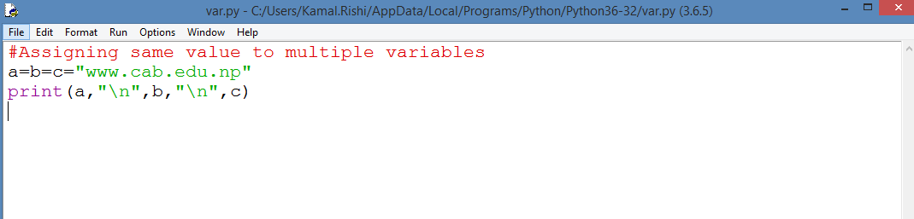
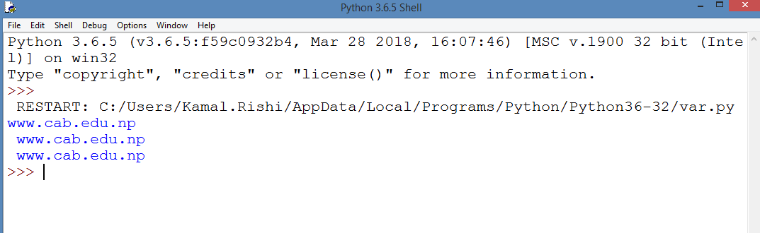
Assigning same value to the multiple variable

Slide 46
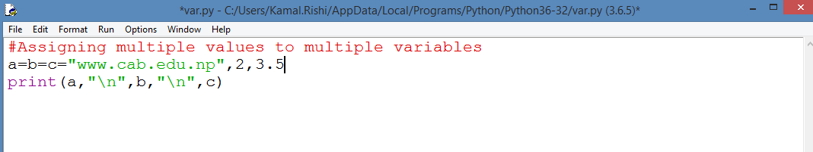
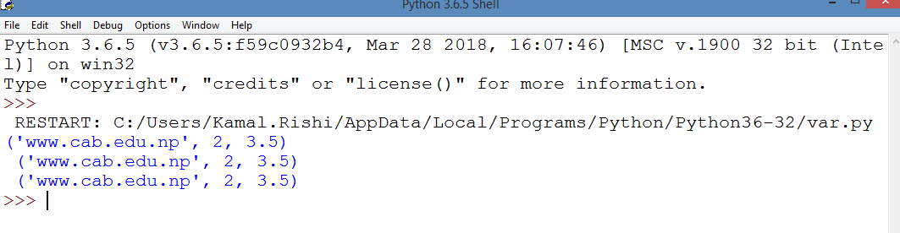
Assigning multiple values to multiple variables

Slide 47
Data-Types
All features in Pythons are associated with an object.
In python data types are classes and variables are instance (object) of these classes.
The native data types supported by Python are string, integer, float and complex numbers.
Different types of data types in python are:
Python numbers
Python lists
Python tuples
Python strings
Python sets
Python dictionary

Slide 48
Data-Types
None Type
None data-type represents an object that does not contain any value
In Java, it is called as NULL Object
In Python, it is called as NONE Object
In boolean expression, NONE data-type represents ‘False’
Example:
a = “”

Slide 49
Data-Types
Numeric Type
int
No limit for the size of an int datatype
Can store very large numbers conveniently
Only limited by the memory of the system
Example:
a = 20111122884787794389839

Slide 50
Data-Types
Numeric Type
float
Example-1:
A = 56.78
Example-2:
B = 22.55e3 ⇔ B = 22.55 x 10^3

Slide 51
Data-Types
Numeric Type
Complex
Written in the form a + bj OR a + bJ
a and b may be ints or floats
Example:
c1 = 1 +9.5j c2 = -1.5 - 4j

Slide 52
Representation
Binary, Octal, Hexadecimal
Binary (Prefixed with 0b OR 0B)
0b11001110
0B10101100
Octal (Prefixed with 0o OR 0O)
0o167
0O345
Hexadecimal (Prefixed with 0x OR 0X)
0xAE
0Xab

Slide 53
Conversion
Explicit
Coercion / type conversions
Example-1:
x = 15.56
int(x) #Will convert into int and display 15
Example-2:
x = 15
float(x) #Will convert into float and display 15.0

Slide 54
Conversion
Explicit
Coercion / type conversions
Example-1:
a = 15.56
complex(a) #Will convert into complex and display (15.56 + 0j)
Example-2:
a = 15.5
b = 3
complex(a, b) #Will convert into complex and display (15.5 + 3j)

Slide 55
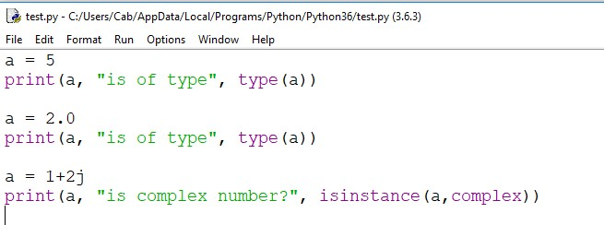
Python Numbers

Slide 56
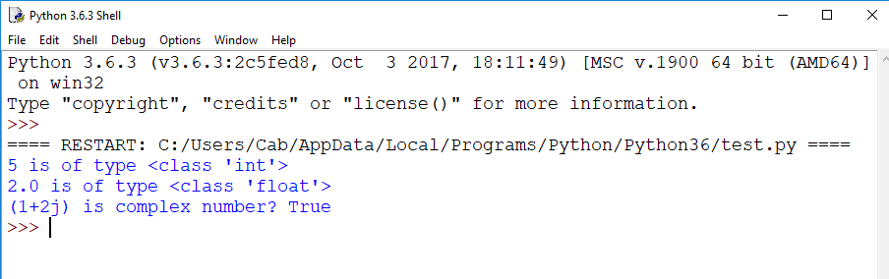

Slide 57
Conversion between data types
Conversion can be done by using different types of type conversion functions like:
int(),
float(),
str() etc.

Slide 58
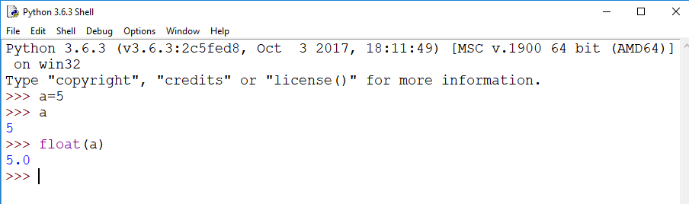
int to float

Slide 59
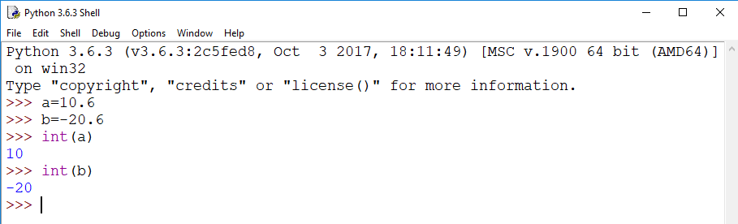
float to int

Slide 60
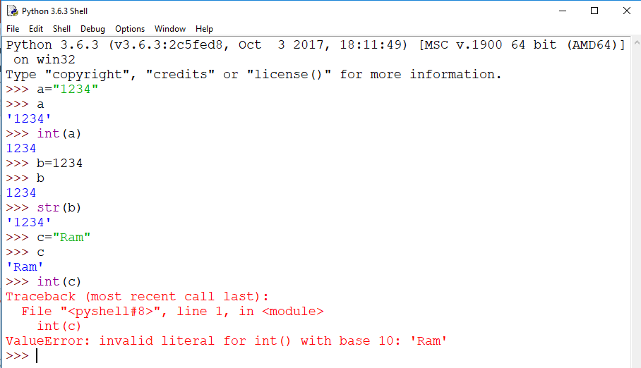
To and form string

Slide 61
Python Type Conversion and Type Casting
The process of converting the value of one data type (integer, string, float, etc.) to another data type is type conversion
Python has two types of type conversion.
Implicit Type Conversion
Explicit Type Conversion

Slide 62
Type Conversion is the conversion of object from one data type to another data type
Implicit Type Conversion is automatically performed by the Python interpreter
Python avoids the loss of data in Implicit Type Conversion
Explicit Type Conversion is also called Type Casting, the data types of object are converted using predefined function by user
In Type Casting loss of data may occur as we enforce the object to specific data type

Slide 63
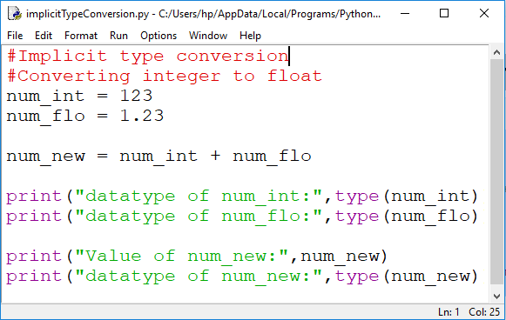
Implicit Type Conversion
Automatically converts one data type to another data type
Always converts smaller data type to larger data type to avoid the loss of data

Slide 64
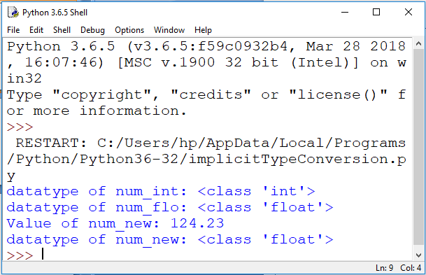

Slide 65
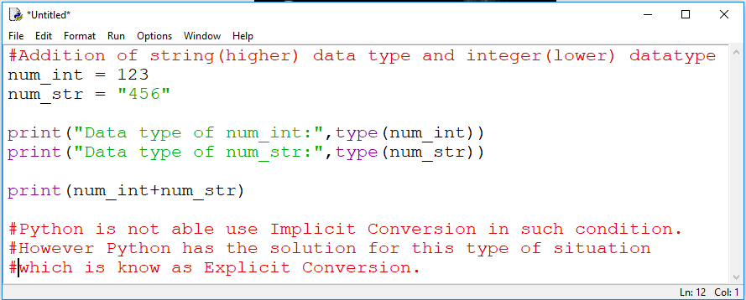
Problem in implicit type conversion

Slide 66
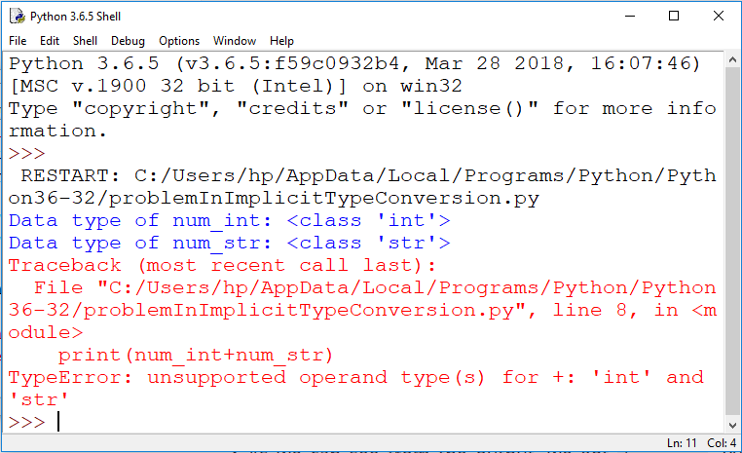

Slide 67
Explicit Type Conversion
Users convert the data type of an object to required data type.
Predefined functions like int(), float(), str(), etc. are to perform explicit type conversion
Is also called typecasting because the user casts (change) the data type of the objects.
Syntax :
(required_datatype)(expression)
Int(b)

Slide 68
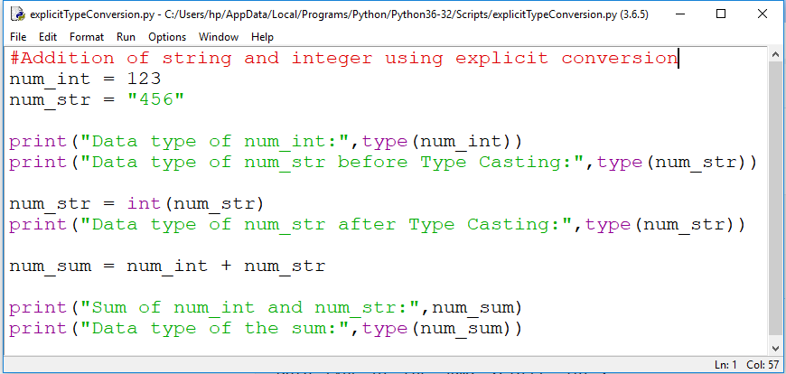
Example

Slide 69
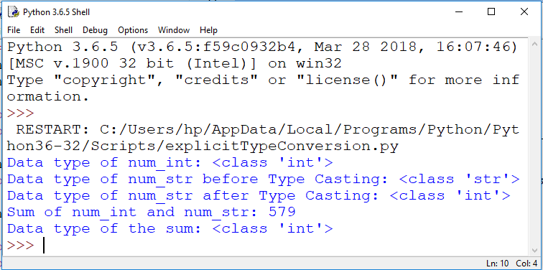

Slide 70
Python Input, Output and Import
Widely used functions for standard input and output operations are:
print() and
input()

Slide 71
The print() Function
The task of print function is to display the contents on the screen
print(argument)
>>>print(‘Hi welcome to python programming’)
print(1000)

Slide 72
print with quotation
Use (\)-backslash
print(“the attachment, \”remaining\””)
Output:
the attachment, "remaining"

Slide 73
Print with end argument
print(‘hello’,end=‘’)
print(‘world’,end=‘’)
print(‘goodbye’)
Output:
hello world goodbye

Slide 74
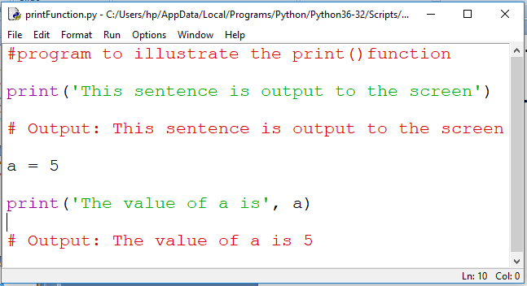

Python Output Using print() function

Slide 75
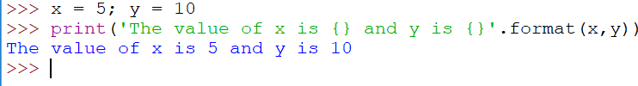
Output formatting
Can be done by using the str.format() method
Is visible to any string object
Here the curly braces {} are used as placeholders. We can specify the order in which it is printed by using numbers (tuple index).

Slide 76
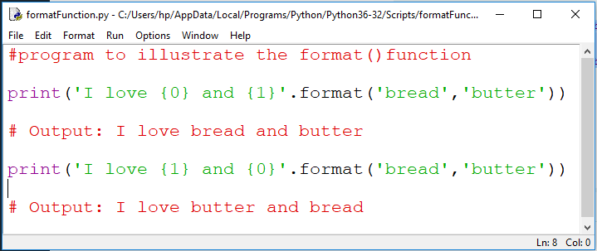

Example

Slide 77
We can even use keyword arguments to format the string

Slide 78
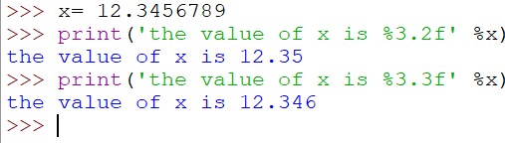
We can even format strings like the old printf() style used in C
We use the % operator to accomplish this

Slide 79
Syntax: print("formatted string" % (variable list))
Example | Output
a = 10 print("The value of a: %i" % a) | The value of a: 10
a, b = 10, 20 print("a: %d \t b: %d" %(a, b)) | a: 10 b: 20
name = "Ram"
print("%c" % name[2]) | m
print("%s" % name[0:2]) | Ra
num = 123.345727 print("Num: %f" % num) print("Num: %8.2f" % num) | Num: 123.345727 Num: 123.35

Slide 80
Example | Output
a, b, c = 1, 2, 3
print("First= {0}". format(a))
print("First= {0}, Second= {1}". format(a, b)) | First= 1
print("First= {one}, Second= {two}". format(one=a, two=b)) | First= 1, Second= 2
print("First= {}, Second= {}". format(a, b)) | First= 1, Second= 2
 | First= 1, Second= 2
name, salary = "Ram", 123.45 print("Hello {0}, your salary: {1}". format(name, salary)) print("Hello {n}, your salary: {s}". format(n=name, s=salary)) | Hello Ram, your salary: 123.45 Hello Ram, your salary: 123.45

Slide 81
Example | Output
print() | Prints the '\n' character
print("Hello") | Hello
print('Hello') | Hello
print("Hello \nWorld") | Hello World
print("Hello \tWorld") | Hello World
print("Hello \\nWorld") | Hello \nWorld
print(3 * 'Hello ') | Hello Hello Hello
print("Hello"+"World") | HelloWorld
print("Hello","World", “students”) | Hello World students

Slide 82
Example |  | Output
a, b = 1, 2 print(a, b) | 1 2
print(a, b, sep=",") | 1,2
print(a, b, sep=':') | 1:2
print(a, b, sep='---') print(“ Hello”, “How are you?”, sep=“---”) | 1---2 Hello --- How are you?
print("Hello", end="") print("World") | HelloWorld
print("Hello", end="\t") print("World") | Hello World

Slide 83
To use formatted string literals, begin a string with f or F before the opening quotation mark or double or triple quotation mark. Inside this string, you can write a Python expression between { and } characters that can refer to variables or literal values.
>>> f'hello'
Output : 'hello'
>>> roll =10
>>> name="jyoti"
>>> f' roll no: {roll} name_stud: {name}‘
>>> F' roll no: {roll} name_stud: {name}‘
Output:
' roll no: 10 name_stud: jyoti‘
' roll no: 10 name_stud: jyoti'

Slide 84
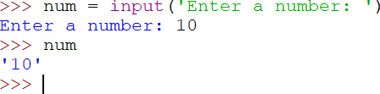
Input() function
input() function to take the input from the user.
The syntax for input() is :
input([prompt])
where prompt is the string we wish to display on the screen.
It is optional

Slide 85
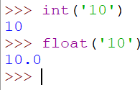
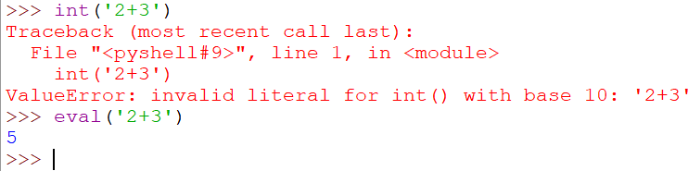
Entered value 10 is a string, not a number.
To convert this into a number we can use int() or float() functions
This same operation can be performed using the eval(). It can evaluate expressions, provided the input is a string.

Slide 86
eval() function
num=eval (input("enter the value of num: "))
sum=num+5
print('value of num is {}'.format(num))
print('value of sum is {}'.format(sum))
Output:
enter the value of num: 12
value of num is 12
value of sum is 17
>>>

Slide 87
Python Import
When our program grows bigger, it is a good idea to break it into different modules.
A module is a file containing Python definitions and statements.
Python modules have a filename and end with the extension .py
Definitions inside a module can be imported to another module or the interactive interpreter in Python
We use the import keyword to do this

Slide 88
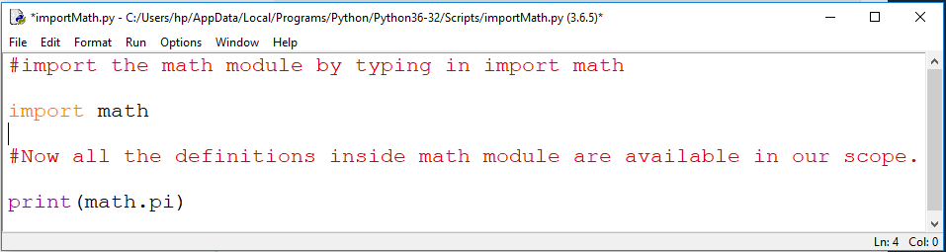


Slide 89

import some specific attributes and functions only, using the from keyword.

Slide 90
List of Function under math Module
Name of Function | Meaning | Example:
ceil(X) | Round X to nearest integer and returns that integer. | >>>import math >>> math.ceil(10.23) 11
floor(X) | Returns the largest value not greater than X | >>>import math >>> math.floor(18.9) 18
exp(X) | Returns the exponential value for e^{x} | >>>import math >>> math.exp(1) 2.718281828459045
log(X) | Returns the natural logarithmic of x (to base e) | >>>import math >>> math.log(2.71828) 0.999999327347282
log(x,base) | Returns the logarithmic of x to the given base | >>>import math >>> math.log(8,2) 3.0
Note: a) There are many other function such as sqrt(), sin(), cos(), tan(), asin(), acos(), degrees(), etc under math module b) The statement import math should be the first statement should be written on interactive mode when you are trying to execute any of the math function.

