Slide 1
Python Data Types

Slide 2
Data-Types
All features in Pythons are associated with an object.
In python data types are classes and variables are instance (object) of these classes.
The native data types supported by Python are string, integer, float and complex numbers.
Different types of data types in python are:
Python numbers
Python lists
Python tuples
Python strings
Python sets
Python dictionary

Slide 3
Data-Types
None Type
None data-type represents an object that does not contain any value
In Java, it is called as NULL Object
In Python, it is called as NONE Object
In boolean expression, NONE data-type represents ‘False’
Example:
a = “”

Slide 4
Data-Types
Numeric Type
int
No limit for the size of an int datatype
Can store very large numbers conveniently
Only limited by the memory of the system
Example:
a = 20

Slide 5
Data-Types
Numeric Type
float
Example-1:
A = 56.78
Example-2:
B = 22.55e3 ⇔ B = 22.55 x 10^3

Slide 6
Data-Types
Numeric Type
Complex
Written in the form a + bj OR a + bJ
a and b may be ints or floats
Example:
c = 1 + 5j c = -1 - 4.4j

Slide 7
Representation
Binary, Octal, Hexadecimal
Binary (Prefixed with 0b OR 0B)
0b11001100
0B10101100
Octal (Prefixed with 0o OR 0O)
0o134
0O345
Hexadecimal (Prefixed with 0x OR 0X)
0xAB
0Xab

Slide 8
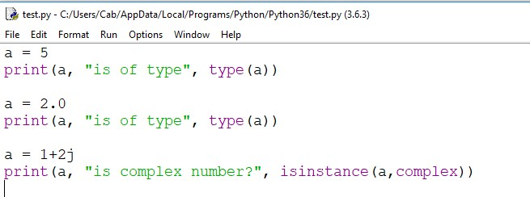
Python Numbers

Slide 9
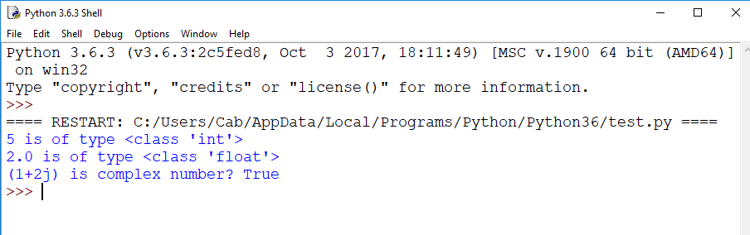

Slide 10
Python List
Ordered sequence of items
Can contain heterogeneous data
Lists are mutable, meaning, value of elements of a list can be altered.
Syntax:
Items separated by commas are enclosed within brackets [ ]
Example: a= [1,2.2,'python']
print(a[0])

Slide 11
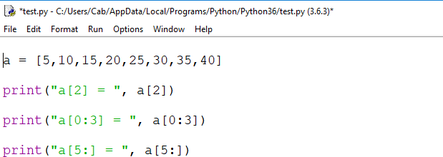
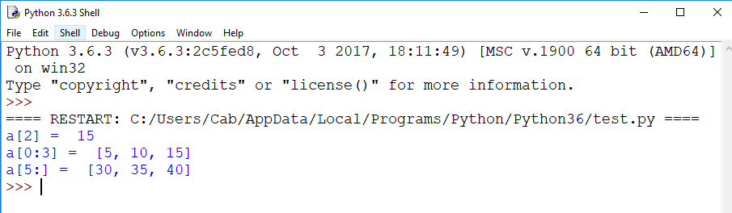
Extracting elements from the list

Slide 12
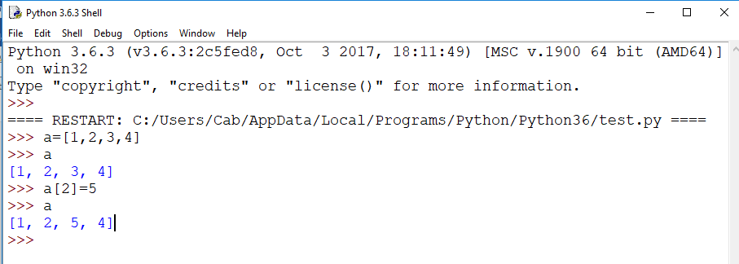
Note: Lists are mutable, meaning, value of elements of a list can be altered.

Slide 13
Python Tuple
Same as list but immutable.
Used to write-protect the data
Syntax:
Items separated by commas are enclosed within brackets ( )
Example:
t = (5,'program', 1+3j)

Slide 14
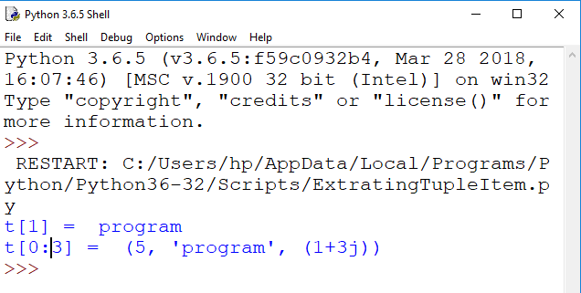
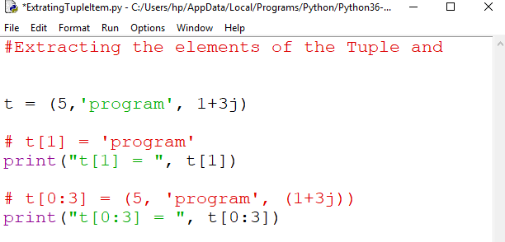

Slide 15
Python Strings
use single quotes or double quotes to represent strings.
Multi-line strings can be denoted using triple quotes, ''' or """.
Example:
s = "This is a string"
s1 = '''a multiline
string’’’
Strings are also immutable.

Slide 16
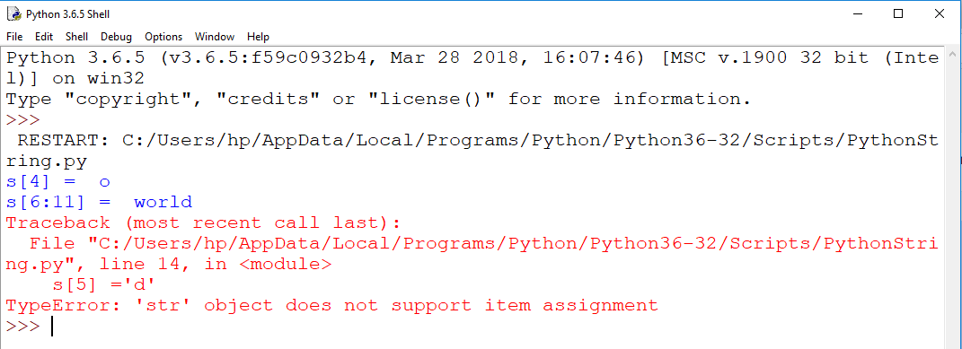
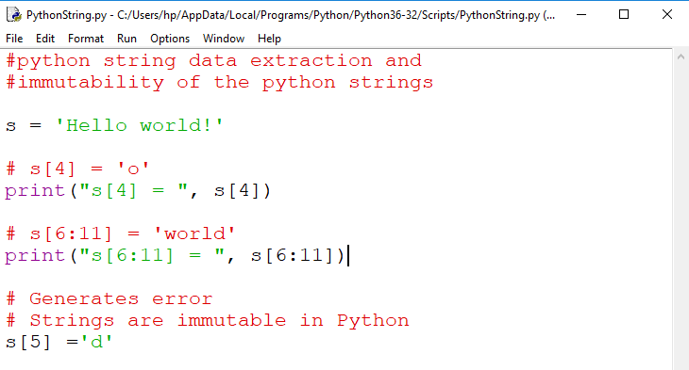

Slide 17
Python Set
Unordered collection of unique items
defined by values separated by comma inside braces { }

Slide 18
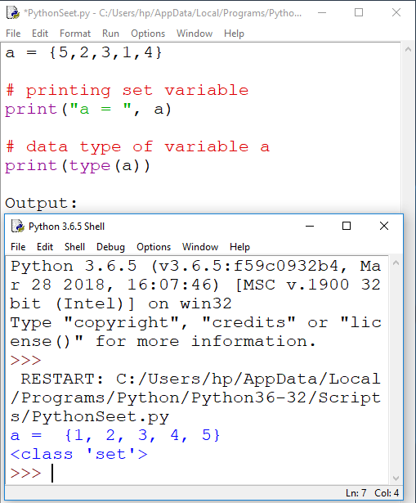

Slide 19
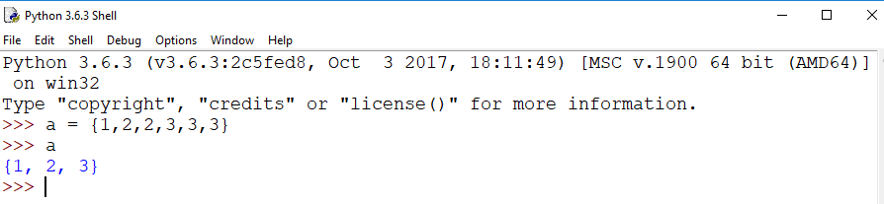
Set have unique values. They eliminate duplicates.
Example:

Slide 20
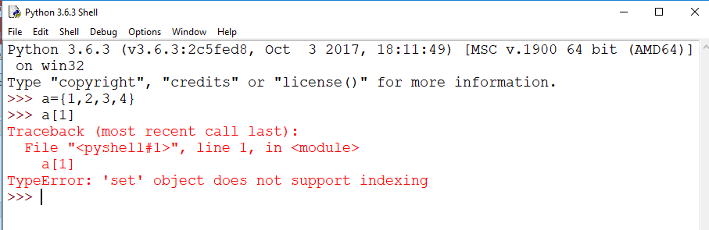
Since, set are unordered collection, indexing has no meaning.
Hence the slicing operator [] does not work.
Example:

Slide 21
Python Dictionary
An unordered collection of key-value pairs.
Must know the key to retrieve the value.
Are defined within braces {} with each item being a pair in the form key: value
Key and value can be of any type
>>>p={'name':'Sonam', 'age':18}
>>> p
{'name': 'Sonam', 'age': 18}
>>> type(p)
<class 'dict'>

Slide 22
>>> p['name']
'Sonam'
>>> p['age']
18
>>countrycode={"India":"+91", "USA":"+1", "singapore":"+65"} # “India” is key and Value is +91
>>> countrycode["USA"]
'+1‘
>>> countrycode["India"]
'+91'

