Slide 1
Loop Control Statements

Slide 2
Introduction
Python Supports two types of loop controlled statements.
a) while Loop (Condition Controlled Loop)
b) For Loop (Count Controlled Loop)
The while loop is condition controlled loop an it is controlled by true or false conditions.
Whereas the for loop is a count controlled loop which repeats for specified number of times.

Slide 3
The While Loop
The while loop is frequently used in programming for repeated execution of statement/s in a loop.
It executes sequence of statements repeatedly as long as condition remains true.
Syntax of while loop is as
The reserved keyword while begins with the while statement.
The test-condition is a Boolean expression.
while statement is terminated with colon(:)
The statement(s) within while loop will be executed till the condition is true
while test-condition: #Loop Body statement(s)

Slide 4
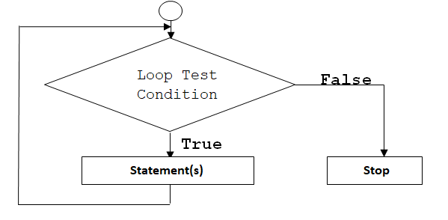
Flow chart of While Loop

Slide 5
Program on While Loop
Program to print the numbers from one to five using while loop
count=0 # initialize the counter while count<=5: # Test condition print("Count = ",count) # print the value of count count=count+1 # Increment value of count by 1 Output: Count = 0 Count = 1 Count = 2 Count = 3 Count = 4 Count = 5

Slide 6
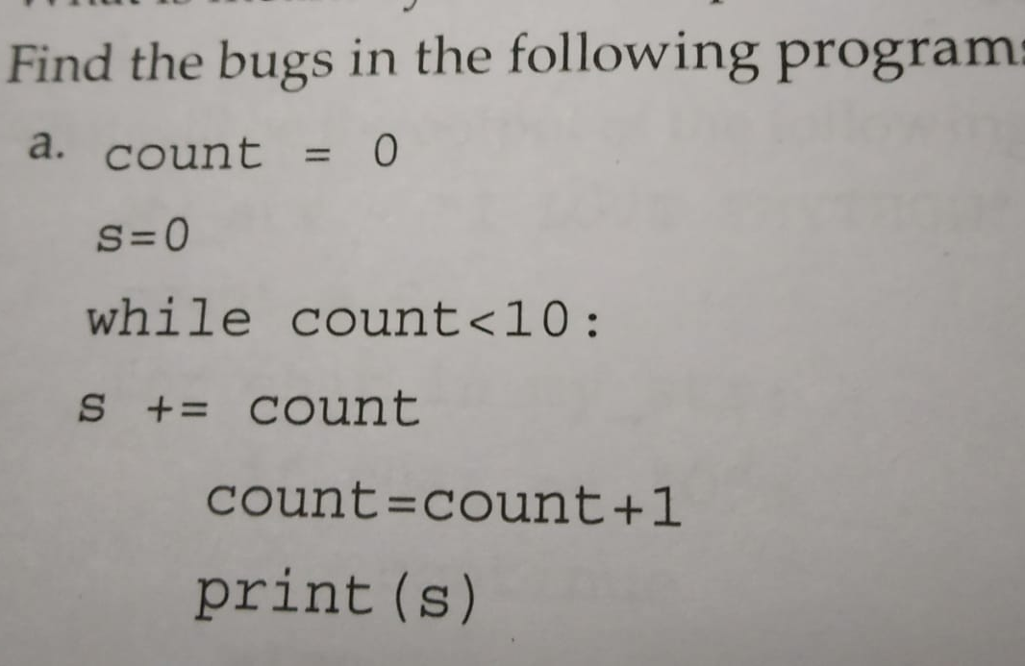

Slide 7
The range() function
The range() is a in built function.
It is used to generate the list of integers.
The range function has one, two or three parameters.
The general form of the range function is as follows
range(begin, end, step)
Whereas,
The begin is the first beginning number in the sequence at which the list starts.
The end is the limit i.e. the last number in sequence. (This number must not be included in the elements of list)
The step is the difference between the each number in sequence.

Slide 8
Examples of range() function
Creates the list of 5 integers
To create a list of integers from 1 to 20 with a difference of 2 between two successive integers
>>> list(range(1,6)) [1,2,3,4,5]
>>> list(range(1,20,2)) [1, 3, 5, 7, 9, 11, 13, 15, 17, 19]

Slide 9
The for loop
Python for loop iterates through a sequence of objects i.e. it iterates through each value in a sequence.
Where sequence of object holds multiple items of data stored one after another.
The syntax of for loop is as follows:
Thus, for loop is a python statement which repeats a group of statements for a specified number of times.
for var in sequence: statement(s) ……………………………… ……………………………

Slide 10
Program on for loop
Write a program by using for loop to print numbers from 1 to 5.
for x in range(1,6): print(x,end=' ') Output 1 2 3 4 5
# Print the capital letters from A to Z for x in range(65,91,1): print(chr(x),end=' ') Output A B C D E F……. W X Y Z

Slide 11
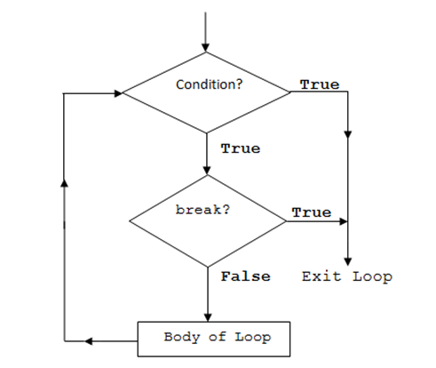
The break Statement
The keyword break allows the programmer to terminate the loop.
When the break statement is encountered inside a loop, the loop is immediately terminated and program control automatically goes to the first statement
following the loop.
Flow chart of break
statement
False

Slide 12
Working of break in while and for loop
while test-Boolean-expression: body of while if condition: break body of while Statement(s)
Working of break in while loop
Working of break in for loop
for var in sequence: body of for if condition: break body of for statement(s)

Slide 13
Program using for and break
count=35 for x in range(0,10): count=count-1 if x==2: break print(count) Output: ?? 35 b) 32 c) 35,34,33 d) 34, 33, 32

Slide 14
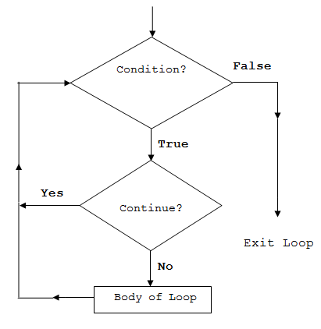
The continue Statement
The continue statement is exactly opposite of the break statement.
When continue is encountered within the loop, the remaining statements within the body are skipped but the loop condition is checked to see if the loop should continue or exited.
Flow chart of continue

Slide 15
Working of continue in while and for loop
while test-Boolean-expression: body of while if condition: continue body of while Statement(s)
Working of continue in while loop
Working of continue in for loop
for var in sequence: body of for if condition: continue body of for statement(s)

Slide 16
sum=0
for i in range(10,0,-2):
sum+=i
print(i)
if i==4:
continue
print(sum)
Output: ???
______________________________________________
sum=0
for i in range(10,0,-2):
sum+=i
print(i)
if i==4:
break
print(sum)
Output: ???

Slide 17
The pass Statement
The pass statement represents null operation, which means nothing happens when it executes.
It can be used when certain statement is required only syntactically but programmer does not wish to execute any code or command.

Slide 18
Program using for and pass
for i in range (1,11): if i==5: pass else: print(i) print('end of for') Output: 1 2 3 4 6 7 8 9 10 end of for

Slide 19
Conclusion
The loops are used to repeat the same code multiple times.
Various loops such as for, and while have been discussed.
The while loop is a condition controlled loop where as for loop is a count controlled loop.
The break statement is used to terminate from the loop.
Where as continue statement is used to skip the current iteration and continues with the next iteration.
Pass statement is not ignored by python interpreter but it does not execute any code

Slide 20
