Slide 1



Exception Handling in Python

Slide 2

Exception
When writing a program, we, more often than not, will encounter errors.
Error caused by not following the proper structure (syntax) of the language is called syntax error or parsing error
Errors can also occur at runtime and these are called exceptions.
They occur, for example, when a file we try to open does not exist (FileNotFoundError), dividing a number by zero (ZeroDivisionError)
Whenever these type of runtime error occur, Python creates an exception object. If not handled properly, it prints a traceback to that error along with some details about why that error occurred.

Slide 3
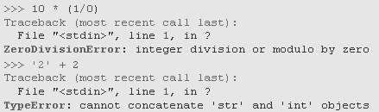
Exceptions
Even if a statement or expression is syntactically correct, it may cause an error when an attempt is made to execute it. Errors detected during execution are called exceptions and are not unconditionally fatal. Most exceptions are not handled by programs, however, and result in error messages like “cannot divide by zero” or “cannot concatenate ‘str’ and ‘int’ objects”.

Slide 4
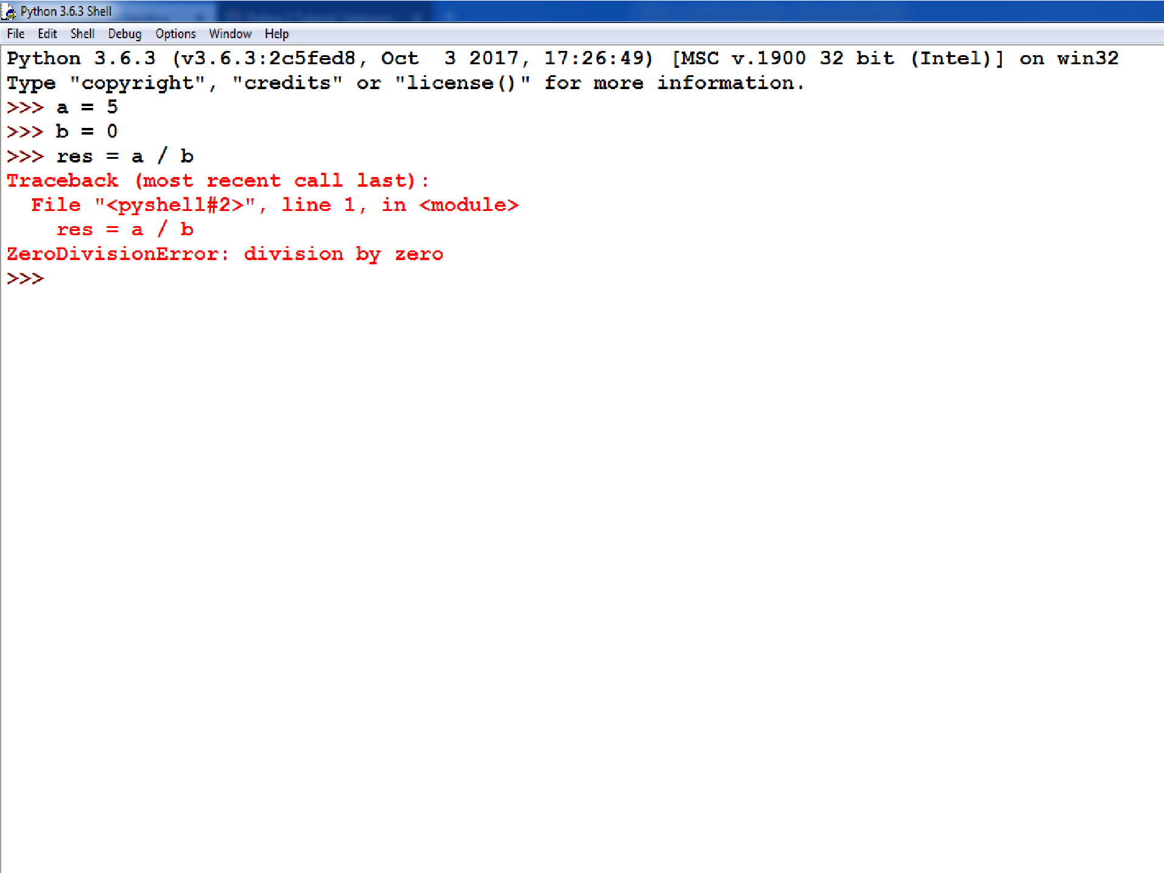

Slide 5

Exception Handling
To handle exceptions, and to call code when an exception occurs, we can use a try/except statement.
The try block contains code that might throw an exception.
If that exception occurs, the code in the try block stops being executed, and the code in the except block is executed.
If no error occurs, the code in the except
block doesn't execute.

Slide 6
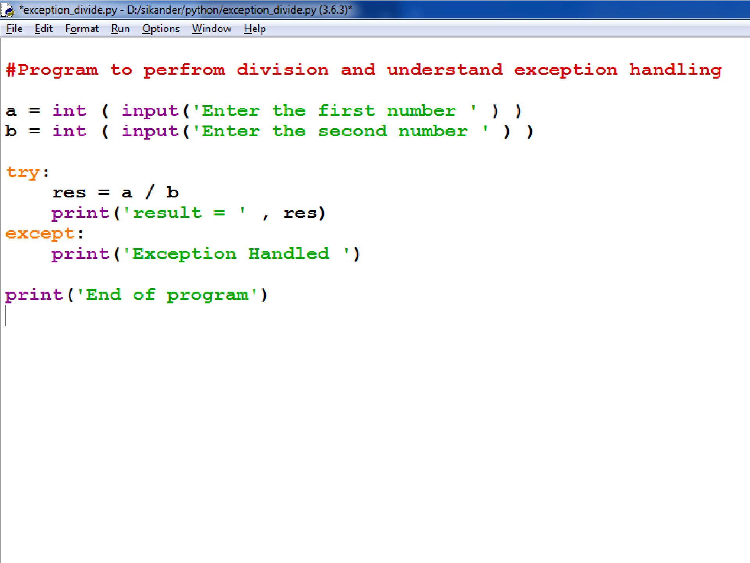

Slide 7

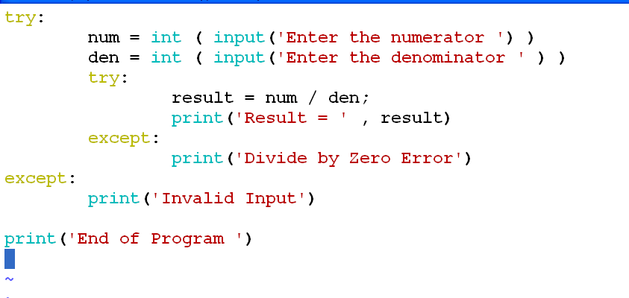
Nested Try Block

Slide 8
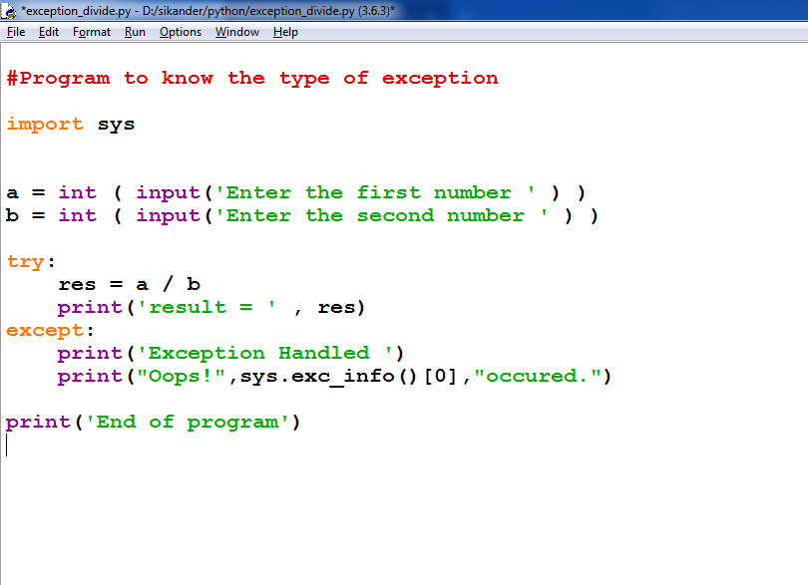

Slide 9
Here are few important points:
A single try statement can have multiple except statements. This is useful when the try block contains statements that may throw different types of exceptions.
After the except clause(s), you can include an else-clause. The code in the else-block executes if the code in the try: block does not raise an exception.
The else-block is a good place for code that does not need the try: block's protection.

Slide 10
try:
a = [1, 2, 3]
print (a[3])
except LookupError:
print ("Index out of bound error.")
else:
print ("Success")
Output:
Index out of bound error.
try:
a = [1, 2, 3]
print (a[2])
except LookupError:
print ("Index out of bound error.")
else:
print ("Success")
Output:
3
Success

Slide 11
Example:
try:
fh = open("testfile", "w")
fh.write("This is my test file for exception handling!!")
except IOError: print "Error: can\'t find file or read data"
else: print "Written content in the file successfully"
fh.close()
This will produce following result:
Written content in the file successfully

Slide 12
The try-finally clause:
You can use a finally: block along with a try: block. The finally block is a place to put any code that must execute, whether the try-block raised an exception or not.
The syntax of the try-finally statement is this:
try:
You do your operations here;
......................
Due to any exception, this may be skipped.
finally:
This would always be executed.
......................

Slide 13
Example:
try:
fh = open("testfile", "w")
fh.write("This is my test file for exception handling!!")
finally:
print "Error: can\'t find file or read data"
If you do not have permission to open the file in writing mode then this will produce following result:
Error: can't find file or read data

Slide 14
A try statement can have multiple different except blocks to handle different exceptions.

Slide 15
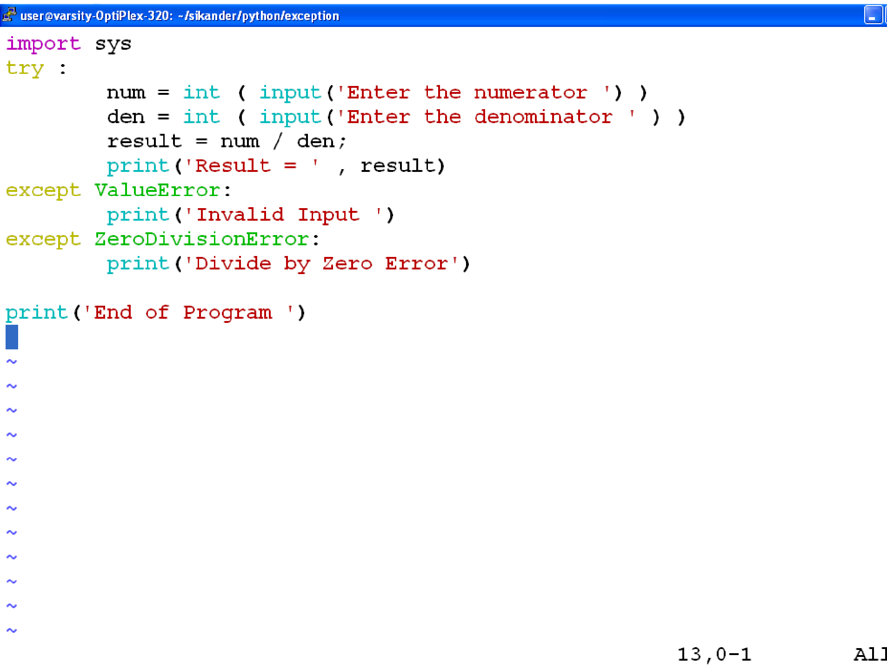

Slide 16
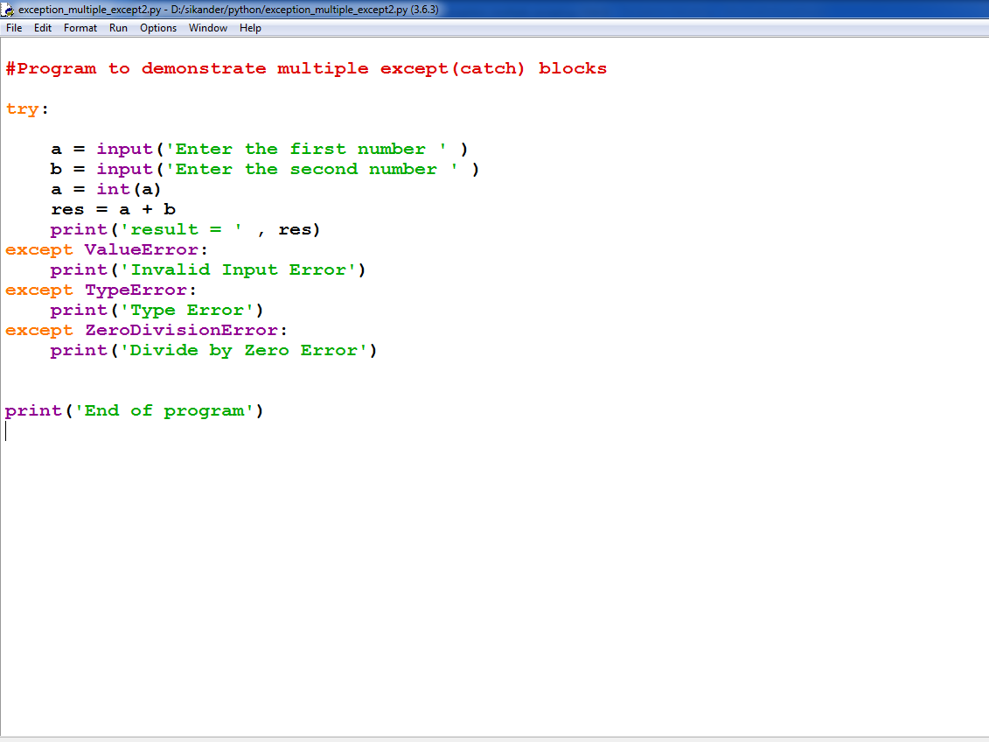
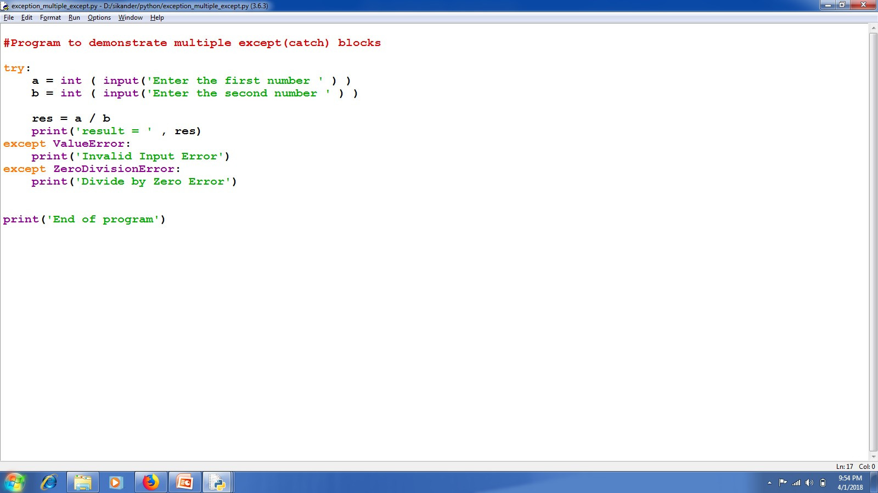

Slide 17
Multiple exceptions can also be put into a single except block using parentheses, to have the except block handle all of them.

Slide 18
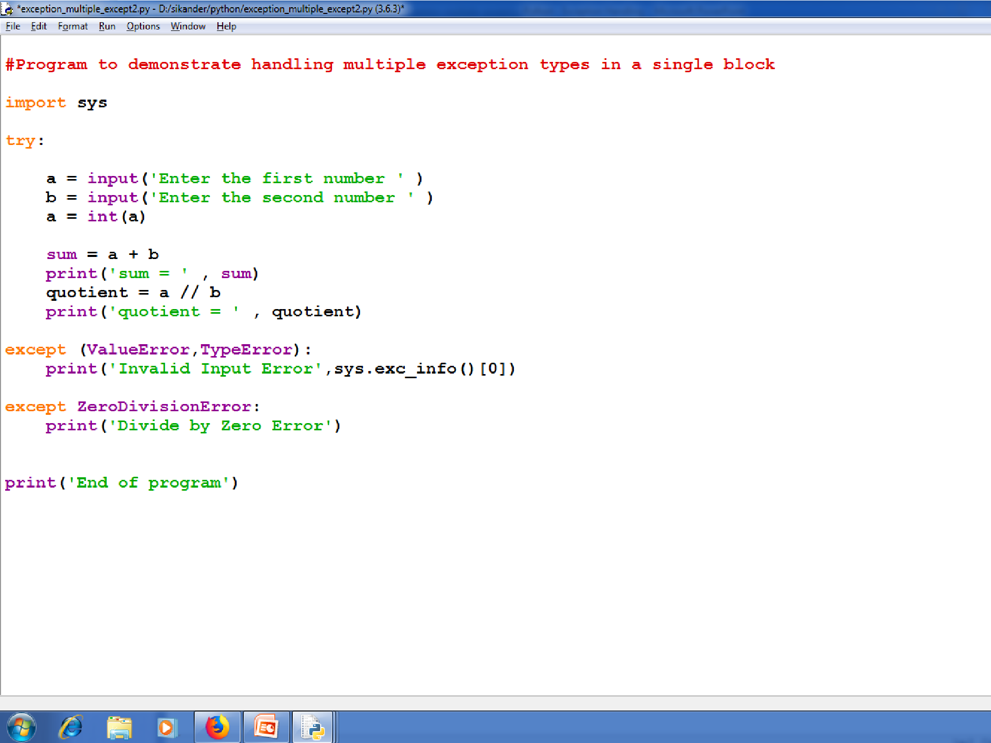

Slide 19

Raising Exception
Raising exception is similar to throwing exception in C++/Java.
You can raise exceptions by using the raise statement

Slide 20

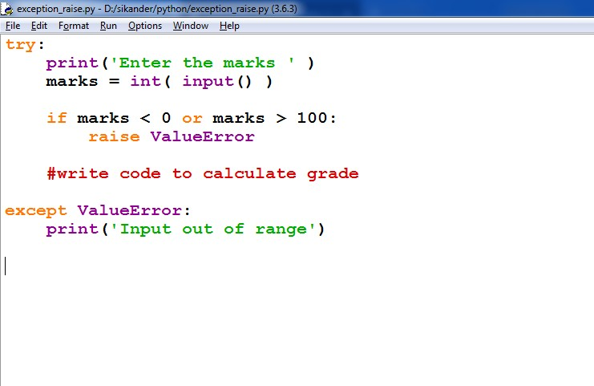
Raising Exceptions

Slide 21
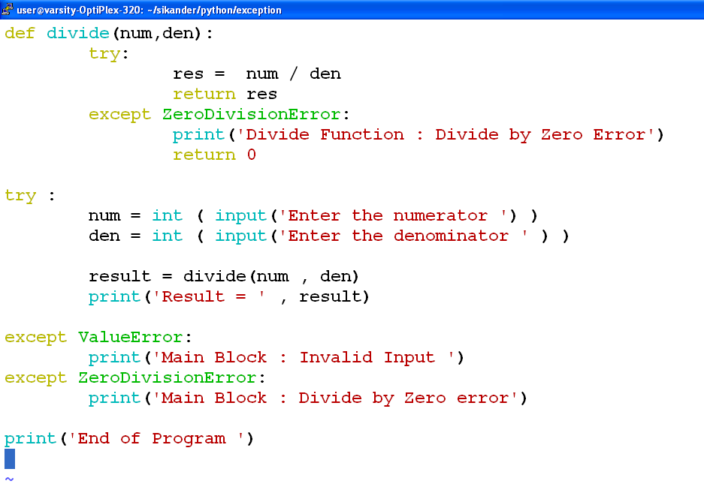

Slide 22
User-Defined Exceptions:
Python also allows you to create your own exceptions by deriving classes from the standard built-in exceptions.
Here is an example related to RuntimeError. Here a class is created that is subclassed from RuntimeError. This is useful when you need to display more specific information when an exception is caught.
In the try block, the user-defined exception is raised and caught in the except block. The variable e is used to create an instance of the class Networkerror.
class Networkerror(RuntimeError):
def __init__(self, arg):
self.args = arg
So once you defined above class, you can raise your exception as follows:
try:
raise Networkerror("Bad hostname")
except Networkerror,e:
print e.args

Slide 23

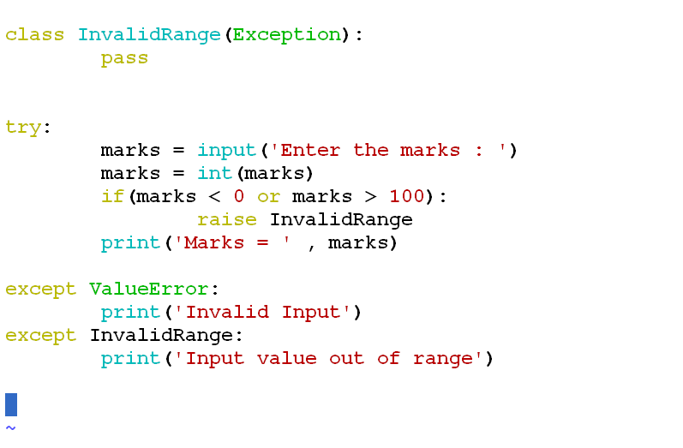
User Defined Exception

