Slide 1
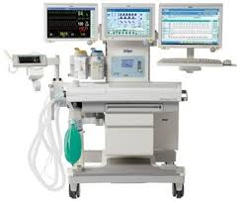
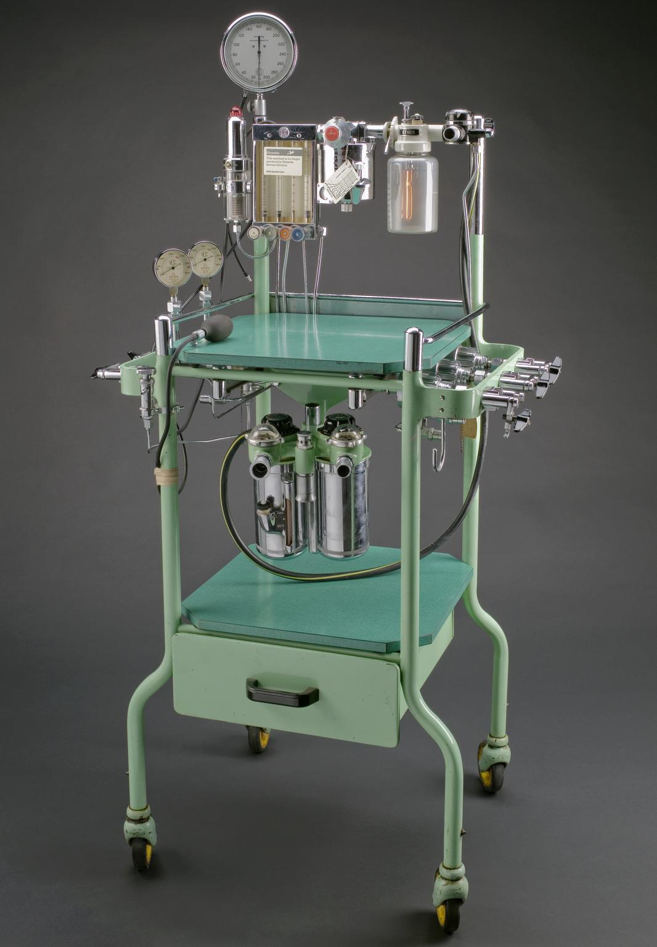
ANAESTHSIA MACHINE: Working Principles
Presenter: Dr. M Ramya Bhavana
Moderator: Dr Surya Prakash

Slide 2
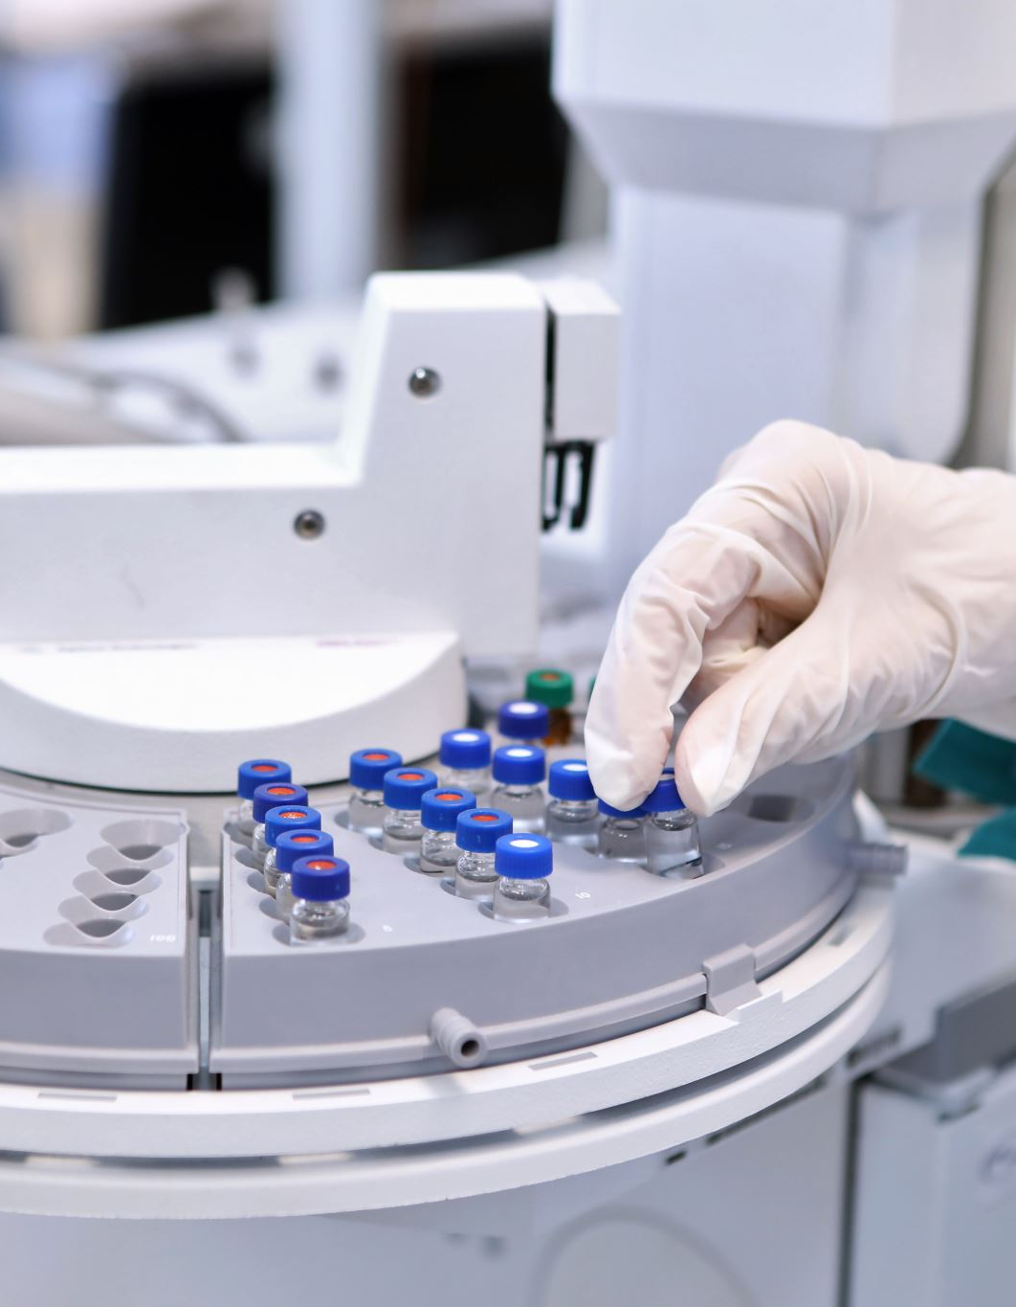
Functions of Anesthesia machine
To control patients' ventilation
Oxygen delivery
To administer inhalational anaesthetics
The proper functioning of anesthesia machine is crucial for patients' safety.

Slide 3
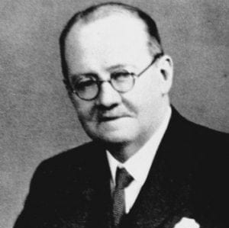
History
The first anesthesia machine was made by Sir Henry Edmund Gaskin Boyle in 1917, hence the name Boyle’s machine

Slide 4
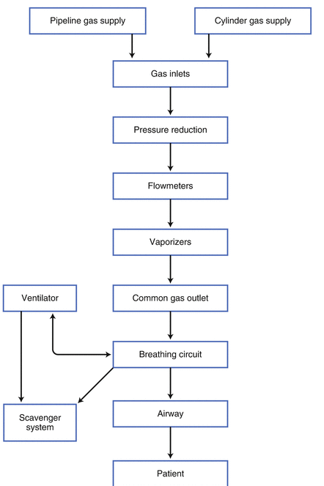
The Anesthesia Machine working principle

Slide 5
Anesthesia workstation
Anesthesia machine
Vs

Slide 6
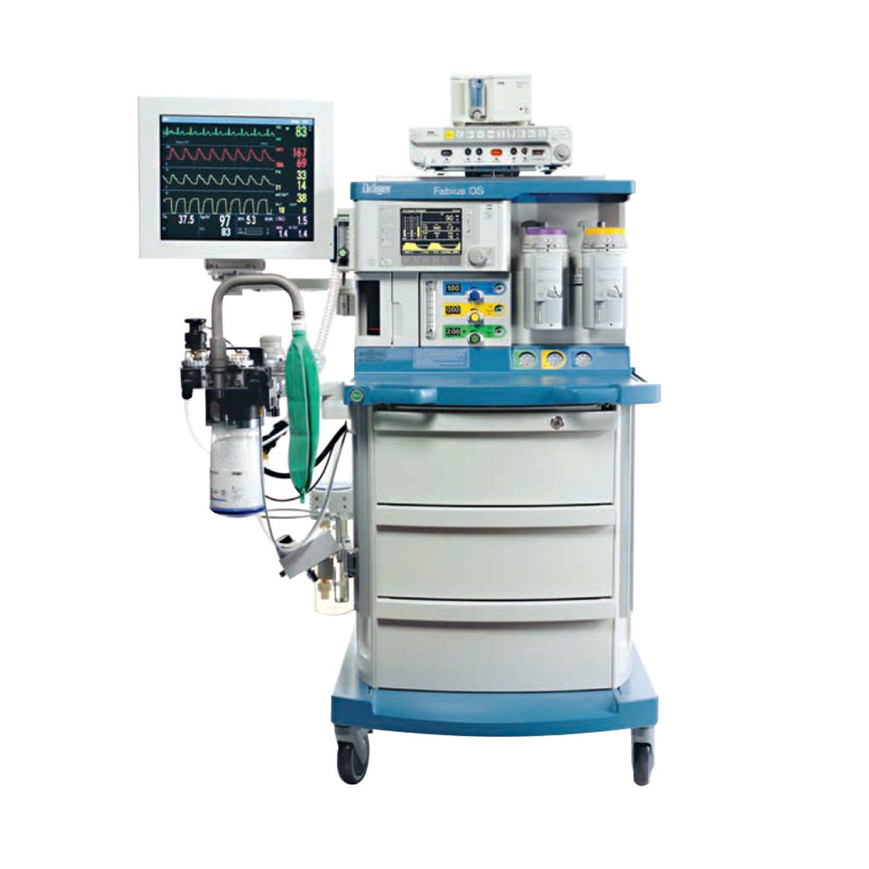
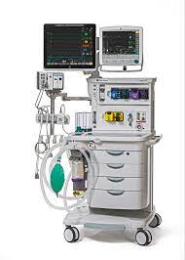
Modern workstations
Abs Drager Anesthesia Machine
Datex Ohmeda Anesthesia Machine

Slide 7
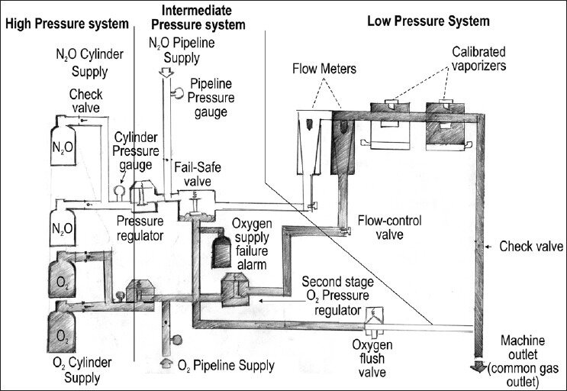
Pneumatic components of workstation
Classified based on the amount of pressure inside the machine
1. High pressure system.
2. Intermediate pressure system.
3. Low pressure system.

Slide 8
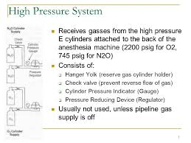
High Pressure System
It consists of
1. cylinders
2. hanger yoke
3. first pressure reducing valve
4. check valve
5. cylinder pressure gauge
6. pressure regulator

Slide 9
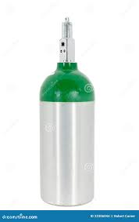
Cylinders
Parts of cylinder
Valve
Neck
Shoulder
Body

