Slide 1
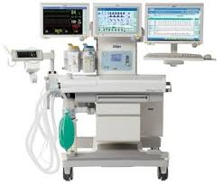
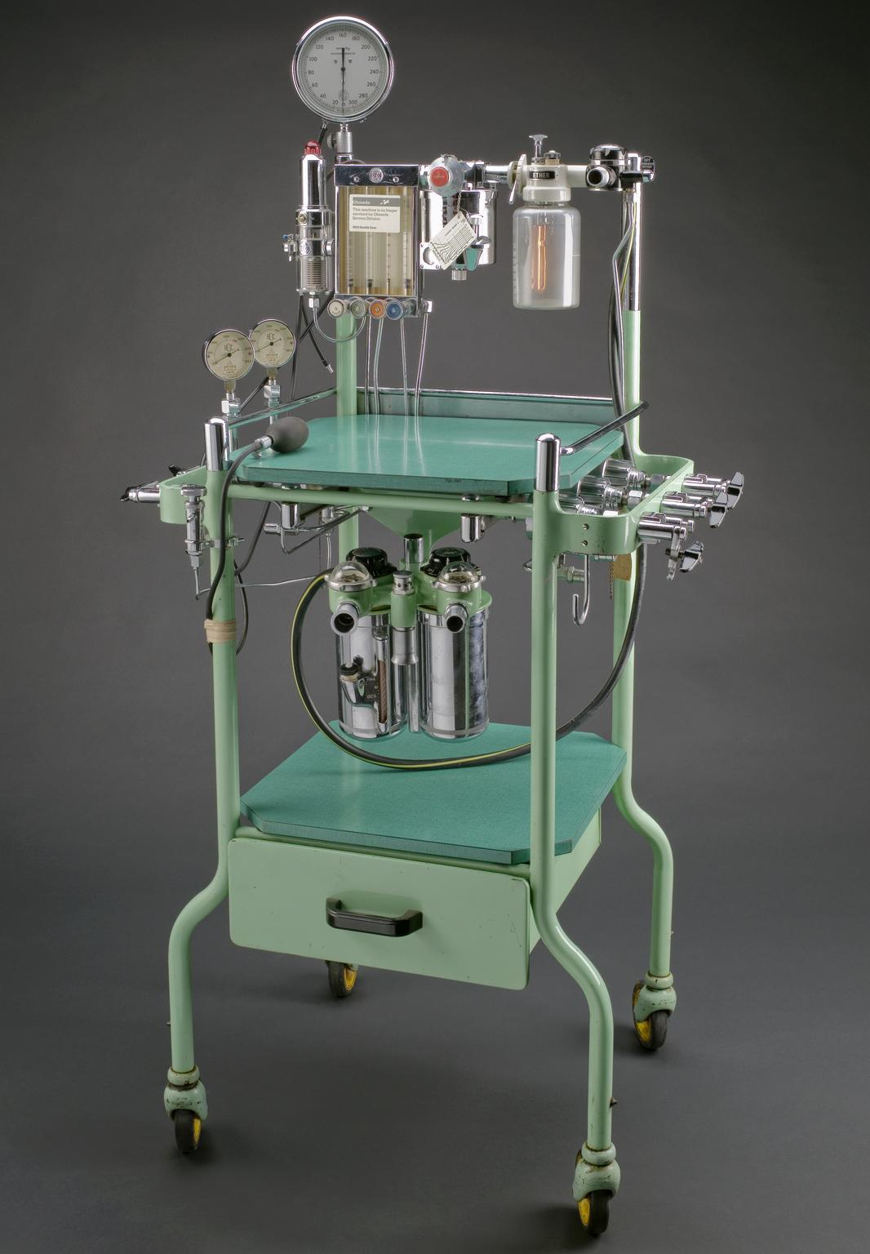
ANAESTHSIA MACHINE: Working Principles
Presenter: Dr. M Ramya Bhavana
Moderator: Dr Surya Prakash

Slide 2
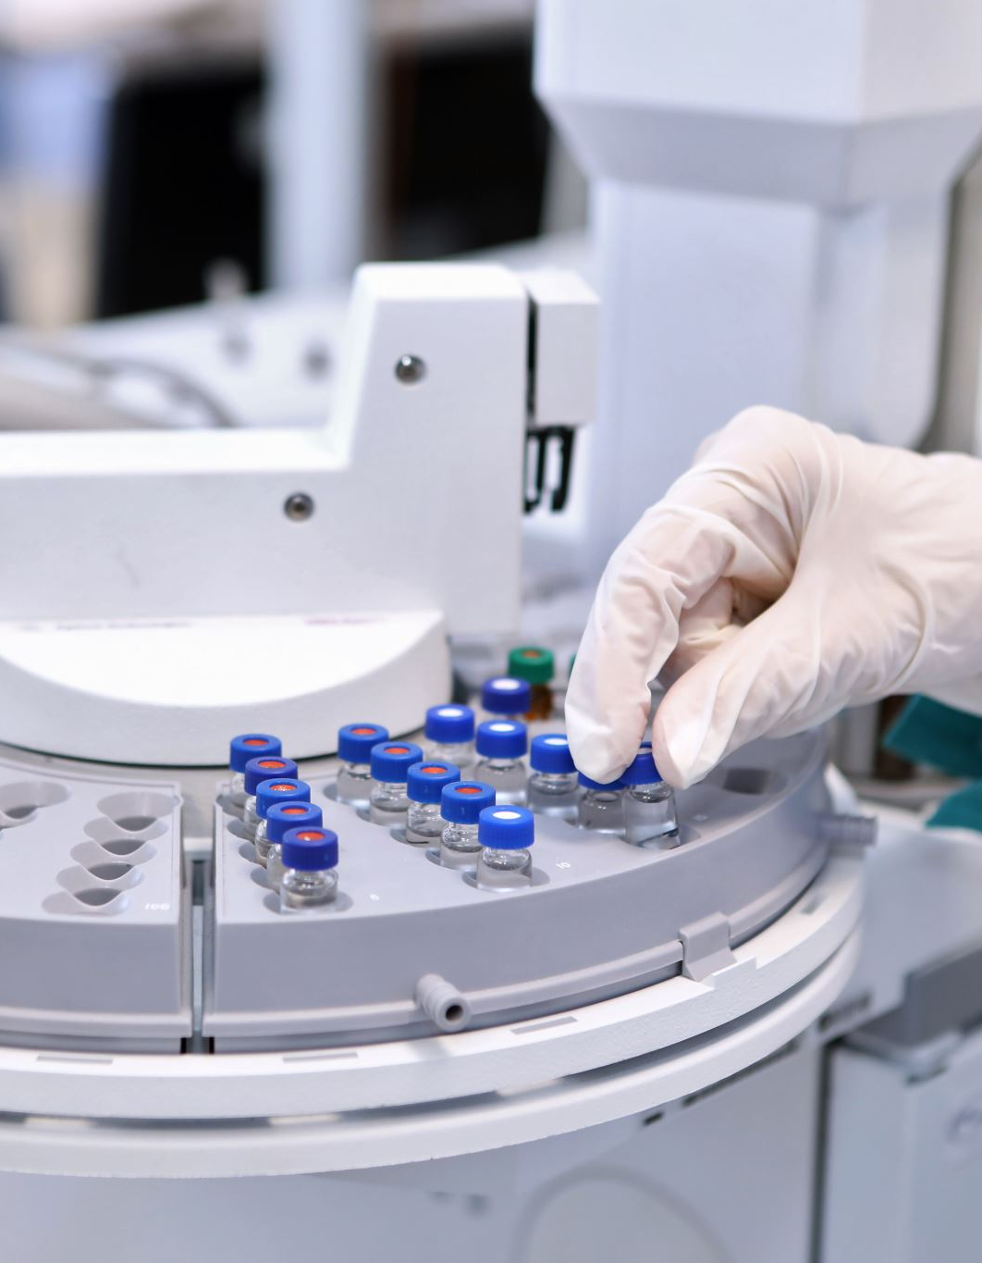
Functions of Anesthesia machine
To control patients' ventilation
Oxygen delivery
To administer inhalational anaesthetics
The proper functioning of anesthesia machine is crucial for patients' safety.

Slide 3
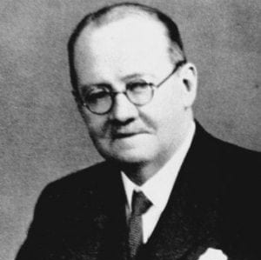
History
The first anesthesia machine was made by Sir Henry Edmund Gaskin Boyle in 1917, hence the name Boyle’s machine

Slide 4
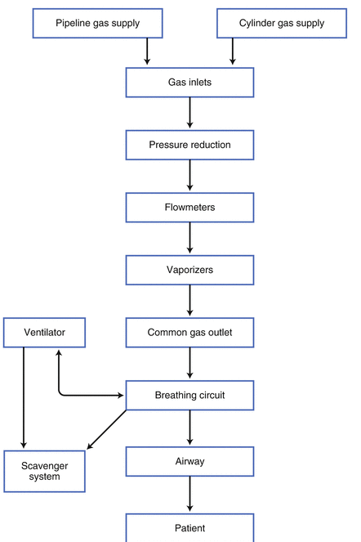
The Anesthesia Machine working principle

Slide 5
Anesthesia workstation
Anesthesia machine
Vs

Slide 6
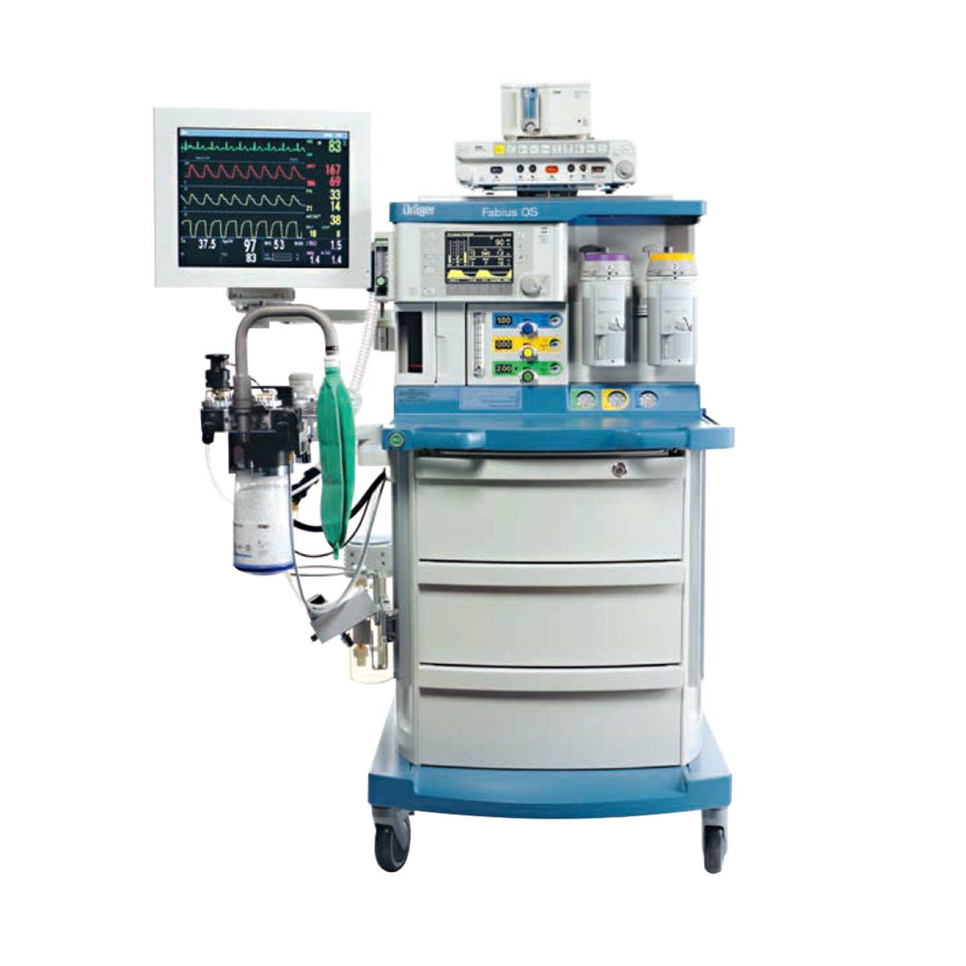
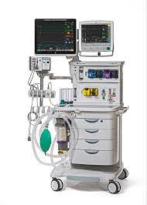
Modern workstations
Abs Drager Anesthesia Machine
Datex Ohmeda Anesthesia Machine

Slide 7
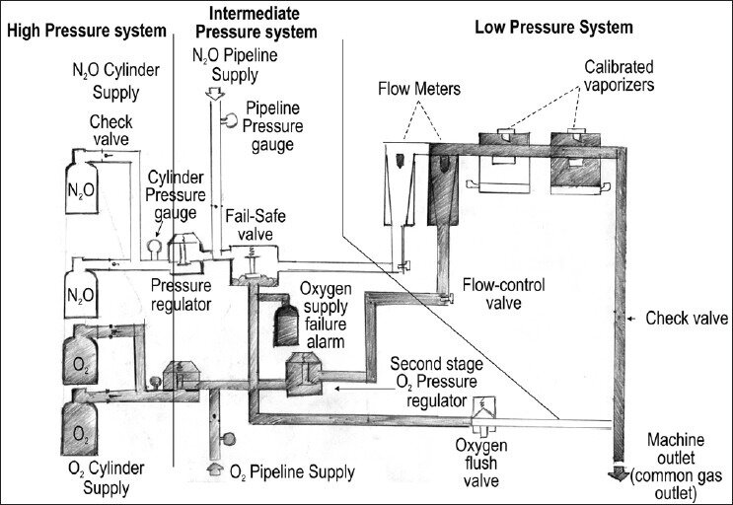
Pneumatic components of workstation
Classified based on the amount of pressure inside the machine
1. High pressure system.
2. Intermediate pressure system.
3. Low pressure system.

Slide 8
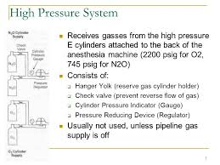
High Pressure System
It consists of
1. cylinders
2. hanger yoke
3. first pressure reducing valve
4. check valve
5. cylinder pressure gauge
6. pressure regulator

Slide 9
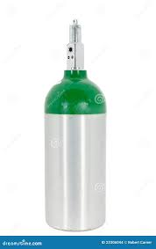
Cylinders
Parts of cylinder
seamless body: one of the safety features
Valve
Neck
Shoulder
Body

Slide 10
Material with which Cylinders are made of
Previously cylinders were made of hand forged steel,
Its tensile strength was very less, so, walls had to made very thick, hence, the cylinders were very heavy and internal volume was very less.
Present cylinders were made of molybdenum steel, and its tensile strength is good, and the walls were thin, hence they were weight less, so, this provides the cylinder capacity volume increase by 20%.

Slide 11
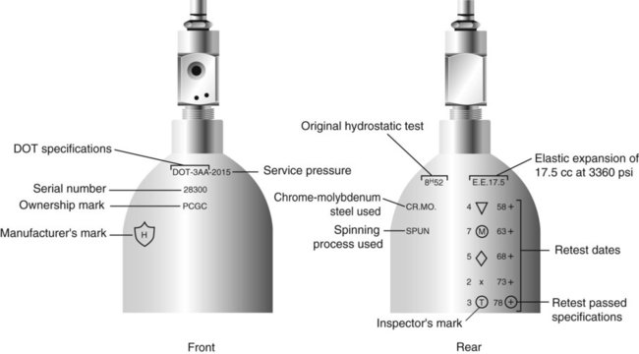
Markings on the cylinders

Slide 12
Markings on the cylinders
1. DOT = Date Of Transfer
2. Service pressure = Pressure with which oxygen is filled in the cylinder for use.
3. EE = Elastic Expansion
4. Cylinders that have marked 3 AA are manufacture by using steel.
5. The markings 3AL & 3ALM indicates that the cylinders are made up of Aluminum.

Slide 13
Markings engraved on the cylinders
Service pressure
Dates of test performed
Chemical formula of cylinders content
Tare weight (weight of empty cylinder)

Slide 14
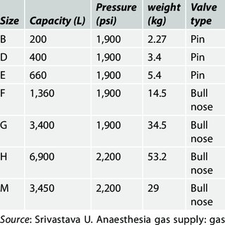
Identification of Medical Gas Cylinder

Slide 15
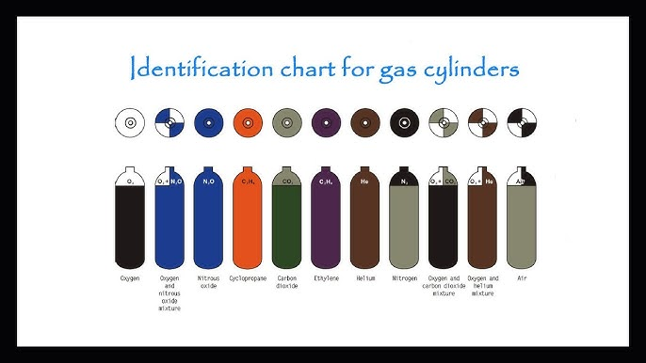
Color coding of cylinders

Slide 16
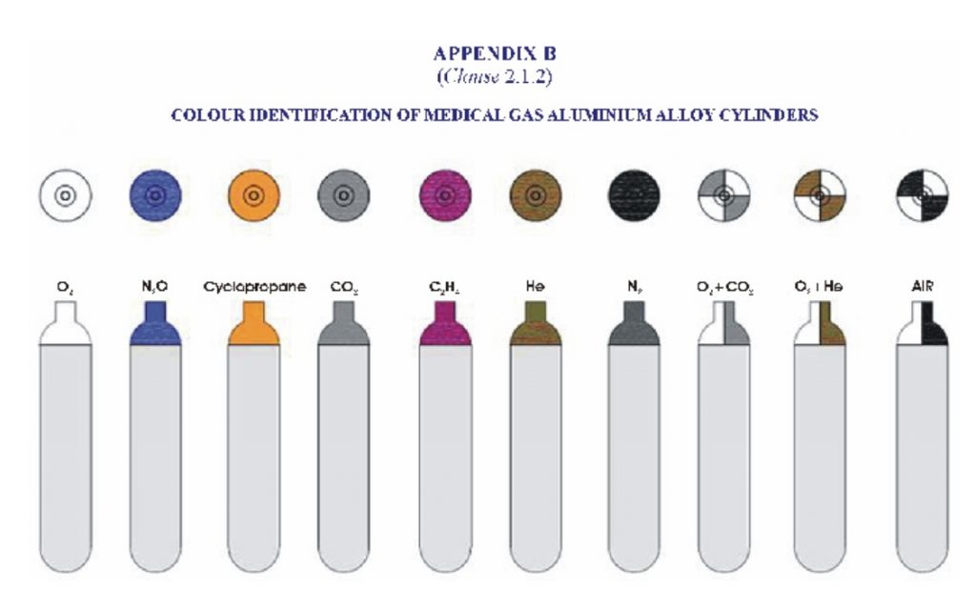
New International color coding
1. Body of all medical gas cylinders are white.
2. By using the shoulder color we can recognize the cylinders.

Slide 17
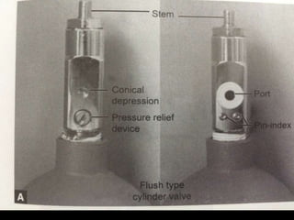
Cylinder valves
They are made of
Brass & Chromium platted, but not with molybdenum steel like cylinders.

Slide 18
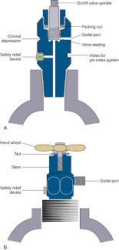
Cross section of cylinder valve

Slide 19
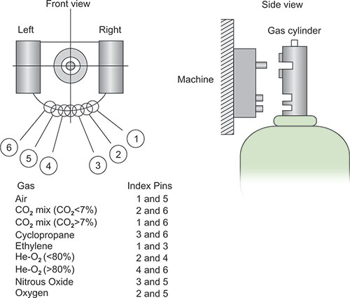
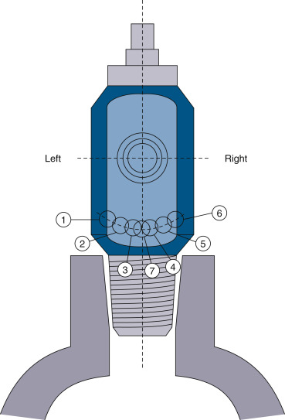
Pin Index safety system-Philip Wood Bridge (1952)

Slide 20
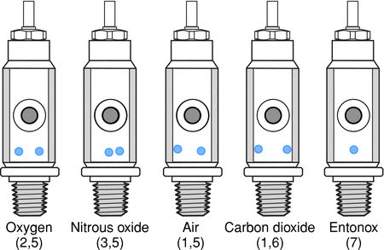
Pin Index Numbers

Slide 21
What happens when the cylinders are heated up in the sun ?
What is safety feature to prevent it?
According to ideal gas law PV=nRT “at a constant volume as temperature increase, pressure inside the cylinder also increases” causing explosion or cylinder break
The answer is “Pressure relief device”

Slide 22
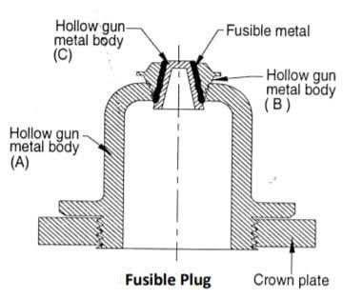
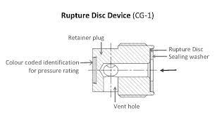
Pressure relief device
Venting of contents at dangerously high pressures
Types
1. Rupture disc
2. Fusible Plug
3. Combination of both
4. Pressure relief value

Slide 23
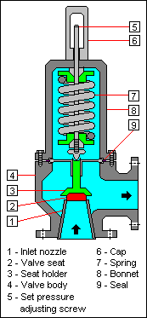
Pressure relief valve

Slide 24
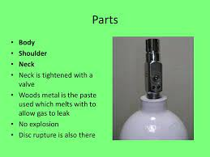
Woods metal
1. Present between cylinder value and cylinder body
2. Whenever temperature increases woods melts out and gases are vented out.

Slide 25

Safety features of cylinders
Made of molybdenum steel – high tensile strength
Color coding
Safety relief valve
Pin Index Safety System

Slide 26

Cracking in the cylinder
Before connecting to the Yoke, the cylinder valve be cracked (i.e opened only slightly) to blow away any dust or flammable sliting on the valve.
The person opening the cylinder should be positioned so that the value outlet points away from self, patient & machine.

Slide 27
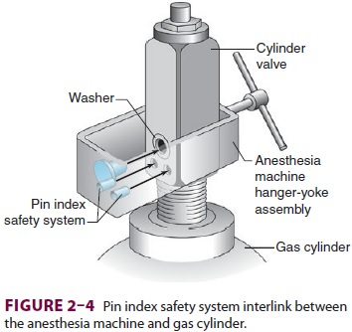
Hanger Yoke Assembly
It is the place where cylinder is attached to the Anesthesia machine.
Orients & support the cylinder.
Maintains unidirectional flow of gases towards the machine.
Provides a gas tight seal

Slide 28
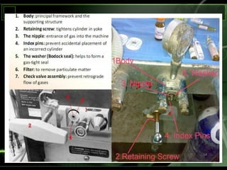
Parts of Hanger Yoke Assembly

