Slide 1
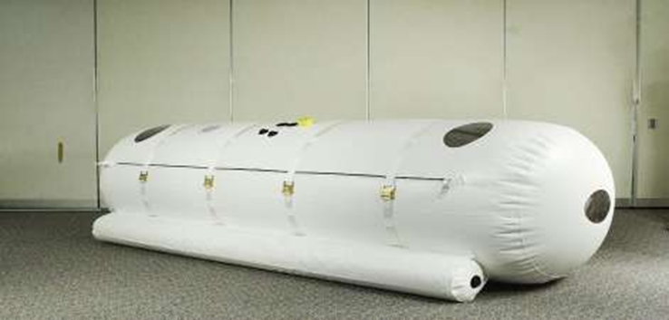
Hyperbaric Oxygen Therapy
Definition
History
Mechanisms of HBO
Types of HBO
Indications
Contra Indications
Complications

Slide 2
Definition
The intermittent administration of 100% Oxygen at higher than atmospheric pressure, i.e. where oxygen dissolves in arterial blood plasma in increased amounts.

Slide 3
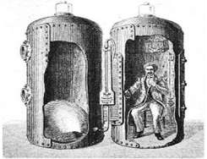
History
Initial discovery:
In 1662 → Henshaw built first hyperbaric chamber
Henshaw’s
Domicilium

Slide 4
1870-Surgical use → Fontaine & Bert Used for Wounds
1889 – Moir,Reduced mortality rate of decompression sickness from 25% to only 1.6% per year.
1960 – BOEREMA,Pioneered the application of HBO to many medical problems.Performs first surgery with HBO.Discovered that Hgb wasn’t necessary for O2 transport
Brummelkamp discovered effects on anaerobes

Slide 5
Physiology
Normally ,O2 demand is met by the Oxygen combined to Hb, which is 95% saturated.
Even if we increase the pO2 , hemoglobin can’t carry more oxygen as it is 100% saturated.
100 ml blood carries 19 ml O2 combined with Hb and 0.32 ml dissolved in plasma.
Under barometric pressures,more oxygen gets dissolved into plasma,this additional O2 is almost sufficient to meet tissue needs without contribution from O2 bound to hemoglobin and is responsible for the beneficial effects of this therapy.

Slide 6
Effect of Pressure On Arterial O2
Content of Oxygen Dissolved in plasma (voL)
total pressure Breathing Air % 100 Oxygen
1 | 0.32 | 2.09
2 | 0.81 | 4.44
3 | 1.31 | 6.80

Slide 7
Mechanism for HBO Therapy
Oxygenation of Ischemic, Hypoxic Tissue:
HBO increases plasma and tissue oxygen tensions 10 times which helps tissues to maintain tissue viability.
Neutrophil Oxidative Killing:
Neutrophils regain ability to kill bacteria by generation of oxygen dependent superoxides and peroxides.
Suppression of multiplication in bacteria:
High oxygen tensions suppress growth of streptococcus and anerobes.

Slide 8
Augmentation of Antibiotic effectiveness:
Increased oxygen tension allows oxygen dependent active transport to bring in antibiotic across bacterial cell wall.
Enhanced fibroblast function:
prevents unnecessary cicatrix formation.
Angiogenesis:
Increased oxygen tension increases vascular endothelial grow factor function as well as secretion of matrix by fibroblasts

Slide 9
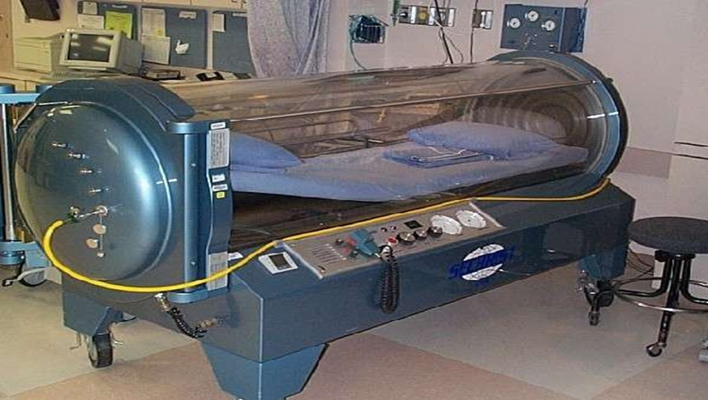
Types of hyperbaric chambers:
Monoplace

Slide 10
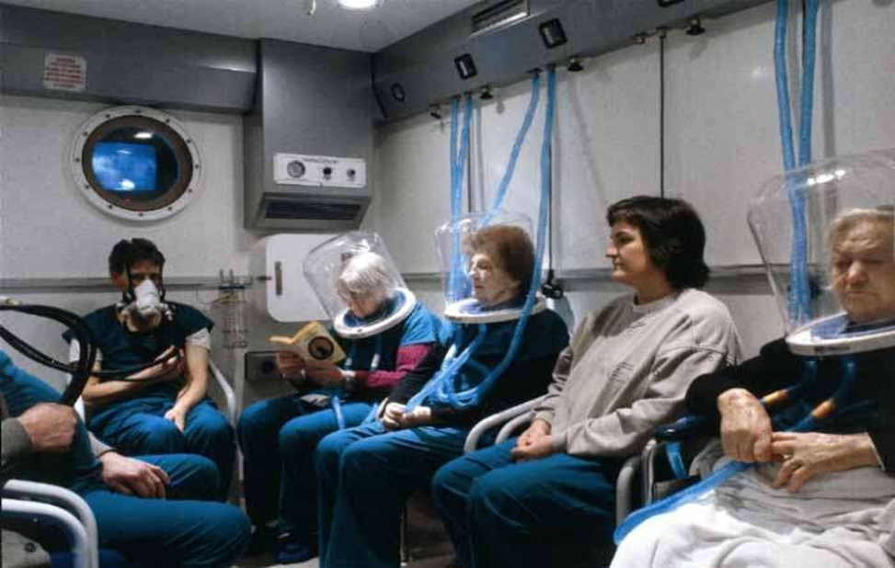
Multiplace

Slide 11
Process Of Treatment
Initial compression for 30 minutes
Treatment for 90 minutes with air breaks (10 minutes every 30 minutes is standard)
Decompression for 30 minutes
All regimens use 100% O2
Pressure -Most use 2.4 atm
Maximum tolerated is 3 atm
4 atm induces seizures

Slide 12
Indications for HBOT
After reviewing all the scientific evidence available to date, the Undersea and Hyperbaric Medical Society, in its latest publication, Hyperbaric Oxygen Therapy Indications (12th ed.), recommends the following 13 indications for HBOT:
1.Air or gas embolism
2.Carbon monoxide poisoning and carbon monoxide +CYANIDE poisoning
3.Clostridial myositis and myonecrosis (gas gangrene)
4.Crush injury, compartment syndrome and other acute
traumatic ischemias

Slide 13
5.Decompression sickness
6.Arterial insufficiency ulcers
7.Severe anemia
8.Intracranial abscess
9.Necrotizing soft tissue infections
10.Osteomyelitis (refractory)
11.Delayed radiation injury (soft tissue and bony necrosis)
12.Compromised grafts and flaps
13.Acute thermal burn injury

Slide 14
Gas embolism
HBO is the first line of treatment for air embolism as:
In hyperbaric conditions, O2 diffuses into the bubbles and displaces the N2 from the bubble.
HBO induces vasoconstriction,thus inhibits air embolus redistribution
It decreases cerebral edema.
Counteracts the ischemic and hypoxic effects of vascular obstruction.
Reduces blood sludging and improves WBC function.

Slide 15
Carbon Monoxide Poisoning
Affinity of CO for haemoglobin(forming carboxyhemoglobin) is 200 times that of oxygen.
Supplemental oxygen is first line therapy
HBO causes carboxyhemoglobin dissociation to occur faster than pure oxygen at sea level pressure.
Breathing Gas
Air, 1 ATA
Oxygen, 1 ATA
Oxygen, 2.5 ATA
Mean Half-life
214 min
43 min
19 min

Slide 16
Gas Gangrene
Anaerobic bacteria are sensitive to increased tissue PO₂.
Diffused O2 raises capillary p02 levels at the wound site, stimulating capillary budding and granulation tissue.
Van Unnik found that-tissue Po₂ of 250 mm Hg is required to stop toxin production which is achieved by HBOT.
High O₂ tensions also causes:
reversal of hypoxia-induced neutrophil function,
enhanced macrophage interleukin (IL)-10 expression
anti-inflammatory effects.

Slide 17
Crush injuries and
Compartment syndrome
In crush injuries and compartment syndrome, HBOT helps in one of the following 3 ways:
(1)Supplements oxygen to poorly perfused areas in early post
injury period
(2)Reduces edema
(3)Mitigates reperfusion injury.

Slide 18
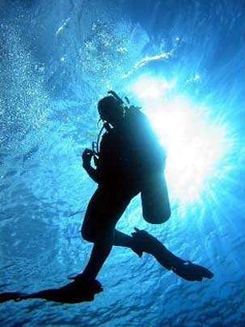
Decompression Sickness
Decompression sickness (caisson disease or “the bends”) is attributed to formation of nitrogen bubbles in the body on rapid decompression.
Occurs in divers, miners and astronauts
Gas bubbles formed, block the lymphatics, veins and arteries
Treatment of choice is HBO
HBOT:
Reduces bubble size
Corrects hypoxia

Slide 19
Arterial insufficiency ulcer
According to Wound Healing Society clinical practice guidelines for arterial insufficiency ulcer(2006) selection criteria include ulcers that are hypoxic (because of ischemia) and whose hypoxia is reversible by hyperbaric oxygenation.
Guideline states:“In patients with non-reconstructable anatomy or whose ulcer is not healing despite revascularization, HBOT should be considered as adjuvant therapy.”

Slide 20
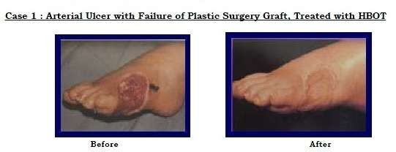

Slide 21
Blood Loss Anemia
Intermittent hyperbaric therapy exposures have been used to relieve temporary physiologic stress from acute anemia
Rarely used for this purpose
May be useful when crossmatching incompatibilities and religious beliefs prevent blood transfusions.

Slide 22
Contraindications
ABSOLUTE: Pneumothorax
RELATIVE :
DRUGS: Alcohol, Nicotine, Cis-platinum, Doxorubicin, Bleomycin, Aromatic hydrocarbons, Disulfiram, Steroids
History of spontaneous pneumothorax or thoracic surgery
Claustrophobia
COPD/URTI
Seizure disorders
Hyperthermia/Hypothermia
Other conditions: Malignant tumors, Acidosis, Pregnancy, Hereditary spherocytosis, Optic neuritis

Slide 23
Complications
Mild problems :
Claustrophobia (in monoplace chambers),
Fatigue
Headache.
More serious complications:
Myopia that can last for weeks or months,
Sinus damage,
middle ear barotrauma
Lung damage.
Major complication:
Oxygen toxicity can result in convulsions, fluid in the lungs, and even respiratory failure.

Slide 24
Tonsillectomy
An adenotonsillectomy considered a simple procedure, has the potential for significant airway challenges.
Considerations of airway obstruction, shared airway, mechanical suspension of the airway, management of intubation and extubation, pain management, and the desire for a rapid awakening are all subtleties of anesthesia for this procedure.

Slide 25
The patient undergoing a tonsillectomy and/or adenoidectomy will probably have a higher incidence of airway obstruction because of the hypertrophied tissues.
Chronic obstruction and infections of the tonsils can lead to systemic involvement, producing additional cardiac and respiratory anomalies.
Adult patients with severe obstructive sleep apnea may require awake intubation before the induction of general anesthesia.

Slide 26
A cuffed tube is recommended in those older than 8 to 10 years of age,4 with continued attention given to inflation pressures of the cuff.
A properly sized pediatric ETT should allow a leak at 20 cm H2O airway pressure, which reduces the likelihood of postoperative croup and edema.
After the airway is secured, the mouth gag is inserted by the surgeon. An adequate depth of anesthesia is needed to facilitate gag insertion.

Slide 27
Several major goals need to be considered when choosing an anesthetic:
(1) provide a depth of anesthesia adequate to blunt strong reflex activity elicited by the procedure,
(2) a rapid return of protective reflexes, (3) good postoperative analgesia,
(4) reduced postoperative bleeding
(5) minimal PONV.
The use of intermediate-acting muscle relaxants is acceptable.
Judicious narcotic supplementation will reduce the total amount of inhalation agent required and provide analgesia with minimal postoperative respiratory depression.
Disadvantages of opiates include increased sensitivity and desaturation in sleep apnea patients and PONV.

Slide 28
Suggested techniques include modest opioids and acetaminophen doses for analgesia, dexamethasone and ondansetron for antiemetic prophylaxis, and deep extubation of the trachea to minimize coughing and airway stimulation when prudent.
Blood loss during tonsillectomy is difficult to assess but has been estimated to average 4 mL/kg or 5% of blood volume.

Slide 29
The postoperative tonsillectomy patient should be transported to the recovery in the “tonsil position”—that is, on one side with the head slightly down.
This allows blood or secretions to drain out of the mouth rather than flow back onto the vocal cords.
The patient must be awake enough to manage his or her own airway.
To hydrate the airway, 100% oxygen with a high-humidity mist is given by facemask or face tent. The pharynx should be rechecked directly for bleeding and edema before discharge.

Slide 30
Routine tonsillectomy is generally performed as an outpatient procedure. A small subset of children are observed overnight if there are sufficient age, comorbidity, or perioperative concerns.
Although postoperative bleeding is the most serious complication, persistent vomiting, poor oral intake, and persistent desaturation are the most common reasons for unscheduled overnight admission after ambulatory surgery.
The incidence of postoperative nausea and vomiting can be as high as 70% during the first 24 hours after tonsillectomy. This is due to swallowed blood, opioid administration, or pharyngeal stimulation, and significantly increases the risk of overnight admission, delayed oral intake, and lower patient satisfaction

Slide 31
Post tonsillectomy bleeding:
Patients may swallow large volumes of blood before bleeding is actually discovered.
The patient may present with signs of hypovolemia evidenced by tachycardia, hypotension, and agitation.
If the blood is swallowed, the patient may have nausea and vomiting.
Appropriate laboratory tests including hemoglobin, hematocrit, and coagulation profile should be performed to determine patient status.
Restoration of intravascular volume and/or blood based on the volume lost should precede induction.

Slide 32
All patients should be assumed to have a significant amount of blood in the stomach and a rapid sequence induction is indicated.
Care with laryngoscopy is necessary to prevent traumatic dislodgement of any clots.
In some patients, an awake intubation to maintain reflexes may be necessary.
At induction of anesthesia, an additional person should be available to provide suctioning of blood from the oropharynx.

Slide 33
The patient should be placed in a slight head-down position to protect the trachea and glottis from aspiration of blood.
Gastric decompression is performed to assess for occult blood loss and decrease the risk of subsequent pulmonary aspiration.
The induction agent selected is based on the hemodynamics and condition of the patient.
Emergence and extubation of the trachea should occur after return of protective laryngeal reflexes.

Slide 34
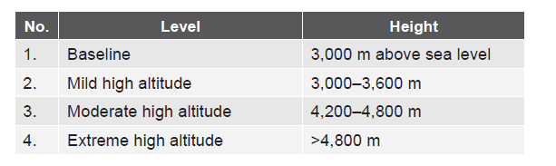
HIGH ALTITUDE Introduction
Pathophysiological Changes
I. Central nervous system
Vasodilatation causing:
Raised ICP
Increased cerebral blood flow
Altered behavior
Drowsiness, incoordination
Lack of judgment
Sleep—speech disturbances
Unconsciousness, seizures

Slide 35
II. Cardiovascular:
Tachycardia
Hypertension
Increased blood volume by 30%
Increased erythropoiesis
Hematocrit increases from 40 to 65%
Local vasodilation due to tissue hypoxia
Pulmonary HTN due to hypoxic pulmonary vasoconstriction
III. Hypothermia:
Causes:
• Arrhythmias
• AV block
• Hypotension
• Negative inotropism

Slide 36
IV. Respiratory system (RS):
Reduced PIO2
Reduced ambient pressure
Reduced gas density
Increased diffusion capacity (normal 2.1 mL/mm Hg/min)
Reduced oxygen gradient leading to ventilation perfusion mismatch
Hypoxia induced hyperapnea: Leftward shift of ODC
Pulmonary edema due to:
• Increased hydrostatic pressure
• Increased pulmonary vascular permeability
• Coagulation defect
• Increased oxygen free radicals
• Increased autonomic activity causing neurogenic pulmonary edema

Slide 37
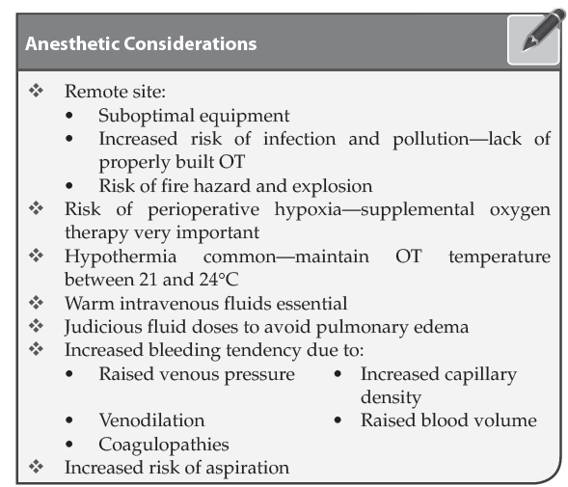

Slide 38
Preoperative Preparation
NPO 6 hours
Informed consent
Opioid/benzodiazepine premedication
Antisialogogues—glycopyrrolate/atropine
Antibiotic prophylaxis
Antiaspiration prophylaxis
DVT prophylaxis
Machine
Boyles type F with Goldman vaporizer for halothane
Spirometers used to calibrate flowmeters
Flowmeters show low reading at high flows due to low gas density
Hazardous if low flow anesthesia used with high nitrous oxide concentration
Oxygen analyzers show false low reading unless calibrated
Oxygen analyzer essential if low flow used
Venturi devices deliver higher O2 than at sea level
Venturi mask delivering 35% at sea level delivers 41% at 10,000 feet

Slide 39
Reduce fire hazard by:
• Avoiding ether
• Use battery operated lights in OT
• Reduced overall fire risk as PIO2 is low
Regional Anesthesia
Increased incidence of bowel and bladder distension after subacromial bursal block SAB)
Increased incidence of post dural puncture headache due to:
Chronically increased CSF pressure
Dehydration
Duration of action of local anesthetics shortened
Prevent Phrenic N palsy during:
Interscalene block
Supraclavicular block
Stellate ganglion block
Induction
All patients at risk of aspiration due to delayed gastric emptying
Rapid sequence induction (RSI) preferred
Thiopentone has slower onset due to prolonged brain arm circulation time at high latitude
Propofol, etomidate, benzodiazepines safe

Slide 40
Larger amounts of propofol required
Ether induction slow and requires high concentration
Gas volume in ETT cuff and PAC balloon expands
Periodic checking of blood glucose levels as high latitude increases glucose consumption.
Inhalational Agents
Potency proportional to partial pressure and not percentage in mixture of O2
Nitrous oxide potency reduced as barometric pressure reduces
Nitrous oxide to be given at 50% to be effective
Fixed concentration of volatile anesthetics have reduced potency
Halothane can be used:
• Ideal for rapid induction and recovery
• High potency
• Non inflammable
• Reduced incidence of laryngospasm
Delivery of halothane increased at high altitude though partial pressure remains constant
Isoflurane also suitable

Slide 41
Neuromuscular Blockade
Succinylcholine safe for short duration surgery
NDMR action prolonged in hypothermic patients
Continue assisted ventilation till patient regains complete consciousness
Complete reversal mandatory as patients are dependent on hyperventilation for oxygenation
Maintain PaO2 and PaCO2 at baseline levels rather than normal values
Ventilation
High oxygen concentration to be given due to:
• Anesthetic deprived compensatory mechanisms
• Reduced PIO2 and PAO2 at high altitude
• Hypoxic brain damage at lower PaO2
• Reduced compensation for acidosis at high altitude
Ventilation at high altitude dependent on hypoxic drive
Administration of narcotics blunts hypoxic drive and precipitates hypoxia

Slide 42
Temperature
Warm OT and warm IV fluids mandatory
Warming blankets
Humidified inspired gases
Heated peritoneal/bladder/colonic lavage
Fluid Balance
Challenging due to preexisting hypovolemia and hypoosmolarity
Fluid bolus prior to induction in hypovolemic patients
Avoid aggressive fluid challenges in patients at high
risk for High Altitude Pulmonary Edema
Titrate to maintain renal perfusion
Clear IV lines of air bubbles as development of R to L shunts through Patent Foramen Ovale common in high altitude

Slide 43
Deep Vein Thrombosis
Common due to:
• Hypercoagulability
• Polycythemia
Increased risk of postoperative stroke/TIA/DVT
Dissociative Anesthesia
Advantageous as:
• Minimally suppresses ventilation
• Reduces dose of opioids
Ketamine 1–6 mg/kg total dose + atropine 20 μ/kg + midazolam 0.05 mg/kg for TIVA useful
Useful if supplemental O2 not available for use

Slide 44
ANESTHESIA IN SPACE: Physiological Changes in Space
Cardiovascular changes:
• Increase in LV end diastolic volume
• Paradoxical reduction in CVP due to microgravity
• Reduced LV mass due to cardiac atrophy/injury
• Central redistribution of blood
• Facial edema
• Diuresis with plasma volume depletion (≥20%)
Autonomic dysfunction:
• Especially on return to earth
• Occurs due to:
Cardiovascular deconditioning
Reduced intravascular volume
Increased NO expression
Downregulation of α-adrenergic receptors
Ventricular atrophy
Changes in arterial stiffness

Slide 45
G forces:
• Increase in gravitational forces during launch as space craft accelerates to orbital speed
• Absence of gravitational stress (microgravity) during the period in space
Neuromuscular changes: Skeletal muscle atrophy even after short missions
Technical Challenges
Airway
Difficult intubation due to facial edema
Both intubator and patient to be secured
Intubator to stabilize head of patient by holding it between knees
Use smaller size ETT if vocal cord edema is present
LMA, intubating LMA, cuffed oropharyngeal airway used alternatively

Slide 46
Fluid Therapy
Hypovolemia may not be adequately treatable due to reduced quantity of supplies.
Air fluid interface in IV fluids generate bubbles as fluids and gases do not separate on basis of differing densities due to lack of gravity.
Air bubbles do not rise up but remain mixed in solution.
IV bag to be degassed before flight/removed by in-line filteration as IV fluid bags contain fluids akin to foam.
Neuromuscular Blockade
Succinylcholine to be avoided as it may cause cardiovascular collapse.
Disuse and skeletal muscle atrophy due to immobilization causes proliferation of extra-junctional receptors causing hyperstimulation and cardiac arrest on SCH use.
Resistance to NDMR may occur.
Subarachnoid block: Increased risk of cardiovascular collapse due to autonomic dysfunction.

Slide 47
Vaporizers
Devices which depend on gravity induced separation of fluids and gases malfunction.
This is because vaporizers require gravity to confine liquids to bottom of reservoir
Closed Environment
Safe use of anesthetic gases difficult in space craft.
Drugs used in flight should not be capable of reaching crew through the closed cabinet atmosphere.
Dumping of exhaust O2 into cabin atmosphere avoided to prevent fire hazard.
Minimum flow system for xenon may be useful.

Slide 48
Complications
Nephrolithiasis and Osteoporosis
Due to gravitational unloading.
This causes loss of calcium from bones along with hypercalciuria.
Space Motion Sickness
GERD may occur during flight and after landing
Dizziness, drowsiness, nausea, and vomiting
Increased risk of aspiration
Hemorrhage and Hypovolemia
Reduced chances of bleeding
This is because due to high surface tension of blood, it will remain on surface of wound.
Chances of arterial bleeds spilling out still remains.
Hypotension may be increased by preexisting volume loss and increased G forces during reentry

Slide 49
Ebullism
Cabin pressure in space craft is 760 mm Hg.
That of extra-vehicular activity (EVA) space suits is 222 mm Hg.
This reduced pressure in EVA suit increases risk of decompression sickness.
If the suit is disrupted during EVA, astronauts ambient pressure quickly drops to zero.
This causes generalized bubble formation called ebullism.
Body fluid boils due to ambient pressure being lower than saturated water vapor pressure.
Hypoxia
Astronauts breathe 100% oxygen in EVA suits
Disruption of the suit causes hypoxia
Electrolyte disturbances: Hypokalemia and hypomagnesemia common due to reduced dietary intake.
Other Advantages
On board diagnostic tools like remotely guided USG examination
Remote robotic surgery substituted for on-board surgeon

Slide 50
THANK YOU

