Slide 1
What makes a board game sell?
Ryan Solava

Slide 2

Why board games?
Hobby board games had an estimated market of $9.27 billion in 2020.
Expected to grow to $12 billion by 2023
Over 4500 games released in 2019

Slide 3
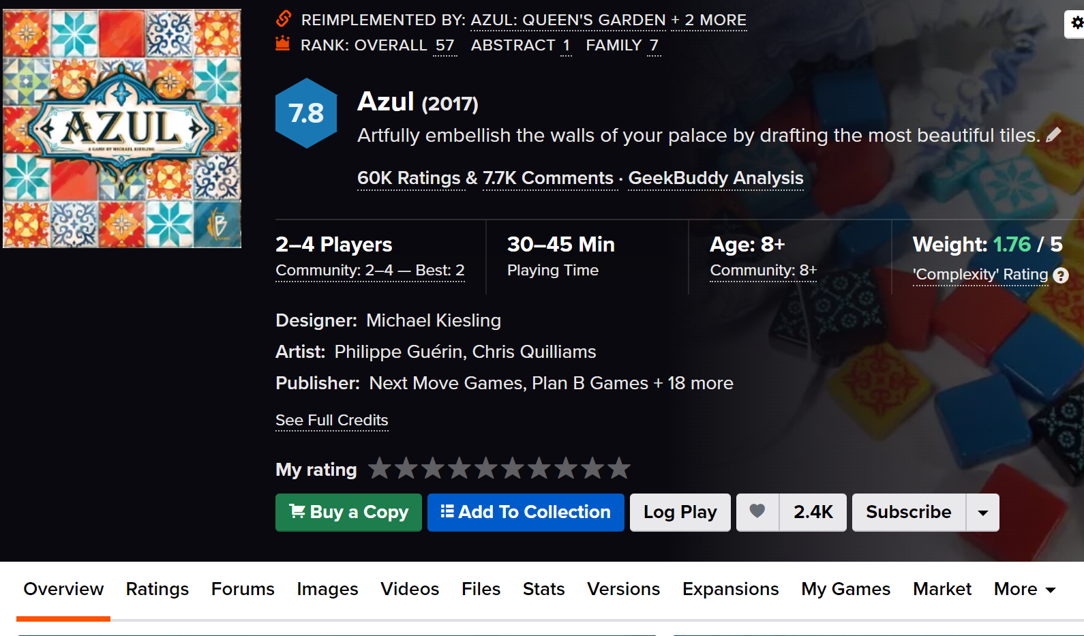
Data
Scraped from Board Game Geek
21,379 games (rows)
Target: Number of
users who own the game
Features:
Year
Rating
Complexity
Play time
Player count
Suggested age
Genre
Mechanics
Designers
Publishers

Slide 4
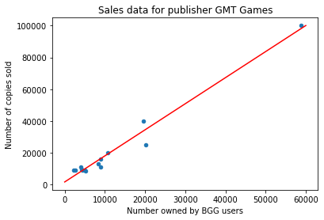
Why use number owned?
The number of copies a games sells is not publicly available.
The number of users who own the game, and sales seems to be very correlated (with some exceptions)

Slide 5
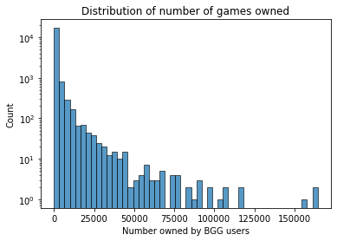
Hit games are rare

Slide 6
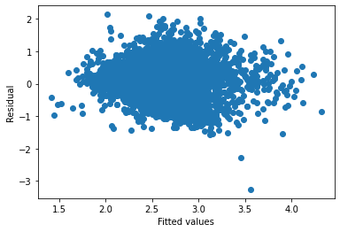

Regression
Linear regression (OLS)
$R^{2}$ of .278
Highly heteroskadastic (hard to predict massive successes)
Non-linear relationships between features

Slide 7

Regression
Linear regression (OLS)
Random Forest Regressor
$R^{2}$ of .278
Highly heteroskadastic (hard to predict massive successes)
Non-linear relationships between features
$R^{2}$ of .459
Able to handle non-linear relationships
Irreducible error or uncaptured features
Important features?
Complexity
Publisher
Designer
Genre
Mechanics

Slide 8
What affects sales?

Slide 9
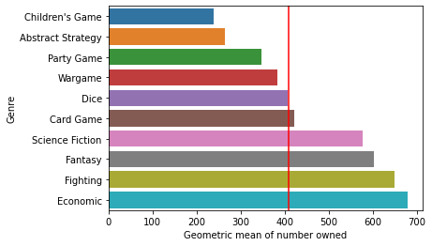
What affects sales?
Genre & Mechanics

Slide 10
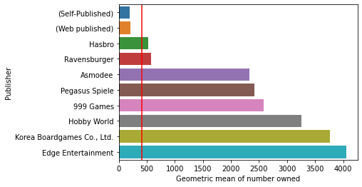
What affects sales?
Publisher & Designer

Slide 11
Conclusions
Medium weight games are most successful
Resources/name recognition are vital
Genre and mechanics matter
But no formula for massive success

Slide 12
Thank you!

