Slide 1

Chess.com User conversion
Ryan Solava

Slide 2
Influx of new users
15 Million
Games played per day
12.6%
Of new users play regularly

Slide 3
Data & Tools
Data:
All games from 1000 users over 2 years
Color, result, ELO, time controls
Tools:
Excel for analysis
Tableau for visualization

Slide 4
Data science solution
Data
Model
Predict conversion
Targeted interventions
By predicting which new users are likely to convert to regular users, we can improve the conversion rate.

Slide 5
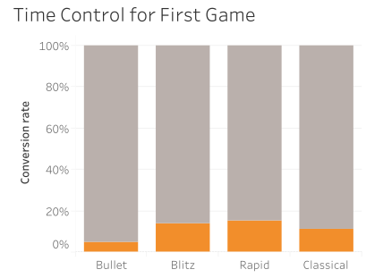
Time control matters

Slide 6
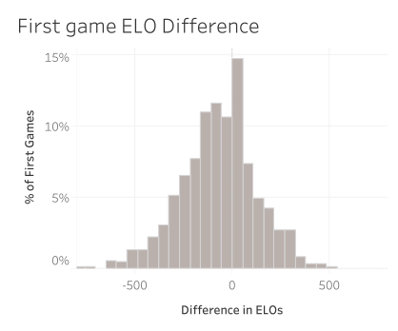
Unbalanced matchmaking hurts

Slide 7
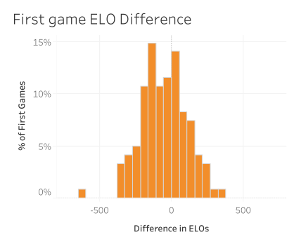
Unbalanced matchmaking hurts

Slide 8
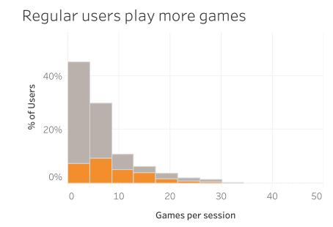
Longer sessions

Slide 9
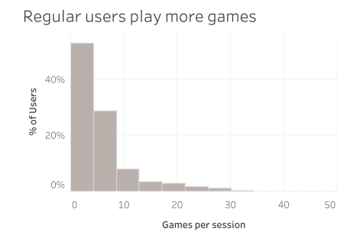
Longer sessions

Slide 10
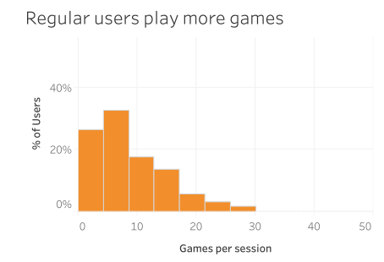
Longer sessions

Slide 11
Take aways
Rapid and blitz are most successful
Keep matchmaking tight for first game
Encourage longer play sessions

Slide 12
Next steps
Build predictive model and apply interventions
Perform A/B testing to see how effective the interventions are
Consider user churn and/or conversion to paid

Slide 13
Thank you!

