Slide 1

Can someone find me a nice Latte?
Ryan Solava

Slide 2

Coffee Shop Recommendations
Goal: Find coffee shops that suit a customer’s needs
Coffee shops in Austin, TX
Personally, likely to travel there soon
Unfamiliar to me
Addicted to caffeine

Slide 3
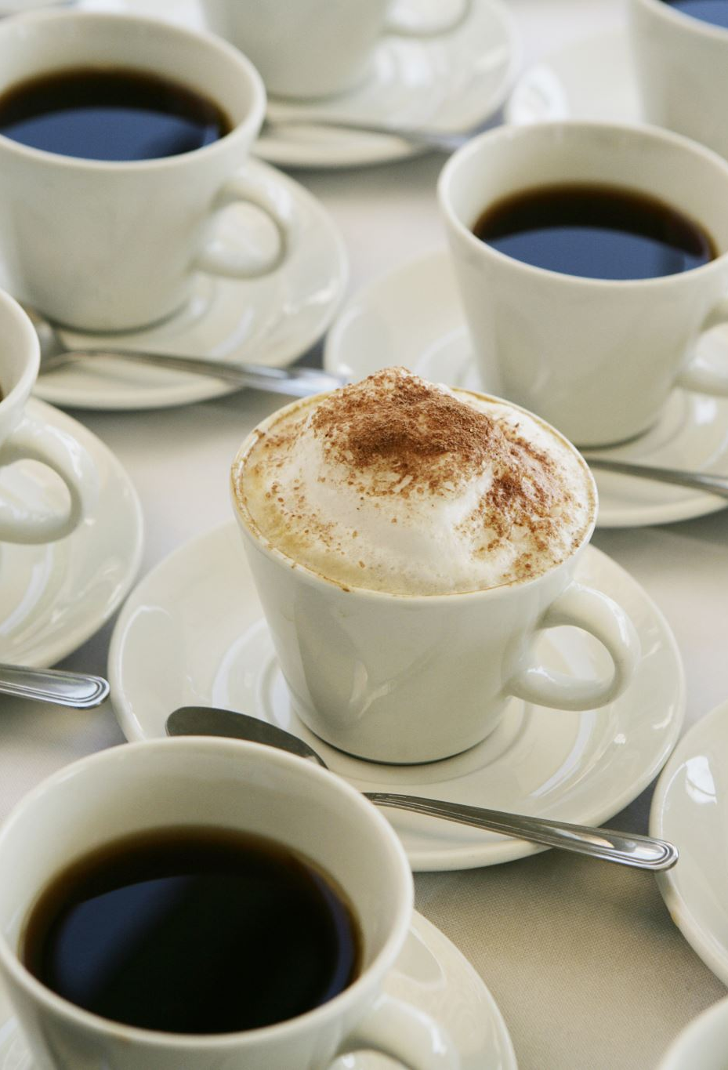
Data Sources
~7,600 reviews of coffee shops in Austin, TX
From Yelp
Considered at the sentence level
Gives ~58,000 documents

Slide 4
Tools
Python, Pandas, and Numpy for standard data science tools
Sklearn’s CountVectorizer and TFIDF
Matrix decomposition algorithms – LSA, NMF, LDA
spaCy for lemmatization
VADER for sentiment analysis
NLTK for stemming and tokenizing
Streamlit to create the web app

Slide 5
What do Reviewers care about?

Slide 6
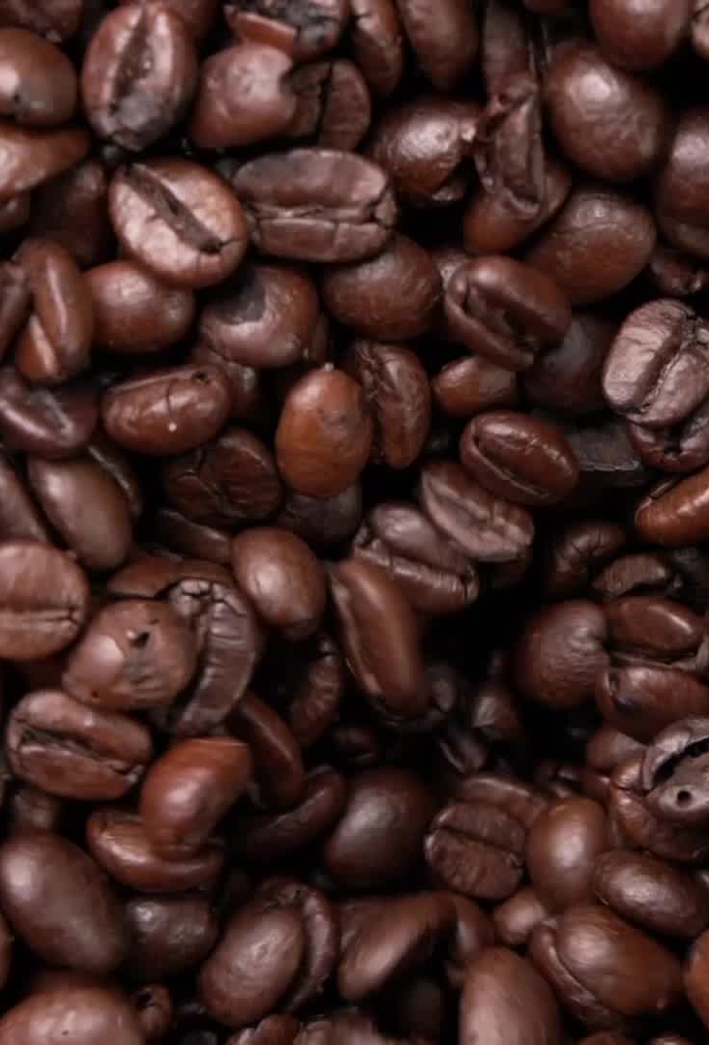
Topic Generation
Tried many options
Best results with
CountVectorizer
LDA
1 and 2-grams
Lemmatization
5 documents minimum
90% maximum
12 topics

Slide 7
Topics
Outdoor Seating | 7. Service
2. Coffee flavor | 8. Wait time
3. Music and atmosphere | 9. Ice cream and baked goods
4. Work space | 10. General praise
5. Latte flavor | 11. Location in the city
6. Breakfast | 12. Other food

Slide 8
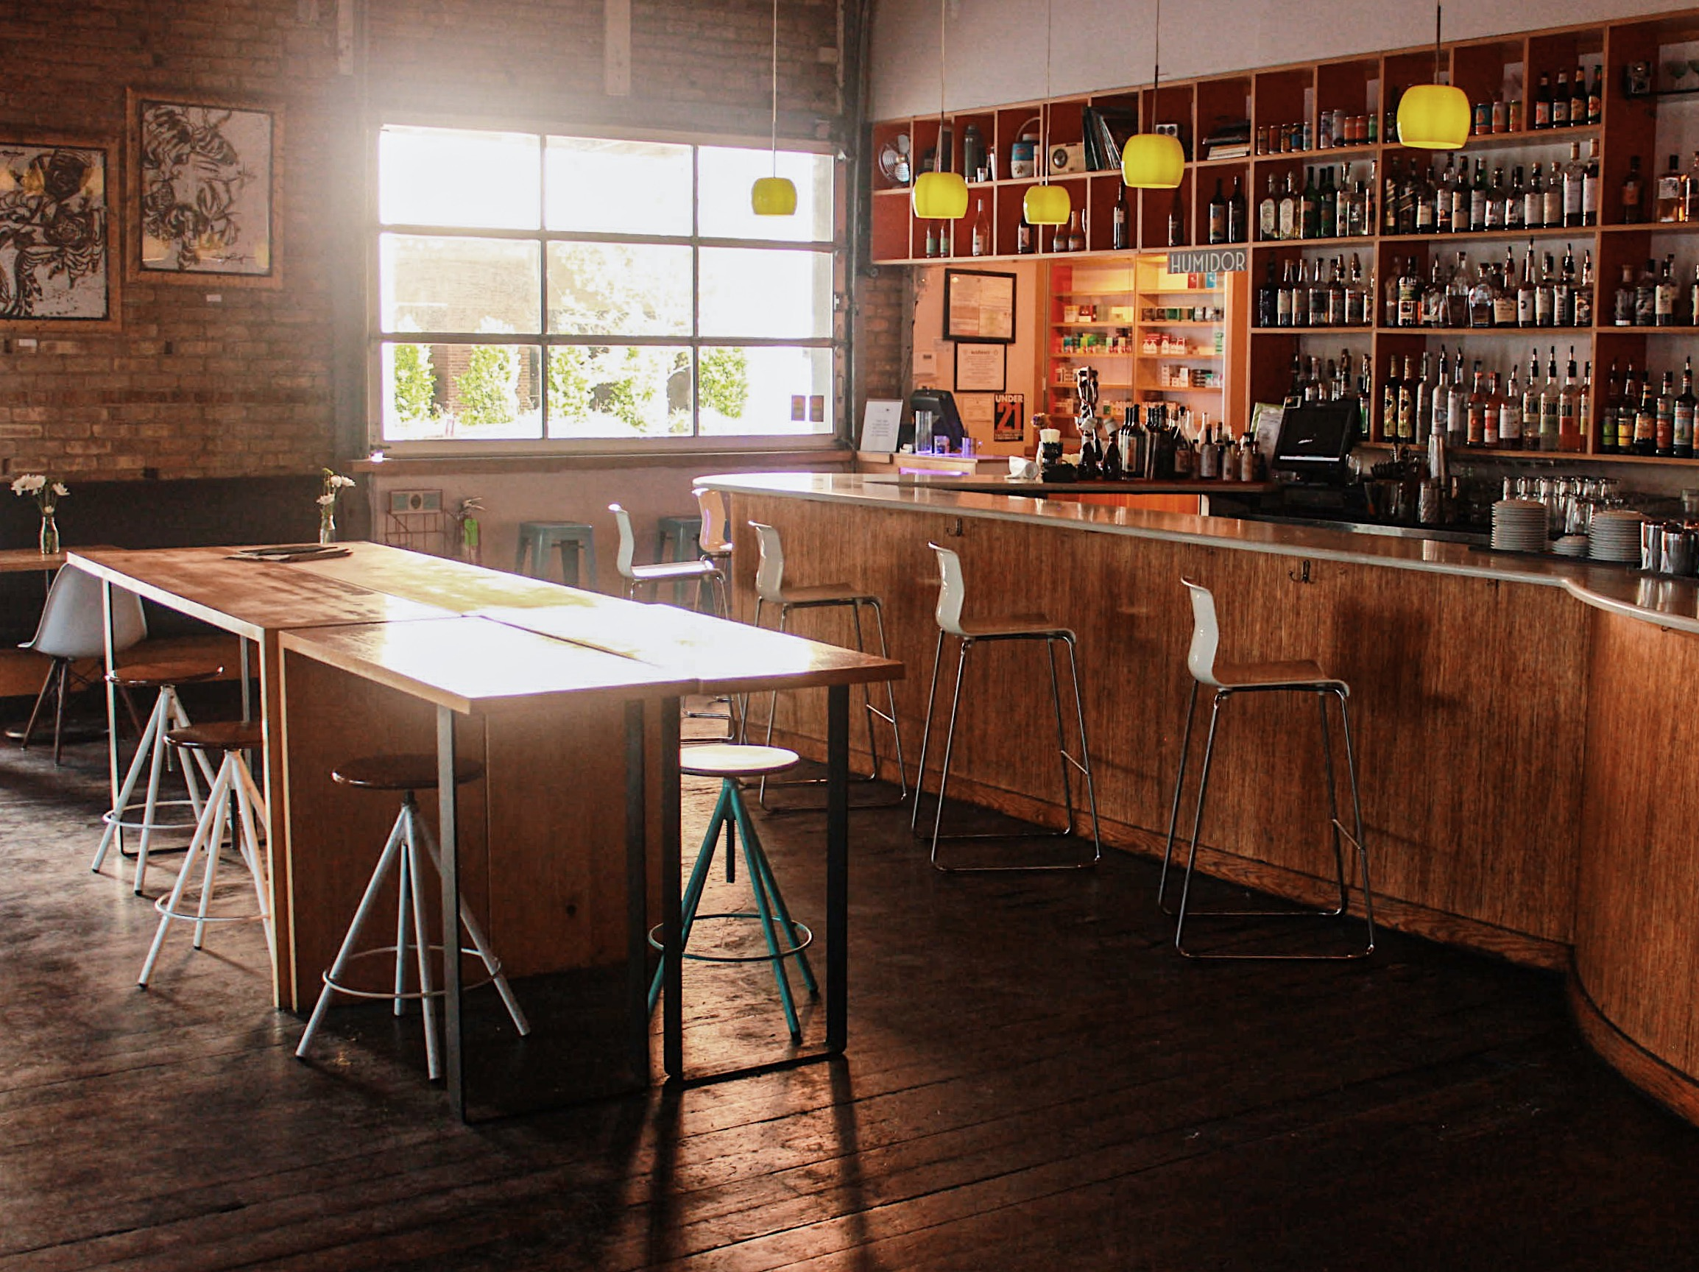
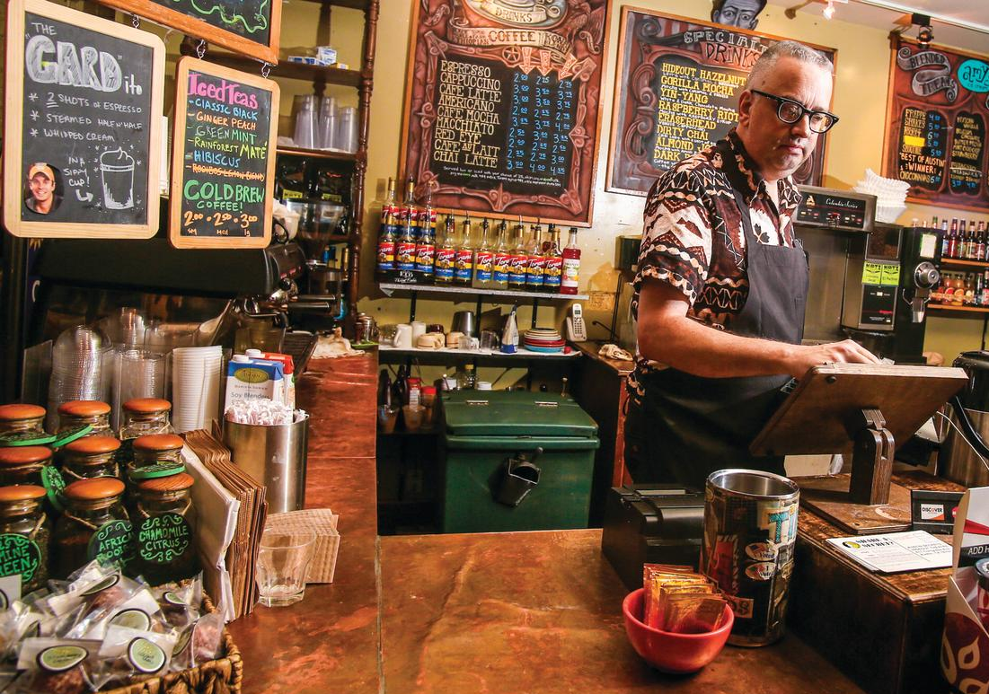
Recommender
Halcyon Coffee
The Hideout Coffeehouse

Slide 9
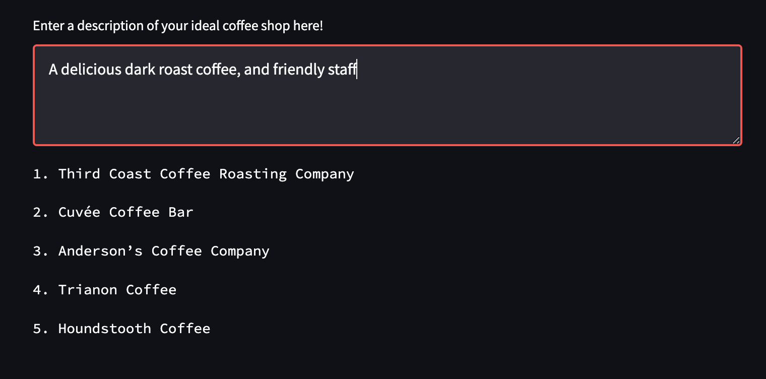
Recommender

Slide 10
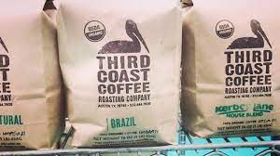
Recommender

Slide 11
Conclusions & Next Steps
Customers look for a variety of things from a coffee shop
Can use review data to recommend coffee shops
Next steps:
Refine the app and add additional functionality
Expand the dataset to other areas

Slide 12

Thank You! Any questions?

