Slide 1

Detecting Toxic comments with Deep Learning
Ryan Solava

Slide 2
Online harassment & Youtube
YouTube is the second most trafficked site on the internet
Over 122 million daily active users
According to the CDC, 15.7% of high schoolers experienced online bullying over a 12 month period.
A serious problem for online platforms

Slide 3
Data Sources
YouTube dataset
~3,500 YouTube comments
Pre-labelled as online harassment or not
Multi-platform dataset
~160,000 comments from a variety of platforms
Pre-labelled as online harassment or not
Kaggle, Twitter, Wikipedia, and YouTube
Can we train a model on a variety of platforms and apply it to one?

Slide 4
Tools
NLP
Scikitlearn’s LDA, CountVectorizer and TFIDF
Spacy
Scatterplot
Keras for Deep learning
Google Colab for GPU usage

Slide 5
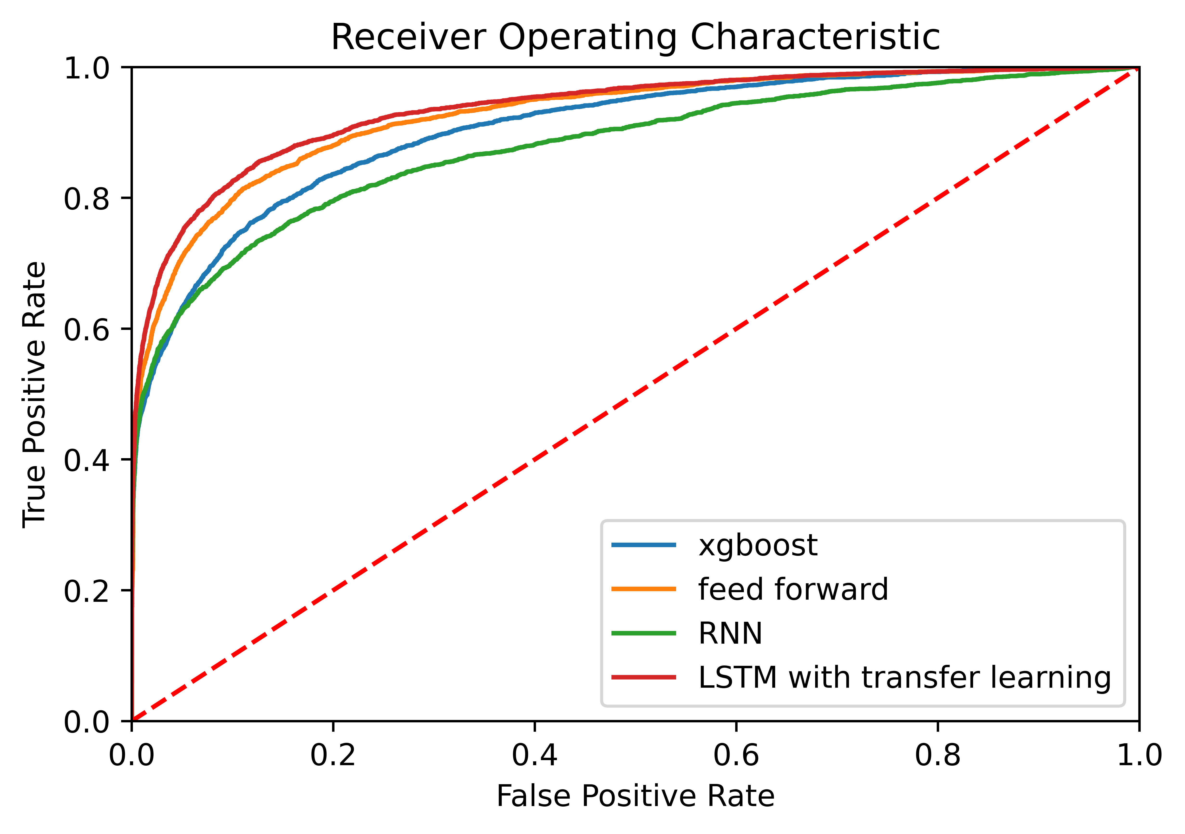
Models
Xgboost – Baseline NLP model
Feed forward – NLP topics to small NN
RNN – RNN with no transfer learning
LSTM – RNN with transfer learning
(a variety of models)

Slide 6
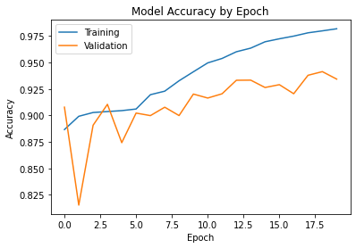
Final Model
Pre-trained embedding from Google news
One LSTM layer with 100 nodes
Two fully connected layers with 50 and 20 nodes
Dropout used during training

Slide 7
Confusion Matrix for multI-platform
 | Positive | Negative
Positive | 27138 | 1675
Negative | 812 | 2312

Slide 8
Confusion Matrix when applied to Youtube
 | Positive | Negative
Positive | 1993 | 1054
Negative | 230 | 187

Slide 9
Conclusion
Deep learning outperforms NLP models
Model still has too low recall
Cultural differences in platforms greatly affect performance

Slide 10
Thank You!

