Slide 1
Serverless deployment of ML model
- Rohan Somvanshi

Slide 2
Serverless Architecture
Custom code which executes on the servers you do not own
Function as a service (making use of Cloud Services: AWS , Azure etc)
Custom code with backend as a service

Slide 3
Benefits ?
Low maintenance cost for infrastructure
Only pay for your usage, no upfront cost
Easy scaling
High availability

Slide 4
AWS Lambda
Function as a service
Reason why serverless computing exists today
Highly compact and easy to work with
Pay only for the compute time
Highly scalable

Slide 5
AWS API Gateway
API as a service
Provides abstraction on lambda/compute
Performance at any scale
Highly configurable (caching layer/response codes/routes)
Out of the box caching/security/versioning/monitoring
Low cost: Pay only for requests and data transferred
AWS lambda + API Gateway = Serverless API

Slide 6
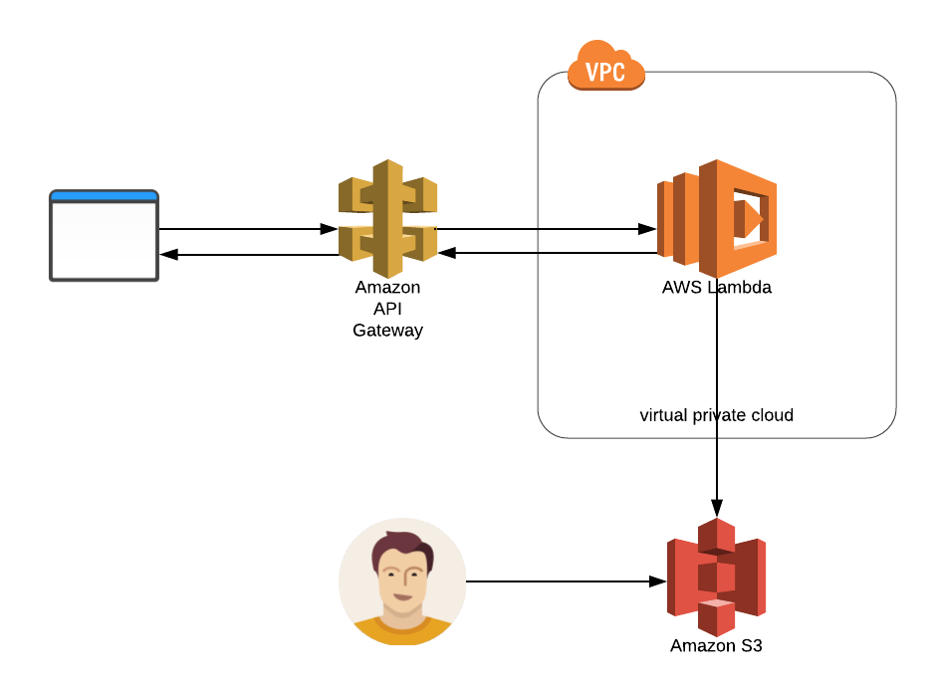

Use case: ML Prediction API
Train and save your model in AWS S3
Write prediction code in Lambda
Compute meets storage
Out of the box integration : Lambda <-> S3
Serve with API Gateway
Deploy: Just run terraform - ~ 5 minutes

Slide 7
Bottlenecks…
Lambda is stateless, model persistence?
API response latency
Building dependencies for python data science libraries
Lambda package upload limits : 256 MB

Slide 8
Possible solutions ??

Slide 9
Lambda Execution Context
Make use of Lambda Execution Context : Persist model outside handler function
Execution Context has transient store of 500 MB
Try to keep the container in use
Possibly with periodic scheduled calls
Can be a good synthetic monitoring

Slide 10
Cache Responses
API Gateway offers good cache configuration options
Need to pay more but its worth in case of high usage
Does not even trigger lambda

Slide 11
Build dependencies on EC2
Build dependencies on EC2 for data science libraries
numpy, sklearn, scikit-learn, Tensorflow
Can be automated with Terraform/Packer

Slide 12
Keep model out of lambda package
Lambda has a package size limit : 256 MB
Keep only the required library dependencies
Keep model out of lambda package

Slide 13
When to use?
Productionizing lightweight machine learning models, where
Dependencies can be managed with 256 MB
Model size is ~300 MB

Slide 14
How much does it cost?
1 req/sec is almost free with Lambda and API Gateway Free-tier
10x traffic : ~ $600

Slide 15
When not to use?
Productionizing big machine learning models where,
Dependencies are large in size
Cannot be packaged within lambda limits or response times
Possible options:
AWS SageMaker
Make containers and run anywhere
Tensorflow serving for more complex pipeline

