Slide 2
PP Hints and tips – edit on normal view
One thing at a time please
Your job as presenter is to control the flow of information so that you and your audience stay in sync. Your viewers will read everything that is on the screen when it is displayed
You should only need two, at the most three levels of bullet points
No Paragraphs
Use the PowerPoint to illustrate your points and reinforce what you are saying
Use dark text on a light background
Especially if presenting to a large audience in an auditorium
Light text on a dark background can be more difficult to read if room lighting is not managed correctly
Align left or right
centered text is harder to read
http://www.lifehack.org/articles/technology/10-tips-for-more-effective-powerpoint-presentations.html
www.metocean.co.nz

Slide 3
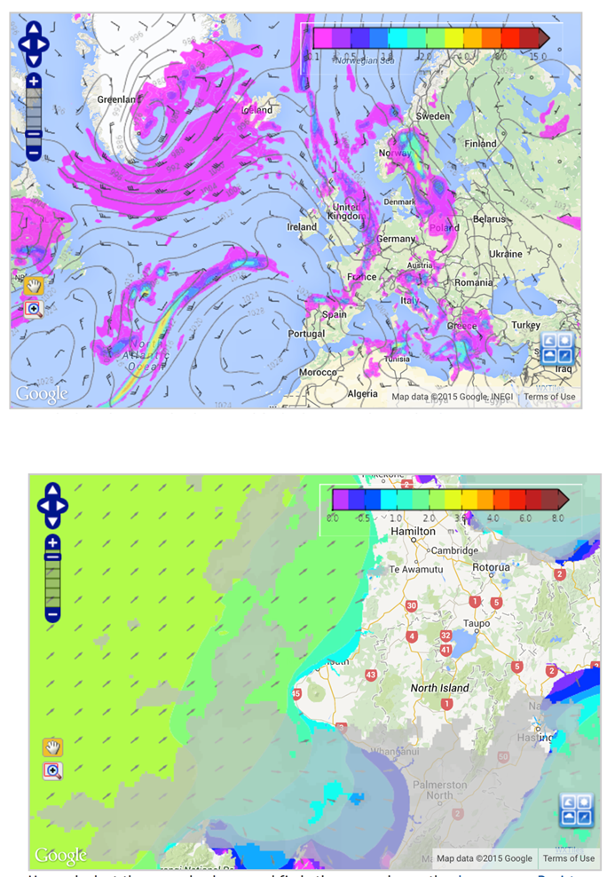
Images
Images are important for MSL Presentations
Images can be placed at the side of the text or below - which ever looks the best
Use more slides and less crowding if you have a lot of images.
On each slide only use images that support the message of that slide
www.metocean.co.nz

Slide 4
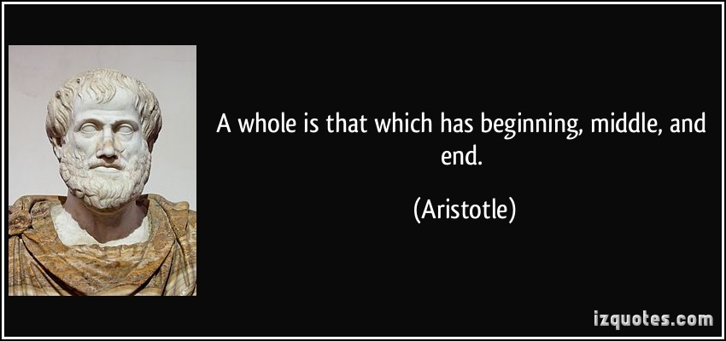
Other hints and tips
Have a beginning, a middle and an end
Tell your audience what you are going to tell them, tell it, and then summarize it.
Having trouble? Write your last slide first - if you don't know where you are going, it is unlikely you will be able to get there
Plan your conclusion first; know what you want to convey. Make the rest of your slides lead to and support the final result.
www.metocean.co.nz

Slide 5
Break the rules
There are times when the PowerPoint rules won’t apply. If there’s a good reason to break the rule, break it.
“Rule breaking is perfectly acceptable behavior – it’s ignoring the rules or breaking them because you just don’t know any better that leads to shoddy boring presentations that lead to boredom, depression, psychopathic breaks, and eventually death. And you don’t want that, do you?”
http://www.lifehack.org/articles/technology/10-tips-for-more-effective-powerpoint-presentations.html
www.metocean.co.nz

Slide 6
www.metocean.co.nz

