Slide 2
Outline
One thing at a time please
No Paragraphs
Use dark text on a light background
Align left or right
http://www.lifehack.org/articles/technology/10-tips-for-more-effective-powerpoint-presentations.html
www.metocean.co.nz

Slide 3
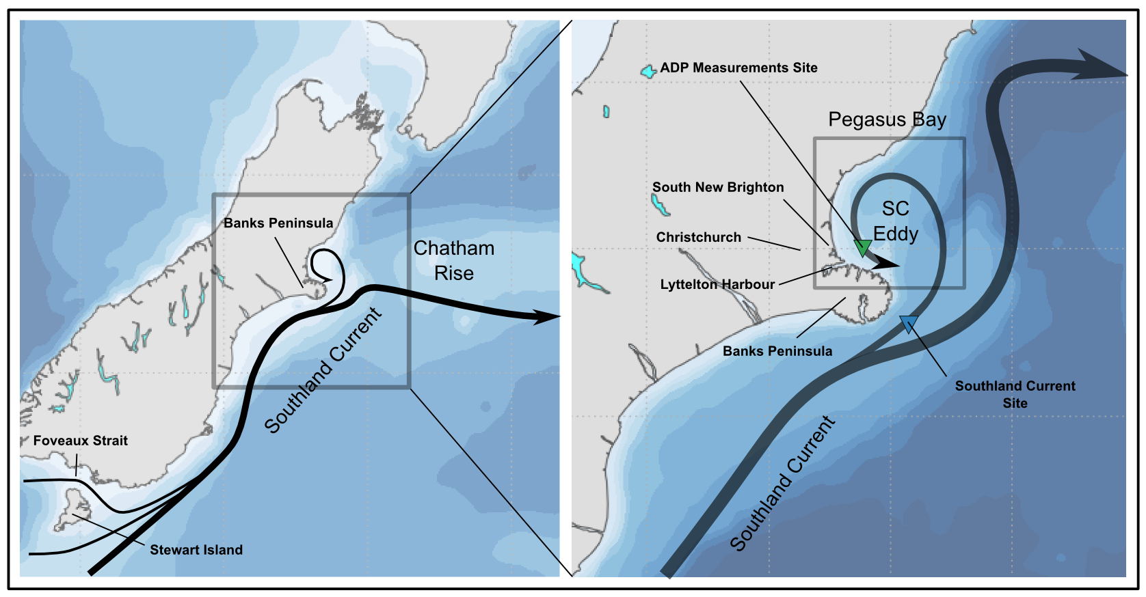
Motivation
According to Chiswell (1996) and Reynolds-Flemming et al. (2005)
www.metocean.co.nz

Slide 4
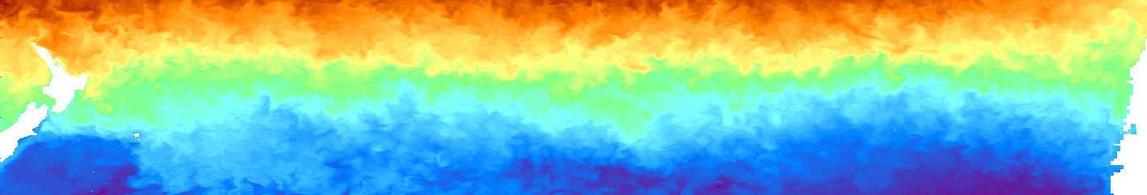
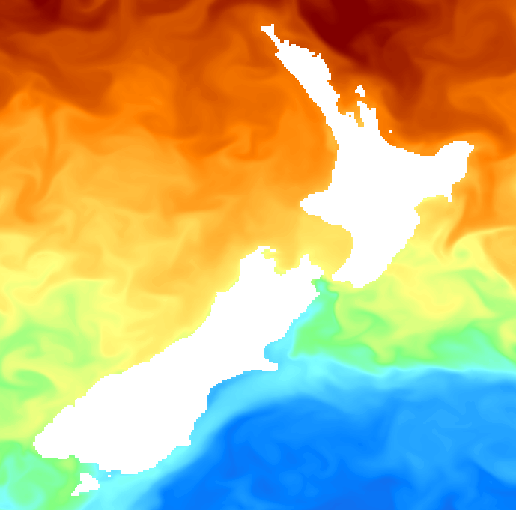
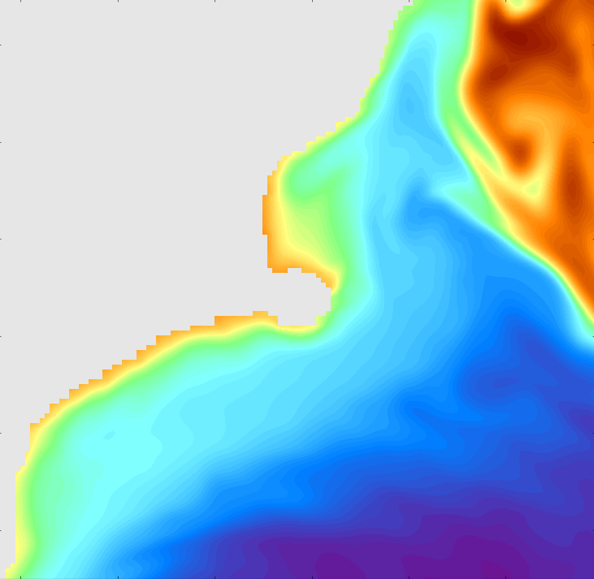
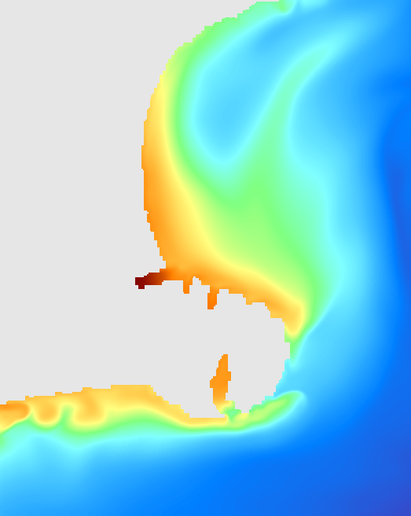
Overview of the forcing mechanisms
NZ
Rossby Waves: ~10-30 days, ~100-200 km
Chile
Eddies + topography +
Local BC instabilities
Southland current eddy
Coastal jets and waves
Frontal structures
Tides
Winds
100 km
100 km
Rossby Waves
Southland Current
www.metocean.co.nz

Slide 5
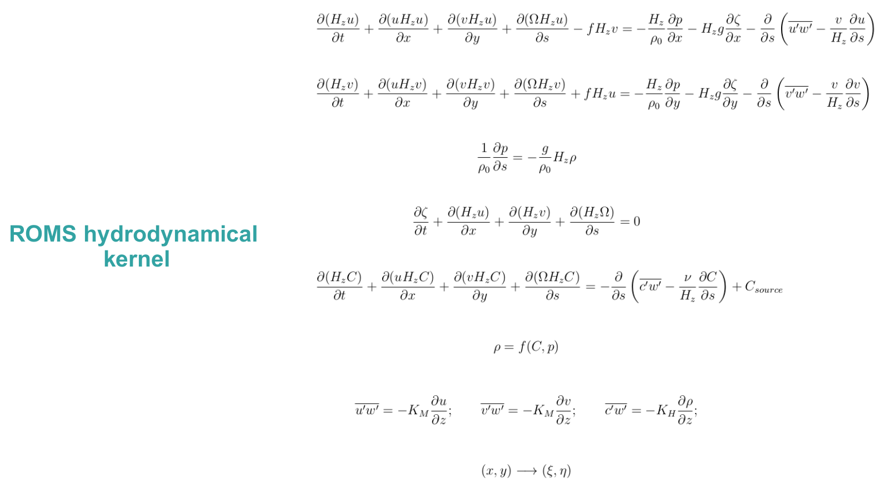
Numerical Model
Haidvogel et al. (2008)
www.metocean.co.nz

Slide 6
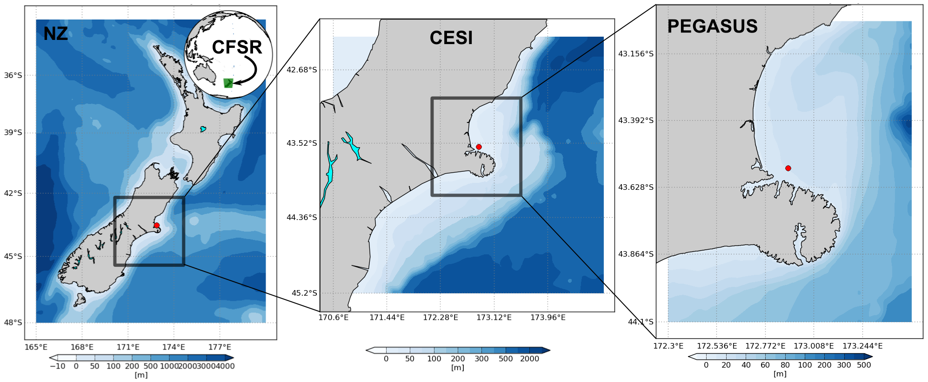
Model setup
www.metocean.co.nz

Slide 7
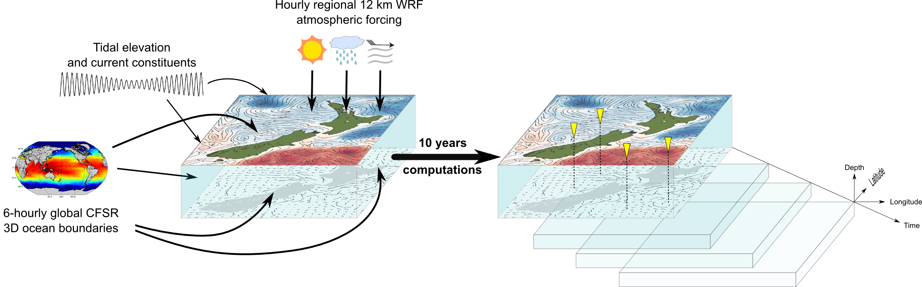
Hindcast approach
www.metocean.co.nz

Slide 8
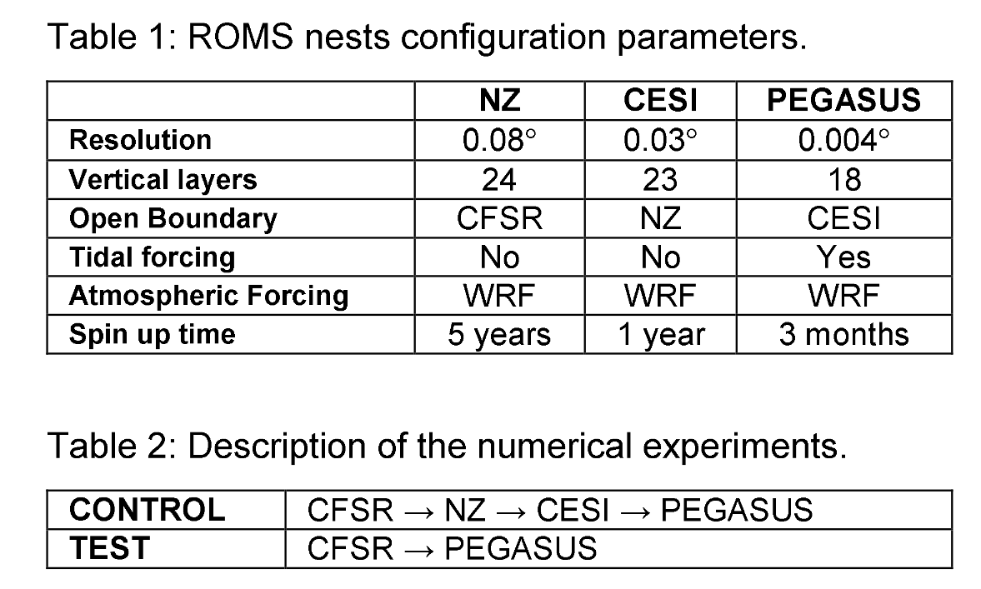
Investigation approach
www.metocean.co.nz

Slide 9
Results
www.metocean.co.nz

Slide 10
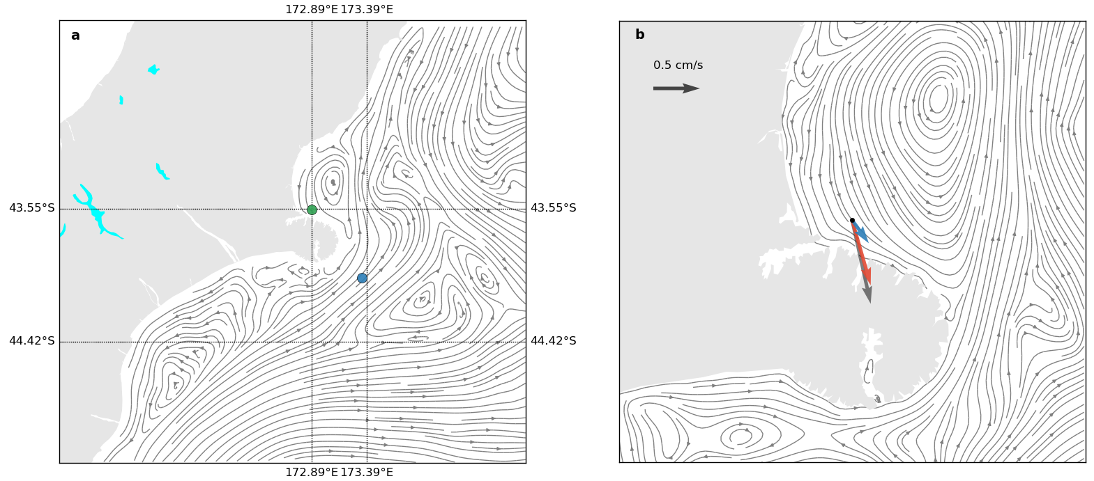
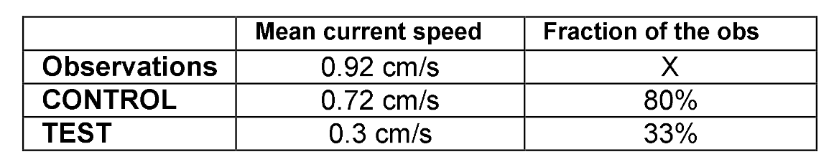
Results – average flow
www.metocean.co.nz

Slide 11
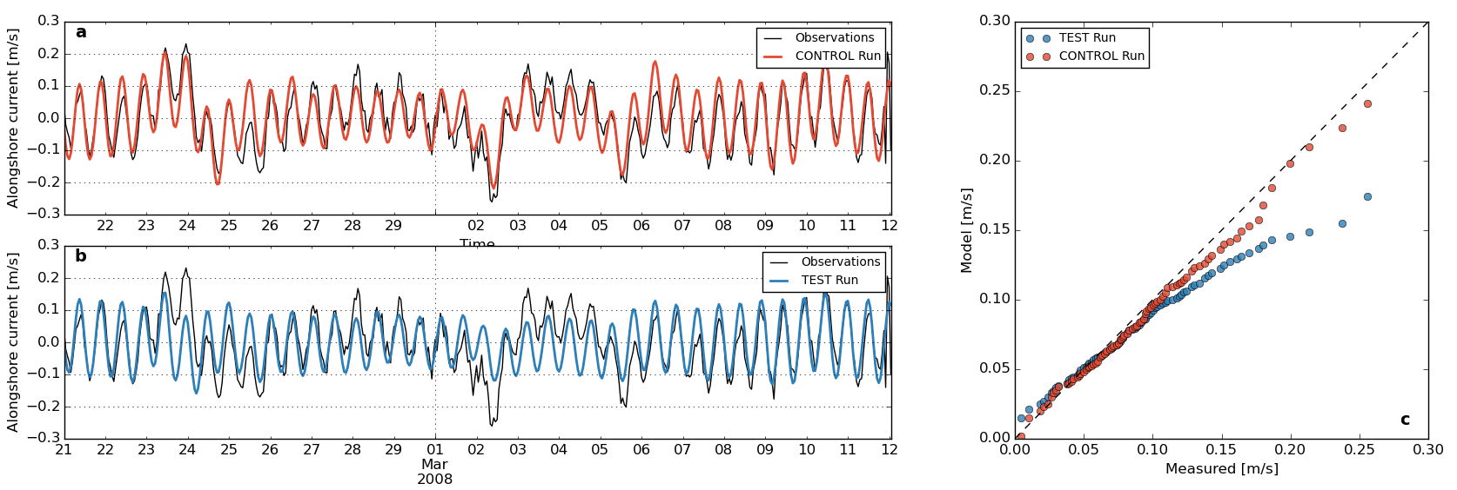
Results – model validation
www.metocean.co.nz

Slide 12
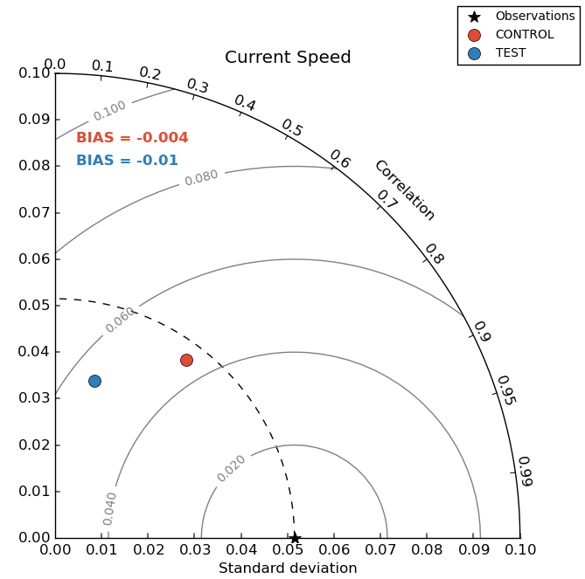
Results – model validation
www.metocean.co.nz

Slide 13
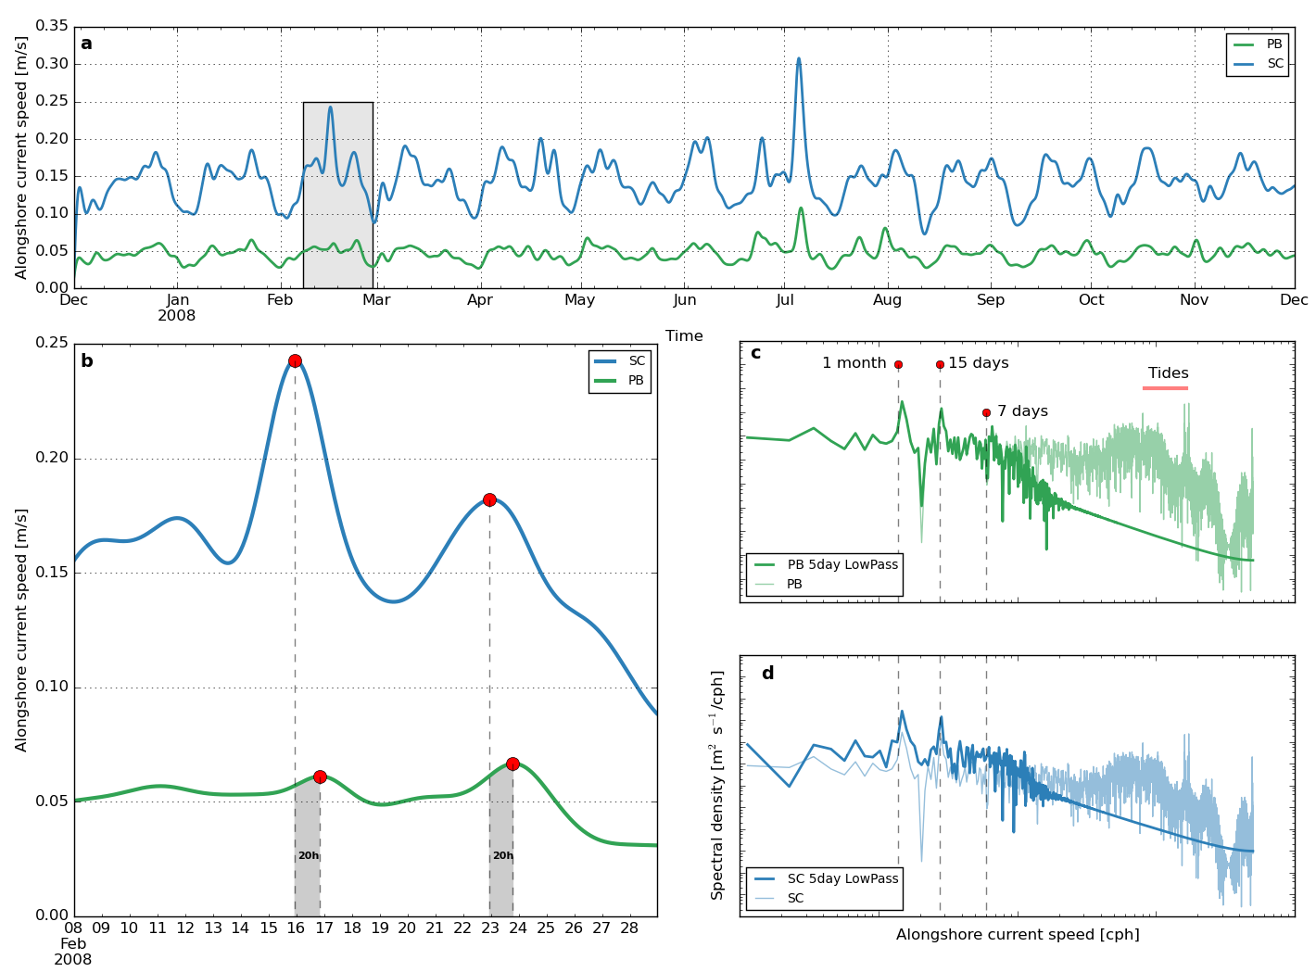
Results – along-shore flow analysis
www.metocean.co.nz

Slide 14
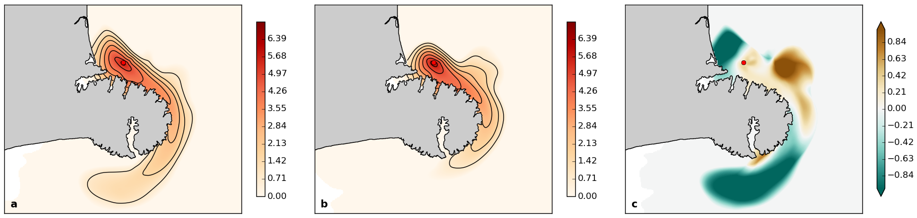
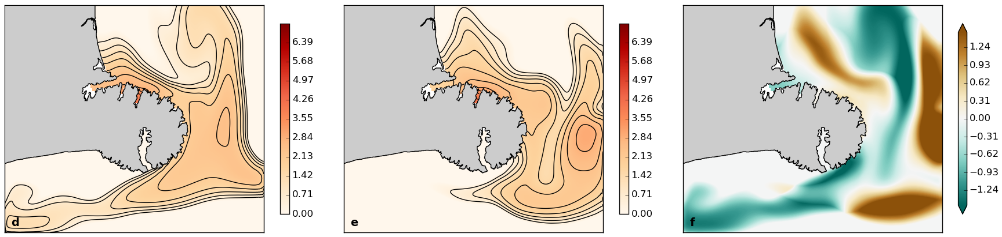
Results – potential effects on plume dispersion
www.metocean.co.nz

Slide 15
Final Remarks
www.metocean.co.nz

