Slide 2
Outline
One thing at a time please
No Paragraphs
Use dark text on a light background
Align left or right
http://www.lifehack.org/articles/technology/10-tips-for-more-effective-powerpoint-presentations.html
www.metocean.co.nz

Slide 3
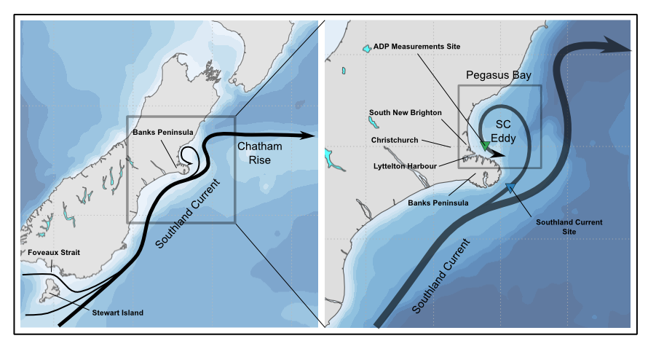
www.metocean.co.nz

Slide 4
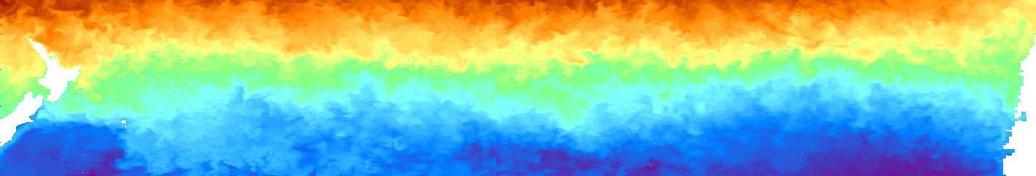
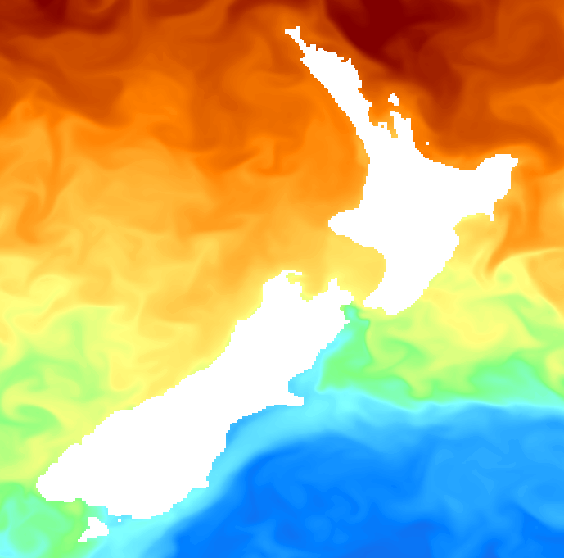
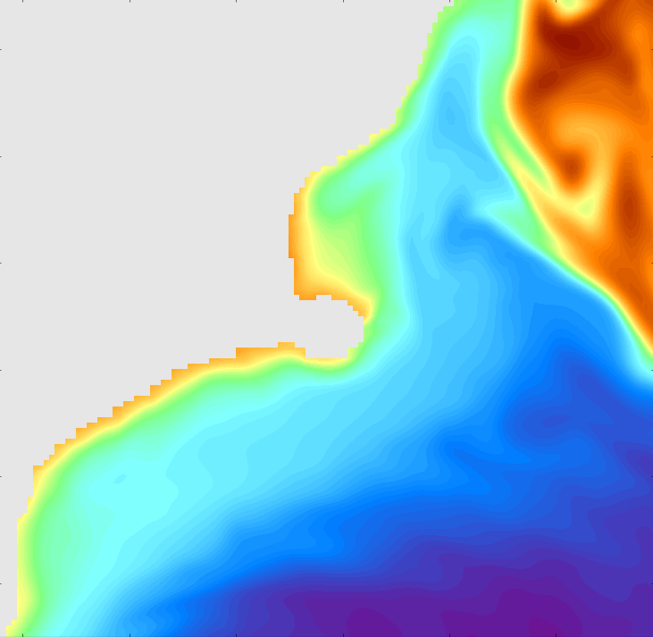
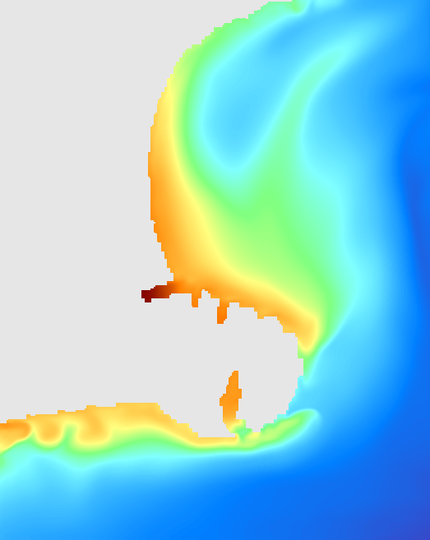
Forcing Mechanisms
NZ
Rossby Waves: ~10-30 days, ~100-200 km
Chile
Eddies + topography +
Local BC instabilities
Southland current eddy
Coastal jets and waves
Frontal structures
Tides
Winds
100 km
100 km
Rossby Waves
Southland Current
www.metocean.co.nz

Slide 5
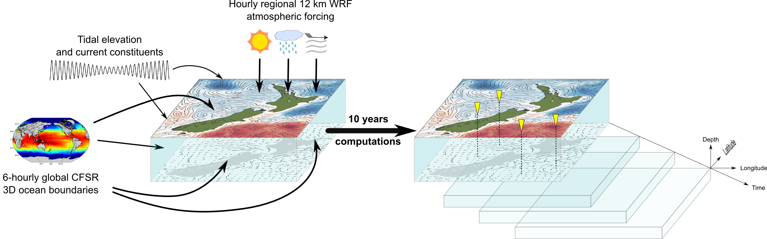
Hindcast Methodology
www.metocean.co.nz

Slide 6
ROMS
www.metocean.co.nz

Slide 7
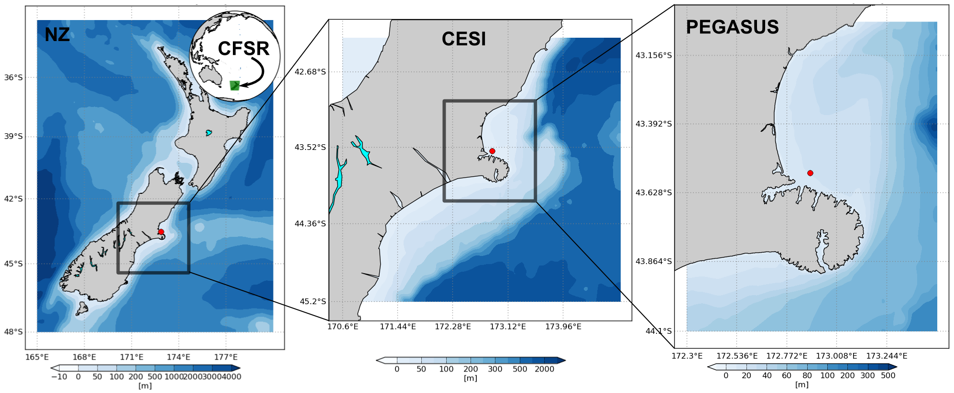
www.metocean.co.nz

Slide 8
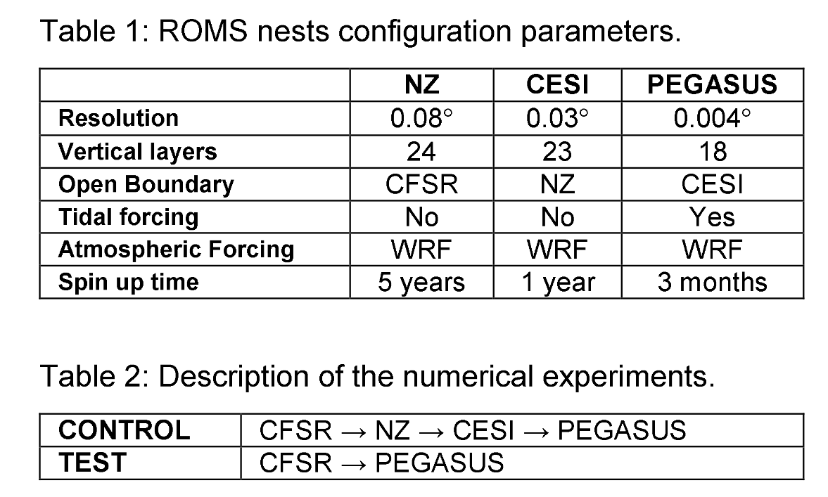
www.metocean.co.nz

Slide 9
Month animation
www.metocean.co.nz

Slide 10
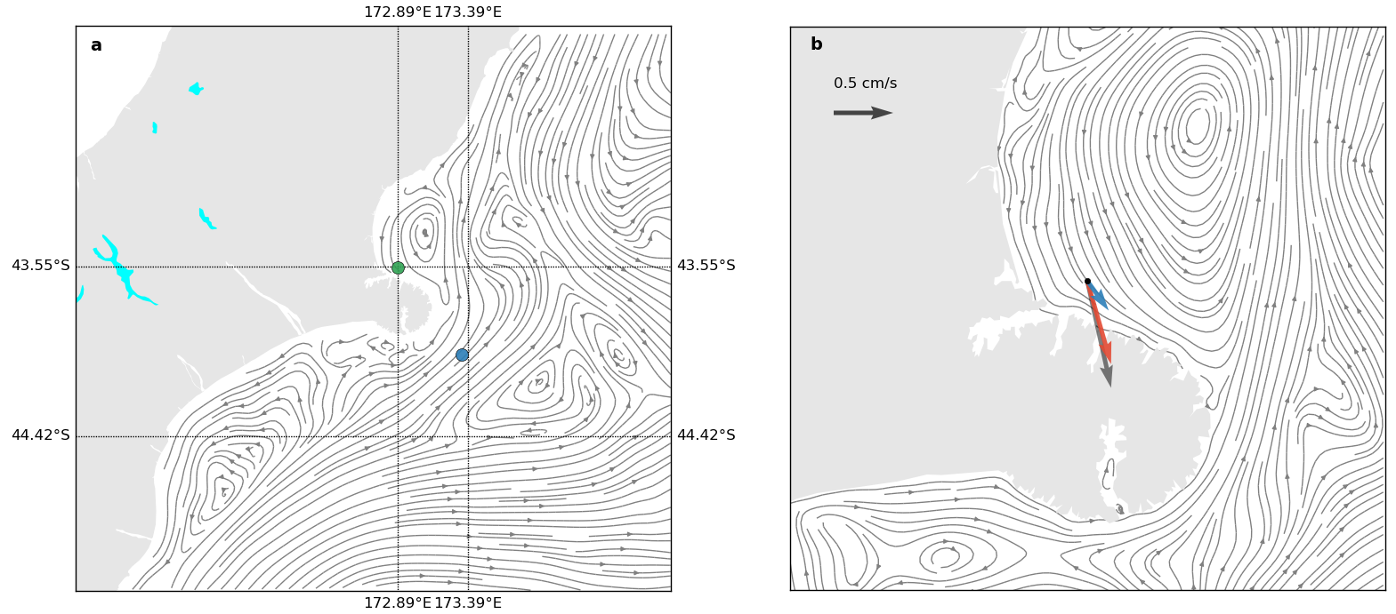
www.metocean.co.nz

Slide 11
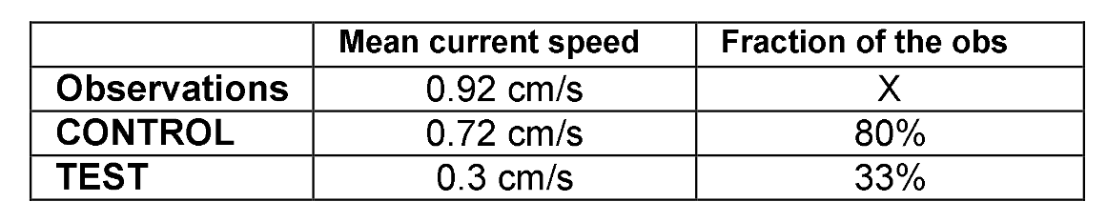
www.metocean.co.nz

Slide 12
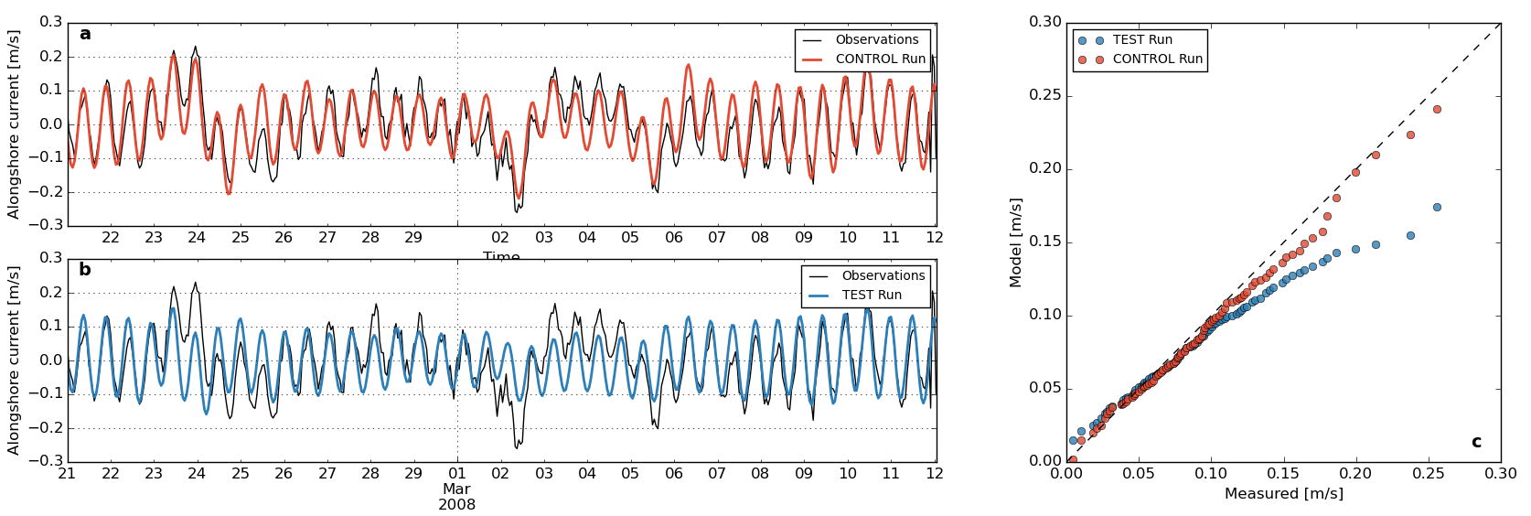
www.metocean.co.nz

Slide 13
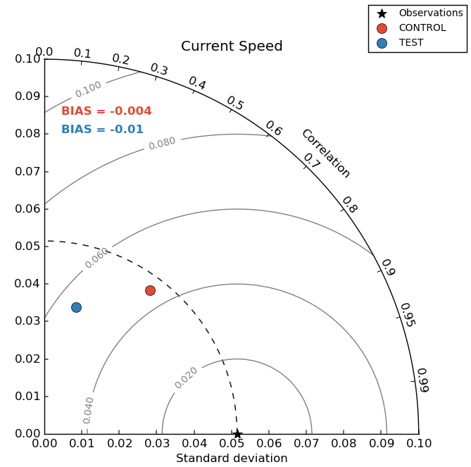
www.metocean.co.nz

Slide 14
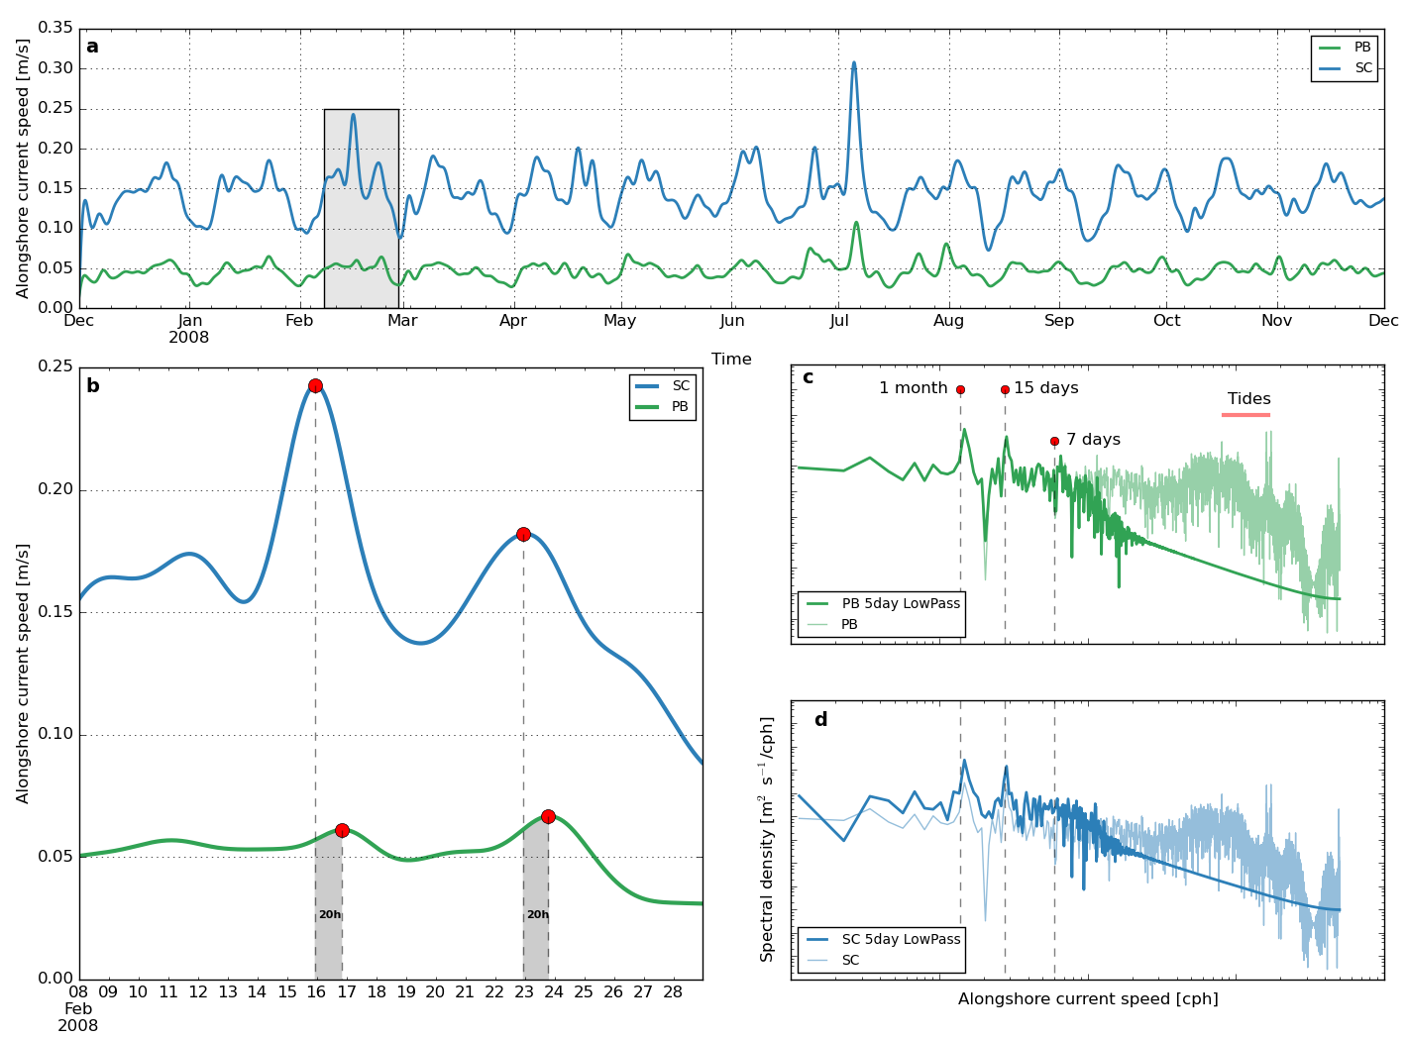
www.metocean.co.nz

Slide 15
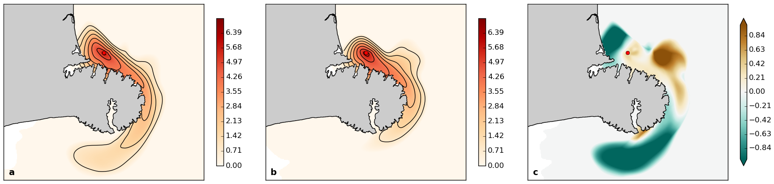
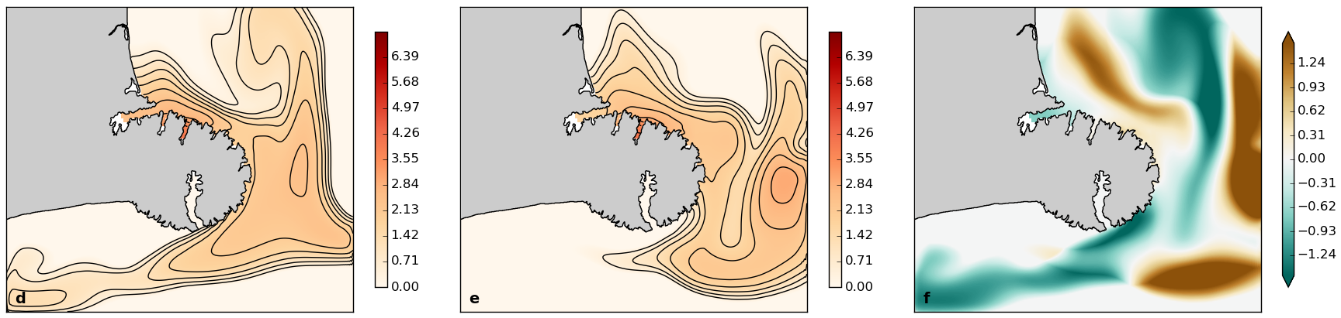
www.metocean.co.nz

Slide 16
www.metocean.co.nz

